Slide 1
Business Analytics vs.
Data Science
by
Milo Schield
Member: International Statistical Institute
US Rep: International Statistical Literacy Project
Director, W. M. Keck Statistical Literacy Project
Presented at the
Annual Decision Sciences Institute Meeting
Tampa FL. Nov 22, 2014.
Slides at: www.StatLit.org/pdf/2014-Schield-DSI-Slides.pdf
Notes:
Analyzing Numbers in the News
15 May 2008
2008SchieldNNN6up.pdf
1
1

Slide 2
Data Science (DS), Data Analytics (DA), Business Analytics (BA)
2
In any new field, new terms are a bit vague. Distinctions are shades of grey; not black-white.
DS, DA, BA all involve some combination of mathematics, computer science and statistics.
Ideally, a DS major would take a substantial number of courses in all three areas. Ideally, they work from start-to-finish on a DS project.
Most students don’t have time for this.
Notes:
Analyzing Numbers in the News
15 May 2008
2008SchieldNNN6up.pdf
2
2

Slide 3
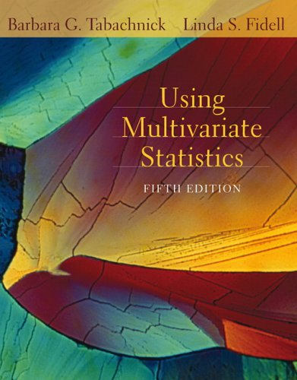

Mathematics Aspect
3
2nd Stat courses can be classified by:
Math pre-req: algebra, pre-calc or calculus.
Topics: Just regression (Mendenhall-Sincich, Draper-Smith). Multilevel / hierarchical models (Gelman-Hill). Multivariate methods: cluster analysis, discriminant analysis, factor analysis, principle components, logistic regression, etc. (Sharma, Johnson-Wichern, Berenson-Levine-Goldstein)
Notes:
Analyzing Numbers in the News
15 May 2008
2008SchieldNNN6up.pdf
3
3

Slide 4
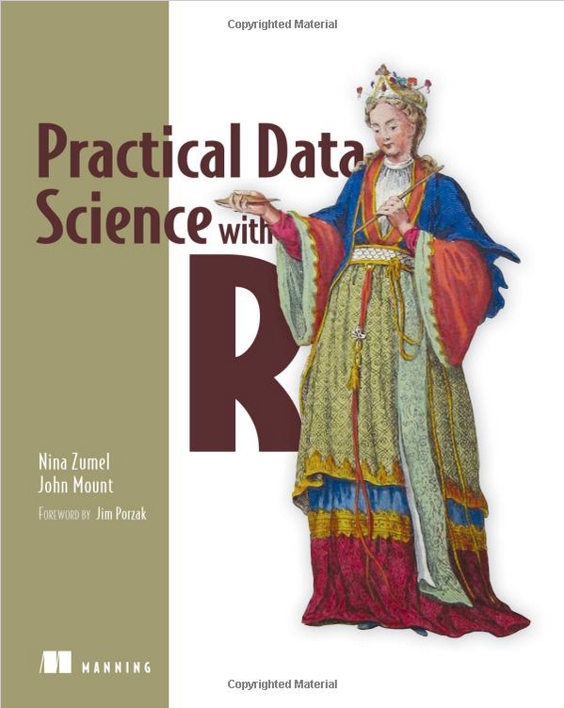
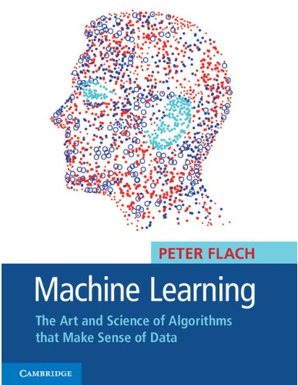
Computer Science
Perspective
4
Data acquisition, manipulation & summarization are big topics in Computer Science.
Computer software is a big issue: SQL databases, SAS, R, Hadoop, etc.
Notes:
Analyzing Numbers in the News
15 May 2008
2008SchieldNNN6up.pdf
4
4

Slide 5
Data Science
5
Data science is dominated by computer scientists and mathematicians. The primary focus is on associations: correlations, models, prediction ...
Neither computer science nor mathematics has any language for causation. Both focus on what is necessary or sufficient.
Both mathematics and computer science focus on the form – and generally eschew the matter.
Notes:
Analyzing Numbers in the News
15 May 2008
2008SchieldNNN6up.pdf
5
5

Slide 6
Business Analytics
6
For science, the goal is truth – deep truths. For the physical sciences, the truth typically includes causal connections. For math and computer science, causation is conspicuously absent.
For business, the goal is create products and services that will be bought by customers at a price that generates a profit. Sometimes this involves prediction; other times is involves an intervention. Both of these involve causal connections.
Notes:
Analyzing Numbers in the News
15 May 2008
2008SchieldNNN6up.pdf
6
6

Slide 7
Four Big Ideas in
Teaching Big-Data
7
Association is not causation, but is often a sign of causation somewhere.
Confounding. Why getting more data may not reduce confounding.
Coincidence: Why coincidence increases as the amount of data (# of rows) increases.
Error: Why errors (false positives) increase as the object of interest gets smaller (rarer).
Notes:
Analyzing Numbers in the News
15 May 2008
2008SchieldNNN6up.pdf
7
7

Slide 8
Statistical Literacy:
Big Idea #1: Association
8
Just saying “Association is not Causation” exemplifies the “abstinence approach” to statistics.
Abstinence may be fine in a math class. It is not acceptable in a Business program where associations are typically a sign of causation somewhere.
Students should learn which statistical associations give stronger support for a causal connection.
Notes:
Analyzing Numbers in the News
15 May 2008
2008SchieldNNN6up.pdf
8
8

Slide 9
Statistical Literacy:
Big Idea #2: Confounding
9
Confounders are related factors not taken into account in a study.
The influence of confounders [confounding] is omni-present in observational studies.
Simpson’s paradox (sign reversal or confounding)
is incidental when modelling or forecasting,
dominates when searching for causes.
Notes:
Analyzing Numbers in the News
15 May 2008
2008SchieldNNN6up.pdf
9
9

Slide 10
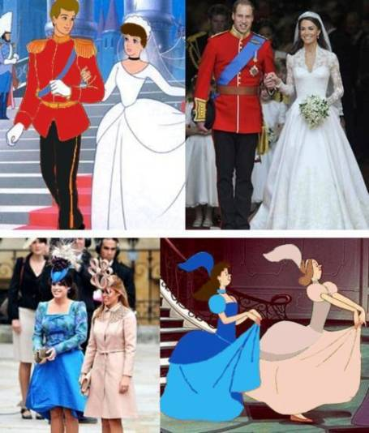
Statistical Literacy:
Big Idea #3: Coincidence
10
Margin of error decreases
as sample size increases.
The Law of Very Large
Numbers: the unlikely
becomes almost certain
given enough tries.
Coincidence may be totally spurious or a sign of causation.
Notes:
Analyzing Numbers in the News
15 May 2008
2008SchieldNNN6up.pdf
10
10

Slide 11
Statistical Literacy:
Big Idea #4: Tests
11
False positive are a constant problem in tests.
Qualitatively, the lower the prevalence of the group, the higher the chance of a false positive.
Quantitatively, if the prevalence of the group of interest is the same as the error rate in the test, then the prediction accuracy is always 50%.
The quantitative relationship is simple, memorable and helps in evaluating tests using Big Data.
Notes:
Analyzing Numbers in the News
15 May 2008
2008SchieldNNN6up.pdf
11
11

Slide 12
Conclusion
12
Business Analytics should focus on teaching the big ideas underlying the statistics produced by any analysis of observational data: big or small.
Business Analytics should help students see which associations give stronger support for a causal connection. They should be able to see the influence of confounders, of coincidence and Type-1 errors in big data.
Notes:
Analyzing Numbers in the News
15 May 2008
2008SchieldNNN6up.pdf
12
12

Slide 13
References
13
Berenson, (2013). Statistics Course for Big Data & Analytics. Slides at www.statlit.org/pdf/2013-Berenson-DSI-MSMESB-Slides.pdf
Berenson, (2013). Big Data Implications for Stat Analysis & Instruction. www.statlit.org/pdf/2013-Berenson2-DSI-MSMESB-Slides.pdf
Levine, Szabat & Stephan (2013). Data Discovery www.statlit.org/
pdf/2013-Levine-Szabat-Stephan-DSI-MSMESB-Slides.pdf
Schield, M. (2014). Two Big Ideas for Teaching Big Data: ECOTS Paper at www.statlit.org/pdf/2014-Schield-ECOTS.pdf
Schield, M. (2014). Big Data: Coincidence. National Numeracy Network. www.statlit.org/pdf/2014-Schield-NNN1-Slides.pdf
Stine, D. (2013): Big Data Implications for intro stats.
www.statlit.org/pdf/2013-Stine-DSI-MSMESB-Slides.pdf
Notes:
Analyzing Numbers in the News
15 May 2008
2008SchieldNNN6up.pdf
13
13

