Slide 1
ODYSSEY: A Journey to Lifelong Statistical Literacy
Milo Schield
Editor: www.StatLit.org
Elected member: International Statistical Institute
US Chair: International Statistical Literacy Project
17 July 2014 ICOTS-9
www.StatLit.org/pdf/2014-Schield-ICOTS-Slides.pdf
Notes:
Analyzing Numbers in the News
15 May 2008
2008SchieldNNN6up.pdf
1
1
This is a start-up guide to Odysseys2sense: a web based forum.

Slide 2
Statistical Literacy: Teaching vs. Practicing
2
Statistical literacy (critical thinking with statistics) requires
analytical skills: decoding statistical summaries, grammar and arguments
communication skills: how the presentation influences the apparent strength of an argument
Students need lots of practice to develop these skills.
Students remember 90% of the subject matter if they do the task themselves even as a simulation, as opposed to 10%, 20% and 50% if they read, hear or watch someone else do the task respectively. Menn (1993)
Notes:
Analyzing Numbers in the News
15 May 2008
2008SchieldNNN6up.pdf
2
2
This is a start-up guide to Odysseys2sense: a web based forum.

Slide 3
Forgetting; Group Learning
3
Learning without retention is a tremendous waste.
Students in a traditional [statistics] course lost 48% of their course gain within 4 months after the course. Title et al. (2012).
Group learning can be a powerful tool. Doing this online is almost impossible without some kind of forum.
Notes:
Analyzing Numbers in the News
15 May 2008
2008SchieldNNN6up.pdf
3
3
This is a start-up guide to Odysseys2sense: a web based forum.

Slide 4
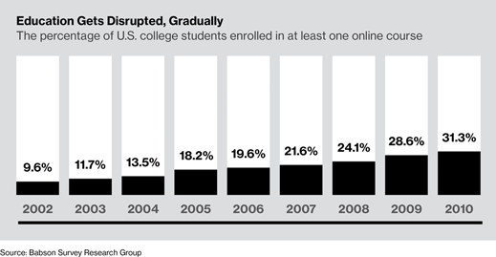
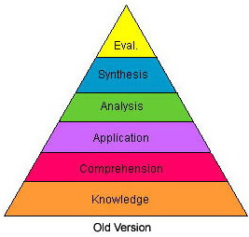
Writing/Speaking Online Forums
4
Demonstrating critical thinking (see Bloom’s taxonomy) requires that students write or speak. Online forums are commonly used.
Notes:
Analyzing Numbers in the News
15 May 2008
2008SchieldNNN6up.pdf
4
4
This is a start-up guide to Odysseys2sense: a web based forum.

Slide 5
Classifying Online Forums
5
Online forums can be grouped into five levels:
L1: Basic. Quick feedback. Typical
L2: L1 + no free-riders [Moodle Q&A]
L3: L2 + all players are anonymous
L4: L3 + everyone grades everyone
L5: L4 + system scores players [Odyssey]
Notes:
Analyzing Numbers in the News
15 May 2008
2008SchieldNNN6up.pdf
5
5
This is a start-up guide to Odysseys2sense: a web based forum.

Slide 6
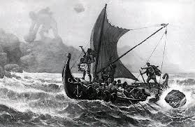
Odyssey Forum
6
Odysseys™ is a unique online forum that is used by several colleges and universities.
Before they can see anything, players must
submit their initial response to a challenge
grade three or four responses by others.
The system updates each player’s power based on:
the grades received from others
the power of those giving the grades.
For details, see Schield (2012a and 2012b).
Notes:
Analyzing Numbers in the News
15 May 2008
2008SchieldNNN6up.pdf
6
6
This is a start-up guide to Odysseys2sense: a web based forum.

Slide 7
Good Forums
7
The key to good forums is the same as that for good discussions. The topics or challenges must:
be open-ended (as opposed to right-wrong)
encourage multiple approaches
encourage discussion and reflection.
The following challenges have been used in teaching statistical literacy face-to-face and online.
Notes:
Analyzing Numbers in the News
15 May 2008
2008SchieldNNN6up.pdf
7
7
This is a start-up guide to Odysseys2sense: a web based forum.

Slide 8
Over 40 “Challenges” in the last three years.
Challenges have been grouped as follows:
Critical thinking exercises (7)
Reading and interpreting tables and graphs (6)
Reading and interpreting surveys (6)
Explaining data patterns (5)
Observational studies: Cross-sectional (7)
Observational studies: Longitudinal (6)
Evaluating randomized experiments (6)

Slide 9
1) Critical Thinking
All Statistics are Facts
Can critical thinking be taught?
Is Sylvia Browne a real psychic?
How much math do we really need?
Damned Lies and Statistics: Joel Best
Gambler's Fallacy: Run at Monte Carlo
Coincidence or not? Canadian Lottery winner.

Slide 10
2) Reading Tables and Graphs
TABLES:
UK Bank-Raids data
Pioneer-Press Circulation Statistics
Per-Person Spending: Married vs. Single
US Dropout-Rates by race, income, ESL, etc.
AARP Insurance Savings: Mean, Median and Most
GRAPHS:
Libertarian/Tea-Party/Christian-Right Overlaps

Slide 11
3) Surveys
1 in 50 US Kids is homeless: study
Halloween Consumer Survey (2012)
Oregon has lowest rate of childhood obesity
1 in 10 Chinese adults are diabetics, study finds
Students Consider Prostitution to Pay for Education
Third of U.S. teens with phones text 100 times a day
95% Margin of Error

Slide 12
4) Explaining Data
Excess of Males in the SAT tails
Are heights normally-distributed?
Overweight Increases over Time
Low Graduation Rates: Minnesota Schools
25,000 U.S. Deaths Linked to Sugary Drinks

Slide 13
5) Evaluating Observational Studies: Cross-sectional
Spanking Lowers IQ
ADHD Leads to Weight Gain
TV Ownership Linked to Well-Being
College students: Later classes, lower grades
Study: Women Who Drink Tend to Be Thinner
Low-carb diet can increase bad cholesterol levels
African Americans get fewer heart-protecting drugs

Slide 14
6) Evaluating Observational Studies: Longitudinal
Fewer Boys Following 9/11
Women on the pill live longer: Study
Interpreting a “Stream” Data Display
High gas prices drive down traffic fatalities
US Income Mobility Study: Ten Year Comparison
Drinking Water Before Meals Helps Weight Loss

Slide 15
7) Evaluating Randomized Experiments
Comparing training programs
"Booze + diet soda = bigger buzz?
Bigger Tableware Helps Widen Waistlines
Giving Criminals $$ after Release Cuts Recidivism?
Not statistically significant = no difference?

Slide 16
Student Responses
I like being anonymous to review others work.
The best quality was the immediate feedback I received.
I liked creating a response to the questions before having the opportunity to read what others had replied. I felt my initial response was independent.
It helped me read and understand graphs and articles better using my critical reasoning skills. Odyssey helped me develop more confidence in my ability to critically evaluate articles and graphs and charts.

Slide 17
Use Odyssey Again? Best students like it most!
17
.
Notes:
Analyzing Numbers in the News
15 May 2008
2008SchieldNNN6up.pdf
17
17
This is a start-up guide to Odysseys2sense: a web based forum.

Slide 18
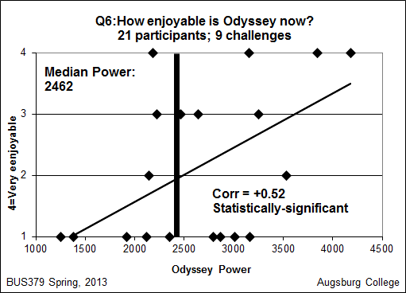
Is Odyssey Enjoyable? Best students agree more!
18
.
Notes:
Analyzing Numbers in the News
15 May 2008
2008SchieldNNN6up.pdf
18
18
This is a start-up guide to Odysseys2sense: a web based forum.

Slide 19
Conclusion
Students need to practice in class what they should be doing after the class is finished.
Most students will encounter statistics in their personal lives via the everyday media.
They need practice analyzing statistics in the media.
Odyssey is one way of doing this online.
See the associated paper for details.

Slide 20
Bibliography
20
Menn, D. (1993, Oct). Multimedia in education. PC World, M52-M60.
Schield, M. (2012a) Odysseys User Guide. Copy at www.statlit.org /pdf/2012-Odysseys-Guide-6up.pdf
Schield, M. (2012b) Odysseys System Guide. Copy at www.statlit.org/pdf/2012-Odysseys-Guide2-6up.pdf
Schield, M. (2014). Odyssey: A Journey to Lifelong Statistical Literacy. ICOTS. Copy at www.statlit.org/pdf/2014-Schield-ICOTS.pdf
Title, Topliff, Vanderstoep, Holmes & Swanson (2012). Retention of Statistical Concepts in a Randomization-Based Introductory Statistics Curriculum. SERJ May, 2012, p 21.
Notes:
Analyzing Numbers in the News
15 May 2008
2008SchieldNNN6up.pdf
20
20

Slide 21
Survey
How many of you are in or are connected with
business or economics? 5/72
epidemiology, sociology, education, history, journalism or political-science? 13/72
How many cover ANY of these in Intro Stat? 18/72
confounding in problems or on exams,
coincidence in big data, effect size OR
effect of confounding on stat. significance

Slide 22
Statistics Education Problem
When teaching Intro Stats, how many discuss:
different kinds of observational studies?
using observational associations to find causes?
Most teachers don’t teach these; most teach an abstinence-based course. [Only 1% of the 300+ ICOTS abstracts mention cause]
Most college students will encounter causation repeatedly both professionally (social sciences, law, medicine) and personally (health/politics).

Slide 23
New Course & Textbook: Statistical Literacy for Managers
First half: Traditional Descriptive & Inferential
Tables & graphs in ordinary English
Models and distributions
Sampling, bias, confidence intervals & overlap
Second half: Big Data (Association/Causation)
Coincidence & Law of Very Large Numbers
Confounding: Influence on stat. significance
Cross-sectional, longitudinal & random assign

Slide 24
Need Focus/Support Group to Change Statistical Education
Need feedback/support from statistical educators
who deal with observational studies (business, sociology, education, social work, law, health),
who focus on general education and the humanities (political-science, history, journalism), OR
who want to see change in statistical education
If interested, e-mail Schield@Augsburg.edu

