Slide 1
Statistics for Managers ** DRAFT **
by
Milo Schield, Augsburg College
Member: International Statistical Institute
US Rep: International Statistical Literacy Project
Director, W. M. Keck Statistical Literacy Project
August 11, 2015
Paper: www.StatLit.org/pdf/2015-Schield-ASA.pdf Slides: www.StatLit.org/pdf/2015-Schield-ASA-6up.pdf
Notes:
StatLit for Managers
2013
2013Schield-MBAA
1
Analyzing Numbers in the News
15 May 2008
2008SchieldNNN6up.pdf
1
1

Slide 2
Intro Stats: What are the biggest weaknesses?
Introductory statistics typically ignores:
statistics big contributions to human knowledge
different goals of statistical users
Different kinds of causation
Confounding. Tintle et al. (2014) & Cornfield
differences in study design (resist confounding)
big data; focus on small data
Notes:
StatLit for Managers
2013
2013Schield-MBAA
2
Analyzing Numbers in the News
15 May 2008
2008SchieldNNN6up.pdf
2
2

Slide 3
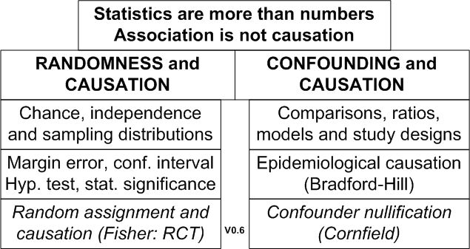
1. Statistics Big Contributions to Human Knowledge
.
Notes:
StatLit for Managers
2013
2013Schield-MBAA
3
Analyzing Numbers in the News
15 May 2008
2008SchieldNNN6up.pdf
3
3

Slide 4
2. Statistical Techniques Depends on User’s Goal
Describe: Summarize data; fit to models
Predict using association-based models
Generalize from sample statistics; infer that an observed association is statistically significant.
Explain using association-based connections
Explain effects of causes; causes of effects
Notes:
StatLit for Managers
2013
2013Schield-MBAA
4
Analyzing Numbers in the News
15 May 2008
2008SchieldNNN6up.pdf
4
4

Slide 5
3. Different Kinds of Causation
Experimental causation: Repetition of cause on same subject produces the same effect.
Fisher causation: Randomized Controlled Trials statistically control for pre-existing confounders
Epidemiological Causation. Cause is necessary. E.g., Cholera epidemic and Broad Street pump.
Probabilistic Causation: Cause neither necessary nor sufficient. E.g., Smoking and lung cancer.
Notes:
StatLit for Managers
2013
2013Schield-MBAA
5
Analyzing Numbers in the News
15 May 2008
2008SchieldNNN6up.pdf
5
5

Slide 6
4. Confounding
Not listed in McKenzie's 2004 survey of 30 “possible core concepts” in statistics education.
Not listed in index of most intro statistics textbooks
Featured in Fisher-Cornfield debate on association between smoking and lung cancer. Cornfield (1958)
“Confounding and variations are two major obstacles in learning from data”. Tintle, Cobb, etc. (2013)
Can be visually demonstrated. Wainer (2003).
Notes:
StatLit for Managers
2013
2013Schield-MBAA
6
Analyzing Numbers in the News
15 May 2008
2008SchieldNNN6up.pdf
6
6

Slide 7
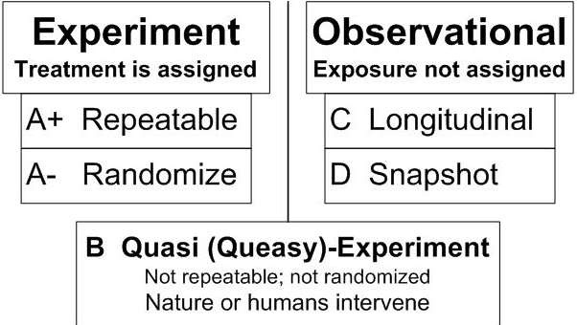
5. Types and Grades of Studies: Strength in Arguments
7
.
Notes:
Teaching Teachers Statistical Literacy OnlineTeaching Teachers Statistical Literacy OnlineStatistical Literacy Using Odysseys2Sense2008 StatLit Skills Survey
15 October 201115 October 2011Jan 7, 2011Fall 2008
2011SchieldNNN6up.pdf2011SchieldNNN6up.pdf2011SchieldMAA6up.pdf2008SchieldSkillsSurvey6up.pdf
7
Statistical Literacy at AugsburgSocial Construction of Rankings
9 Oct 20108/4/2010
www.StatLit.org/pdf/2010SchieldAugsburg6up.pdfwww.StatLit.org/pdf/2010SchieldASA6up.pdf
7
Social Construction of Rankings
8/4/2010
www.StatLit.org/pdf/2010SchieldASA6up.pdf
7
2008 StatLit Skills Survey
Fall 2008
2008SchieldSkillsSurvey6up.pdf
7
We have the top and bottom of this pyramid.
The Top: We know where we are headed. We are clear on our goal.
Our common goal is to see quantitative literacy grow.
The bottom: We have the foundation.
The need for quantitative literacy has been documented.
The books by Steen and Madison have documented this very clearly.
So, we have the foundation and we know where we are headed.
-------------------------------------
To support an interdisciplinary area, college-wide support is necessary.
To obtain college-wide support, the subject must have wide faculty support.
And in today’s climate, it must be assessable.
Unless QL is a clearly-stated campus-wide goal, QL programs are likely to be transient.
Interdisciplinary programs cannot survive in a disciplinary world without strong college support
None of this will not happen unless quantitative literacy is “understandable and teachable.”
That brings us back to the problems mentioned in the previous slide.
Quantitative literacy must be “understandable and teachable.” Whether QL is understandable and teachable depends critically on the content of QL.
> Let’s focus in on some core content of Quantitative Literacy >

Slide 8
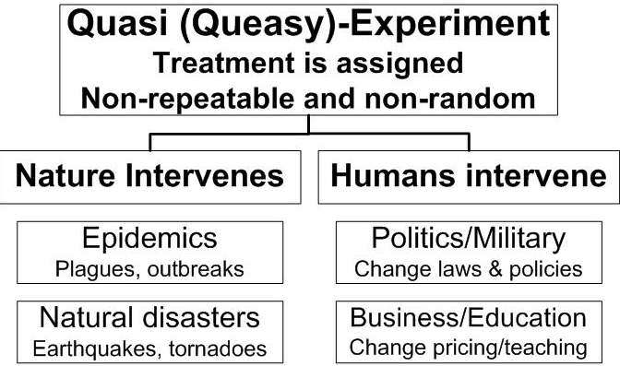
Details on Quasi-Experiments
8
.
Notes:
Teaching Teachers Statistical Literacy OnlineTeaching Teachers Statistical Literacy OnlineStatistical Literacy Using Odysseys2Sense2008 StatLit Skills Survey
15 October 201115 October 2011Jan 7, 2011Fall 2008
2011SchieldNNN6up.pdf2011SchieldNNN6up.pdf2011SchieldMAA6up.pdf2008SchieldSkillsSurvey6up.pdf
8
Statistical Literacy at AugsburgSocial Construction of Rankings
9 Oct 20108/4/2010
www.StatLit.org/pdf/2010SchieldAugsburg6up.pdfwww.StatLit.org/pdf/2010SchieldASA6up.pdf
8
Social Construction of Rankings
8/4/2010
www.StatLit.org/pdf/2010SchieldASA6up.pdf
8
2008 StatLit Skills Survey
Fall 2008
2008SchieldSkillsSurvey6up.pdf
8
We have the top and bottom of this pyramid.
The Top: We know where we are headed. We are clear on our goal.
Our common goal is to see quantitative literacy grow.
The bottom: We have the foundation.
The need for quantitative literacy has been documented.
The books by Steen and Madison have documented this very clearly.
So, we have the foundation and we know where we are headed.
-------------------------------------
To support an interdisciplinary area, college-wide support is necessary.
To obtain college-wide support, the subject must have wide faculty support.
And in today’s climate, it must be assessable.
Unless QL is a clearly-stated campus-wide goal, QL programs are likely to be transient.
Interdisciplinary programs cannot survive in a disciplinary world without strong college support
None of this will not happen unless quantitative literacy is “understandable and teachable.”
That brings us back to the problems mentioned in the previous slide.
Quantitative literacy must be “understandable and teachable.” Whether QL is understandable and teachable depends critically on the content of QL.
> Let’s focus in on some core content of Quantitative Literacy >

Slide 9
Managers have unique needs
More breadth than consumers (stat literacy)
Less depth than producers (stat competence)
More emphasis on coincidence, time-series, confounding, observational studies and causation
More breadth on statistical significance for correlation, chi-square, comparisons and RR.
Less depth on inference (e.g., inference, tests)
More use of Excel
Notes:
StatLit for Managers
2013
2013Schield-MBAA
9
Analyzing Numbers in the News
15 May 2008
2008SchieldNNN6up.pdf
9
9

Slide 10
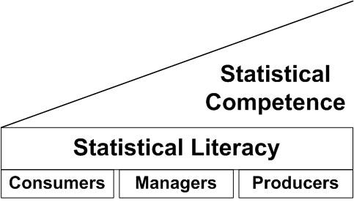
Managers Versus Consumers and Producers
.
Notes:
StatLit for Managers
2013
2013Schield-MBAA
10
Analyzing Numbers in the News
15 May 2008
2008SchieldNNN6up.pdf
10
10

Slide 11
Statistics for Managers Table of Contents
11
0. Introduction/Overview
Descriptive Statistics: Summarize/present
Predictive Statistics: Association-based
Inferential Statistics
Explanatory Statistics: Association-based
Causal Statistics
Items in boxes are “new”
Smith (2013). Six Types of Analyses… DataScientistInsights.com.
http://stats.stackexchange.com/questions/1194/practical-thoughts-on-explanatory-vs-predictive-modeling
Notes:
StatLit for Managers
2013
2013Schield-MBAA
11

Slide 12
0. Introduction
12
Why Managers need statistics
Data Analytics and Big Data
Coincidence versus skill; Spurious vs real
Statistics are numbers in context:
Statistics: socially constructed; can be influenced
Association is not causation (e.g., randomness)
Take CARE in interpreting statistics:
Context and confounding
Assembly, Randomness, Error/bias
Notes:
StatLit for Managers
2013
2013Schield-MBAA
12

Slide 13
3. Broader Scope for Statistical Significance
Statistical significance: Less than a 5% chance…
Name & suit of next card. Count of next two die. Suit of next three cards. Heads/tails of next five coins.
Correlation > 2/Sqrt(N). N = # pairs. For N > 10
Rel-Risk > 1 + 2/Sqrt(k1). K1 = n*p1 for p1 < p2
Chi-square > 2N. N = DF + 1 = # Groups
F > 2.1 + 11/(n-k) + 2/(k-1). N = sample size; k = groups
Source: www.statlit.org/pdf/2015-Schield-StatChat-Slides.pdf
Notes:
StatLit for Managers
2013
2013Schield-MBAA
13
Analyzing Numbers in the News
15 May 2008
2008SchieldNNN6up.pdf
13
13

Slide 14
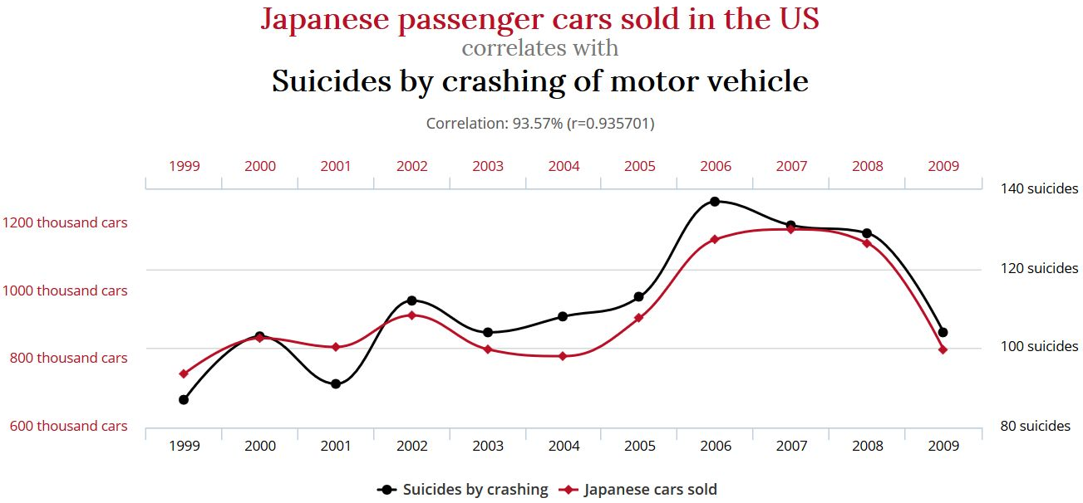
3. Correlation = 93.6%. Isn’t this statistically significant?
www.tylervigen.com
Normal Statistical Significance Cutoffs Don’t Apply to Time-Based Correlations
Notes:
StatLit for Managers
2013
2013Schield-MBAA
14
Analyzing Numbers in the News
15 May 2008
2008SchieldNNN6up.pdf
14
14

Slide 15
Conclusion
15
Managers need a statistics curriculum that is better aligned with their work. A curriculum that focuses primarily on sampling error, confidence intervals and hypothesis tests is of limited value.
This curriculum includes most of the elements of a traditional research course, but changes the balance. Less probability, derivation and calculation; more descriptive statistics, more explanatory statistics and more causal statistics.
Notes:
StatLit for Managers
2013
2013Schield-MBAA
15

Slide 16
References (1)
16
Cook & Campbell (1979). Quasi-Experiments.
Kayaly, Dina El (2013). Towards more real-live teachings of business statistics: a Review of Challenges…. www.msm.nl/resources/uploads/2014/02/MSM-WP2013-21.pdf
Leek and Peng (2015). P-values are just the tip of the iceberg. Nature.
Schield, M. (2015). Statistically-Significant Shortcuts. Statchat, Macalester. www.statlit.org/pdf/2015-Schield-StatChat-Slides.pdf
Schield, M. (2014). Two Big Ideas for Teaching Big Data: ECOTS. www.statlit.org/pdf/2014-Schield-ECOTS.pdf
Schield, M. (2013). Reinventing Business Statistics. MBAA. www.StatLit.org/pdf/2013-Schield-MBAA.pdf
Smith (2013). Six Types of Analyses… DataScientistInsights.com
Tintle, Chance, Cobb, Rossman, Roy, Swanson and VanderStoep (2014). Challenging the state of the art in post-introductory statistics. ISI
Notes:
StatLit for Managers
2013
2013Schield-MBAA
16

Slide 17
References (2)
17
ASA (2012). GAISE Report.
Ehrenberg, A. S. C. (1976). We must preach what is practised: a radical review of statistical teaching. Journal of the Royal Statistical Society, Series D, 25(3),195–208.
Pearl, D., Garfield, J., delMas, R., Groth, R., Kaplan, J. McGowan, H., and Lee, H.S. (2012). Connecting Research to Practice in a Culture of Assessment for Introductory College-level Statistics. www.causeweb.org/research/guidelines/ResearchReport_Dec_2012.pdf
Schield, M. (1996). The Goal of Introductory Statistics: MSMESB. www.statlit.org/pdf/1996Schield-MSMESB.pdf
Schield, M. (2006). Presenting Confounding and Standardization Graphically. STATS Magazine, American Statistical Association. Fall 2006. p 14-18. www.StatLit.org/pdf/2006SchieldSTATS.pdf
Notes:
StatLit for Managers
2013
2013Schield-MBAA
17

