Slide 1
Augsburg: Above-Average Value-Added Education
by
Milo Schield
Faculty Meeting Feb 17, 2015
Slides at:
www.StatLit.org/pdf/ 2015-Schield-Food4Thought.pdf
Notes:
Model Trendline Linear 2Y1X using Excel 2013
11/24/2013 V0a
www.StatLit.org/pdf/Model-Trendline-Linear-2Y1X-Excel2013-6up.pdf
1
Analyzing Numbers in the News
15 May 2008
2008SchieldNNN6up.pdf
1
1

Slide 2
Our Hidden Asset
2
In the December faculty meeting, President Pribbenow said "Augsburg must leverage its assets." I agree.
I believe that Augsburg has an asset – an intellectual asset: an asset that the faculty creates and can be proud of.
This asset is the Augsburg value-added education: the intellectual improvement that Augsburg provides for its students.
Notes:
Model Trendline Linear 2Y1X using Excel 2013
11/24/2013 V0a
www.StatLit.org/pdf/Model-Trendline-Linear-2Y1X-Excel2013-6up.pdf
2
Analyzing Numbers in the News
15 May 2008
2008SchieldNNN6up.pdf
2
2

Slide 3
Value-Added Education Measured by the CLA
3
CLA: College Learning Assessment
A 90 minute test of critical thinking.
Involves students writing essays involving claims and reasons (arguments).
I think this is the best 90 minute test of critical thinking currently available.
Given to Freshman and to Seniors.
Used by over 170 US colleges and universities.
Notes:
Analyzing Numbers in the News
15 May 2008
2008SchieldNNN6up.pdf
3
3

Slide 4
College Learning Assessment (CLA)
4
.
Notes:
Model Trendline Linear 2Y1X using Excel 2013
11/24/2013 V0a
www.StatLit.org/pdf/Model-Trendline-Linear-2Y1X-Excel2013-6up.pdf
4
Analyzing Numbers in the News
15 May 2008
2008SchieldNNN6up.pdf
4
4

Slide 5
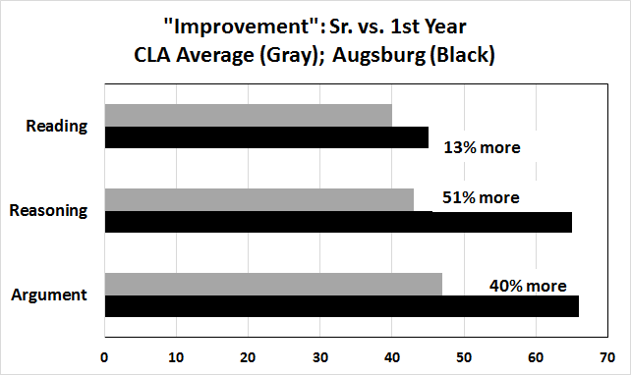
.
5
.
Notes:
Model Trendline Linear 2Y1X using Excel 2013
11/24/2013 V0a
www.StatLit.org/pdf/Model-Trendline-Linear-2Y1X-Excel2013-6up.pdf
5
Analyzing Numbers in the News
15 May 2008
2008SchieldNNN6up.pdf
5
5

Slide 6
Summary
6
Augsburg is above-average in adding value:
in critical reading and evaluation.
in scientific and quantitative reasoning.
in argumentation.
I teach statistical literacy; I am aware of lots of statistical problems.
But I have taught remedial critical thinking. I think these statistics reflect what we are doing.
Notes:
Analyzing Numbers in the News
15 May 2008
2008SchieldNNN6up.pdf
6
6

Slide 7
Closing
7
Touting Augsburg as a leader in value-added education will enhance our reputation and allow us to attract more students.
Adding value is something we do already. This is something we can do better.
To survive tough times, we – as a faculty – should commit to doing this well.
Food for thought!
Notes:
Model Trendline Linear 2Y1X using Excel 2013
11/24/2013 V0a
www.StatLit.org/pdf/Model-Trendline-Linear-2Y1X-Excel2013-6up.pdf
7
Analyzing Numbers in the News
15 May 2008
2008SchieldNNN6up.pdf
7
7

Slide 8
I’d Like ….
8
I'd like to see our faculty support the CLA challenge. I think we can do even more to help our students construct arguments that are strong, sound and persuasive while being sensitive to the views and opinions of others.
I'd like to see us require that all entering students and all graduating students take this assessment – with the option to have their scores recorded on their transcript.
Notes:
Analyzing Numbers in the News
15 May 2008
2008SchieldNNN6up.pdf
8
8

