Slide 1
What’s Wrong with Introductory Statistics?
by
Milo Schield, Augsburg College
Member: International Statistical Institute
US Rep: International Statistical Literacy Project
Director, W. M. Keck Statistical Literacy Project
VP. National Numeracy Network
October 26, 2015
www.StatLit.org/pdf/2015-Schield-StatChat2-6up.pdf
Notes:
StatLit for Managers
2013
2013Schield-MBAA
1
Analyzing Numbers in the News
15 May 2008
2008SchieldNNN6up.pdf
1
1
First big idea: Statistical educators at JSM are an extremely biased sample compared to their student abilities and majors.

Slide 2
USCOTS Cobb 1: What’s wrong with Stat 101?
Context: Peripheral in math; central in statistics.
Algorithmic thinking: Mt. Holyoke students do this in an introductory course with no prerequisite.
Experience: nothing motivates students to learn statistics as effectively as an unsolved applied problem
Schield: Q. What is context? Data context | student context?
Q. Algorithmic? Rank? Median? OLS? Standardizing?
Q. Mt. Holyoke students or all students?
Notes:
StatLit for Managers
2013
2013Schield-MBAA
2
Analyzing Numbers in the News
15 May 2008
2008SchieldNNN6up.pdf
2
2

Slide 3
USCOTS Cobb 2: What’s wrong with Stat 101?
We spend too little time on randomized assignment
Don’t study relation b/t study design & scope of inference
We don’t teach Bayesian thinking
We ignore most of the steps in the scientific process. We encourage a mistaken view of statistics as separate from scientific thinking.
Agreed! But are any of these relevant if we aren’t interested in causation or confounding?
Notes:
StatLit for Managers
2013
2013Schield-MBAA
3
Analyzing Numbers in the News
15 May 2008
2008SchieldNNN6up.pdf
3
3

Slide 4
USCOTS De Veaux 1: What Keeps Me Up At Night
Dick: I worry about Data Scientists teaching our course. Most intro stats courses are taught outside math-stats. That horse left the barn a long time ago.
Dick: Students think stats is irrelevant for their lives/work If ‘statistics’ means ‘statistical inference”, isn’t this justified?
Dick: “Students think Stats is essentially uni/bi-variate” Does any intro text use multivariate to illustrate confounding?
Dick: We continue to change the course around the edges. Is that because we are fixated on having just “one course”?
Notes:
StatLit for Managers
2013
2013Schield-MBAA
4
Analyzing Numbers in the News
15 May 2008
2008SchieldNNN6up.pdf
4
4

Slide 5
USCOTS De Veaux 2: The Problem & Take Away
The Problem:
We teach the wrong stuff, the wrong way in wrong order. This presumes we know what is right in teaching statistics.
I want my students to take away:
1. Idea that stats is relevant, intuitive, cool and “valuable” Do we agree on what is essential and valuable about statistics?
2. Healthy skepticism for data quality, models and inference. Will they see value or relevance if we promote healthy skepticism?
Notes:
StatLit for Managers
2013
2013Schield-MBAA
5
Analyzing Numbers in the News
15 May 2008
2008SchieldNNN6up.pdf
5
5

Slide 6
USCOTS: De Veaux 3: Advice & Where Are We?
Recommendations for Cool Stuff:
1. Introduce models early; motivate uni/bi-variate questions Does introducing models w/o inference promote bad practice.
2. Omit math of sampling distributions; omit some methods. Do you do this – or will you do this – in any of your texts?
Where are we?
Statistics is more than a collection of tools. What do we do to support this? Where do statistics come from? How can statistics be influenced? Can significance be influenced?
Notes:
StatLit for Managers
2013
2013Schield-MBAA
6
Analyzing Numbers in the News
15 May 2008
2008SchieldNNN6up.pdf
6
6

Slide 7
USCOTS Schield Response: What is Wrong with Stat 101?
Schield: This is the wrong question! It is an evaluation question. Any evaluation needs a standard of value.
First answer these questions:
• Who are the students in Stat 101?
• What are their aptitudes, goals and attitudes?
• What should they know about statistics?
These answers establish an appropriate standard of value.
See www.StatLit.org/pdf/2015-Schield-USCOTS.pdf.
Notes:
StatLit for Managers
2013
2013Schield-MBAA
7
Analyzing Numbers in the News
15 May 2008
2008SchieldNNN6up.pdf
7
7
We tend to represent the top 10% of SAT scores; we are not representative of most college students.
We tend to teach at the higher-end institutions; our students are not representative of most college students.
My audience is at the 60th to 80th percentile.

Slide 8
Schield 2: Proposed Solutions*
“One size fits all” doesn’t work any more. We should drop the idea of “the course” in intro stats.
We should design/support three intro statistics courses:
Stat 102: Applied Math-Stats. Calculus & model based.
Stat 101: Traditional. Algebra-based.
Stat 100: Statistical Literacy. Media-based; minimal Algebra
All three must include the major contributions of statistics to human knowledge!
* Copy at www.StatLit.org/pdf/2015-Schield-USCOTS.pdf
Notes:
Teaching Teachers Statistical Literacy OnlineTeaching Teachers Statistical Literacy OnlineStatistical Literacy Using Odysseys2Sense2008 StatLit Skills Survey
15 October 201115 October 2011Jan 7, 2011Fall 2008
2011SchieldNNN6up.pdf2011SchieldNNN6up.pdf2011SchieldMAA6up.pdf2008SchieldSkillsSurvey6up.pdf
8
Statistical Literacy at AugsburgSocial Construction of Rankings
9 Oct 20108/4/2010
www.StatLit.org/pdf/2010SchieldAugsburg6up.pdfwww.StatLit.org/pdf/2010SchieldASA6up.pdf
8
Social Construction of Rankings
8/4/2010
www.StatLit.org/pdf/2010SchieldASA6up.pdf
8
2008 StatLit Skills Survey
Fall 2008
2008SchieldSkillsSurvey6up.pdf
8
We have the top and bottom of this pyramid.
The Top: We know where we are headed. We are clear on our goal.
Our common goal is to see quantitative literacy grow.
The bottom: We have the foundation.
The need for quantitative literacy has been documented.
The books by Steen and Madison have documented this very clearly.
So, we have the foundation and we know where we are headed.
-------------------------------------
To support an interdisciplinary area, college-wide support is necessary.
To obtain college-wide support, the subject must have wide faculty support.
And in today’s climate, it must be assessable.
Unless QL is a clearly-stated campus-wide goal, QL programs are likely to be transient.
Interdisciplinary programs cannot survive in a disciplinary world without strong college support
None of this will not happen unless quantitative literacy is “understandable and teachable.”
That brings us back to the problems mentioned in the previous slide.
Quantitative literacy must be “understandable and teachable.” Whether QL is understandable and teachable depends critically on the content of QL.
> Let’s focus in on some core content of Quantitative Literacy >

Slide 9
Students vary widely in aptitude Teachers in Top 10 to 20%;
.
Notes:
StatLit for Managers
2013
2013Schield-MBAA
9
Analyzing Numbers in the News
15 May 2008
2008SchieldNNN6up.pdf
9
9
We tend to represent the top 10% of SAT scores; we are not representative of most college students.
We tend to teach at the higher-end institutions; our students are not representative of most college students.
My audience is at the 60th to 80th percentile.

Slide 10
Stat 101 students: What are their attitudes?
Of those taking Stat I:
less than 1% take Stat II (10-yrs @ Univ. St. Thomas)
less than 0.2% major in statistics (nationwide).
most see less value in statistics after the course than they did before. Schield and Schield (2008).
more say “Worst course I ever took” [anecdotal]
www.amstat.org/misc/StatsBachelors2003-2013.pdf 1,135 stat majors in 2013 at 32 colleges www.StatLit.org/pdf/2015-Schield-UST-Enroll-in-Statistics.pdf
Notes:
StatLit for Managers
2013
2013Schield-MBAA
10
Analyzing Numbers in the News
15 May 2008
2008SchieldNNN6up.pdf
10
10

Slide 11
Students Taking Intro Stats at US Four-Year Colleges
Four-year colleges only.
Notes:
StatLit for Managers
2013
2013Schield-MBAA
11
Analyzing Numbers in the News
15 May 2008
2008SchieldNNN6up.pdf
11
11
We tend to represent the top 10% of SAT scores; we are not representative of most college students.
We tend to teach at the higher-end institutions; our students are not representative of most college students.
My audience is at the 60th to 80th percentile.

Slide 12
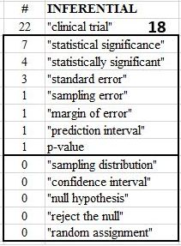
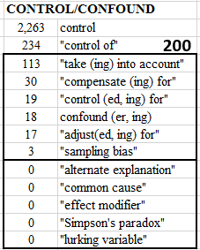
Harvard Business Review: Website Search of 40K Items
.
Notes:
StatLit for Managers
2013
2013Schield-MBAA
12
Analyzing Numbers in the News
15 May 2008
2008SchieldNNN6up.pdf
12
12

Slide 13
Statistics Education May Be Splitting
More focus on the sampling distribution for those in STEM. See “randomization”
Less focus on the sampling distribution for those in the social sciences and professions. See Sharpe, DeVeaux & Velleman (2011) and Utts (2014)
Ignore the sampling distribution completely for those students in non-quantitative majors.
Notes:
StatLit for Managers
2013
2013Schield-MBAA
13
Analyzing Numbers in the News
15 May 2008
2008SchieldNNN6up.pdf
13
13

Slide 14
Sharpe, DeVeaux & Velleman Business Statistics (2011)
They omit the derivation of the central limit theorem.
Based on a simulation, they note that the shape of this sampling distribution is approximately Normal. After testing the simulation against a Normal model, they state
"So, the particular Normal model, N[p, Sqrt(p*q/n)] is a sampling distribution model for the sample proportion."
They conclude by saying "this model can be justified theoretically with just a little mathematics."
They do present the Central Limit theorem for proportions (page 261) and for means (page 322).
Notes:
StatLit for Managers
2013
2013Schield-MBAA
14
Analyzing Numbers in the News
15 May 2008
2008SchieldNNN6up.pdf
14
14

Slide 15
Utts: Seeing Through Statistics 4th edition
The derivation of a sampling distribution is bypassed.
P 412: The sampling distribution for proportions is introduced as the "Rule for sample proportions“. "The following is what statisticians have determined to be approximately true …"
P. 416 Under "Defining the Rule for Sample Means", it states, "The Rule for Sample Means is simple: …."
The phrase "central limit theorem" is not in the index.
P-values are included. Less attention to their derivation; more attention to their interpretation in journal articles.
Notes:
StatLit for Managers
2013
2013Schield-MBAA
15
Analyzing Numbers in the News
15 May 2008
2008SchieldNNN6up.pdf
15
15

Slide 16
Big Task: What are the key topics?
16
There should be core statistical literacy list that applies to every college graduate. It should include the biggest contributions of statistics to human knowledge.
There should be separate lists for those students in quantitative majors. These lists might vary by the student’s major and their math aptitude.
Notes:
StatLit for Managers
2013
2013Schield-MBAA
16

Slide 17
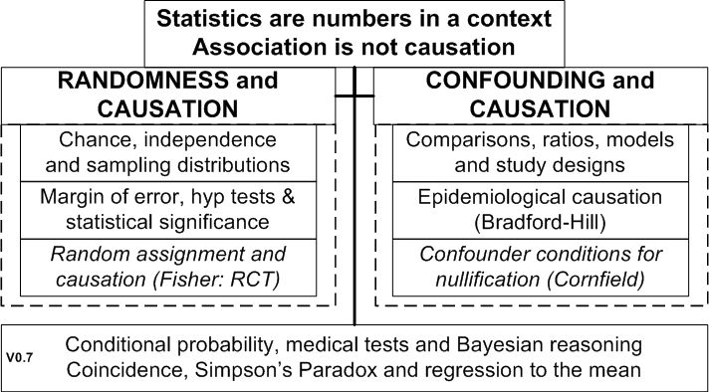
Contributions of Statistics to Human Knowledge
17
.
Notes:
StatLit for Managers
2013
2013Schield-MBAA
17

Slide 18
Conclusion
18
More college students (over half) take intro statistics than any other course (except English).
One-size fits all is no longer viable. Statistics education must support Stat 100, 101 and 102.
Statistics education should (1) support different flavors for different majors, and (2) agree on the contributions of statistics to human knowledge.
Notes:
StatLit for Managers
2013
2013Schield-MBAA
18

Slide 19
References
19
McKenzie, John, Jr. (2004) . Teaching the Core Concepts. ASA www.statlit.org/pdf/2004McKenzieASA.pdf
Schield, M. (2015). Statistical Inference for Managers. ASA www.statlit.org/pdf/2015-Schield-ASA.pdf
Schield, M. (2014). Two Big Ideas for Teaching Big Data: ECOTS. www.statlit.org/pdf/2014-Schield-ECOTS.pdf
Notes:
StatLit for Managers
2013
2013Schield-MBAA
19

Slide 20
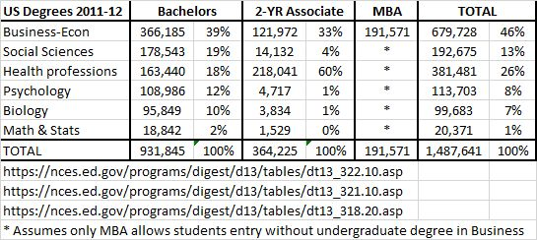
Students Interests and Needs Vary by Discipline
Business is the largest group taking statistics.
Notes:
StatLit for Managers
2013
2013Schield-MBAA
20
Analyzing Numbers in the News
15 May 2008
2008SchieldNNN6up.pdf
20
20
As defined by David Moore, statistical literacy is what is needed by statistical consumers.
Statistical competence is what is needed by statistical producers.
I argue that managers are in–between.

Slide 21
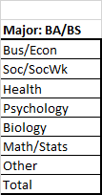
Teachers Mainly Math/Stat; Teachers are Unlike Students
Stat Educators @JSM are a biased sample
Notes:
StatLit for Managers
2013
2013Schield-MBAA
21
Analyzing Numbers in the News
15 May 2008
2008SchieldNNN6up.pdf
21
21
Our educational backgrounds are radically different from those of our students.
We studied mathematics or statistics. Most students studying statistics are in Business/Econ, Soc, Health or Psych.

Slide 22
Biz Stat-Teachers at Top End Biz Teachers Unlike Biz Students
Quants score 7 ACT points higher than non-quants (Augsburg)
Quantitative majors (left) focus on problem solving
Qualitative majors (right) focus on critical thinking
Biggest group of Stat-Ed teachers teach upper-left.
Biggest group of business majors is in lower-right.
Notes:
StatLit for Managers
2013
2013Schield-MBAA
22
Analyzing Numbers in the News
15 May 2008
2008SchieldNNN6up.pdf
22
22
The students taught by statistical educators at JSM are not representative. Their students tend to be in the upper left corner: Highest aptitude; strong math background.
Their students focus on problem solving and the statistical process.
My audience is in the lower-right corner. Their goal is to use summary statistics to make better decisions.

Slide 23
Understanding the “Logic of Statistical Inference”
23
McKenzie (2004) asked statistical educators to pick the top-three core concepts in intro statistics:
75% Variation 31% Association vs. causation 25% Hypothesis tests and 24% Sampling distribution 22% Confidence intervals 14% Randomness and statistical significance
%: Percentage of votes by Statistical Educators
Sample size: 56 95% ME = 12 percentage points
Notes:
StatLit for Managers
2013
2013Schield-MBAA
23

