Slide 1
Understanding
Social Statistics
Milo Schield, Augsburg College
Member: International Statistical Institute
US Rep: International Statistical Literacy Project
VP. National Numeracy Network
IASE Roundtable in Berlin
July 1, 2016
www.StatLit.org/pdf/2016-Schield-IASE-1Slides.pdf
Notes:
StatLit for Managers
2013
2013Schield-MBAA
1
Analyzing Numbers in the News
15 May 2008
2008SchieldNNN6up.pdf
1
1
First big idea: Statistical educators at JSM are an extremely biased sample compared to their student abilities and majors.

Slide 2
Teaching Statistica
We teach the wrong stuff; We teach it the wrong way; We teach it in the wrong order. de Veaux
Consider teaching “Association is not causation”
1973 Berkeley sex discrimination case
Ice cream sales and burglaries
Problem: These involve confounding – not chance.
Solution: Chance-based associations.
Who gets longest run in 10 flips of a coin?
How can we distinguish luck from skill?
Notes:
StatLit for Managers
2013
2013Schield-MBAA
2
Analyzing Numbers in the News
15 May 2008
2008SchieldNNN6up.pdf
2
2
First big idea: Statistical educators at JSM are an extremely biased sample compared to their student abilities and majors.

Slide 3
What are Statistics?
Summaries from random selection/assignment.
Probabilities or relative frequencies
Summaries of quantitative data; classified facts
Data; numerical data
e. Numbers in context where the context matters.
Quantitative summaries of real things:
things that have natures.
Notes:
StatLit for Managers
2013
2013Schield-MBAA
3
Analyzing Numbers in the News
15 May 2008
2008SchieldNNN6up.pdf
3
3
Math speaks of variables, values and correlations. Never about things with natures.
The social sciences speak of factors and categories.
The Humanities speak of characteristics such as gender, age, education, etc.

Slide 4
All Statistics Are
about some aspect of reality. They have units.
  51% is not a statistic. “51% of babies are male” is.
  No: P(A&B) where P(A) = P(B) = ½.
  Yes: Chance of two heads in 2 flips of a fair coin.
2. “socially constructed” (Joel Best)
    Constructed by people who decide what to count, measure, control for and present.
    “Socially constructed” refers to the process – not the presence or absence of reality.
Notes:
StatLit for Managers
2013
2013Schield-MBAA
4
Analyzing Numbers in the News
15 May 2008
2008SchieldNNN6up.pdf
4
4
Math speaks of variables, values and correlations. Never about things with natures.
The social sciences speak of factors and categories.
The Humanities speak of characteristics such as gender, age, education, etc.

Slide 5
Statistics is Different from Mathematics
Math ignores or abstracts out the context.
  There are no natures in mathematics
  Math deals with variables and values
  Math deals with associations and co-variates
  Math deals with logical operations
  Math has no operator for “causes”
Statistics deals with entities that have natures
  Statistics deals with “causes” and “confounders”
  Numbers are statistics without their context
  Mathematics is really a branch of statistics
Notes:
StatLit for Managers
2013
2013Schield-MBAA
5
Analyzing Numbers in the News
15 May 2008
2008SchieldNNN6up.pdf
5
5
Math speaks of variables, values and correlations. Never about things with natures.
The social sciences speak of factors and categories.
The Humanities speak of characteristics such as gender, age, education, etc.

Slide 6
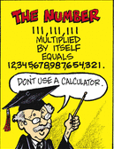
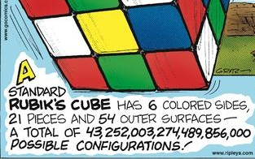
Statistics vs. Math
.
Notes:
StatLit for Managers
2013
2013Schield-MBAA
6
Analyzing Numbers in the News
15 May 2008
2008SchieldNNN6up.pdf
6
6

Slide 7
Math-Stats
7
Math is based on formulas, patterns & structure; Statistics is based on data.
Notes:
Clinical Trials vs. Causal HeterogeneityStatistical Literacy: Confounding2008 StatLit Skills Survey
29 July, 2012Dec 10, 2010Fall 2008
2012Schield-ASA6up.pdf2010SchieldUST6up.pdf2008SchieldSkillsSurvey6up.pdf
7
Statistical Literacy: Confounding2008 StatLit Skills Survey
Dec 10, 2010Fall 2008
2010SchieldUST6up.pdf2008SchieldSkillsSurvey6up.pdf
7
2008 StatLit Skills Survey
Fall 2008
2008SchieldSkillsSurvey6up.pdf
7
We have the top and bottom of this pyramid.
The Top: We know where we are headed. We are clear on our goal.
Our common goal is to see quantitative literacy grow.
The bottom: We have the foundation.
The need for quantitative literacy has been documented.
The books by Steen and Madison have documented this very clearly.
So, we have the foundation and we know where we are headed.
-------------------------------------
To support an interdisciplinary area, college-wide support is necessary.
To obtain college-wide support, the subject must have wide faculty support.
And in today’s climate, it must be assessable.
Unless QL is a clearly-stated campus-wide goal,
QL programs are likely to be transient.
Interdisciplinary programs cannot survive in a disciplinary world without strong college support
None of this will not happen unless quantitative literacy is “understandable and teachable.”
That brings us back to the problems mentioned in the previous slide.
Quantitative literacy must be “understandable and teachable.”
Whether QL is understandable and teachable depends critically on the content of QL.
> Let’s focus in on some core content of Quantitative Literacy >

Slide 8
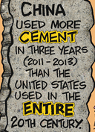

What are Social Statistics?
.
a. Statistics involving people
b. Statistics obtained from
observational studies.
Notes:
StatLit for Managers
2013
2013Schield-MBAA
8
Analyzing Numbers in the News
15 May 2008
2008SchieldNNN6up.pdf
8
8
First big idea: Statistical educators at JSM are an extremely biased sample compared to their student abilities and majors.

Slide 9
Social Statistics: are observational
Observational statistics are influenced by:
Randomness and Error/bias (like all statistics)
Control:
  where they came from (the source/population).
  what was – and was not – controlled for
  what kind of study was involved.
Assembly:
  how they were collected, defined, grouped, summarized, compared and presented.
  the context in which things were counted or measured
Notes:
StatLit for Managers
2013
2013Schield-MBAA
9
Analyzing Numbers in the News
15 May 2008
2008SchieldNNN6up.pdf
9
9

Slide 10
Social Statistics:
Associations
Baseball players whose names begin with the letter “D” are more likely to die young
Asian-Americans are most susceptible to heart attacks on the fourth day of the month
Drinking a full pot of coffee every morning will add years to your life, but one cup a day increases the risk of pancreatic cancer.
Source: Standard Deviations: Flawed Assumptions, Tortured Data, and Other Ways to Lie with Statistics by Gary Smith (2015).
Notes:
StatLit for Managers
2013
2013Schield-MBAA
10
Analyzing Numbers in the News
15 May 2008
2008SchieldNNN6up.pdf
10
10

Slide 11
Social Statistics:
Defining Groups
11
# US children: Elevated levels of lead:
27,000 in 2009
259,000 in 2010 [Almost a factor of 10]
In 2010, the CDC reduced the minimum for elevated levels of lead from 10 to five*.
* micrograms per dl of blood
www.cdc.gov/nceh/lead/data/StateConfirmedByYear1997-2011.htm
Notes:
Clinical Trials vs. Causal HeterogeneityStatistical Literacy: Confounding2008 StatLit Skills Survey
29 July, 2012Dec 10, 2010Fall 2008
2012Schield-ASA6up.pdf2010SchieldUST6up.pdf2008SchieldSkillsSurvey6up.pdf
11
Statistical Literacy: Confounding2008 StatLit Skills Survey
Dec 10, 2010Fall 2008
2010SchieldUST6up.pdf2008SchieldSkillsSurvey6up.pdf
11
2008 StatLit Skills Survey
Fall 2008
2008SchieldSkillsSurvey6up.pdf
11
We have the top and bottom of this pyramid.
The Top: We know where we are headed. We are clear on our goal.
Our common goal is to see quantitative literacy grow.
The bottom: We have the foundation.
The need for quantitative literacy has been documented.
The books by Steen and Madison have documented this very clearly.
So, we have the foundation and we know where we are headed.
-------------------------------------
To support an interdisciplinary area, college-wide support is necessary.
To obtain college-wide support, the subject must have wide faculty support.
And in today’s climate, it must be assessable.
Unless QL is a clearly-stated campus-wide goal,
QL programs are likely to be transient.
Interdisciplinary programs cannot survive in a disciplinary world without strong college support
None of this will not happen unless quantitative literacy is “understandable and teachable.”
That brings us back to the problems mentioned in the previous slide.
Quantitative literacy must be “understandable and teachable.”
Whether QL is understandable and teachable depends critically on the content of QL.
> Let’s focus in on some core content of Quantitative Literacy >

Slide 12
Social Statistics:
Control & Confounding
12
The male-female difference in weights among 20-year-olds is 27 pounds.
156#: Male weight; 129# Female weight
70” Male height: 70"; Female height: 64"
Weight of 70” high females is 142#.
* www.cdc.gov/growthcharts/html_charts/bmiagerev.htm
The male-female difference in weight for
20-year olds is 14 pounds after controlling for height.
Notes:
Clinical Trials vs. Causal HeterogeneityStatistical Literacy: Confounding2008 StatLit Skills Survey
29 July, 2012Dec 10, 2010Fall 2008
2012Schield-ASA6up.pdf2010SchieldUST6up.pdf2008SchieldSkillsSurvey6up.pdf
12
Statistical Literacy: Confounding2008 StatLit Skills Survey
Dec 10, 2010Fall 2008
2010SchieldUST6up.pdf2008SchieldSkillsSurvey6up.pdf
12
2008 StatLit Skills Survey
Fall 2008
2008SchieldSkillsSurvey6up.pdf
12
We have the top and bottom of this pyramid.
The Top: We know where we are headed. We are clear on our goal.
Our common goal is to see quantitative literacy grow.
The bottom: We have the foundation.
The need for quantitative literacy has been documented.
The books by Steen and Madison have documented this very clearly.
So, we have the foundation and we know where we are headed.
-------------------------------------
To support an interdisciplinary area, college-wide support is necessary.
To obtain college-wide support, the subject must have wide faculty support.
And in today’s climate, it must be assessable.
Unless QL is a clearly-stated campus-wide goal,
QL programs are likely to be transient.
Interdisciplinary programs cannot survive in a disciplinary world without strong college support
None of this will not happen unless quantitative literacy is “understandable and teachable.”
That brings us back to the problems mentioned in the previous slide.
Quantitative literacy must be “understandable and teachable.”
Whether QL is understandable and teachable depends critically on the content of QL.
> Let’s focus in on some core content of Quantitative Literacy >

Slide 13


Social Statistics
Using Ordinary English
Zohr is largest-ever gas field found in the Med.
The largest-ever gas field (Zohr) is found in the Med.
www.yahoo.com/news/largest-ever-med-gas-field-found-off-egypt-143205171.html
3. Largest-ever gas-field <snip> found in the Med.
4. Zohr is largest-ever gas field that is in the Med.
5. Zohr is largest-ever gas field, that is in the Med.
Notes:
StatLit for Managers
2013
2013Schield-MBAA
13
Analyzing Numbers in the News
15 May 2008
2008SchieldNNN6up.pdf
13
13

Slide 14
Describing Statistics using
Ordinary English
80% of world’s city dwellers breathing bad air: UN
7. Zohr is largest-ever gas field that is in the Med.
8. Zohr is largest-ever gas field, that is in the Med.
9. Largest-ever gas-field found in the Med.
www.yahoo.com/news/largest-ever-med-gas-field-found-off-egypt-143205171.html
Notes:
StatLit for Managers
2013
2013Schield-MBAA
14
Analyzing Numbers in the News
15 May 2008
2008SchieldNNN6up.pdf
14
14

Slide 15

Association vs. Causation
Using Ordinary English
How Climate Change is Fueling Rise in Shark Attacks
www.yahoo.com/news/climate-change-fueling-rise-shark-145333862.html
Notes:
StatLit for Managers
2013
2013Schield-MBAA
15
Analyzing Numbers in the News
15 May 2008
2008SchieldNNN6up.pdf
15
15

Slide 16
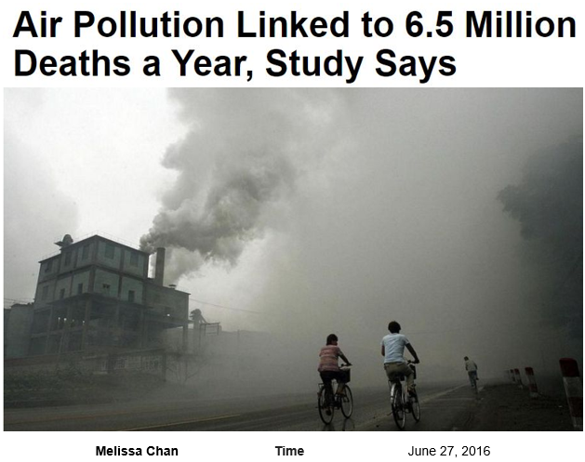
Speculative [Spotty] Statistics
Using Ordinary English
Notes:
StatLit for Managers
2013
2013Schield-MBAA
16
Analyzing Numbers in the News
15 May 2008
2008SchieldNNN6up.pdf
16
16

Slide 17
Student Survey of
Perceived Value
Q1. Do you think that showing students the value of studying statistics is an important goal of your course?
Q2. Have you ever surveyed your students before/after the course on how much value they see in learning statistics?
Q3. Do you realize that most value surveys show students see less value in studying statistics after than before?
Q4. Is this a stated goal of the introductory statistics course? If not, why not?
Notes:
StatLit for Managers
2013
2013Schield-MBAA
17
Analyzing Numbers in the News
15 May 2008
2008SchieldNNN6up.pdf
17
17

Slide 18
What is wrong with Stat 101? Schield 1
Wrong question! First answer these:
Who are the students in Stat 101?
What are their aptitudes, goals and attitudes?
Then answer this:
What are the primary contributions of statistics
to human knowledge?
My answers are at www.StatLit.org/pdf/2015-Schield-USCOTS.pdf
Notes:
StatLit for Managers
2013
2013Schield-MBAA
18
Analyzing Numbers in the News
15 May 2008
2008SchieldNNN6up.pdf
18
18

Slide 19
College Students
Intellectual aptitudes?
.
Notes:
StatLit for Managers
2013
2013Schield-MBAA
19
Analyzing Numbers in the News
15 May 2008
2008SchieldNNN6up.pdf
19
19
We tend to represent the top 10% of SAT scores; we are not representative of most college students.
We tend to teach at the higher-end institutions; our students are not representative of most college students.
My audience is at the 60th to 80th percentile.

Slide 20
Stat 101 students:
What are their goals?
Of 1.6M US graduates with BA/BS, 57% took Stat 101
Of the 910,605 students in Stat 101 at US 4-yr colleges,
38% in Business or Economics (347,985)
19% in Social Science or History (168,500)
13% in Health (120,488)
10% in Psychology (94,271)
9% in Engineering (83,109)
9% in Biological Science (80,756)
2% in mathematics or statistics (15,496)
57% of Stat 101 students deal mainly with observational studies (Business & Social Science majors).
Assumes all graduates in these majors took statistics. 2012 USSA. Table 302. Bachelor’s degrees.
Notes:
StatLit for Managers
2013
2013Schield-MBAA
20
Analyzing Numbers in the News
15 May 2008
2008SchieldNNN6up.pdf
20
20

Slide 21
Stat 101 students:
Attitudes toward Statistics
Of those taking Stat I:
most see less value in statistics after the course than before. Schield and Schield (2008).
Many say “Worst course I ever took” [anecdotal]
Lost almost half of the course gain within 4 months
in consensus course. Tintle et al, (2012) SERJ
Lost 33% of what they knew on their final within 12 month in an online course. Nadir (2004). Teaching-Learning Medicine.
www.amstat.org/misc/StatsBachelors2003-2013.pdf 1,135 stat majors in 2013 at 32 colleges
www.StatLit.org/pdf/2015-Schield-UST-Enroll-in-Statistics.pdf
Notes:
StatLit for Managers
2013
2013Schield-MBAA
21
Analyzing Numbers in the News
15 May 2008
2008SchieldNNN6up.pdf
21
21

Slide 22
Stat 101 students:
Interest Advanced Statistics
Of those taking Stat I:
less than 1% take Stat II (10-yrs @ Univ. St. Thomas)
May take Psych/Soc/Marketing Research Methods.
less than 0.2% major in statistics (nationwide).
www.amstat.org/misc/StatsBachelors2003-2013.pdf 1,135 stat majors in 2013 at 32 colleges
www.StatLit.org/pdf/2015-Schield-UST-Enroll-in-Statistics.pdf
Notes:
StatLit for Managers
2013
2013Schield-MBAA
22
Analyzing Numbers in the News
15 May 2008
2008SchieldNNN6up.pdf
22
22

Slide 23
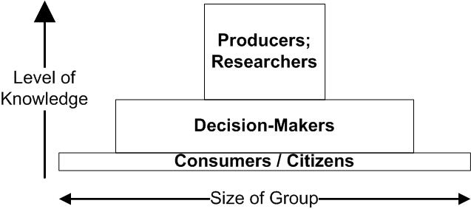
Three Audiences:
Three Courses
.
Notes:
StatLit for Managers
2013
2013Schield-MBAA
23
Analyzing Numbers in the News
15 May 2008
2008SchieldNNN6up.pdf
23
23

Slide 24
Schield 2: What is Wrong with THE Intro Statistics Course*
“One size fits all” doesn’t work any more.
We should drop the idea of “the course” in intro stats.
We should support three algebra-intro statistics courses:
Stat 102: Social Statistics for Decision Makers. Algebra
Stat 101: Traditional Research-Inference. Algebra-based.
Stat 100: Statistical Literacy. Media-based; minimal Algebra
All include the big contributions of stats to human knowledge
Notes:
Teaching Teachers Statistical Literacy OnlineTeaching Teachers Statistical Literacy OnlineStatistical Literacy Using Odysseys2Sense2008 StatLit Skills Survey
15 October 201115 October 2011Jan 7, 2011Fall 2008
2011SchieldNNN6up.pdf2011SchieldNNN6up.pdf2011SchieldMAA6up.pdf2008SchieldSkillsSurvey6up.pdf
24
Statistical Literacy at AugsburgSocial Construction of Rankings
9 Oct 20108/4/2010
www.StatLit.org/pdf/2010SchieldAugsburg6up.pdfwww.StatLit.org/pdf/2010SchieldASA6up.pdf
24
Social Construction of Rankings
8/4/2010
www.StatLit.org/pdf/2010SchieldASA6up.pdf
24
2008 StatLit Skills Survey
Fall 2008
2008SchieldSkillsSurvey6up.pdf
24
We have the top and bottom of this pyramid.
The Top: We know where we are headed. We are clear on our goal.
Our common goal is to see quantitative literacy grow.
The bottom: We have the foundation.
The need for quantitative literacy has been documented.
The books by Steen and Madison have documented this very clearly.
So, we have the foundation and we know where we are headed.
-------------------------------------
To support an interdisciplinary area, college-wide support is necessary.
To obtain college-wide support, the subject must have wide faculty support.
And in today’s climate, it must be assessable.
Unless QL is a clearly-stated campus-wide goal,
QL programs are likely to be transient.
Interdisciplinary programs cannot survive in a disciplinary world without strong college support
None of this will not happen unless quantitative literacy is “understandable and teachable.”
That brings us back to the problems mentioned in the previous slide.
Quantitative literacy must be “understandable and teachable.”
Whether QL is understandable and teachable depends critically on the content of QL.
> Let’s focus in on some core content of Quantitative Literacy >

Slide 25
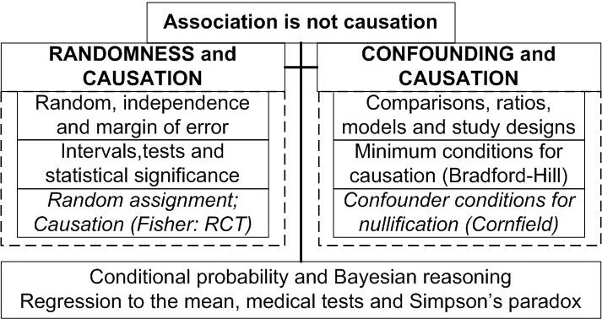
Major Contributions of Statistics to Human Knowledge
Milo Schield
Notes:
Teaching Teachers Statistical Literacy OnlineTeaching Teachers Statistical Literacy OnlineStatistical Literacy Using Odysseys2Sense2008 StatLit Skills Survey
15 October 201115 October 2011Jan 7, 2011Fall 2008
2011SchieldNNN6up.pdf2011SchieldNNN6up.pdf2011SchieldMAA6up.pdf2008SchieldSkillsSurvey6up.pdf
25
Statistical Literacy at AugsburgSocial Construction of Rankings
9 Oct 20108/4/2010
www.StatLit.org/pdf/2010SchieldAugsburg6up.pdfwww.StatLit.org/pdf/2010SchieldASA6up.pdf
25
Social Construction of Rankings
8/4/2010
www.StatLit.org/pdf/2010SchieldASA6up.pdf
25
2008 StatLit Skills Survey
Fall 2008
2008SchieldSkillsSurvey6up.pdf
25
We have the top and bottom of this pyramid.
The Top: We know where we are headed. We are clear on our goal.
Our common goal is to see quantitative literacy grow.
The bottom: We have the foundation.
The need for quantitative literacy has been documented.
The books by Steen and Madison have documented this very clearly.
So, we have the foundation and we know where we are headed.
-------------------------------------
To support an interdisciplinary area, college-wide support is necessary.
To obtain college-wide support, the subject must have wide faculty support.
And in today’s climate, it must be assessable.
Unless QL is a clearly-stated campus-wide goal,
QL programs are likely to be transient.
Interdisciplinary programs cannot survive in a disciplinary world without strong college support
None of this will not happen unless quantitative literacy is “understandable and teachable.”
That brings us back to the problems mentioned in the previous slide.
Quantitative literacy must be “understandable and teachable.”
Whether QL is understandable and teachable depends critically on the content of QL.
> Let’s focus in on some core content of Quantitative Literacy >

Slide 26
References
26
Cobb, G. (2015). What’s Wrong with Stat 101? USCOTS Handout.
De Veaux, D. (2015). Introductory Statistics in the 21st Century. USCOTS slides
Schield, Milo (2015). Ten-year Enrollments Stat I/II at St. Thomas
www.StatLit.org/pdf/2015-Schield-UST-Enroll-in-Statistics.pdf
Schield, Milo (2015). What is wrong with THE Introductory Statistics Course. www.StatLit.org/pdf/2015-Schield-USCOTS.pdf
Tintle, Chance, Cobb, Rossman, Roy, Swanson & VanderStoep (2014) Challenging the state of the art in post-introductory statistics. Proceedings 59th ISI World Statistics Congress. P. 295-300. http://2013.isiproceedings.org/Files/IPS032-P1-S.pdf
Notes:
StatLit for Managers
2013
2013Schield-MBAA
26

Slide 27
2. Statistical Techniques
Depends on User’s Goal
Describe: Summarize data; fit to models
Predict using association-based models
Generalize from sample statistics; infer that
an observed association is statistically significant.
Explain using association-based connections
Explain effects of causes; causes of effects
Notes:
StatLit for Managers
2013
2013Schield-MBAA
27
Analyzing Numbers in the News
15 May 2008
2008SchieldNNN6up.pdf
27
27

Slide 28
3. Different Kinds of Causation
Experimental causation: Repetition of cause
on same subject produces the same effect.
Fisher causation: Randomized Controlled Trials statistically control for pre-existing confounders
Epidemiological Causation. Cause is necessary.
E.g., Cholera epidemic and Broad Street pump.
Probabilistic Causation: Cause neither necessary nor sufficient. E.g., Smoking and lung cancer.
Notes:
StatLit for Managers
2013
2013Schield-MBAA
28
Analyzing Numbers in the News
15 May 2008
2008SchieldNNN6up.pdf
28
28

Slide 29
4. Confounding
Not listed in McKenzie's 2004 survey of 30
“possible core concepts” in statistics education.
Not listed in index of most intro statistics textbooks
Featured in Fisher-Cornfield debate on association between smoking and lung cancer. Cornfield (1958)
“Confounding and variations are two major obstacles in learning from data”. Tintle, Cobb, etc. (2013)
Can be visually demonstrated. Wainer (2003).
Notes:
StatLit for Managers
2013
2013Schield-MBAA
29
Analyzing Numbers in the News
15 May 2008
2008SchieldNNN6up.pdf
29
29

Slide 30
4. Confounding vs. Mechanism
.
Notes:
StatLit for Managers
2013
2013Schield-MBAA
30
Analyzing Numbers in the News
15 May 2008
2008SchieldNNN6up.pdf
30
30

Slide 31
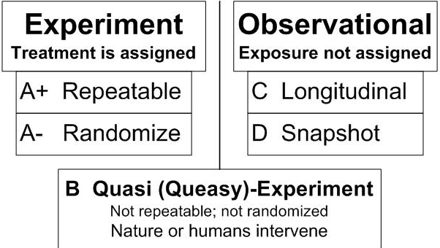
Types and Grades of Studies:
Strength in Arguments
31
.
Notes:
Teaching Teachers Statistical Literacy OnlineTeaching Teachers Statistical Literacy OnlineStatistical Literacy Using Odysseys2Sense2008 StatLit Skills Survey
15 October 201115 October 2011Jan 7, 2011Fall 2008
2011SchieldNNN6up.pdf2011SchieldNNN6up.pdf2011SchieldMAA6up.pdf2008SchieldSkillsSurvey6up.pdf
31
Statistical Literacy at AugsburgSocial Construction of Rankings
9 Oct 20108/4/2010
www.StatLit.org/pdf/2010SchieldAugsburg6up.pdfwww.StatLit.org/pdf/2010SchieldASA6up.pdf
31
Social Construction of Rankings
8/4/2010
www.StatLit.org/pdf/2010SchieldASA6up.pdf
31
2008 StatLit Skills Survey
Fall 2008
2008SchieldSkillsSurvey6up.pdf
31
We have the top and bottom of this pyramid.
The Top: We know where we are headed. We are clear on our goal.
Our common goal is to see quantitative literacy grow.
The bottom: We have the foundation.
The need for quantitative literacy has been documented.
The books by Steen and Madison have documented this very clearly.
So, we have the foundation and we know where we are headed.
-------------------------------------
To support an interdisciplinary area, college-wide support is necessary.
To obtain college-wide support, the subject must have wide faculty support.
And in today’s climate, it must be assessable.
Unless QL is a clearly-stated campus-wide goal,
QL programs are likely to be transient.
Interdisciplinary programs cannot survive in a disciplinary world without strong college support
None of this will not happen unless quantitative literacy is “understandable and teachable.”
That brings us back to the problems mentioned in the previous slide.
Quantitative literacy must be “understandable and teachable.”
Whether QL is understandable and teachable depends critically on the content of QL.
> Let’s focus in on some core content of Quantitative Literacy >

Slide 32
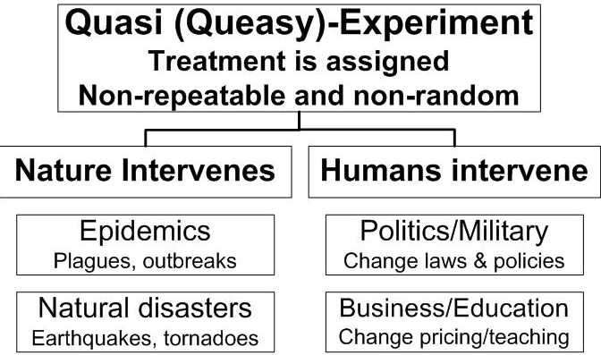
Details on Quasi-Experiments
32
.
Notes:
Teaching Teachers Statistical Literacy OnlineTeaching Teachers Statistical Literacy OnlineStatistical Literacy Using Odysseys2Sense2008 StatLit Skills Survey
15 October 201115 October 2011Jan 7, 2011Fall 2008
2011SchieldNNN6up.pdf2011SchieldNNN6up.pdf2011SchieldMAA6up.pdf2008SchieldSkillsSurvey6up.pdf
32
Statistical Literacy at AugsburgSocial Construction of Rankings
9 Oct 20108/4/2010
www.StatLit.org/pdf/2010SchieldAugsburg6up.pdfwww.StatLit.org/pdf/2010SchieldASA6up.pdf
32
Social Construction of Rankings
8/4/2010
www.StatLit.org/pdf/2010SchieldASA6up.pdf
32
2008 StatLit Skills Survey
Fall 2008
2008SchieldSkillsSurvey6up.pdf
32
We have the top and bottom of this pyramid.
The Top: We know where we are headed. We are clear on our goal.
Our common goal is to see quantitative literacy grow.
The bottom: We have the foundation.
The need for quantitative literacy has been documented.
The books by Steen and Madison have documented this very clearly.
So, we have the foundation and we know where we are headed.
-------------------------------------
To support an interdisciplinary area, college-wide support is necessary.
To obtain college-wide support, the subject must have wide faculty support.
And in today’s climate, it must be assessable.
Unless QL is a clearly-stated campus-wide goal,
QL programs are likely to be transient.
Interdisciplinary programs cannot survive in a disciplinary world without strong college support
None of this will not happen unless quantitative literacy is “understandable and teachable.”
That brings us back to the problems mentioned in the previous slide.
Quantitative literacy must be “understandable and teachable.”
Whether QL is understandable and teachable depends critically on the content of QL.
> Let’s focus in on some core content of Quantitative Literacy >

Slide 33
Speculative [Spotty] Statistics
Using Ordinary English
7 million premature deaths annually linked to air pollution
www.who.int/mediacentre/news/releases/2014/air-pollution/en/
Contaminants in outdoor air caused more than
3 million premature deaths a year: UN
http://theconversation.com/air-pollution-causes-more-than-3-million-premature-deaths-a-year-worldwide-47639
The City of London has dangerous levels of PM10 estimated to cause more than 3,000 deaths per year
Does a death certificate ever list air pollution as a cause of death? If not, who are these people? Where do these statistics come from?
Notes:
StatLit for Managers
2013
2013Schield-MBAA
33
Analyzing Numbers in the News
15 May 2008
2008SchieldNNN6up.pdf
33
33

Slide 34
Simple Comparisons
Increasing Income Inequality
1. Initially Group A earns 100; B earns 10.
2. Incomes in both groups increase by 10%.
3. Now, Group A earns 110; B earns 11.
A. Ratio (10:1) remains unchanged.
B. Difference increases by 90 to 99.
Income gap increases: both get same % increase
Notes:
StatLit for Managers
2013
2013Schield-MBAA
34
Analyzing Numbers in the News
15 May 2008
2008SchieldNNN6up.pdf
34
34

Slide 35
Simple Comparisons
Decreasing Income Inequality
1. Initially Group A earns 100; B earns 10.
2. Incomes in both groups increase by 10
3. Now, Group A earns 110; B earns 20.
A. After-before ratio decreases from 10:1 to 11:2 (5.5 : 1)
B. After-before difference is unchanged at 90.
Income ratio decreases: both get same $ increase.
Notes:
StatLit for Managers
2013
2013Schield-MBAA
35
Analyzing Numbers in the News
15 May 2008
2008SchieldNNN6up.pdf
35
35

Slide 36
Intro Stats: What are the biggest weaknesses?
Introductory statistics typically ignores:
statistics big contributions to human knowledge
different goals of statistical users
Different kinds of causation
Confounding. Tintle et al. (2014) & Cornfield
differences in study design (resist confounding)
big data; focus on small data
Notes:
StatLit for Managers
2013
2013Schield-MBAA
36
Analyzing Numbers in the News
15 May 2008
2008SchieldNNN6up.pdf
36
36

Slide 37
Background:
McKenzie (2004)
In 2004, McKenzie surveyed statistical educators on the core concepts in Statistics.
www.statlit.org/pdf/2004McKenzieASA.pdf
The 2004 choices excluded several big ideas:
* Models, multivariate thinking, and confounding
* Bayesian thinking
* Effect sizes
* Context: Where do statistics come from?
This paper presents the results of an updated survey among two different groups: students and statistical educators.
Notes:
StatLit for Managers
2013
2013Schield-MBAA
37
Analyzing Numbers in the News
15 May 2008
2008SchieldNNN6up.pdf
37
37

Slide 38
Understanding the
“Logic of Statistical Inference”
38
McKenzie (2004) asked statistical educators to pick the top-three core concepts in intro statistics:
75% Variation
31% Association vs. causation
25% Hypothesis tests and
24% Sampling distribution
22% Confidence intervals
14% Randomness and statistical significance
%: Percentage of votes by Statistical Educators
Sample size: 56 95% ME = 12 percentage points
Notes:
StatLit for Managers
2013
2013Schield-MBAA
38

Slide 39
Stat 101 students:
What are their attitudes?
Of those taking Stat I:
less than 1% take Stat II (10-yrs @ Univ. St. Thomas)
less than 0.2% major in statistics (nationwide).
most see less value in statistics after the course than they did before. Schield and Schield (2008).
more say “Worst course I ever took” [anecdotal]
www.amstat.org/misc/StatsBachelors2003-2013.pdf 1,135 stat majors in 2013 at 32 colleges
www.StatLit.org/pdf/2015-Schield-UST-Enroll-in-Statistics.pdf
Notes:
StatLit for Managers
2013
2013Schield-MBAA
39
Analyzing Numbers in the News
15 May 2008
2008SchieldNNN6up.pdf
39
39

Slide 40
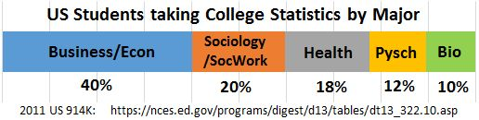
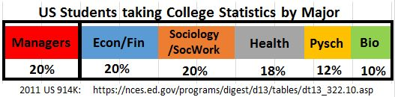
Students Taking Intro Stats at US Four-Year Colleges
Four-year colleges only.
Notes:
StatLit for Managers
2013
2013Schield-MBAA
40
Analyzing Numbers in the News
15 May 2008
2008SchieldNNN6up.pdf
40
40
We tend to represent the top 10% of SAT scores; we are not representative of most college students.
We tend to teach at the higher-end institutions; our students are not representative of most college students.
My audience is at the 60th to 80th percentile.

Slide 41
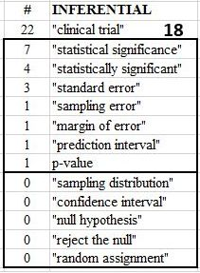
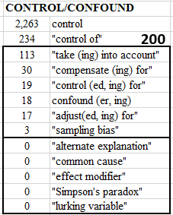
Harvard Business Review:
Website Search of 40K Items
.
Notes:
StatLit for Managers
2013
2013Schield-MBAA
41
Analyzing Numbers in the News
15 May 2008
2008SchieldNNN6up.pdf
41
41

Slide 42
Statistics Education
May Be Splitting
More focus on the sampling distribution for those in STEM. See “randomization”
Less focus on the sampling distribution for those in the social sciences and professions.
See Sharpe, DeVeaux & Velleman (2011) and Utts (2014)
Ignore the sampling distribution completely for those students in non-quantitative majors.
Notes:
StatLit for Managers
2013
2013Schield-MBAA
42
Analyzing Numbers in the News
15 May 2008
2008SchieldNNN6up.pdf
42
42

Slide 43
Sharpe, DeVeaux & Velleman
Business Statistics (2011)
They omit the derivation of the central limit theorem.
Based on a simulation, they note that the shape of this sampling distribution is approximately Normal. After testing the simulation against a Normal model, they state
"So, the particular Normal model, N[p, Sqrt(p*q/n)] is a sampling distribution model for the sample proportion."
They conclude by saying "this model can be justified theoretically with just a little mathematics."
They do present the Central Limit theorem for proportions (page 261) and for means (page 322).
Notes:
StatLit for Managers
2013
2013Schield-MBAA
43
Analyzing Numbers in the News
15 May 2008
2008SchieldNNN6up.pdf
43
43

Slide 44
Utts: Seeing Through Statistics
4th edition
The derivation of a sampling distribution is bypassed.
P 412: The sampling distribution for proportions is introduced as the "Rule for sample proportions“. "The following is what statisticians have determined to be approximately true …"
P. 416 Under "Defining the Rule for Sample Means",
it states, "The Rule for Sample Means is simple: …."
The phrase "central limit theorem" is not in the index.
P-values are included. Less attention to their derivation; more attention to their interpretation in journal articles.
Notes:
StatLit for Managers
2013
2013Schield-MBAA
44
Analyzing Numbers in the News
15 May 2008
2008SchieldNNN6up.pdf
44
44

Slide 45
Big Task:
What are the key topics?
45
There should be core statistical literacy list that applies to every college graduate. It should include the biggest contributions of statistics to human knowledge.
There should be separate lists for those students in quantitative majors. These lists might vary by the student’s major and their math aptitude.
Notes:
StatLit for Managers
2013
2013Schield-MBAA
45

Slide 46
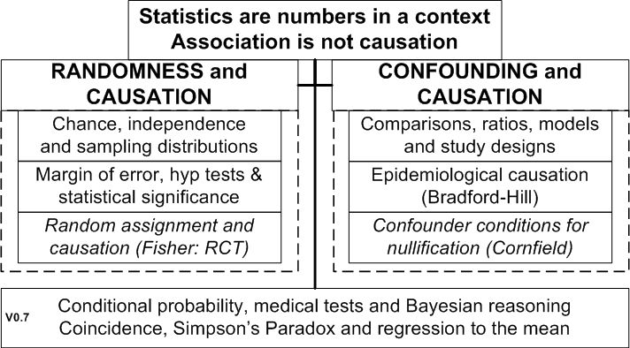
Contributions of Statistics to Human Knowledge
46
.
Notes:
StatLit for Managers
2013
2013Schield-MBAA
46

Slide 47
Most Important Topics/Ideas
Augsburg StatLit Students
47
1 Name all sources of influence (Take CARE)
2 Confounding
2 Hypothetical thinking: confounders, definitions.
4 Statistics are more than numbers.
5 Association-causation & Randomness (Luck vs. skill)
5 Bias: Placebo, Single blind; double blind
5 Named Ratios grammar; Percent, Percentages, Rates
Notes:
StatLit for Managers
2013
2013Schield-MBAA
47

Slide 48
Conclusion
48
Introductory statistics must be re-engineered:
Allow for differences in students aptitudes
Allow for difference in student interests
Increase focus on multivariate & confounding
Increase focus on Context: Where do Stats come from?
Notes:
StatLit for Managers
2013
2013Schield-MBAA
48

Slide 49
References
49
McKenzie, John, Jr. (2004) . Teaching the Core Concepts. ASA
www.statlit.org/pdf/2004McKenzieASA.pdf
Schield, M. (2015). Statistical Inference for Managers. ASA www.statlit.org/pdf/2015-Schield-ASA.pdf
Schield, M. (2014). Two Big Ideas for Teaching Big Data: ECOTS. www.statlit.org/pdf/2014-Schield-ECOTS.pdf
Notes:
StatLit for Managers
2013
2013Schield-MBAA
49

Slide 50
References (1)
50
Cook & Campbell (1979). Quasi-Experiments.
Kayaly, Dina El (2013). Towards more real-live teachings of business statistics: a Review of Challenges…. www.msm.nl/resources/uploads/2014/02/MSM-WP2013-21.pdf
Leek and Peng (2015). P-values are just the tip of the iceberg. Nature.
Schield, M. (2015). Statistically-Significant Shortcuts. Statchat, Macalester. www.statlit.org/pdf/2015-Schield-StatChat-Slides.pdf
Schield, M. (2014). Two Big Ideas for Teaching Big Data: ECOTS. www.statlit.org/pdf/2014-Schield-ECOTS.pdf
Schield, M. (2013). Reinventing Business Statistics. MBAA.
www.StatLit.org/pdf/2013-Schield-MBAA.pdf
Smith (2013). Six Types of Analyses… DataScientistInsights.com
Tintle, Chance, Cobb, Rossman, Roy, Swanson and VanderStoep (2014). Challenging the state of the art in post-introductory statistics. ISI
Notes:
StatLit for Managers
2013
2013Schield-MBAA
50

Slide 51
Statistics for Decision Makers
Table of Contents
51
0. Introduction/Overview
Descriptive Statistics: Summarize/present
Predictive Statistics: Association-based
Inferential Statistics
Explanatory Statistics: Association-based
Causal Statistics
Items in boxes are “new”
Smith (2013). Six Types of Analyses… DataScientistInsights.com.
http://stats.stackexchange.com/questions/1194/practical-thoughts-on-explanatory-vs-predictive-modeling
Notes:
StatLit for Managers
2013
2013Schield-MBAA
51

Slide 52
0. Introduction
52
Why Managers need statistics
Data Analytics and Big Data
Coincidence versus skill; Spurious vs real
Statistics are numbers in context:
Statistics: socially constructed; can be influenced
Association is not causation (e.g., randomness)
Take CARE in interpreting statistics:
Context and confounding
Assembly, Randomness, Error/bias
Notes:
StatLit for Managers
2013
2013Schield-MBAA
52

