Slide 1
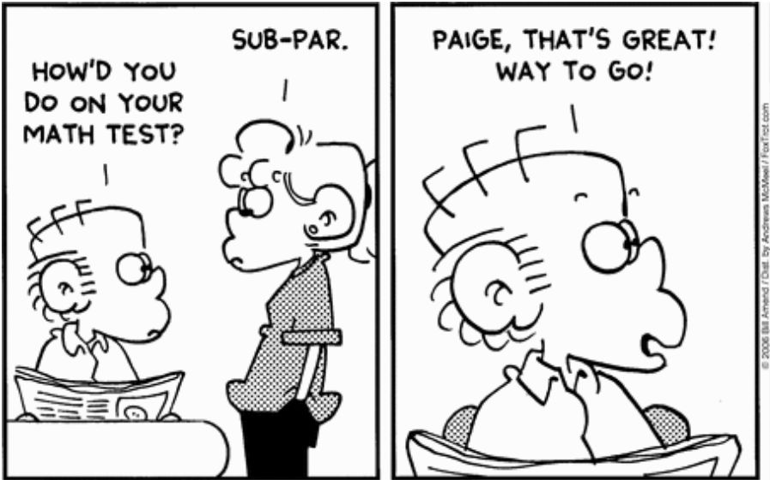
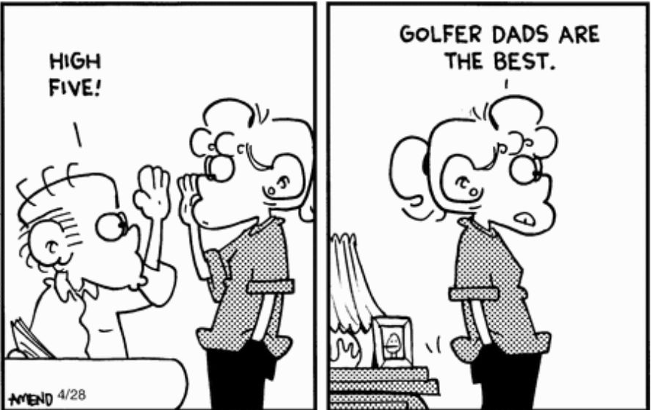
.
.
Notes:
StatLit for Managers
2013
2013Schield-MBAA
1
Analyzing Numbers in the News
15 May 2008
2008SchieldNNN6up.pdf
1
1

Slide 2
Audience
40%: School teachers: Current or previous
30%: College faculty: Current or previous
20%: Education, non-profit
10%: Industry, commercial
Notes:
StatLit for Managers
2013
2013Schield-MBAA
2
Analyzing Numbers in the News
15 May 2008
2008SchieldNNN6up.pdf
2
2

Slide 3
Statistical Literacy 2017
Milo Schield, Augsburg College
Elected Member: International Statistical Institute
US Rep: International Statistical Literacy Project
VP. National Numeracy Network
CME Presentation in Toronto
Fields Institute
April 29, 2016
www.StatLit.org/pdf/2017-Schield-CME-Slides.pdf
Notes:
StatLit for Managers
2013
2013Schield-MBAA
3
Analyzing Numbers in the News
15 May 2008
2008SchieldNNN6up.pdf
3
3
First big idea: Statistical educators at JSM are an extremely biased sample compared to their student abilities and majors.

Slide 4
Statistical Literacy 2017:
Overview
“We teach the wrong stuff; We teach it the wrong way; We teach it in the wrong order.” Richard de Veaux
Statistical Literacy 2017:
What is it – in general?
Who needs it?
3. What is it – in particular?
4. Who can implement it?
Notes:
StatLit for Managers
2013
2013Schield-MBAA
4
Analyzing Numbers in the News
15 May 2008
2008SchieldNNN6up.pdf
4
4
First big idea: Statistical educators at JSM are an extremely biased sample compared to their student abilities and majors.

Slide 5
What are Statistics?
1a
Data; numerical data, classifications of data,
or numerical summaries of data [Ambiguous]
Outcomes from a random process;
randomly-selected or randomly-assigned groups
[Technical distinction]
Numbers in context where the context matters:
Quantitative summaries of real things:
things that have natures, connections & causes
Notes:
StatLit for Managers
2013
2013Schield-MBAA
5
Analyzing Numbers in the News
15 May 2008
2008SchieldNNN6up.pdf
5
5
Math speaks of variables, values and correlations. Never about things with natures.
The social sciences speak of factors and categories.
The Humanities speak of characteristics such as gender, age, education, etc.

Slide 6
Statistics is Different from Mathematics
1a
Math ignores the context.
  Math deals with form (ignores the matter)
  Math deals with variables and values (no natures)
  Math deals with associations and co-variates
  Math has no operator for “causes”
Statistics depends on the context
  Statistics deals with the matter: its nature
  Statistics deals with subjects and characteristics
  Statistics deals with “confounders”
  Statistics deals with “causes”
Notes:
StatLit for Managers
2013
2013Schield-MBAA
6
Analyzing Numbers in the News
15 May 2008
2008SchieldNNN6up.pdf
6
6

Slide 7


Mathematics:
Patterns vs. Nature
1a
.
Notes:
StatLit for Managers
2013
2013Schield-MBAA
7
Analyzing Numbers in the News
15 May 2008
2008SchieldNNN6up.pdf
7
7
Math speaks of variables, values and correlations. Never about things with natures.
The social sciences speak of factors and categories.
The Humanities speak of characteristics such as gender, age, education, etc.

Slide 8

Saying
“Statistics Come From Data” is like saying
“Babies Come from Hospitals”
1a
STAT LIT
It’s true but it leaves out the interesting details
Statistics are answers to questions or interests.
Notes:
Saying “Statistics come from Data” is like saying “Babies come from hospitals”
It’s certainly true but it leaves out the interesting details. And it’s those interesting details that make all of the difference in statistics.
Think about the students in your Intro Stats course on Day 1. How do they view statistics? Would you describe them as healthy critics of the numbers and statistics in the world around them? Would you describe them as completely cynical and untrusting of most, if not all, statistics? Or are they naïve and simply believe every number put before them?
In our recent survey, stat ed instructors estimated that nearly half of their students entered “Stat 101” as Naïve or Awestruck by numbers.
The issue is that…

Slide 9
What is statistical literacy?
In general terms
1b
9
Statistical literacy is needed by citizens and social decision makers to enable them to understand and evaluate the statistics they encounter everyday.
Everyday statistics are used as evidence in arguments.
Legal:
Describe: 90% of a restaurant’s staff speaks Spanish
Compare: Most Mexican restaurant staff speak Spanish
Evaluate: Mexican restaurants discriminate in hiring .
Notes:
Clinical Trials vs. Causal HeterogeneityStatistical Literacy: Confounding2008 StatLit Skills Survey
29 July, 2012Dec 10, 2010Fall 2008
2012Schield-ASA6up.pdf2010SchieldUST6up.pdf2008SchieldSkillsSurvey6up.pdf
9
Statistical Literacy: Confounding2008 StatLit Skills Survey
Dec 10, 2010Fall 2008
2010SchieldUST6up.pdf2008SchieldSkillsSurvey6up.pdf
9
2008 StatLit Skills Survey
Fall 2008
2008SchieldSkillsSurvey6up.pdf
9
We have the top and bottom of this pyramid.
The Top: We know where we are headed. We are clear on our goal.
Our common goal is to see quantitative literacy grow.
The bottom: We have the foundation.
The need for quantitative literacy has been documented.
The books by Steen and Madison have documented this very clearly.
So, we have the foundation and we know where we are headed.
-------------------------------------
To support an interdisciplinary area, college-wide support is necessary.
To obtain college-wide support, the subject must have wide faculty support.
And in today’s climate, it must be assessable.
Unless QL is a clearly-stated campus-wide goal,
QL programs are likely to be transient.
Interdisciplinary programs cannot survive in a disciplinary world without strong college support
None of this will not happen unless quantitative literacy is “understandable and teachable.”
That brings us back to the problems mentioned in the previous slide.
Quantitative literacy must be “understandable and teachable.”
Whether QL is understandable and teachable depends critically on the content of QL.
> Let’s focus in on some core content of Quantitative Literacy >

Slide 10
What is statistical literacy?
Examples:
1b
10
Medical:
Describe: Japanese, who live long, eat low-fat diet
Compare: People with high-fat diets die sooner
Evaluate: High-fat diet causes shorter lifespan.
Social:
Describe: Average school class size is 24
Compare: Best performing classes are smaller
Evaluate: Smaller classes will improve outcomes
Notes:
Clinical Trials vs. Causal HeterogeneityStatistical Literacy: Confounding2008 StatLit Skills Survey
29 July, 2012Dec 10, 2010Fall 2008
2012Schield-ASA6up.pdf2010SchieldUST6up.pdf2008SchieldSkillsSurvey6up.pdf
10
Statistical Literacy: Confounding2008 StatLit Skills Survey
Dec 10, 2010Fall 2008
2010SchieldUST6up.pdf2008SchieldSkillsSurvey6up.pdf
10
2008 StatLit Skills Survey
Fall 2008
2008SchieldSkillsSurvey6up.pdf
10
We have the top and bottom of this pyramid.
The Top: We know where we are headed. We are clear on our goal.
Our common goal is to see quantitative literacy grow.
The bottom: We have the foundation.
The need for quantitative literacy has been documented.
The books by Steen and Madison have documented this very clearly.
So, we have the foundation and we know where we are headed.
-------------------------------------
To support an interdisciplinary area, college-wide support is necessary.
To obtain college-wide support, the subject must have wide faculty support.
And in today’s climate, it must be assessable.
Unless QL is a clearly-stated campus-wide goal,
QL programs are likely to be transient.
Interdisciplinary programs cannot survive in a disciplinary world without strong college support
None of this will not happen unless quantitative literacy is “understandable and teachable.”
That brings us back to the problems mentioned in the previous slide.
Quantitative literacy must be “understandable and teachable.”
Whether QL is understandable and teachable depends critically on the content of QL.
> Let’s focus in on some core content of Quantitative Literacy >

Slide 11
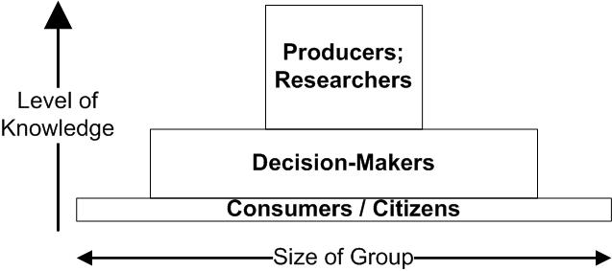
Who Needs Statistical Literacy?
Three Audiences
2
.
Notes:
StatLit for Managers
2013
2013Schield-MBAA
11
Analyzing Numbers in the News
15 May 2008
2008SchieldNNN6up.pdf
11
11

Slide 12
Three Audiences:
More detail
2
12
STEM majors and those who conduct surveys, studies and research.
Social decision-makers:
Politicians, bureaucrats, business leaders, doctors
  Those who inform citizens and decision makers:
  journalists, analysts, lawyers, economists, consultants, sociologists, political scientists, policy advocates, psychologists and educators.
Citizen in a modern republic or democracy.
Notes:
Clinical Trials vs. Causal HeterogeneityStatistical Literacy: Confounding2008 StatLit Skills Survey
29 July, 2012Dec 10, 2010Fall 2008
2012Schield-ASA6up.pdf2010SchieldUST6up.pdf2008SchieldSkillsSurvey6up.pdf
12
Statistical Literacy: Confounding2008 StatLit Skills Survey
Dec 10, 2010Fall 2008
2010SchieldUST6up.pdf2008SchieldSkillsSurvey6up.pdf
12
2008 StatLit Skills Survey
Fall 2008
2008SchieldSkillsSurvey6up.pdf
12
We have the top and bottom of this pyramid.
The Top: We know where we are headed. We are clear on our goal.
Our common goal is to see quantitative literacy grow.
The bottom: We have the foundation.
The need for quantitative literacy has been documented.
The books by Steen and Madison have documented this very clearly.
So, we have the foundation and we know where we are headed.
-------------------------------------
To support an interdisciplinary area, college-wide support is necessary.
To obtain college-wide support, the subject must have wide faculty support.
And in today’s climate, it must be assessable.
Unless QL is a clearly-stated campus-wide goal,
QL programs are likely to be transient.
Interdisciplinary programs cannot survive in a disciplinary world without strong college support
None of this will not happen unless quantitative literacy is “understandable and teachable.”
That brings us back to the problems mentioned in the previous slide.
Quantitative literacy must be “understandable and teachable.”
Whether QL is understandable and teachable depends critically on the content of QL.
> Let’s focus in on some core content of Quantitative Literacy >

Slide 13
College-Bound Students:
Wide variation
2a
.
Notes:
StatLit for Managers
2013
2013Schield-MBAA
13
Analyzing Numbers in the News
15 May 2008
2008SchieldNNN6up.pdf
13
13
We tend to represent the top 10% of SAT scores; we are not representative of most college students.
We tend to teach at the higher-end institutions; our students are not representative of most college students.
My audience is at the 60th to 80th percentile.

Slide 14
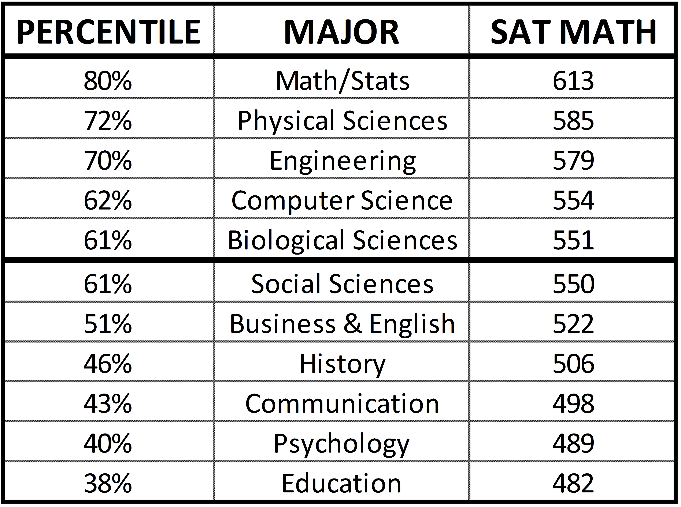
College-Bound US Students
SAT Math Scores by Major
2a
Business Insider (2014). 2014 SAT scores
Notes:
StatLit for Managers
2013
2013Schield-MBAA
14
Analyzing Numbers in the News
15 May 2008
2008SchieldNNN6up.pdf
14
14

Slide 15
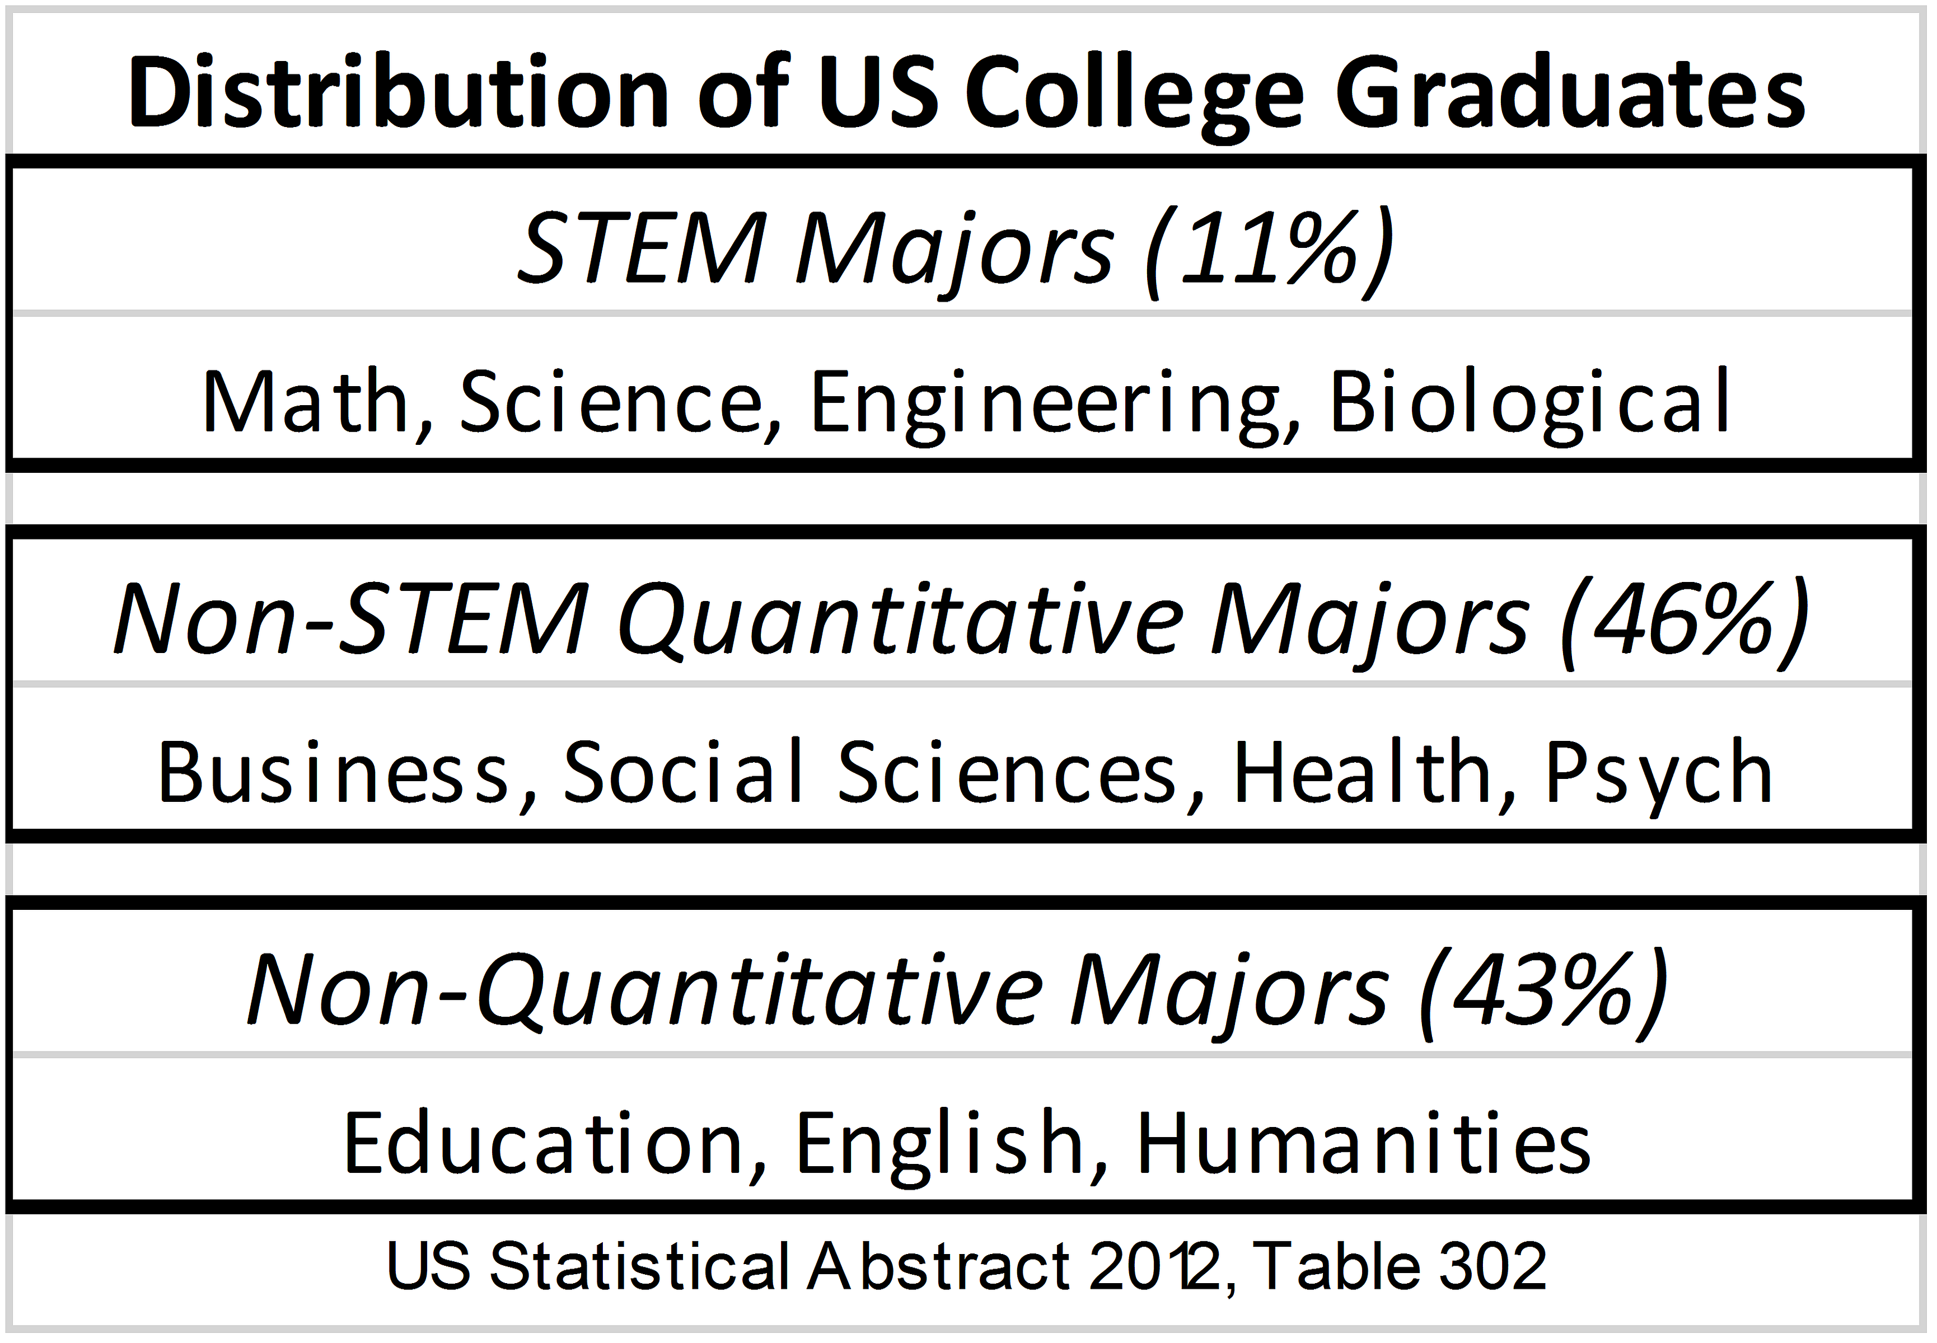
US Stat 101 students by Major
2a
Notes:
StatLit for Managers
2013
2013Schield-MBAA
15
Analyzing Numbers in the News
15 May 2008
2008SchieldNNN6up.pdf
15
15
Health is 7%. Could be classified under STEM.

Slide 16
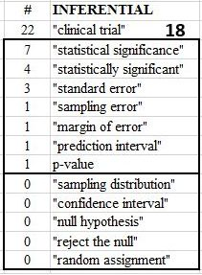
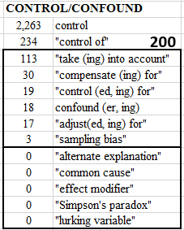
Harvard Business Review:
Website Search of 40K Items
2
.
Notes:
StatLit for Managers
2013
2013Schield-MBAA
16
Analyzing Numbers in the News
15 May 2008
2008SchieldNNN6up.pdf
16
16

Slide 17
Statistical Literacy:
More Detail
3
3a. Association vs. Causation
3b. Classify all the influences on a statistic
Context: Confounding and study design
Assembly/assumptions: How things are defined.
Randomness:
Unlikely is almost certain given enough trials.
Error/Bias:
Notes:
StatLit for Managers
2013
2013Schield-MBAA
17
Analyzing Numbers in the News
15 May 2008
2008SchieldNNN6up.pdf
17
17

Slide 18
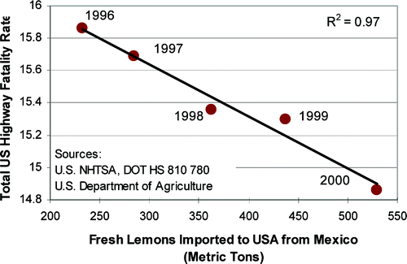
Association: Probably Not Causation
3a
.

Slide 19
Association: Probably Causation
3a

Slide 20
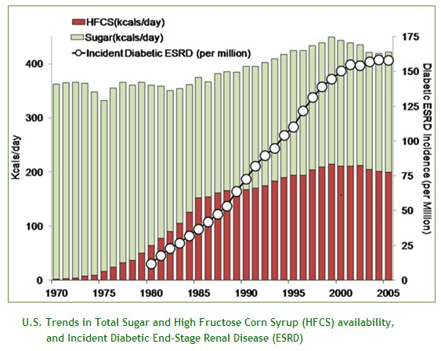
Association: Possibly Causation
3a
.

Slide 21
Distinguish Causation from Association
3a
21
Causation (8%): cause, effects, results, prevents
Association (2%): associate, relate, correlate,
Between (67%):
Action verbs: ups, cuts, raises, boosts, increases
Other: due to, because of, attributed to
Inappropriate use of “causes”:
Obesity causes later onset of puberty in boys
Junk food causes a third of heart attacks.
Schield and Raymond (2009) study 2,000 newspaper headlines involving quantity
Notes:
Causation vs. Association: News Titles
August 5 2009
2009SchieldRaymondASA6Up.pdf
21

Slide 22
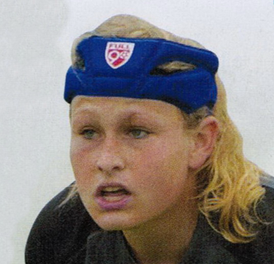
Action-Verb Association
3a
22
“Research shows that the headgear reduces the concussion rate by more than
50 percent.”
8/2011 P. 41
Notes:
Causation vs. Association: News Titles
August 5 2009
2009SchieldRaymondASA6Up.pdf
22

Slide 23
Association-Causation
3a
Baseball players whose names begin with the letter “D” are more likely to die young
Drinking a full pot of coffee every morning will add years to your life, but one cup a day increases the risk of pancreatic cancer.
Asian-Americans are most susceptible to heart attacks on the fourth day of the month
Source: Standard Deviations: Flawed Assumptions, Tortured Data, and Other Ways to Lie with Statistics by Gary Smith (2015).
Notes:
StatLit for Managers
2013
2013Schield-MBAA
23
Analyzing Numbers in the News
15 May 2008
2008SchieldNNN6up.pdf
23
23

Slide 24
Pie Chart: Compare
3a
Protestants are twice as likely to be smokers as are Catholics ?
NO:
Smoker is whole.
Student
error rate:
62%
Notes:
StatLit for Managers
2013
2013Schield-MBAA
24
Analyzing Numbers in the News
15 May 2008
2008SchieldNNN6up.pdf
24
24

Slide 25
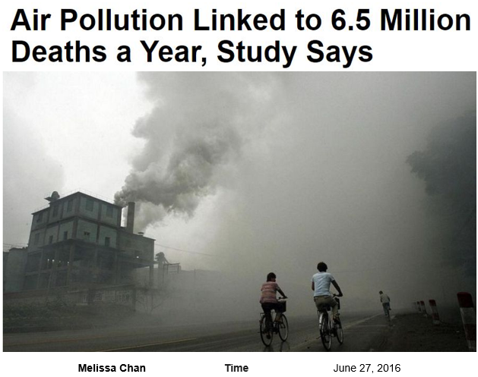
Speculative [Spotty] Statistics
Using Ordinary English
Does a death certificate ever list air pollution
as a cause of death? Does a coroner certify this?
These are association-based statistics.
These are speculative (spotty) statistics.
Notes:
StatLit for Managers
2013
2013Schield-MBAA
25
Analyzing Numbers in the News
15 May 2008
2008SchieldNNN6up.pdf
25
25

Slide 26
Association vs. Causation
11 Headlines, Same Story
26
Study: 45,000 Uninsured Die a Year (CBS News)
45,000 deaths attributable to uninsurance
45,000 US deaths associated with lack of insurance
No health coverage tied to 45,000 deaths a year
Lack of insurance linked to 45,000 deaths
Study: 45,000 U.S. Deaths From Lack of Insurance
One death every 12 minutes due to no health insurance
45,000 ... die because of lack of health insurance
Lack of Health Insurance Kills 45,000 a Year
Lack of Health Insurance cause 44,789 deaths
Lack of insurance to blame for almost 45,000 deaths
Notes:
Causation vs. Association: News Titles
August 5 2009
2009SchieldRaymondASA6Up.pdf
26

Slide 27
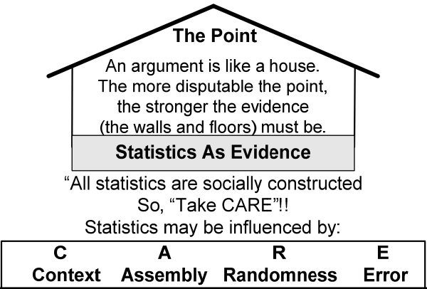
Stats = Premise: Crit. Thinking
Stats = Conclusion: Stat Literacy
.
Notes:
StatLit for Managers
2013
2013Schield-MBAA
27
Analyzing Numbers in the News
15 May 2008
2008SchieldNNN6up.pdf
27
27

Slide 28
Statistical Literacy in detail:
“Take CARE”
3b
Statistical literacy studies all influences on statistic:
Confounding:
  what was – and was not – controlled for
  what kind of study was involved
Assembly/Assumptions:
  how statistics are collected, defined and grouped
  how statistics are summarized, compared & presented
Randomness: small samples and big data
Error/bias
Notes:
StatLit for Managers
2013
2013Schield-MBAA
28
Analyzing Numbers in the News
15 May 2008
2008SchieldNNN6up.pdf
28
28

Slide 29
Confounding:
Using Ordinary English
3b
1) The percentage of women who are runners.
2) The percentage of women among runners.
3) The death rate of men is X per 100,000.
4) The men’s rate of death is X per 100,000
5) Toyota is the car most frequently stolen.
6) Toyota is the car most likely to be stolen.
7) Cadillac is the car most likely to be stolen.
Notes:
StatLit for Managers
2013
2013Schield-MBAA
29
Analyzing Numbers in the News
15 May 2008
2008SchieldNNN6up.pdf
29
29

Slide 30
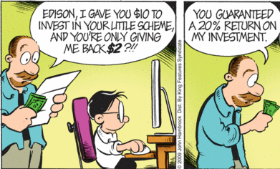

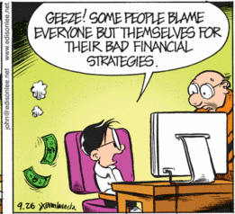
Small Change in Syntax;
Big Change in Semantics
30
Edison 2009/09/26
.
Notes:
Confound those Speculative Statistics
5 August 2009
2009SchieldASA6Up.pdf
30
GAISE CHALLENGE PLUS ATTITUDES
Candice Schau (2003) says that students’ attitudes are the ‘other’ important outcome in statistics education.
Robert Hayden (private communication) noted, “Students will not use what they learn in a statistics course (of any kind) unless they believe they learned something usable.
Macnaughton (2004) has argued that the primary goal of an introductory statistics course should be to give students “a lasting appreciation for the value of statistics.”

Slide 31
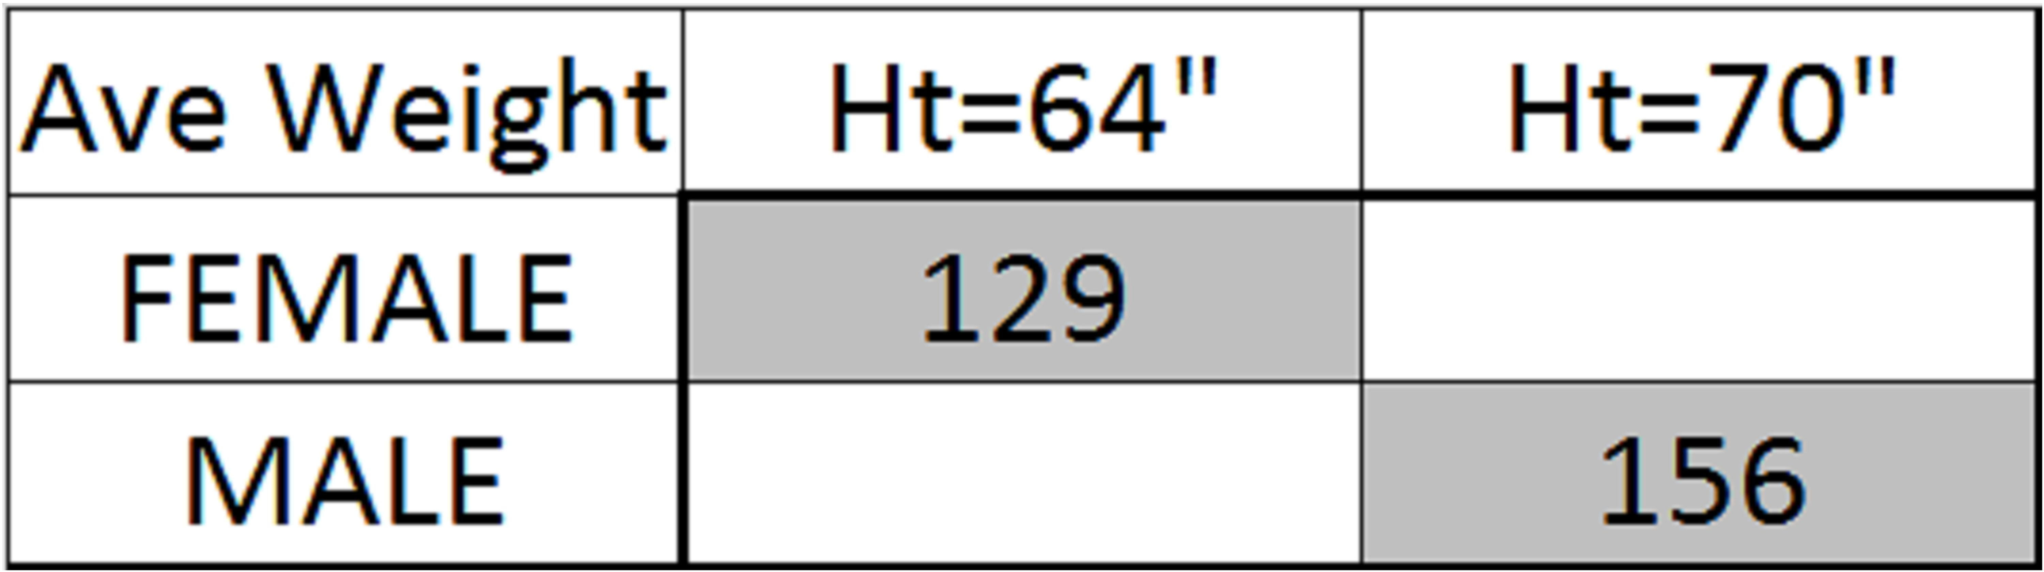
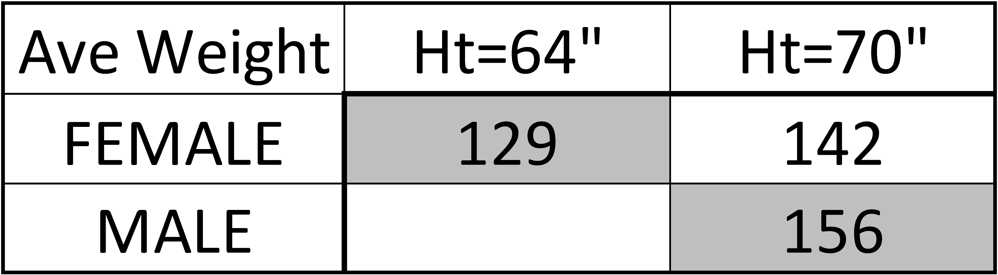
Confounding: Mixed-Fruit vs. Apples-Apples Comparison
.
27#
13#
14#
Notes:
StatLit for Managers
2013
2013Schield-MBAA
31
Analyzing Numbers in the News
15 May 2008
2008SchieldNNN6up.pdf
31
31

Slide 32
Size of a statistic depends on what is “taken into account”
32
Notes:
Teaching Teachers Statistical Literacy OnlineTeaching Teachers Statistical Literacy OnlineStatistical Literacy Using Odysseys2Sense2008 StatLit Skills Survey
15 October 201115 October 2011Jan 7, 2011Fall 2008
2011SchieldNNN6up.pdf2011SchieldNNN6up.pdf2011SchieldMAA6up.pdf2008SchieldSkillsSurvey6up.pdf
32
Quantitative Literacy TodaySocial Construction of Rankings
8 Oct 20108/4/2010
www.StatLit.org/pdf/2010SchieldCarleton6up.pdfwww.StatLit.org/pdf/2010SchieldASA6up.pdf
32
Quantitative Graduation Requirements
15 January 2010
2010SchieldMAA6up.pdf
32

Slide 33

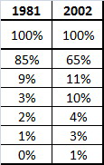
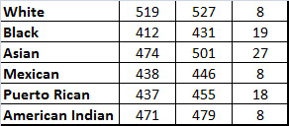
US SAT-VERBAL SCORES
33
Notes:
Statistical Literacy: Confounding2008 StatLit Skills Survey
Dec 10, 2010Fall 2008
2010SchieldUST6up.pdf2008SchieldSkillsSurvey6up.pdf
33
2008 StatLit Skills Survey
Fall 2008
2008SchieldSkillsSurvey6up.pdf
33
I strongly believe that Quantitative Literacy has a bright future.
We have a big job ahead of us. We are trying to change higher education.
We are trying to heard cats – to shape fog.
But we have the tools.
If we can agree on some core QL ideas and concepts,
Ideas and concepts that
Are common across the curriculum,
focus on arguments in everyday life,
relate to context,
enhance students’ critical thinking,
THEN Quantitative Literacy will be
#1 click: VALUED, RESPECTED and ACCEPTED in academia.
#2 click: Working together we can make it happen.
Thank you.

Slide 34
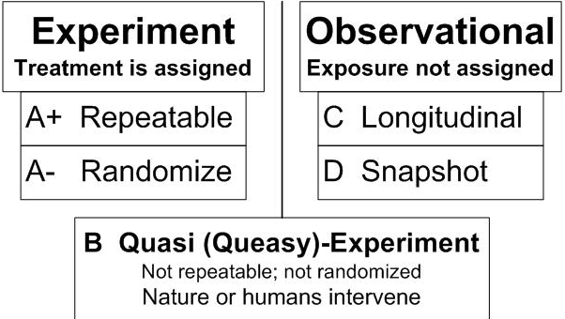
Study design can inhibit certain kinds of confounders
34
.
Notes:
Teaching Teachers Statistical Literacy OnlineTeaching Teachers Statistical Literacy OnlineStatistical Literacy Using Odysseys2Sense2008 StatLit Skills Survey
15 October 201115 October 2011Jan 7, 2011Fall 2008
2011SchieldNNN6up.pdf2011SchieldNNN6up.pdf2011SchieldMAA6up.pdf2008SchieldSkillsSurvey6up.pdf
34
Statistical Literacy at AugsburgSocial Construction of Rankings
9 Oct 20108/4/2010
www.StatLit.org/pdf/2010SchieldAugsburg6up.pdfwww.StatLit.org/pdf/2010SchieldASA6up.pdf
34
Social Construction of Rankings
8/4/2010
www.StatLit.org/pdf/2010SchieldASA6up.pdf
34
2008 StatLit Skills Survey
Fall 2008
2008SchieldSkillsSurvey6up.pdf
34
We have the top and bottom of this pyramid.
The Top: We know where we are headed. We are clear on our goal.
Our common goal is to see quantitative literacy grow.
The bottom: We have the foundation.
The need for quantitative literacy has been documented.
The books by Steen and Madison have documented this very clearly.
So, we have the foundation and we know where we are headed.
-------------------------------------
To support an interdisciplinary area, college-wide support is necessary.
To obtain college-wide support, the subject must have wide faculty support.
And in today’s climate, it must be assessable.
Unless QL is a clearly-stated campus-wide goal,
QL programs are likely to be transient.
Interdisciplinary programs cannot survive in a disciplinary world without strong college support
None of this will not happen unless quantitative literacy is “understandable and teachable.”
That brings us back to the problems mentioned in the previous slide.
Quantitative literacy must be “understandable and teachable.”
Whether QL is understandable and teachable depends critically on the content of QL.
> Let’s focus in on some core content of Quantitative Literacy >

Slide 35
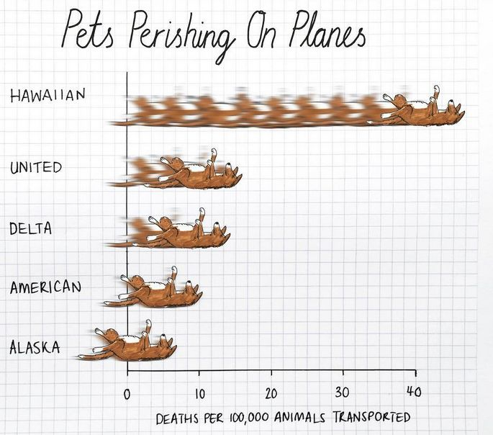
Assembly: What to control for:
United has Worst Pet Record
3a
Nine pets died while being transported
by United
while another
14 were injured last year.
Most of any
US airline…
.
Notes:
StatLit for Managers
2013
2013Schield-MBAA
35
Analyzing Numbers in the News
15 May 2008
2008SchieldNNN6up.pdf
35
35

Slide 36
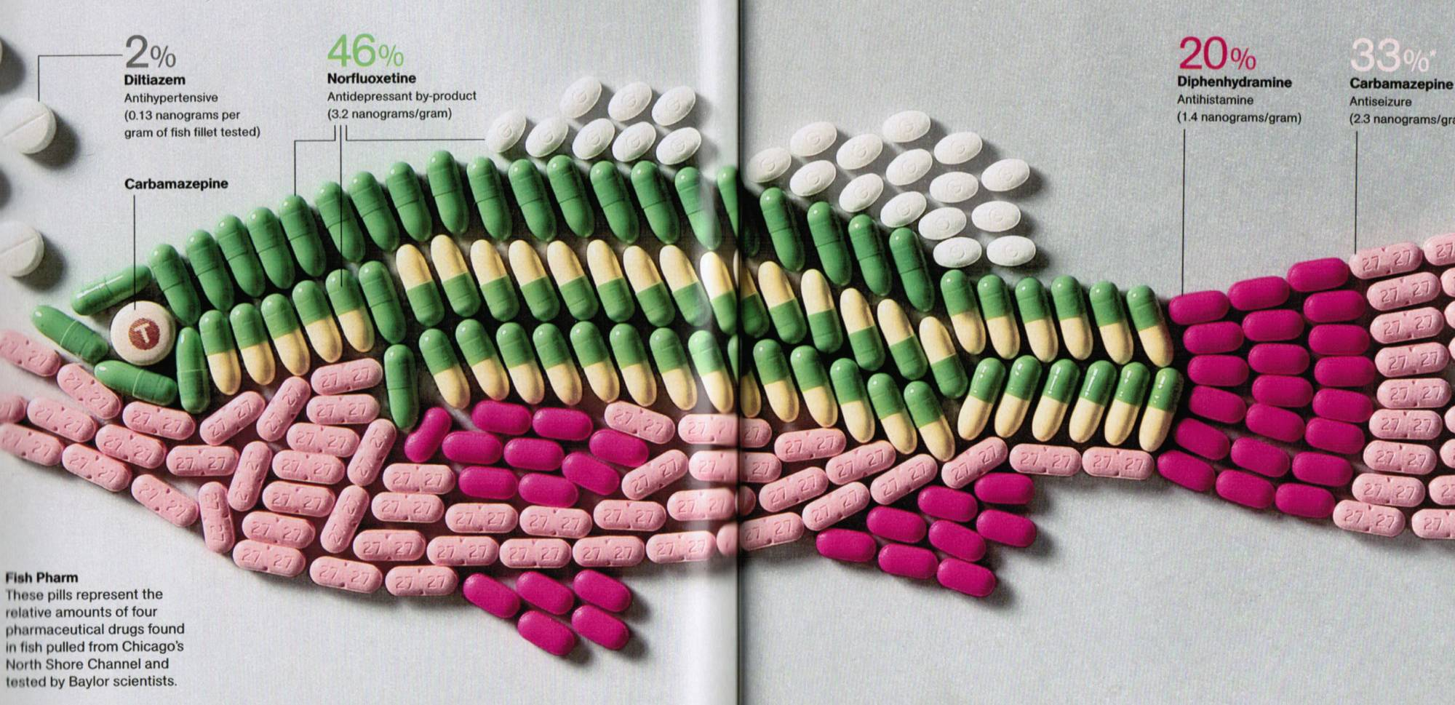
Assembly:
Making small things big
36
7 nanograms per gram = 7 parts in a billion
4/2010 National Geographic
Notes:
Confound those Speculative Statistics
5 August 2009
2009SchieldASA6Up.pdf
36
GAISE CHALLENGE PLUS ATTITUDES
Candice Schau (2003) says that students’ attitudes are the ‘other’ important outcome in statistics education.
Robert Hayden (private communication) noted, “Students will not use what they learn in a statistics course (of any kind) unless they believe they learned something usable.
Macnaughton (2004) has argued that the primary goal of an introductory statistics course should be to give students “a lasting appreciation for the value of statistics.”
Three studies have documented that students see less value in statistics after completing their intro course than they did before they took the course.
To define statistical literacy, Bob Hayden says, "Study life, not books, to see what students need."
"The biggest pitfall ... is the temptation to make it a watered-down version of the methods course."
A good course should be "inspired by an empirical study of what skills are actually needed in real life."

Slide 37
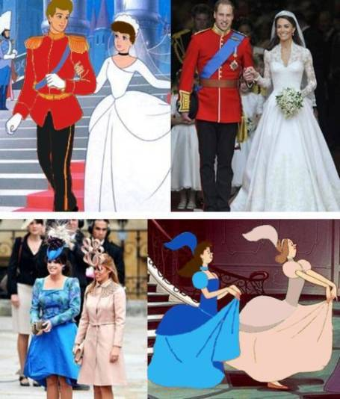
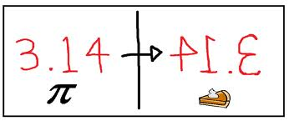

Randomness: Coincidence?
37
.
Notes:
Teaching Teachers Statistical Literacy OnlineTeaching Teachers Statistical Literacy OnlineStatistical Literacy Using Odysseys2Sense2008 StatLit Skills Survey
15 October 201115 October 2011Jan 7, 2011Fall 2008
2011SchieldNNN6up.pdf2011SchieldNNN6up.pdf2011SchieldMAA6up.pdf2008SchieldSkillsSurvey6up.pdf
37
Quantitative Literacy TodaySocial Construction of Rankings
8 Oct 20108/4/2010
www.StatLit.org/pdf/2010SchieldCarleton6up.pdfwww.StatLit.org/pdf/2010SchieldASA6up.pdf
37
Quantitative Graduation Requirements
15 January 2010
2010SchieldMAA6up.pdf
37

Slide 38
Error/Bias
38
A recent survey shows that most Republicans surveyed prefer Obama as President.
Question: Who would you prefer as President?
Barack Obama
The captain of the Italian linear that crashed
Charlie Sheehan
Lady Gaga
Notes:
Teaching Teachers Statistical Literacy OnlineTeaching Teachers Statistical Literacy OnlineStatistical Literacy Using Odysseys2Sense2008 StatLit Skills Survey
15 October 201115 October 2011Jan 7, 2011Fall 2008
2011SchieldNNN6up.pdf2011SchieldNNN6up.pdf2011SchieldMAA6up.pdf2008SchieldSkillsSurvey6up.pdf
38
Quantitative Literacy TodaySocial Construction of Rankings
8 Oct 20108/4/2010
www.StatLit.org/pdf/2010SchieldCarleton6up.pdfwww.StatLit.org/pdf/2010SchieldASA6up.pdf
38
Quantitative Graduation Requirements
15 January 2010
2010SchieldMAA6up.pdf
38

Slide 39
What is Impeding
Statistical Literacy
4a
Math is the most privileged discipline in academia.
Math and statistics have successfully resisted all attempts to support statistical literacy.
This resistance is not a commission: a statement denying the need for statistical literacy.
This resistance is an omission: a total silence on whether math is responsible for deciding what various groups of students need.
Notes:
StatLit for Managers
2013
2013Schield-MBAA
39
Analyzing Numbers in the News
15 May 2008
2008SchieldNNN6up.pdf
39
39

Slide 40

The Challenge
4b
"Quantitative Literacy (QL), the ability to use numbers and data analysis in everyday life, is everybody's orphan.
Despite every person's need for QL, in the discipline-dominated K-16 education system in the United States, there is neither an academic home nor an administrative promoter for this critical competency." Quantitative Literacy: Why Numeracy Matters. p. 153 Bernard Madison
Notes:
StatLit for Managers
2013
2013Schield-MBAA
40
Analyzing Numbers in the News
15 May 2008
2008SchieldNNN6up.pdf
40
40

Slide 41

Statistical Literacy Support by NCTM Past President
4b
“Statistical literacy has risen to the top of
my advocacy list, right alongside numeracy,
and perhaps even ahead of “algebra for all.”
By statistical literacy, I mean ... developing
the ability to reason in the presence of, or
under conditions of uncertainty. ... the facility to read and interpret statistical information and make informed inferences....“ J. Michael Shaughnessy
www.statlit.org/pdf/2010Shaughnessy-StatisticsForAll-NCTM.pdf
Notes:
StatLit for Managers
2013
2013Schield-MBAA
41
Analyzing Numbers in the News
15 May 2008
2008SchieldNNN6up.pdf
41
41

Slide 42

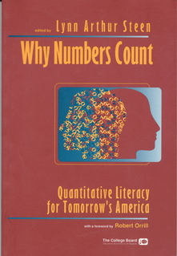
Tension: Statistics vs. Stat Literacy
3a
what most statisticians actually practice is typically more than the average person needs to be an informed citizen, intelligent consumer or skilled worker.
What everyone needs is typically called statistical thinking or statistical literacy, a crucial component of quantitative literacy."
Lynn Steen (2004). Achieving Quantitative Literacy p. 43
Notes:
StatLit for Managers
2013
2013Schield-MBAA
42
Analyzing Numbers in the News
15 May 2008
2008SchieldNNN6up.pdf
42
42

Slide 43
What Needs to be done?
Support!
4c
43
Mathematics Canada has a unique opportunity to become a world leader in supporting statistical literacy in grades 10-18.
The need is obvious, the tools are available. There is support from the American Statistical Association for multivariate thinking.
Lynn Steen (MAA past president) and J. Michael Shaughnessy (NCTM past president) support it.
Notes:
StatLit for Managers
2013
2013Schield-MBAA
43

Slide 44
Mathematics is a highly privileged discipline
44
Mathematics controls all of the quantitative courses taken in K-12.
Mathematics decides whether to offer algebra in 8th grade or 9th grade.
Mathematics decides what courses should be taken by students in non-quantitative majors.
No discipline has as much power as Mathematics.
Notes:
StatLit for Managers
2013
2013Schield-MBAA
44

Slide 45
Mathematics has great responsibility
45
With great power comes great responsibility!
Mathematics often polls other disciplines to see what they want for their students.
Problem: Most other disciplines don’t know what mathematics their students should
Mathematics must take the lead. Mathematics must identify what students in all disciplines need.
Notes:
StatLit for Managers
2013
2013Schield-MBAA
45

Slide 46
Mathematics opportunities
46
Review the literature to see what students need to know about statistics.
Identify the math needed by all college graduates
Join with American statisticians (ASA) in supporting a multivariate focus on observational studies with a strong emphasis on confounding.
Support the National Numeracy Network.
Notes:
StatLit for Managers
2013
2013Schield-MBAA
46

Slide 47
References
47
Business Insider (2014). http://www.businessinsider.com/heres-the-average-sat-score-for-every-college-major-2014-10
De Veaux, D. (2015). Introductory Statistics in the 21st Century. USCOTS slides
Schield, M. (2015). Statistical Inference for Managers. ASA www.statlit.org/pdf/2015-Schield-ASA.pdf
Schield, M. (2014). Two Big Ideas for Teaching Big Data: ECOTS. www.statlit.org/pdf/2014-Schield-ECOTS.pdf
Schield, M. (2013). Reinventing Business Statistics. MBAA.
www.StatLit.org/pdf/2013-Schield-MBAA.pdf
Tintle, Chance, Cobb, Rossman, Roy, Swanson & VanderStoep (2014) Challenging the state of the art in post-introductory statistics. http://2013.isiproceedings.org/Files/IPS032-P1-S.pdf
Notes:
StatLit for Managers
2013
2013Schield-MBAA
47

