Slide 1
Why 25% of Voter Polls are Wrong
by
Milo Schield, Augsburg University
Fellow: American Statistical Association
US Rep: International Statistical Literacy Project
December 2, 2018
Twin Cities Critical Thinking Club (CTC)
Slides: www.StatLit.org/pdf/2018-Schield-CTC-Slides.pdf
Notes:
StatLit for Managers
2013
2013Schield-MBAA
1
Analyzing Numbers in the News
15 May 2008
2008SchieldNNN6up.pdf
1
1

Slide 2
25% of Voter Polls are Wrong!
Polls are short surveys.
Less demographic information.
Fewer choices for answers.
Polls typically involve sampling: sampling error.
Voter polls are of wide-spread interest.
25%* of voter polls in the final 21 days are wrong. Wrong: actual result outside 95% confidence interval
In 2016, 29%** of those in final 21 days were wrong.
* https://fivethirtyeight.com/features/how-the-fivethirtyeight-senate-forecast-model-works/ ** https://fivethirtyeight.com/features/the-polls-are-all-right/
Notes:
StatLit for Managers
2013
2013Schield-MBAA
2
Analyzing Numbers in the News
15 May 2008
2008SchieldNNN6up.pdf
2
2

Slide 3
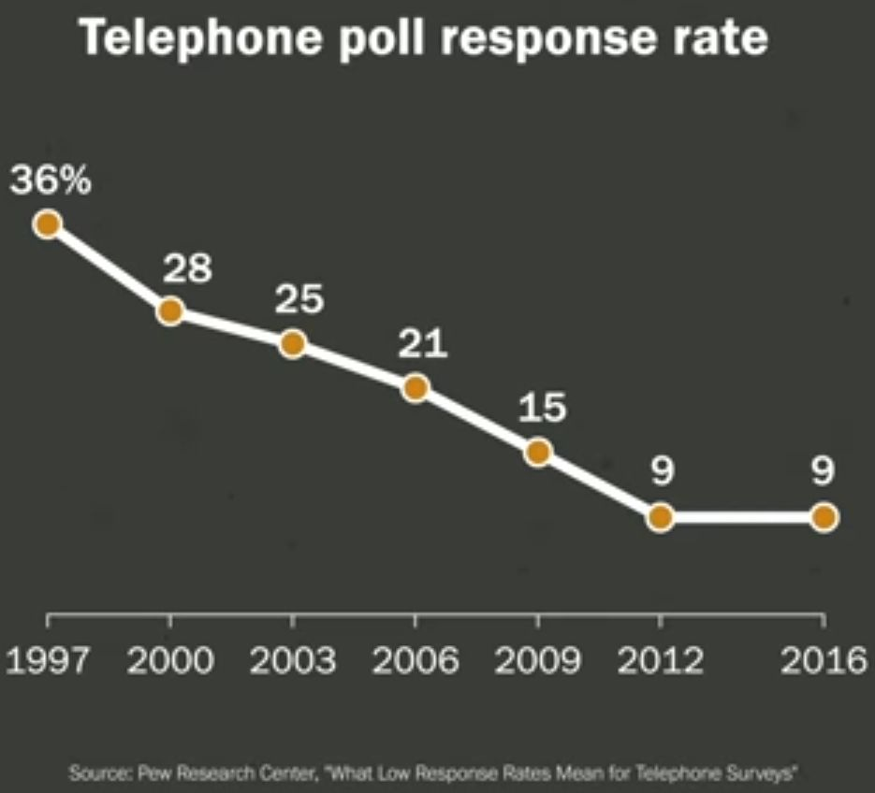
Random Sampling: Non-Response Bias
Surveys and polls often interview people by phone.
Plus: Cheap; random sample.
Minus: Non-response bias.
People who respond are
not representative of the
entire population.
The lower the response rate,
the greater the risk of bias.
http://www.pewresearch.org/2017/05/15/what-low-response-rates-mean-for-telephone-surveys/pm-05-15-2017_rddnonresponse-00-14/
Notes:
StatLit for Managers
2013
2013Schield-MBAA
3
Analyzing Numbers in the News
15 May 2008
2008SchieldNNN6up.pdf
3
3

Slide 4
Voter Polls: Before or After
For a given election, voting polls are either
before the election (opinion polls) or
after the election (exit polls).
Opinion polls forecast: use hypothetical questions
Exit polls explain: use factual questions
Explanatory polls just tabulate – like sports statistics
Forecast polls use models – like weather forecasts
Notes:
StatLit for Managers
2013
2013Schield-MBAA
4
Analyzing Numbers in the News
15 May 2008
2008SchieldNNN6up.pdf
4
4

Slide 5
Chance of Winning: “It depends”
Election (forecast) polls are harder to interpret!
Consider two candidates in different contests
Both have 52% of their respective votes.
Candidate #1 has 60% chance of winning.
Candidate #2 has a 75% chance of winning.
Q. How can they have different chances of winning?
It depends on the size of the polling error!
Notes:
StatLit for Managers
2013
2013Schield-MBAA
5
Analyzing Numbers in the News
15 May 2008
2008SchieldNNN6up.pdf
5
5

Slide 6
Error in Forecast Polls: Sampling and Forecast
Forecast polls have sampling error (theoretical):
Difference b/t sample and population statistic
Entirely due to random sampling
Decreases as sample size increases
Forecast polls also have modeling error (empirical)
Difference between the forecast and actual result
Due to different models of undecided
Independent of sample size
Notes:
StatLit for Managers
2013
2013Schield-MBAA
6
Analyzing Numbers in the News
15 May 2008
2008SchieldNNN6up.pdf
6
6

Slide 7
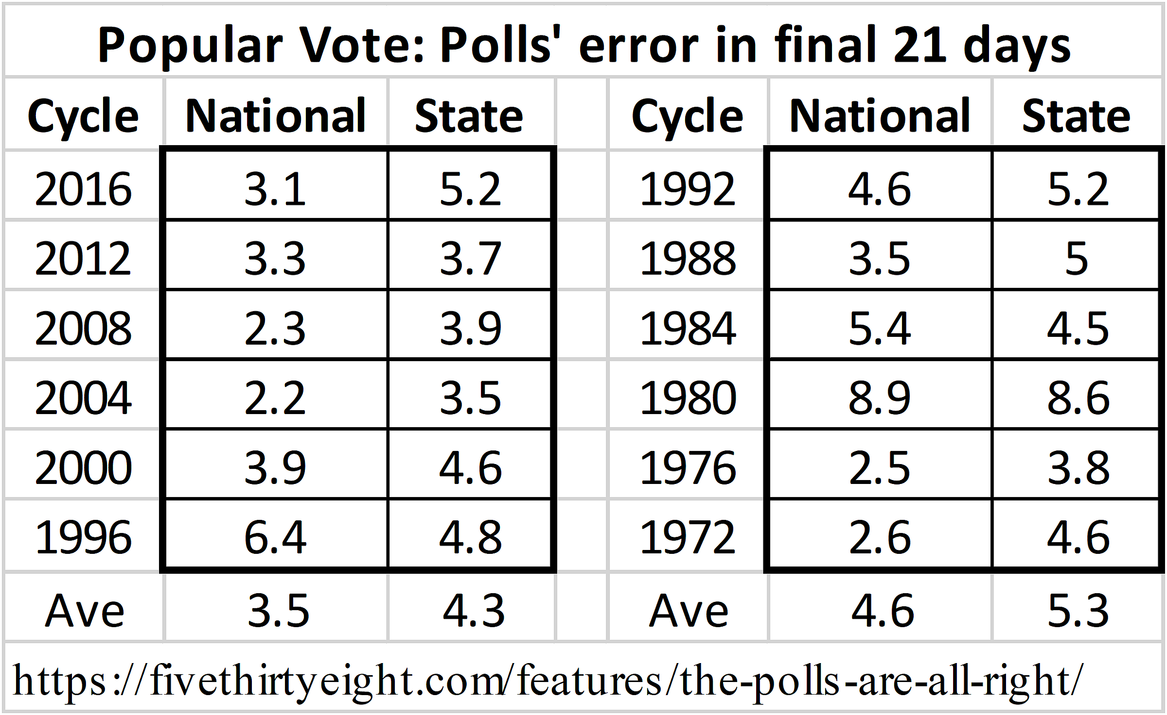
Average Opinion Polling Error 1972-2016
.
Notes:
StatLit for Managers
2013
2013Schield-MBAA
7
Analyzing Numbers in the News
15 May 2008
2008SchieldNNN6up.pdf
7
7

Slide 8
Opinion Polling Error Bigger than Sampling Error
Average popular-vote polling error* in final 21 days:
4 points: Presidential
5.4 points: US Senate and Governor
6.2 points: US House
8.9 points: Primary
* D-R margin error. https://fivethirtyeight.com/features/the-polls-are-all-right/
95% sampling error by sample size:
3.3 points: n = 900
3.0 points: n = 1,024 [Most common sample size]
2.8 points: n = 1,225
Notes:
StatLit for Managers
2013
2013Schield-MBAA
8
Analyzing Numbers in the News
15 May 2008
2008SchieldNNN6up.pdf
8
8

Slide 9
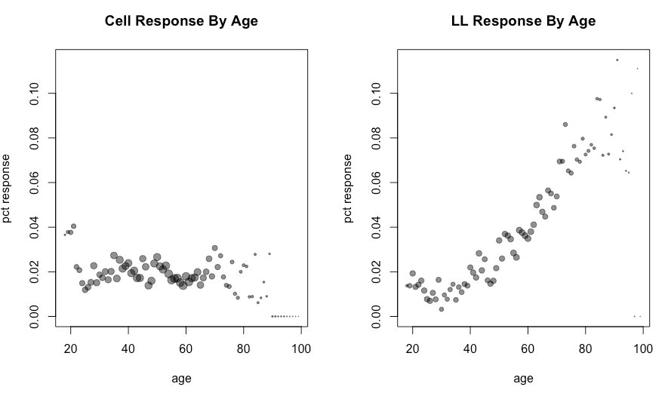
Low Response Rates: Non-Response Bias ???
.
Notes:
StatLit for Managers
2013
2013Schield-MBAA
9
Analyzing Numbers in the News
15 May 2008
2008SchieldNNN6up.pdf
9
9

Slide 10
Causes of Error in Opinion Polls
Causes of error unique to opinion (forecast) polls:
Respondents undecided about whether to vote
Respondents undecided about who to vote for
Respondents change their mind before voting
Voter opinion polls must forecast
which undecided will vote
who undecided voters will vote for
which third-party voters will change their mind
Different polls allocate undecided differently
Polls allocate using demographic/historical data
Notes:
StatLit for Managers
2013
2013Schield-MBAA
10
Analyzing Numbers in the News
15 May 2008
2008SchieldNNN6up.pdf
10
10

Slide 11
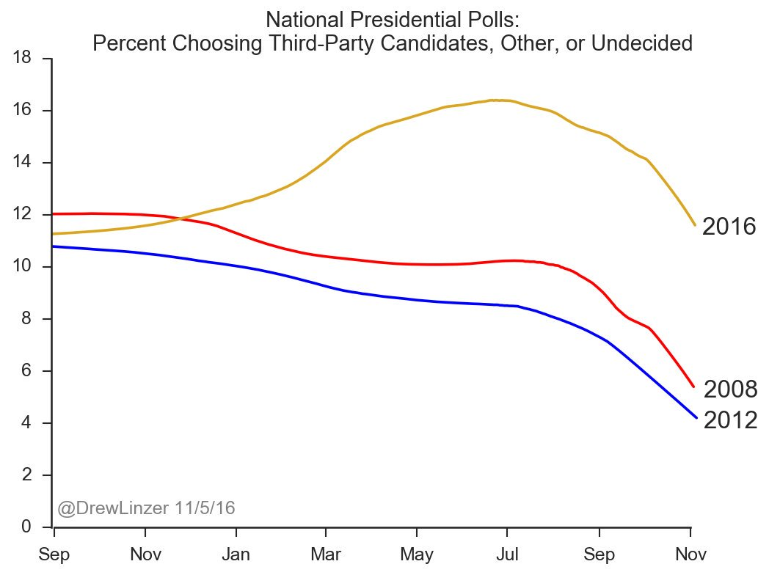
Main Cause of Polling Error: Undecided
Undecided, Third-Party & Other: last three Presidential elections
2016 …..
* Biggest peak (16%)
* Slowest to decide
* Hardest to model
* Biggest problem for forecasters
Drew Linzer tweet (11/5/2016) Permission granted.
www.hot1045.net/decodedc/yes-undecided-voters-still-exist
Notes:
StatLit for Managers
2013
2013Schield-MBAA
11
Analyzing Numbers in the News
15 May 2008
2008SchieldNNN6up.pdf
11
11

Slide 12
Conclusions
To interpret polls, know the difference:
between an opinion poll, an exit poll and a survey
between polling error and sampling error
To evaluate polls, know that
the chance of winning depends on polling error
polling error is bigger than sampling error
polling error exists because opinion polls are forecasts
the size of polling error depends on the contest
Q. How can pollsters educate readers on polling error?
Notes:
StatLit for Managers
2013
2013Schield-MBAA
12
Analyzing Numbers in the News
15 May 2008
2008SchieldNNN6up.pdf
12
12

Slide 13
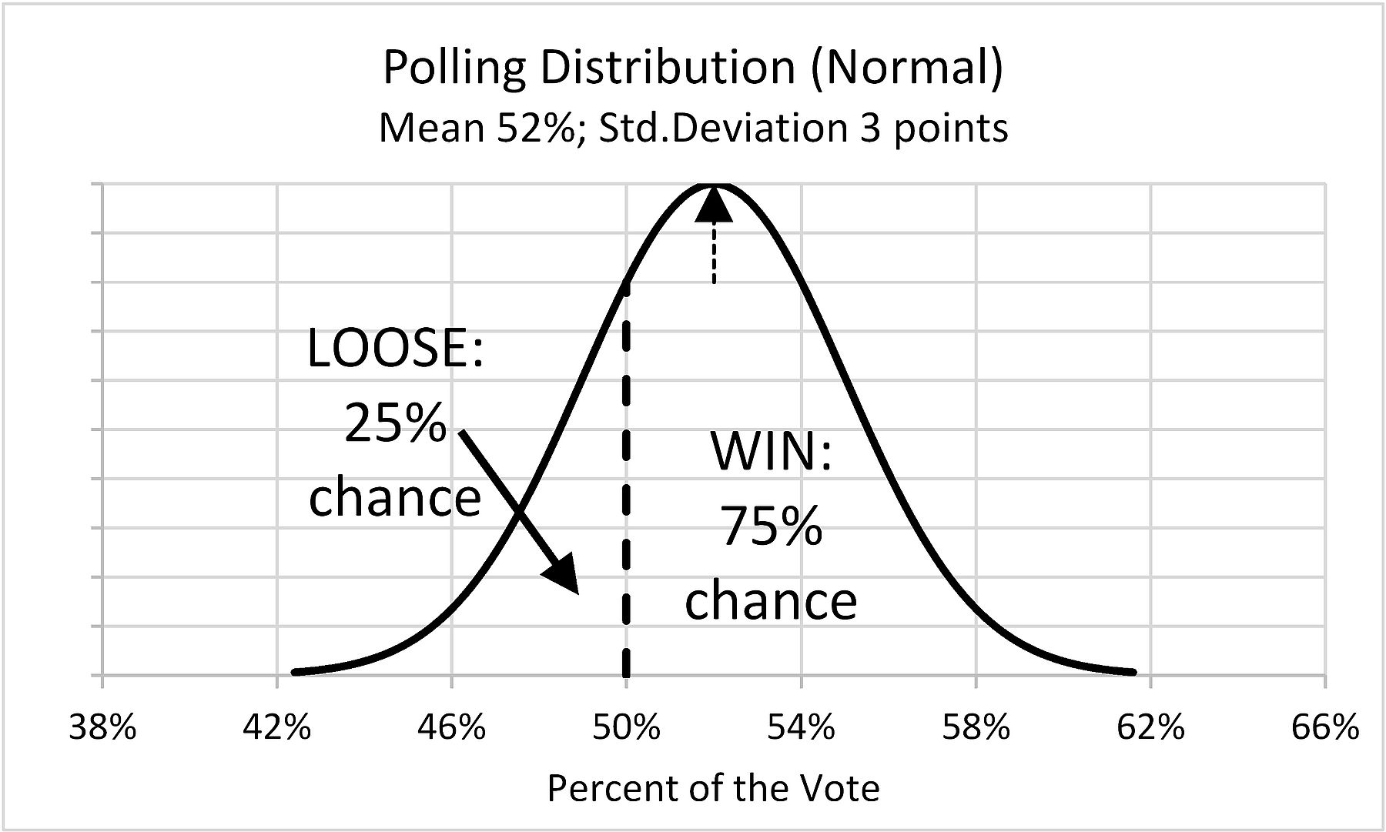
Polls Ave: 52% of the Vote 75% Chance of Winning
Assume polling distribution is normal: 3 pt std.dev.
50% is 0.667 (2/3) std. deviations below mean. 75% chance of winning. 0.748 = 1- Norm.S.Dist(-0.667, 1)
Notes:
StatLit for Managers
2013
2013Schield-MBAA
13
Analyzing Numbers in the News
15 May 2008
2008SchieldNNN6up.pdf
13
13

Slide 14
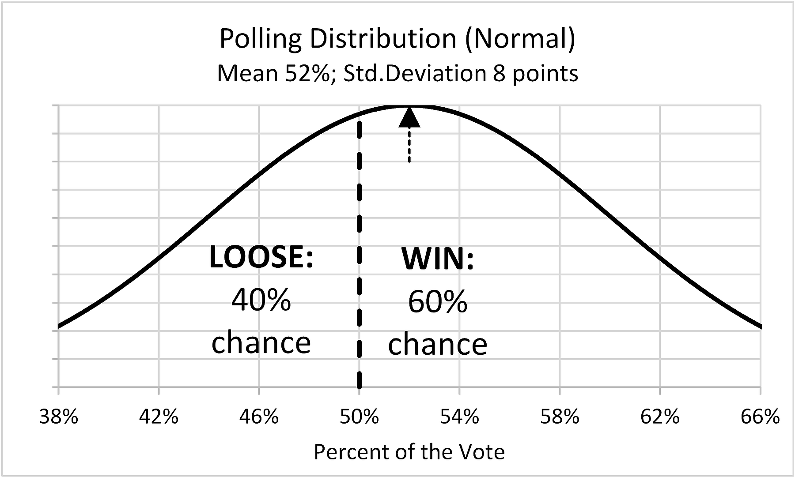
Polls Ave: 52% of the vote. 60% Chance of Winning
Assume polling distribution is Normal: 8 pt std. dev.
50% is 0.25 (2/8) std. deviations below mean. 60% chance of winning. 0.599 = 1- Norm.S.Dist(-0.25, 1)
Notes:
StatLit for Managers
2013
2013Schield-MBAA
14
Analyzing Numbers in the News
15 May 2008
2008SchieldNNN6up.pdf
14
14

Slide 15
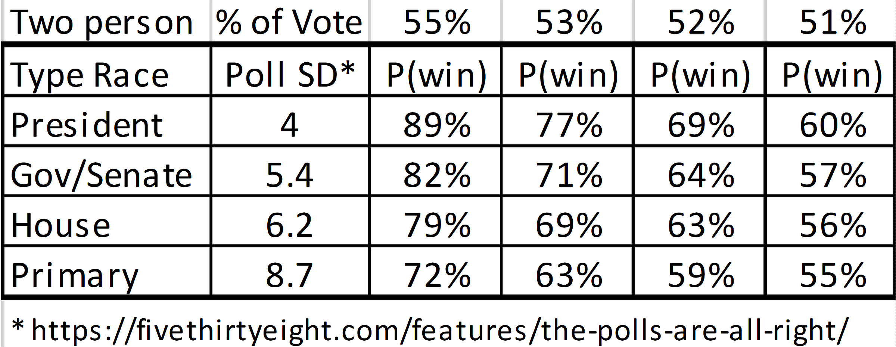
Chance of Winning is a new statistic!
Percentage of the vote does not determine chance of win.
P(win) also depends on the polling variation (error):
“Chance of winning” is meaningless without data from other polls.
Notes:
StatLit for Managers
2013
2013Schield-MBAA
15
Analyzing Numbers in the News
15 May 2008
2008SchieldNNN6up.pdf
15
15

Slide 16
Chance of Winning: “It depends”
Election polls are hard to interpret!
Consider two candidates in different contests
Both have 52.3% of their respective votes.
Candidate #1 has 72% chance of winning.
Candidate #2 has 59% chance of winning.
Q. How can they have different chances of winning?
It depends on the size of the polling error!
Notes:
StatLit for Managers
2013
2013Schield-MBAA
16
Analyzing Numbers in the News
15 May 2008
2008SchieldNNN6up.pdf
16
16

Slide 17
Nate Silver Forecast 2018 Governor Elections
2018 US: Two-candidate governor races:
Q1. Does ‘% of Vote’ determine P(win)? Q2. How can smaller ‘% of Vote’ have larger P(win)?
State | Party | % of Vote | P(win)
MA | R | 54% | 88.8%
NM | D | 55% | 92.9%
AL | R | 57% | 93.3%
SC | R | 57% | 94.6%
NE | R | 56% | 98.1%
CA | D | 58% | 99.4%
Notes:
StatLit for Managers
2013
2013Schield-MBAA
17
Analyzing Numbers in the News
15 May 2008
2008SchieldNNN6up.pdf
17
17

Slide 18
Polls Ave: 51% of Vote 58% Chance of Winning
Assume polling distribution is normal: 5 pt std.dev.
50% is 0.2 (1/5) standard deviation below mean. Republican candidate: 58% chance of winning. 0.579 = 1- Norm.S.Dist(-1/5, 1)
.
Notes:
StatLit for Managers
2013
2013Schield-MBAA
18
Analyzing Numbers in the News
15 May 2008
2008SchieldNNN6up.pdf
18
18

Slide 19
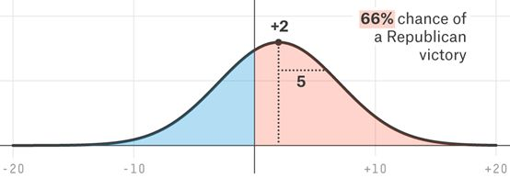
Polls Ave: 52% of the vote. 66% Chance of Winning
Assume polling distribution is Normal: 5 pt std. dev.
50% is 0.4 (2/5) std. deviations below 52%. Republican candidate: 66% chance of winning.
0.655 = 1- Norm.S.Dist(-2/5, 1)
.
Notes:
StatLit for Managers
2013
2013Schield-MBAA
19
Analyzing Numbers in the News
15 May 2008
2008SchieldNNN6up.pdf
19
19

Slide 20
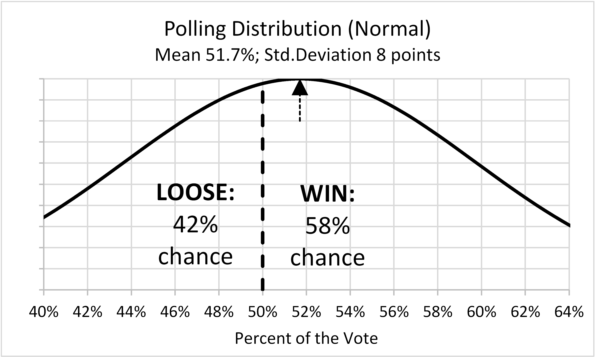
Polls Ave: 51.7% of the vote. 58% Chance of Winning
Assume polling distribution is Normal: 8 pt std. dev.
50% is 0.213 (1.7/8) std. deviations below mean. 58% chance of winning. 0.584 = 1- Norm.S.Dist(-0.213, 1)
.
Notes:
StatLit for Managers
2013
2013Schield-MBAA
20
Analyzing Numbers in the News
15 May 2008
2008SchieldNNN6up.pdf
20
20

Slide 21
Polls Ave: 51.7% of the vote. 58% Chance of Winning
Assume polling distribution is Normal: 8 pt std. dev.
50% is 0.213 (1.7/8) std. deviations below mean. 58% chance of winning. 0.584 = 1- Norm.S.Dist(-0.213, 1)
.
Notes:
StatLit for Managers
2013
2013Schield-MBAA
21
Analyzing Numbers in the News
15 May 2008
2008SchieldNNN6up.pdf
21
21

