Slide 1
US Infant Mortality Rate: National Embarrassment?
by
Milo Schield, Augsburg University
Fellow: American Statistical Association
US Rep: International Statistical Literacy Project
December 2, 2018
Twin Cities Critical Thinking Club (CTC)
Slides: www.StatLit.org/pdf/2018-Schield-CTC3-Slides.pdf
Notes:
StatLit for Managers
2013
2013Schield-MBAA
1
Analyzing Numbers in the News
15 May 2008
2008SchieldNNN6up.pdf
1
1

Slide 2
US: Highest Infant Mortality Rate of 27 Wealthy Countries
“A baby born in the U.S. is nearly three times as likely to die during her first year of life as one born in Finland or Japan. That same American baby is about twice as likely to die in her first year as a Spanish or Korean one.
Despite healthcare spending levels that are significantly higher than any other country in the world, a baby born in the U.S. is less likely to see his first birthday than one born in Hungary, Poland or Slovakia. Or in Belarus. Or in Cuba, for that matter.”
www.washingtonpost.com/news/wonk/wp/2014/09/29/our-infant-mortality-rate-is-a-national-embarrassment.
Notes:
StatLit for Managers
2013
2013Schield-MBAA
2
Analyzing Numbers in the News
15 May 2008
2008SchieldNNN6up.pdf
2
2

Slide 3
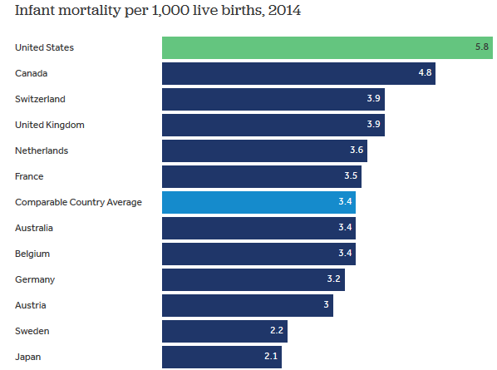
US Ranks X in Infant Mortality
.
Notes:
StatLit for Managers
2013
2013Schield-MBAA
3
Analyzing Numbers in the News
15 May 2008
2008SchieldNNN6up.pdf
3
3

Slide 4
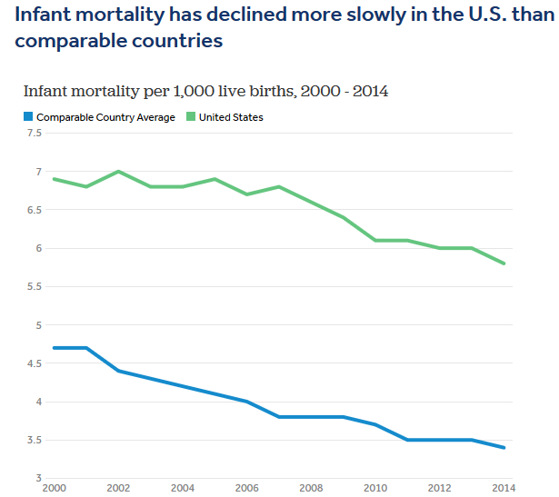
.
.
US: 2000 to 2014
16% improvement
Comparable Countries: 29% improvement
Notes:
StatLit for Managers
2013
2013Schield-MBAA
4
Analyzing Numbers in the News
15 May 2008
2008SchieldNNN6up.pdf
4
4

Slide 5
Define “Improvement”
Improvement between 2000 and 2014:
United States: From 6.9 to 5.8: a 16% drop
Comparables: From 4.8 to 3.4: a 29% drop
Q. What is another way to measure improvement?
A. Percentage point decrease.
United States: a 1.1 point decrease
Comparables: a 1.4 point decrease.
Notes:
StatLit for Managers
2013
2013Schield-MBAA
5
Analyzing Numbers in the News
15 May 2008
2008SchieldNNN6up.pdf
5
5

Slide 6
Define “Infant Mortality”
"Extremely preterm births recorded in some places may be considered a miscarriage or still birth in other countries. Since survival before 22 weeks or under 500 grams is very rare, categorizing these births as live births will inflate reported infant mortality rates "
Oster and her colleagues found that this reporting difference accounts for up to 40 percent of the U.S. infant mortality disadvantage relative to Austria and Finland.
www.washingtonpost.com/news/wonk/wp/2014/09/29/our-infant-mortality-rate-is-a-national-embarrassment.
Notes:
StatLit for Managers
2013
2013Schield-MBAA
6
Analyzing Numbers in the News
15 May 2008
2008SchieldNNN6up.pdf
6
6

Slide 7
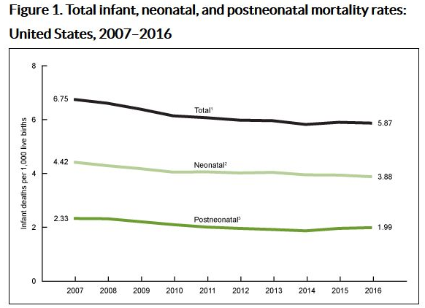
Data: US NIH/CDC
https://www.cdc.gov/nchs/products/databriefs/db326.htm
.
Notes:
StatLit for Managers
2013
2013Schield-MBAA
7
Analyzing Numbers in the News
15 May 2008
2008SchieldNNN6up.pdf
7
7

Slide 8
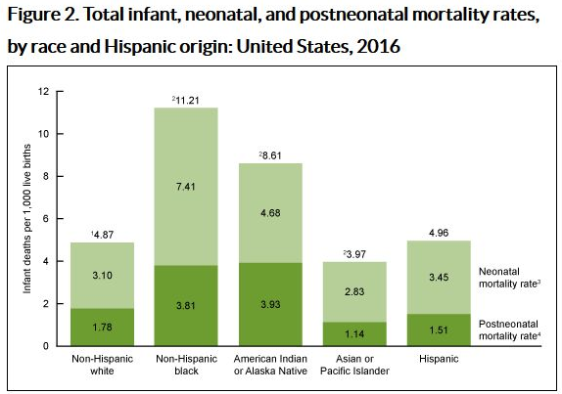
.
.
Notes:
StatLit for Managers
2013
2013Schield-MBAA
8
Analyzing Numbers in the News
15 May 2008
2008SchieldNNN6up.pdf
8
8

Slide 9
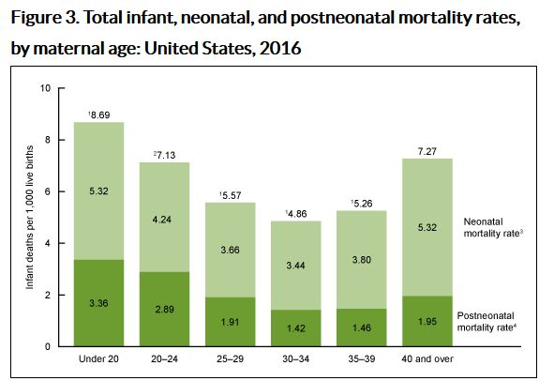
.
.
Notes:
StatLit for Managers
2013
2013Schield-MBAA
9
Analyzing Numbers in the News
15 May 2008
2008SchieldNNN6up.pdf
9
9

Slide 10
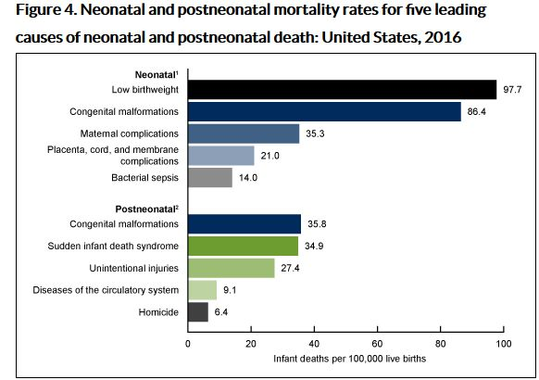
.
.
Notes:
StatLit for Managers
2013
2013Schield-MBAA
10
Analyzing Numbers in the News
15 May 2008
2008SchieldNNN6up.pdf
10
10

Slide 11
Alternate Explanations?
What explains why US has high infant mortality rate?
Broken medical system
Lack of health insurance
____________
Moral: Always look for the story behind the story.
If the story involves statistics, remember,
statistics are numbers involving reality.
Statistics can be influenced (unlike numbers)
Statistics can be influenced by confounders
Alternate explanations require hypothetical thinking
Notes:
StatLit for Managers
2013
2013Schield-MBAA
11
Analyzing Numbers in the News
15 May 2008
2008SchieldNNN6up.pdf
11
11

Slide 12
Bibliography
Infant Mortality by Age at Death in the United States, 2016
NCHS Data Brief No. 326, November 2018. Ely, Driscoll, Mathews.
https://www.cdc.gov/nchs/products/databriefs/db326.htm
Our infant mortality rate is a national embarrassment
Christopher Ingraham. Wonkblog Sept. 29, 2014
www.washingtonpost.com/news/wonk/wp/2014/09/29/our-infant-mortality-rate-is-a-national-embarrassment/
How does infant mortality in the U.S. compare to other countries? Sawyer and Gonzales (2017) Kaiser Family Foundation. www.healthsystemtracker.org/chart-collection/infant-mortality-u-s-compare-countries/
Notes:
StatLit for Managers
2013
2013Schield-MBAA
12
Analyzing Numbers in the News
15 May 2008
2008SchieldNNN6up.pdf
12
12

