Slide 1
Teaching Statistical Literacy at a Community College
Milo Schield
<SchieldMilo@UNM.edu>
Consultant: University of New Mexico
Fellow: American Statistical Association
President: National Numeracy Network
US Rep: International Statistical Literacy Project
Nov 18, 2021
Central New Mexico Community College
www.StatLit.org/pdf/2021-Schield-CNMCC-Slides.pdf
Notes:
Model Trendline Linear 2Y1X using Excel 2013
11/24/2013 V0a
www.StatLit.org/pdf/Model-Trendline-Linear-2Y1X-Excel2013-6up.pdf
1
Analyzing Numbers in the News
15 May 2008
2008SchieldNNN6up.pdf
1
1

Slide 2
Goal:
To convince you to teach Statistical Literacy
2
Statistical Literacy is a course that
shows the power of mathematics and statistics.
As math-stat teachers, we see beauty, value and power in quantitative thinking. We wish our students could see what we see. But all too often they don’t.
community college students will find valuable.
I have taught this at Augsburg University: a four-year college where the average SAT is 60th percentile!
Most are ESL or first generation. My students are similar to those at community colleges.
Notes:
Model Trendline Linear 2Y1X using Excel 2013
11/24/2013 V0a
www.StatLit.org/pdf/Model-Trendline-Linear-2Y1X-Excel2013-6up.pdf
2
Analyzing Numbers in the News
15 May 2008
2008SchieldNNN6up.pdf
2
2

Slide 3
Student Survey
3
After my course, I ask my students three questions.
Did this course improve your critical thinking?
Would you recommend this course to a friend?
Should all students be required to take this course?
When I teach traditional statistics I get ‘Yes’ (Agree or Strongly agree) from 15% to 25% of the students.
When I teach Statistical Literacy to art, music and management majors, I get ‘Yes’ from at least 50%.
Notes:
Model Trendline Linear 2Y1X using Excel 2013
11/24/2013 V0a
www.StatLit.org/pdf/Model-Trendline-Linear-2Y1X-Excel2013-6up.pdf
3
Analyzing Numbers in the News
15 May 2008
2008SchieldNNN6up.pdf
3
3

Slide 4
Statistical Literacy:
UNM Math 1300
4
Statistical Literacy is a new GenEd course at UNM.
Statistical Literacy is designed for consumers of statistics: students in non-quantitative majors that don't require a specific mathematics course such as Journalism, Political Science, Communications, Philosophy, English, Film, Archeology, Music, etc.
Statistical Literacy focuses on the social statistics in the everyday media: how these statistics are constructed and manipulated, and how they are used as evidence in arguments.
Notes:
Model Trendline Linear 2Y1X using Excel 2013
11/24/2013 V0a
www.StatLit.org/pdf/Model-Trendline-Linear-2Y1X-Excel2013-6up.pdf
4
Analyzing Numbers in the News
15 May 2008
2008SchieldNNN6up.pdf
4
4

Slide 5
Statistical Literacy:
Students learn… #1
5
Statistics are different from numbers
Statistics are numbers in context (in reality)
Statistics can be influenced by reality:
  In arithmetic, 1 plus 1 is always 2.
  In reality math:
  1 bunny plus 1 bunny can give three bunnies
  1 ice-cube plus 1 ice-cube can give zero ice-cubes
Notes:
Model Trendline Linear 2Y1X using Excel 2013
11/24/2013 V0a
www.StatLit.org/pdf/Model-Trendline-Linear-2Y1X-Excel2013-6up.pdf
5
Analyzing Numbers in the News
15 May 2008
2008SchieldNNN6up.pdf
5
5

Slide 6
Statistical Literacy:
Students learn… #2
6
Most social statistics are crude associations: They are mixed-fruit comparisons (apples & oranges).
  Patient death rate at City hospital is higher than that at Rural. But after taking into account patient condition, patient death rate at City is lower than that at Rural.
  People who read home and fashion magazines are likely to get pregnant than those who read car and sport magazines. But after controlling for gender, the pregnancy difference decreases substantially
Notes:
Model Trendline Linear 2Y1X using Excel 2013
11/24/2013 V0a
www.StatLit.org/pdf/Model-Trendline-Linear-2Y1X-Excel2013-6up.pdf
6
Analyzing Numbers in the News
15 May 2008
2008SchieldNNN6up.pdf
6
6

Slide 7
Statistical Literacy:
Students learn… #3
7
Learn how to “take something into account”.
  How? Give both groups the same mix.
Learn to think hypothetically about how things could have been defined, counted, measured, and presented.
Learn how to read and interpret statistics in news stories, tables and graphs.
Notes:
Model Trendline Linear 2Y1X using Excel 2013
11/24/2013 V0a
www.StatLit.org/pdf/Model-Trendline-Linear-2Y1X-Excel2013-6up.pdf
7
Analyzing Numbers in the News
15 May 2008
2008SchieldNNN6up.pdf
7
7

Slide 8
Statistical Literacy:
Students learn… #4
8
How to express conditional probability using ordinary English.
  The percentage of women who run
  The percentage of women among runners
  Widows are more likely to commit suicide than widowers.
  Among those who commit suicide, widows are more likely [to be found] than widowers.
Association is not [necessarily] causation;
Disparity is not [necessarily] discrimination.
Notes:
Model Trendline Linear 2Y1X using Excel 2013
11/24/2013 V0a
www.StatLit.org/pdf/Model-Trendline-Linear-2Y1X-Excel2013-6up.pdf
8
Analyzing Numbers in the News
15 May 2008
2008SchieldNNN6up.pdf
8
8

Slide 9
Crude Comparison:
Simpson’s Paradox
Vaccinated are 2.5 times as likely to die as unvaccinated.
After controlling for age, unvaccinated are 3.4 times as likely to die from Covid19 Delta as are the vaccinated.
Notes:
StatLit for Managers
2013
2013Schield-MBAA
9
Analyzing Numbers in the News
15 May 2008
2008SchieldNNN6up.pdf
9
9

Slide 10
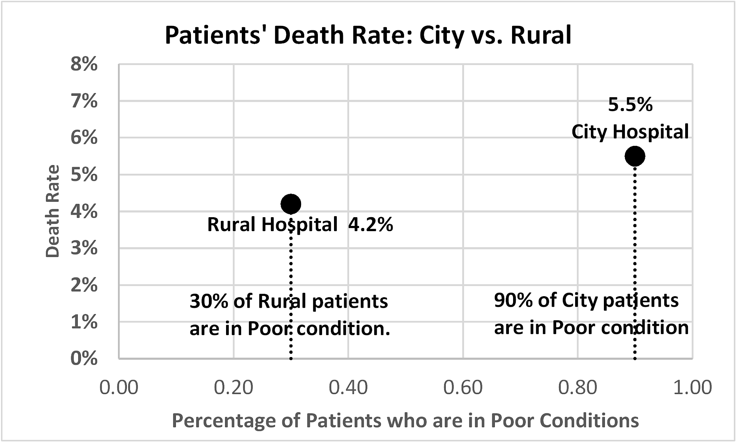
City Hospital has higher patient death rate than Rural.
A ‘crude’ association: True but not the whole story!
What is X
Notes:
StatLit for Managers
2013
2013Schield-MBAA
10
Analyzing Numbers in the News
15 May 2008
2008SchieldNNN6up.pdf
10
10

Slide 11
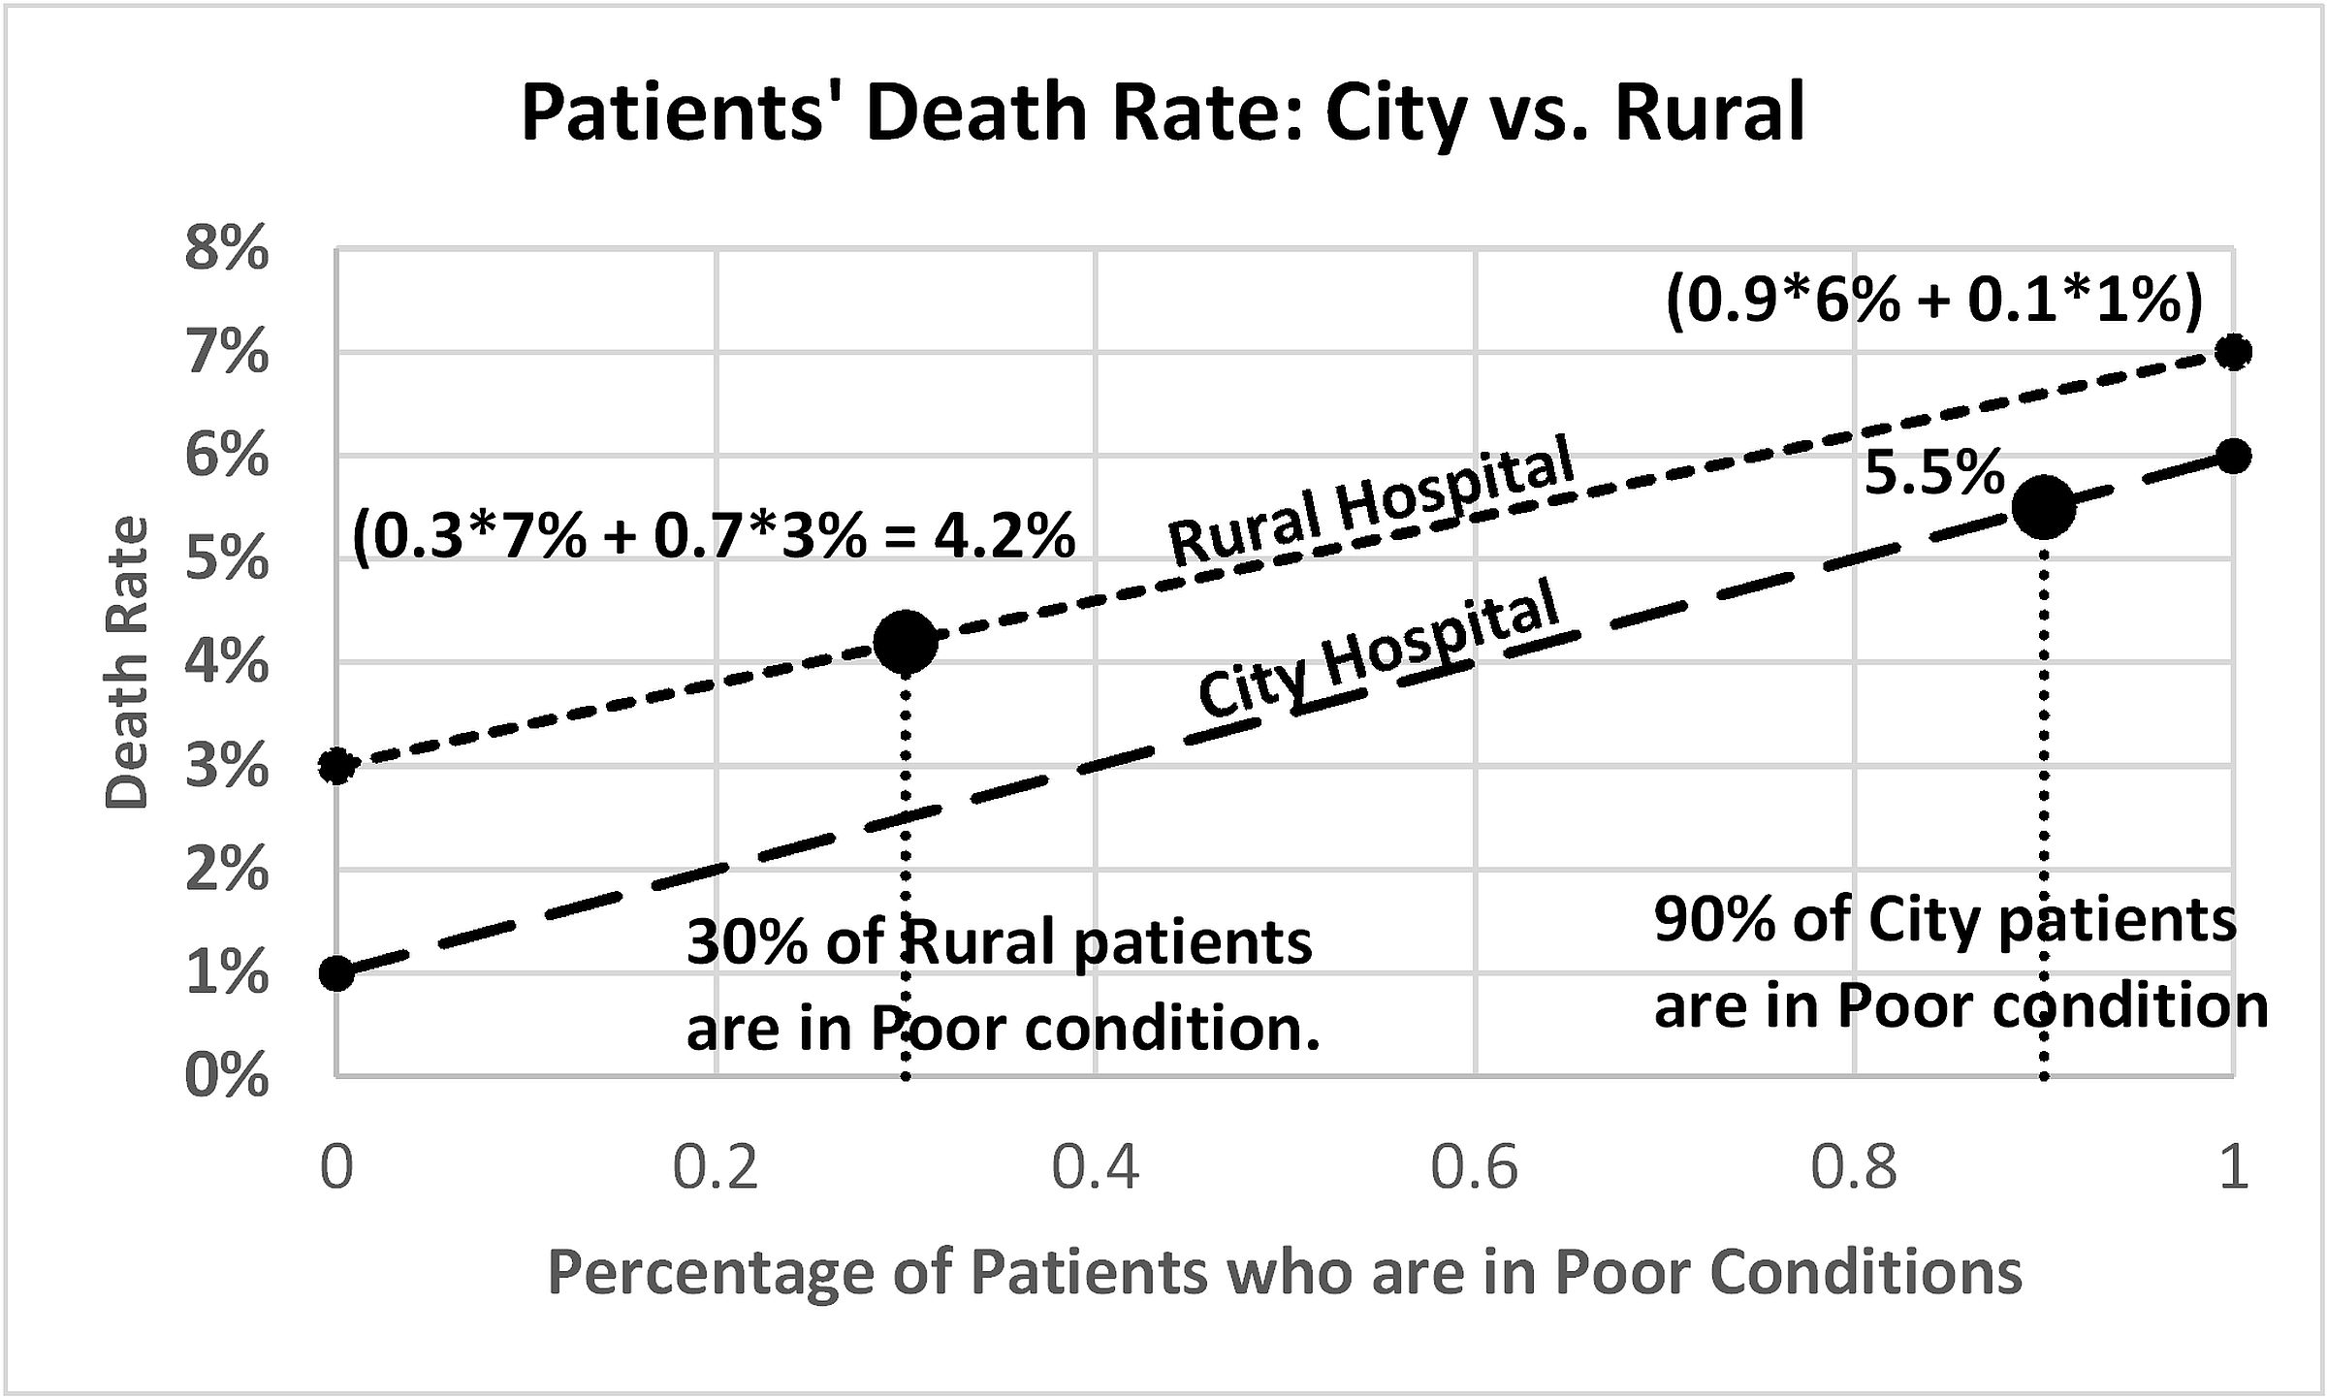
City Hospital has higher patient death rate than Rural
Need to control for patient condition
Notes:
StatLit for Managers
2013
2013Schield-MBAA
11
Analyzing Numbers in the News
15 May 2008
2008SchieldNNN6up.pdf
11
11

Slide 12
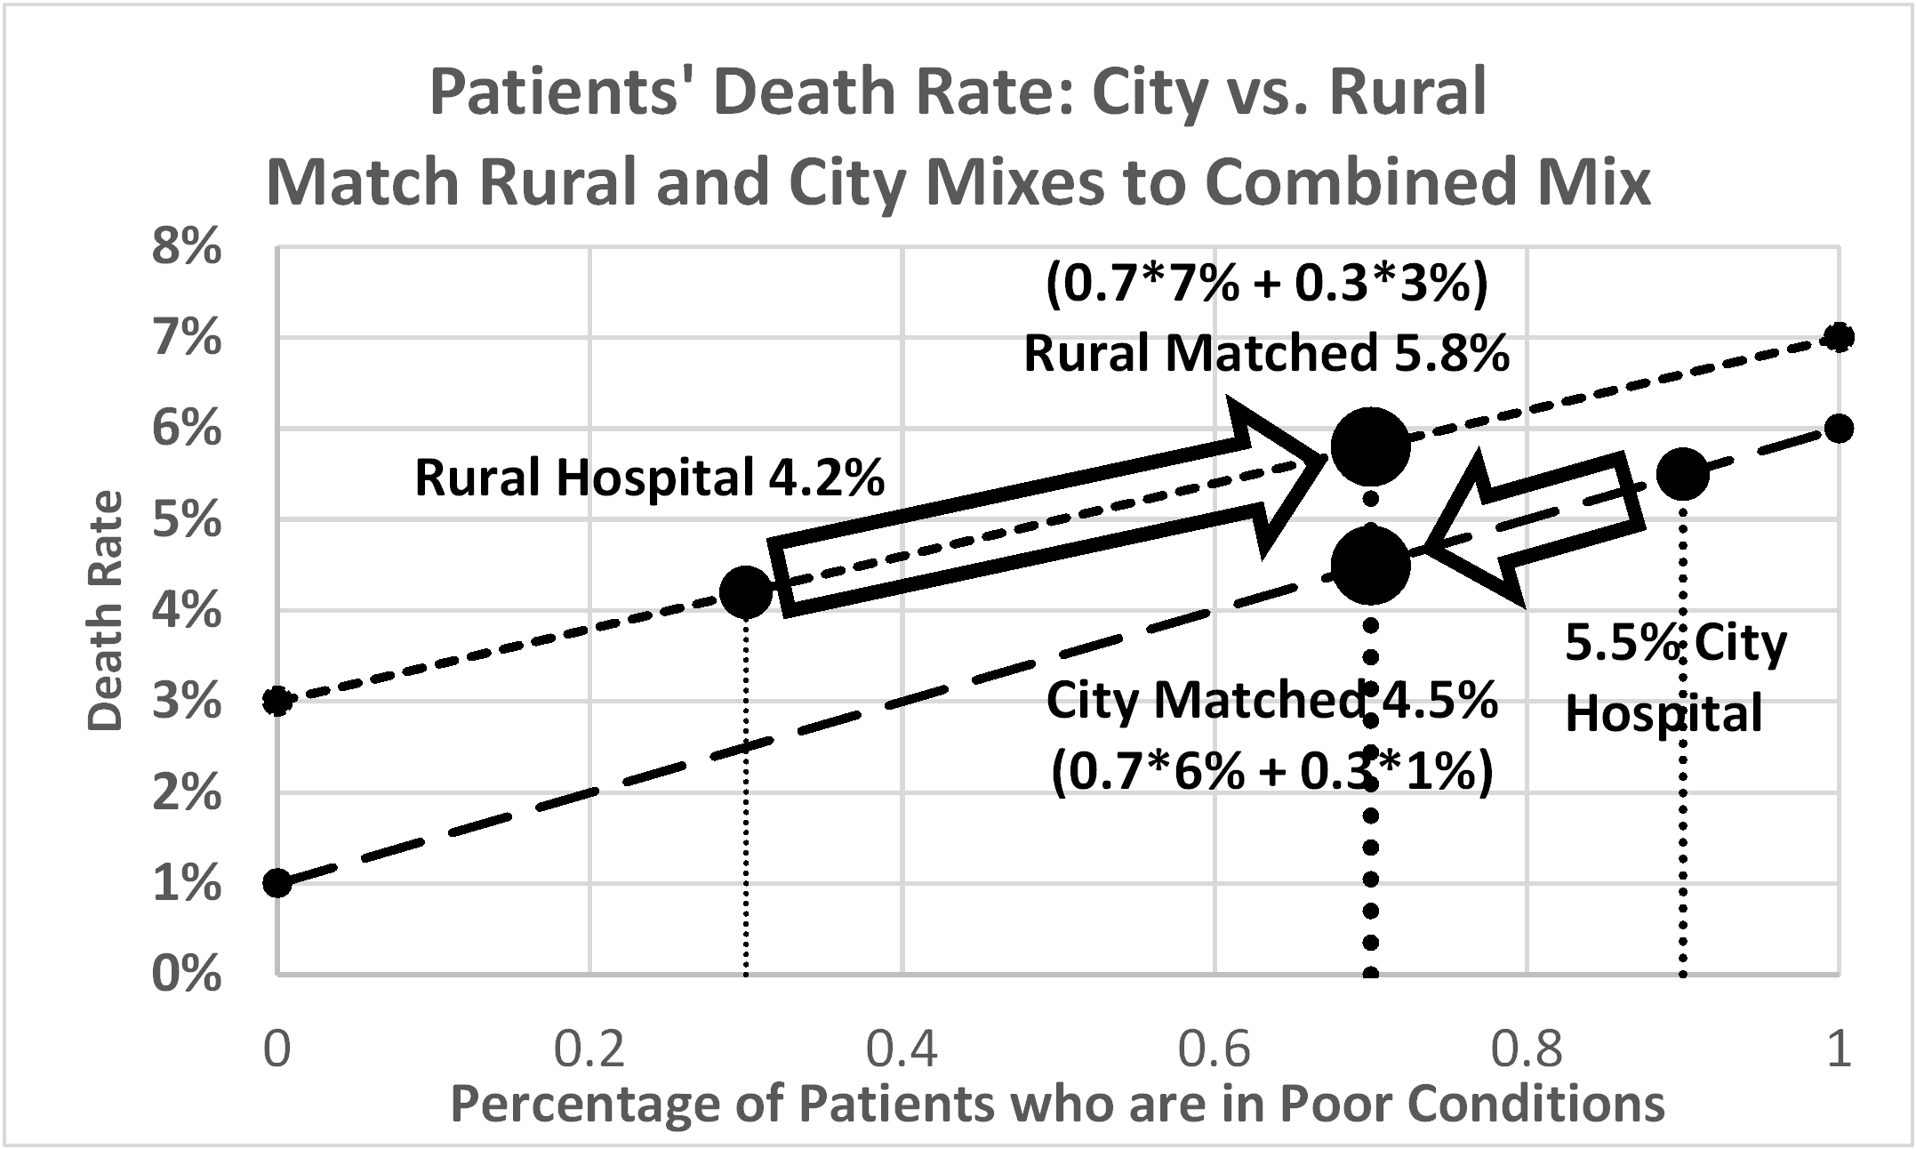
City Hospital has higher patient death rate than Rural
After controlling for patient condition, City has a lower death rate than Rural.
Notes:
StatLit for Managers
2013
2013Schield-MBAA
12
Analyzing Numbers in the News
15 May 2008
2008SchieldNNN6up.pdf
12
12

Slide 13
Statistical Literacy:
Comparison
13
Statistical Literacy has less than a 30% overlap with regular statistics taken by most college students.
No balls and urns, no theorems,
More focus on big data than on small samples
More focus on observational data than on experiments.
More focus on confounding than on randomness.
Statistical literacy has a different mathematical emphasis;
Doesn’t need algebra: no functions, no linear equations.
Need higher-order mathematical thinking.
Notes:
Model Trendline Linear 2Y1X using Excel 2013
11/24/2013 V0a
www.StatLit.org/pdf/Model-Trendline-Linear-2Y1X-Excel2013-6up.pdf
13
Analyzing Numbers in the News
15 May 2008
2008SchieldNNN6up.pdf
13
13

Slide 14
Statistical Literacy:
Empirically Based
14
Yes, this course is different – radically different.
It focuses on statistics that students will encounter in the everyday media. It is empirically based on...
content of over a thousand news stories
  Association, Between (action verbs), Causation
thousands of actual uses of ratio grammar:
  Percent, percentage, rate and chance (probability) grammar.
practices in epidemiology:
  percentage attributable to…; cases attributable to…
practices in multivariate regression:
  Take into account; control for.
Notes:
Model Trendline Linear 2Y1X using Excel 2013
11/24/2013 V0a
www.StatLit.org/pdf/Model-Trendline-Linear-2Y1X-Excel2013-6up.pdf
14
Analyzing Numbers in the News
15 May 2008
2008SchieldNNN6up.pdf
14
14

Slide 15
Statistical Literacy:
Deals with a BIG Problem
15
Today’s social and political arguments typically involve social statistics.
Most of these statistics are crude statistics.
Most of the comparisons are crude associations.
But most of those arguing have never been taught
that there may be a story behind these statistics.
Most of those arguing have no idea of what it means to take into account (control for) a related factor.
Notes:
Model Trendline Linear 2Y1X using Excel 2013
11/24/2013 V0a
www.StatLit.org/pdf/Model-Trendline-Linear-2Y1X-Excel2013-6up.pdf
15
Analyzing Numbers in the News
15 May 2008
2008SchieldNNN6up.pdf
15
15

Slide 16
Statistical Literacy:
Provides a “Solution”
16
Statistical literacy helps students
see the story behind the statistics.
understand what it means to control for something.
understand the confusion of the inverse
P(A|B) .NE. P(B|A).
understand that statistical significance can be reversed by controlling for a confounder.
offer more nuanced arguments involving disparities, discrimination and systemic racism.
Notes:
Model Trendline Linear 2Y1X using Excel 2013
11/24/2013 V0a
www.StatLit.org/pdf/Model-Trendline-Linear-2Y1X-Excel2013-6up.pdf
16
Analyzing Numbers in the News
15 May 2008
2008SchieldNNN6up.pdf
16
16

Slide 17
Statistical Literacy:
Can Improve our World
17
Our world is
drowning in data
drowning in “studies say”
convinced that many (most?) statistics are lies
convinced that disparities prove discrimination
cannot identify a crude association.
We can change that.
We can make our world a better place.
Notes:
Model Trendline Linear 2Y1X using Excel 2013
11/24/2013 V0a
www.StatLit.org/pdf/Model-Trendline-Linear-2Y1X-Excel2013-6up.pdf
17
Analyzing Numbers in the News
15 May 2008
2008SchieldNNN6up.pdf
17
17

Slide 18
Next Steps
18
Review “Offering Statistical Literacy”. Copy at www.statlit.org/pdf/2021-Schield-Offering-Statistical-Literacy.pdf
Obtain, read and study the textbook.
View Schield’s recorded lectures for each chapter.*
Email Schield about attending his online classes
Teach some topics at the end of a statistics class.
Review materials presented to get StatLit approved for general education: www.StatLit.org/UNM.htm
* Recordings at: https://drive.google.com/drive/folders/1-0UbYELnxQytCkaYbFIJo2QyfSa2CKCW
Notes:
Model Trendline Linear 2Y1X using Excel 2013
11/24/2013 V0a
www.StatLit.org/pdf/Model-Trendline-Linear-2Y1X-Excel2013-6up.pdf
18
Analyzing Numbers in the News
15 May 2008
2008SchieldNNN6up.pdf
18
18

Slide 19
Will Central New Mexico C/C be the World Leader?
19
UNM is the first public university in the world to offer a rigorous statistical literacy course focused on social statistics, observational studies and confounding.
Will you – the faculty at New Mexico Community College – accept this challenge and offer Statistical Literacy to your students.
It won’t be easy, but your students will see mathematics and statistics in a different way: a way they can appreciate.
Notes:
Model Trendline Linear 2Y1X using Excel 2013
11/24/2013 V0a
www.StatLit.org/pdf/Model-Trendline-Linear-2Y1X-Excel2013-6up.pdf
19
Analyzing Numbers in the News
15 May 2008
2008SchieldNNN6up.pdf
19
19

