Slide 1
Statistical Literacy: The Diabolical Denominator
Milo Schield
Consultant: Univ. New Mexico
Fellow: American Statistical Association
Elected Member: International Statistical Institute
US Rep: International Statistical Literacy Project
President: National Numeracy Network
MathFest Aug 4, 2021
Paper: www.StatLit.org/pdf/2021-Schield-MathFest.pdf
Slides: www.StatLit.org/pdf/2021-Schield-MathFest-Slides.pdf
Notes:
StatLit for Managers
2013
2013Schield-MBAA
1
Analyzing Numbers in the News
15 May 2008
2008SchieldNNN6up.pdf
1
1

Slide 2
Choice of Denominator (per what?):
Choice of the denominator can cause a:
change in a direction over time
change in direction between group rates
difference between group prevalences
The choice of a denominator is the user’s choice.
That choice can be diabolical: evil, wicked or cruel
Denominator choices have statistical consequences
Notes:
StatLit for Managers
2013
2013Schield-MBAA
2
Analyzing Numbers in the News
15 May 2008
2008SchieldNNN6up.pdf
2
2

Slide 3
#1: Denominator Choice Causes Change in Rates Over Time
.
Notes:
StatLit for Managers
2013
2013Schield-MBAA
3
Analyzing Numbers in the News
15 May 2008
2008SchieldNNN6up.pdf
3
3

Slide 4
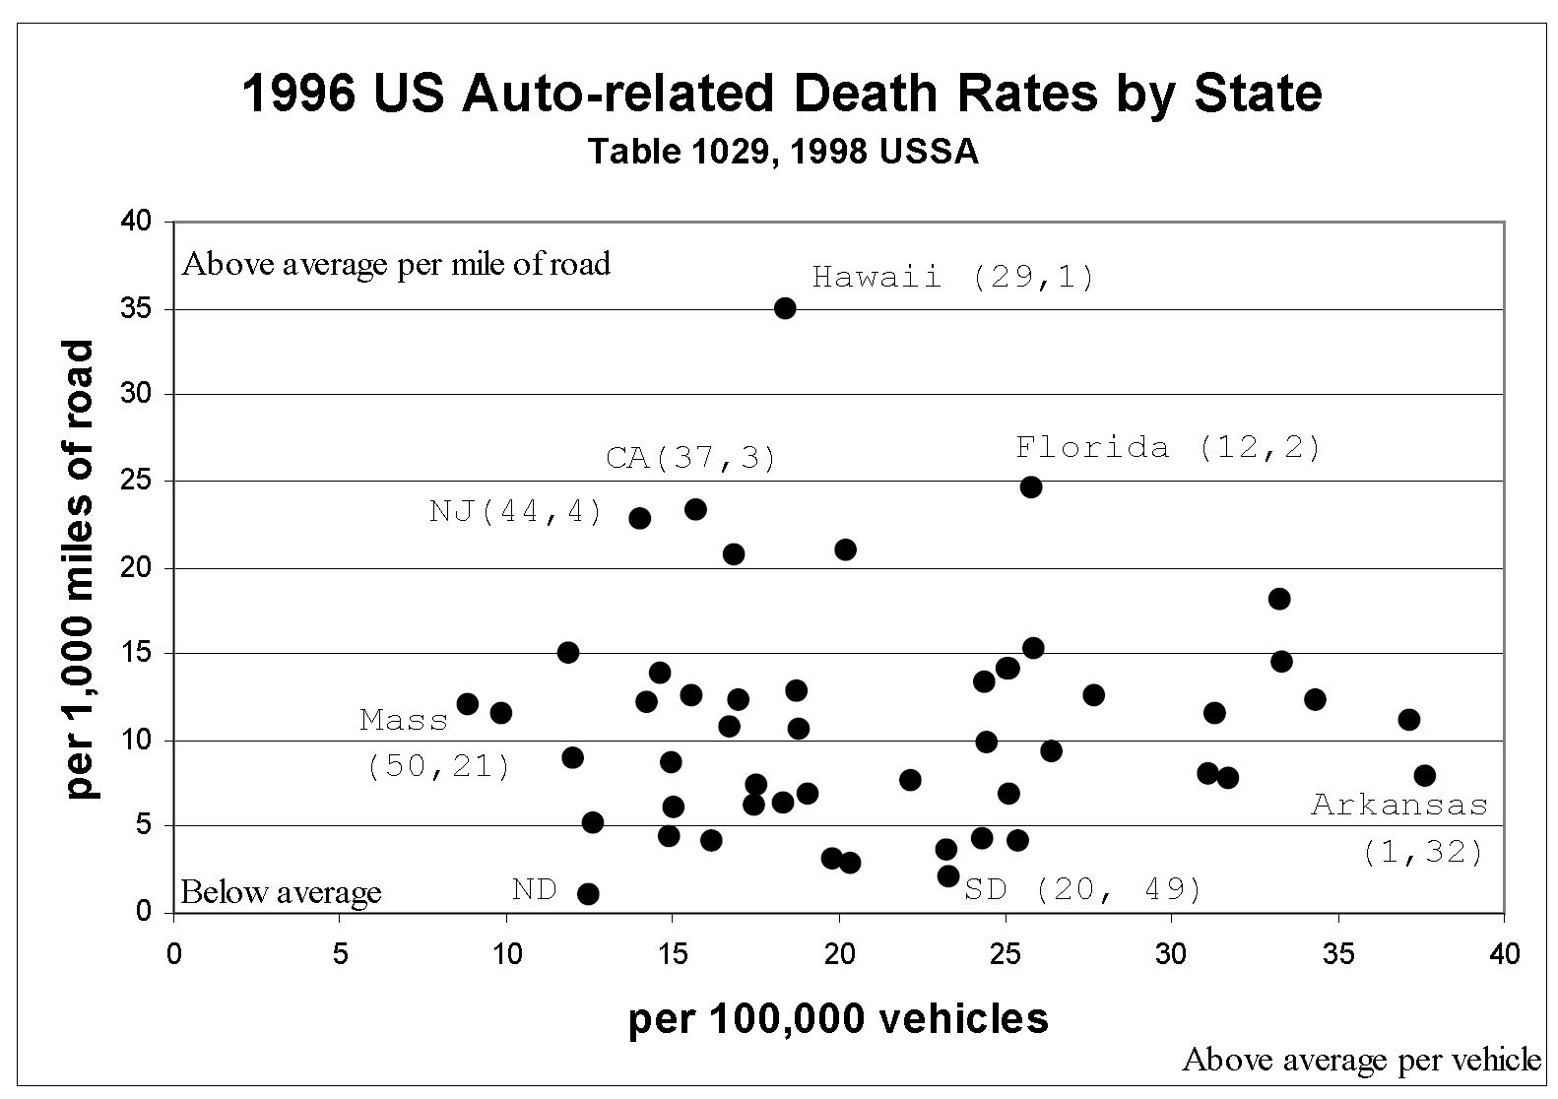
#2A: Denominator Choice Causes Change in Rate-Compare Direction
The 1996 auto-death rate was
7 times as high in HI (35) as in AK (7) per mile of road.
twice as high in AK (38) as in HI (19) per vehicle.
HI: Hawaii AK: Arkansas
Notes:
StatLit for Managers
2013
2013Schield-MBAA
4
Analyzing Numbers in the News
15 May 2008
2008SchieldNNN6up.pdf
4
4

Slide 5
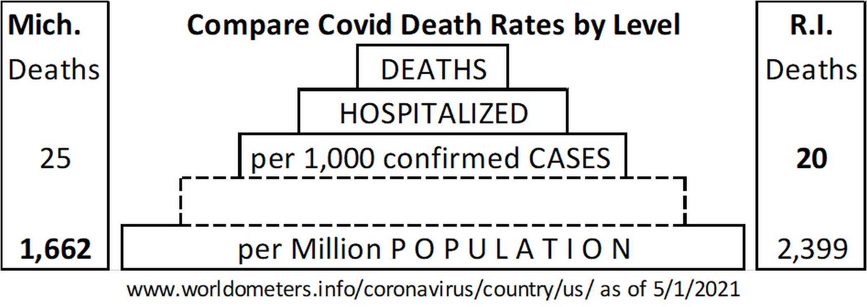
#2B: Denominator Choice Causes Change in Rate-Compare Direction
Mich. has a higher death rate than R.I. per case.
Mich. has a lower death rate than R. I. per capita.
Notes:
StatLit for Managers
2013
2013Schield-MBAA
5
Analyzing Numbers in the News
15 May 2008
2008SchieldNNN6up.pdf
5
5

Slide 6
#2B: Diabolical Denominator. Which Denominator is Right?
Michigan has a higher death rate than Rhode Island
per case.
Michigan has a lower death rate than Rhode Island per capita.
Which denominator is right? Is it ‘per case’ or ‘per capita’?
Maybe neither one!
Notes:
StatLit for Managers
2013
2013Schield-MBAA
6
Analyzing Numbers in the News
15 May 2008
2008SchieldNNN6up.pdf
6
6

Slide 7
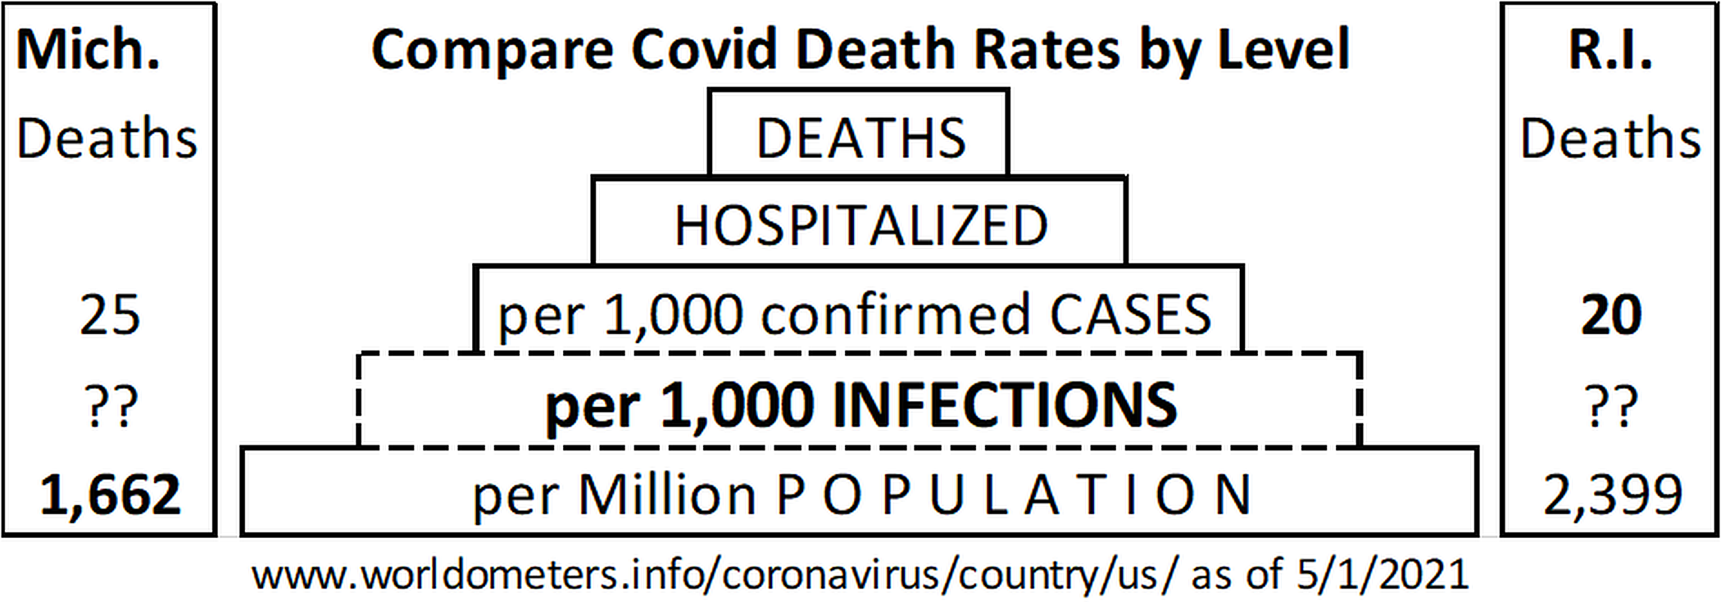
#2B: Diabolical Denominator. Which Denominator is Right?
Q. Per what? A. Infections?
Notes:
StatLit for Managers
2013
2013Schield-MBAA
7
Analyzing Numbers in the News
15 May 2008
2008SchieldNNN6up.pdf
7
7

Slide 8
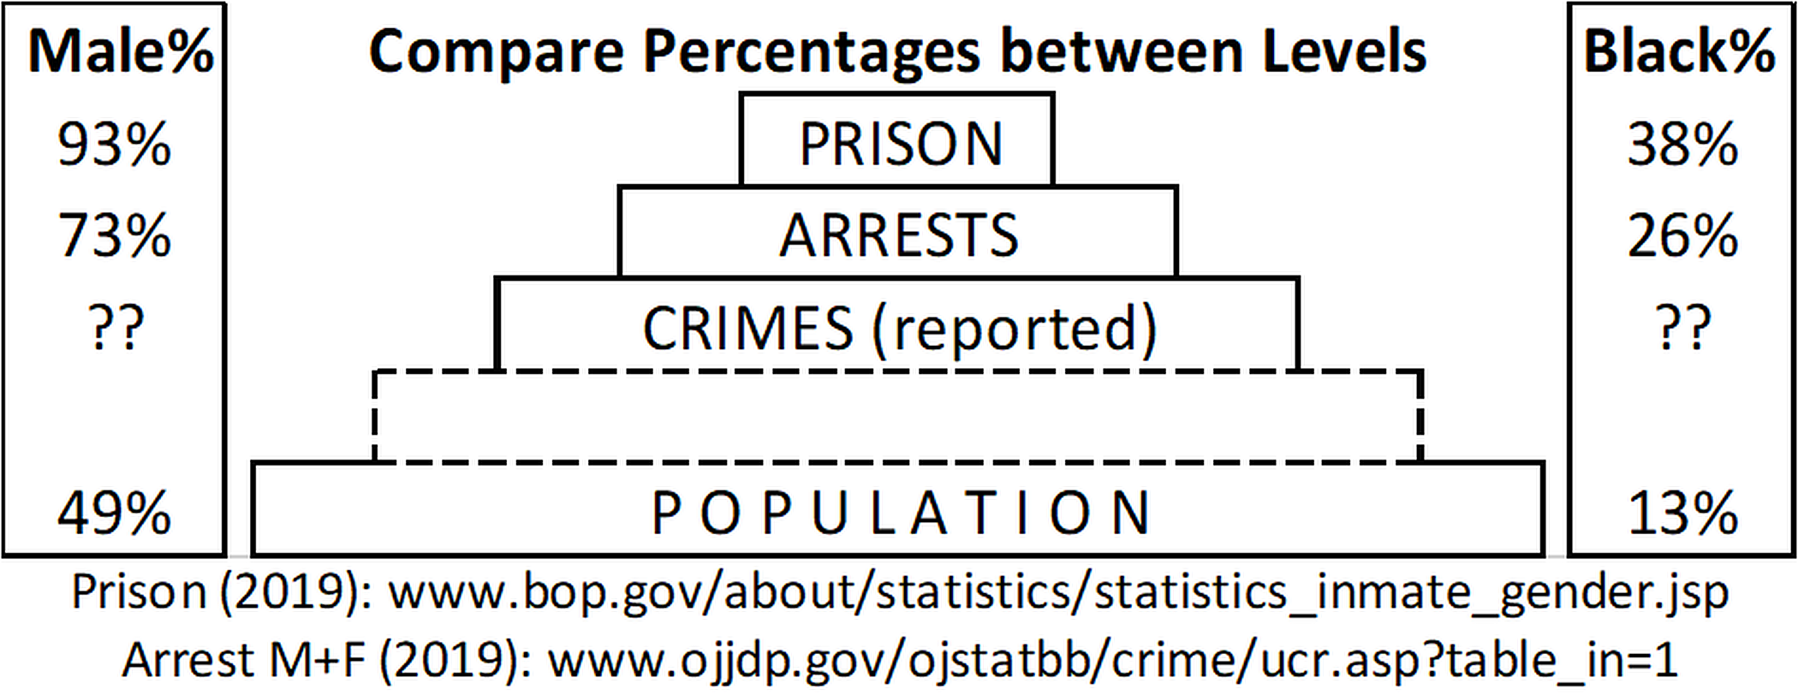
#3: Denominator Choice Shows Difference in Group Prevalences
Guys are 9 times as prevalent among prisoners as gals.
Guys are 93% of prisoners (49% of population).
Blacks are 38% of prisoners (13% of the population)
Notes:
StatLit for Managers
2013
2013Schield-MBAA
8
Analyzing Numbers in the News
15 May 2008
2008SchieldNNN6up.pdf
8
8

Slide 9
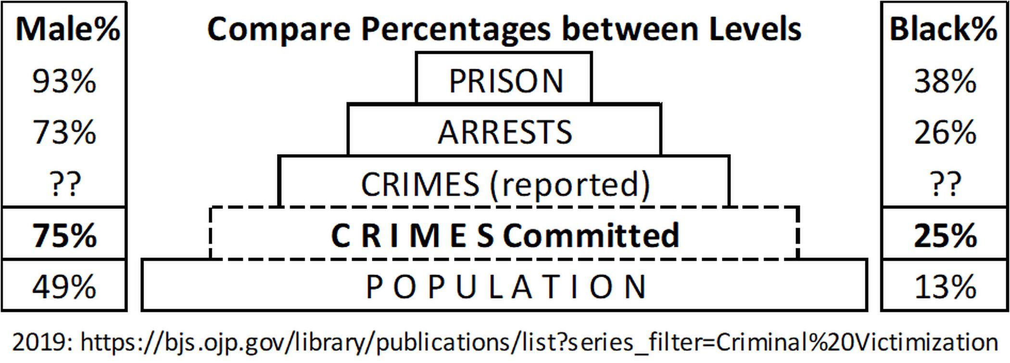
#3: Denominator Choice Shows Difference in Group Prevalences
Compare with their percentage among committed crimes
Males are 73% of arrests (75% of victimizations)
Blacks are 26% of arrests (25% of victimizations)
Notes:
StatLit for Managers
2013
2013Schield-MBAA
9
Analyzing Numbers in the News
15 May 2008
2008SchieldNNN6up.pdf
9
9

Slide 10
Statistical Educators Should Offer a Course that:
asserts that Association is Not Causation
asserts that Disparity is Not Discrimination
focuses on the Story Behind the Statistics
emphasizes how a crude association may conceal the real story!
shows students these things without computers
Notes:
StatLit for Managers
2013
2013Schield-MBAA
10
Analyzing Numbers in the News
15 May 2008
2008SchieldNNN6up.pdf
10
10

Slide 11
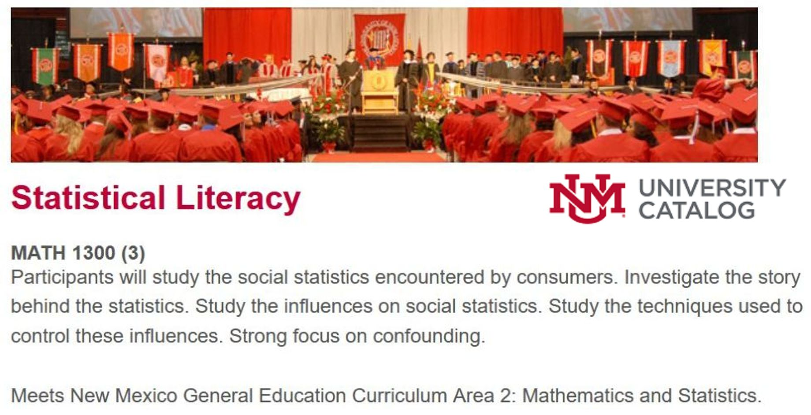
University of New Mexico is offering such a course!
Offering 4 sections fall 2021
Notes:
StatLit for Managers
2013
2013Schield-MBAA
11
Analyzing Numbers in the News
15 May 2008
2008SchieldNNN6up.pdf
11
11

Slide 12
Why Don’t You Teach Statistical Literacy?
To learn more about Statistical Literacy:
Read papers at
www.StatLit.org/Schield-Pubs.htm
Most recent papers:
Statistical Literacy: Teaching Confounding
www.StatLit.org/pdf/2021-Schield-USCOTS.pdf
University of New Mexico Offers a New Confounder-Based Statistical Literacy Course
www.StatLit.org/pdf/2021-Schield-ASA.pdf
Notes:
StatLit for Managers
2013
2013Schield-MBAA
12
Analyzing Numbers in the News
15 May 2008
2008SchieldNNN6up.pdf
12
12

