Slide 1
Teaching Confounding: Part 3: UNM and Cornfield
Milo Schield, Augsburg University
Fellow: American Statistical Association
Member: International Statistical Institute
US Rep: International Statistical Literacy Project
President National Numeracy Network
USCOTS Workshop Online
June 26, 2021
www.StatLit.org/pdf/2021-Schield-USCOTS-Slides3.pdf
Notes:
StatLit for Managers
2013
2013Schield-MBAA
1
Analyzing Numbers in the News
15 May 2008
2008SchieldNNN6up.pdf
1
1

Slide 2
Reason #6: Can’t field a second course
Lack of sections (FTE limit)
University of New Mexico (Albuquerque) is offering MATH 1300: Statistical Literacy.
UNM is using sections normally allocated to the traditional statistical inference course: MATH 1350 Introductory Statistics.

Slide 3
Univ. of New Mexico
Math 1350 Introductory statistical inference. UNM offers ~20 sections (35 max) in ABQ.
Dr. Eric Erhardt (above left) looked for an updated complement to Math 1350.
Dean Peceny (above right) provided funds.
After interviewing several candidates, the committee choose Schield to implement his statistical literacy course.

Slide 4
Getting Course Approved
Getting a new course approved at a large public university is not a simple matter. Dr. Erhardt supervised the process.
This new statistical literacy course needed to satisfy a mathematics requirement:
in the university core curriculum.
in the state higher-education general education curriculum.

Slide 5
Getting Course Approved
Registrar:
New course request (Form B)
Catalog description
Sample syllabus
University of New Mexico (ABQ)
New course signoff
Budgetary load implications

Slide 6
Getting Course Approved
New Mexico Higher Education Department
Add Common Course Number (CCN)
Student Learning Outcomes (SLOs)
NM Higher Education General Education
Add a course to Gen Ed curriculum
Goals and Student Learning Outcomes
Assess Student Learning Outcomes
Sample Assessment

Slide 7
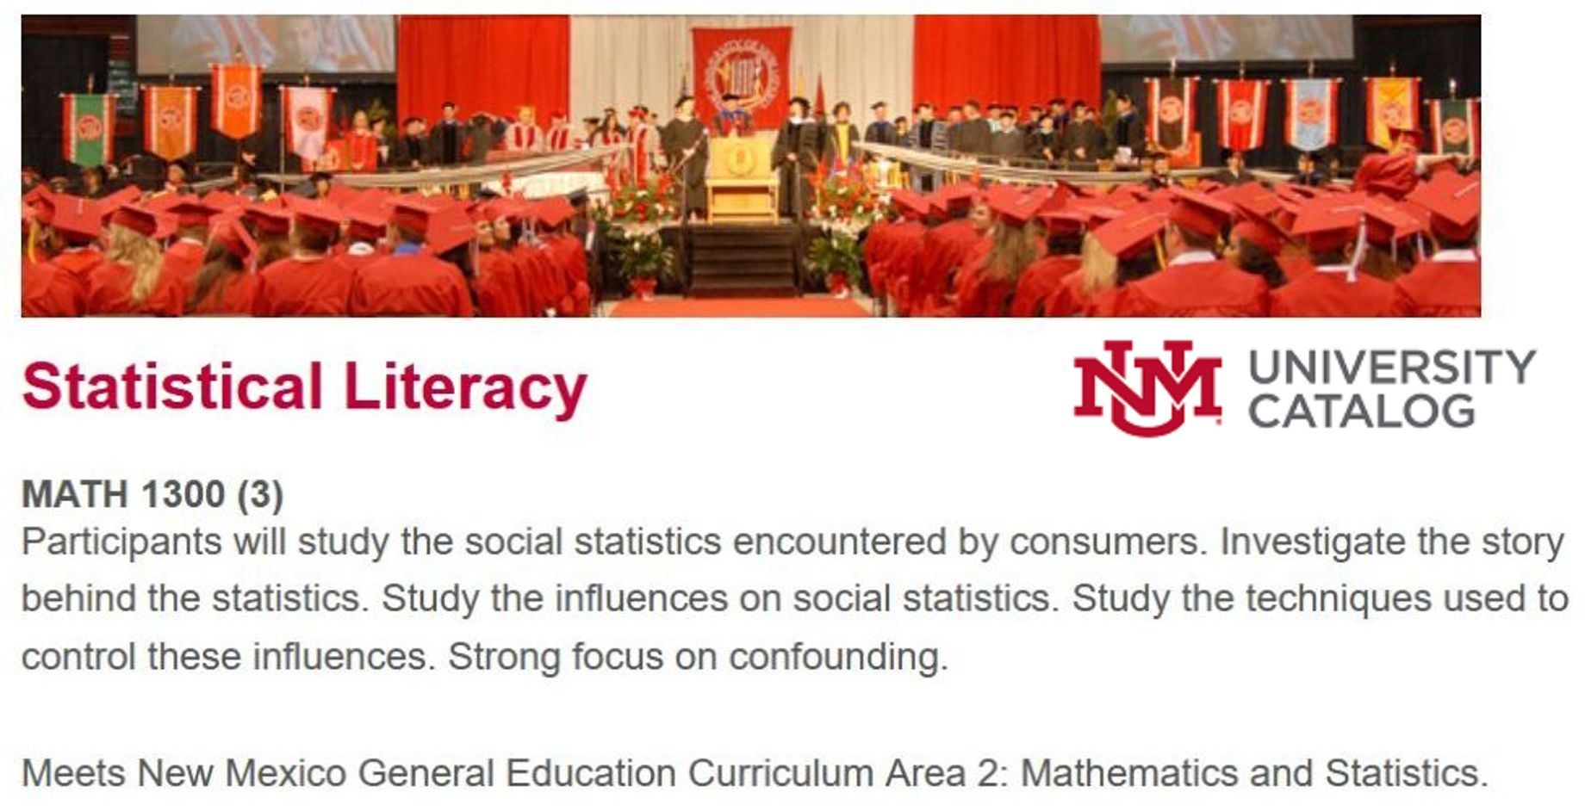
UNM 2021-22 Catalog
.

Slide 8
Course Component #1: Literacy Forum; 20% of grade
Online forum (Odyssey).
Two challenges per week.
Write a short response
No free riders and anonymous
Grading by instructor and peers
Odyssey: A Journey to Life-Long Statistical Literacy
www.statlit.org/pdf/2014-Schield-ICOTS.pdf

Slide 9
Course Component #2: Moodle Exercises: 30% of grade
Multiple choice exercises
8 – 12 exercises per chapter.
One topic per exercise; 5-10 questions each.
Two tries (if more than 2 choices)
Immediate feedback
One-line essay exercises:
Describe and compare counts, averages and percentages presented in tables and graphs.

Slide 10
Course Component #3: Confounder StatLit Textbook
1: Statistical literacy: Take CARE
2: Comparisons and CARE remedies
3: Measurements and Standardization
4: Percent and Percentage Grammar
5: Rate and Chance Grammar. Social statistics
6: Comparisons Using Likely Grammar
7: Difficult Ratios and Cornfield Conditions
8: Influences on Statistical Significance

Slide 11
Course Component #4: Quizzes and Final: 50% of grade
Two, three or four chapter quizzes
Chapters 1 and 2
Chapters 3 and 4
Chapters 4, 5 and 6
Chapters 7 and 8
Final: Comprehensive
Read data in government documents.

Slide 12
Teacher Training A New Prep!!!
Less than a 30% overlap between confounder-based StatLit and traditional intro. Statistics.
Recommendations:
Study Schield papers and StatLit textbook.
Introduce in last weeks of inference course.
Read articles in the everyday media
Analyze news stories in class.
Teach as a topics course

Slide 13
Problem #6 Statistical Cynics
Student: You convinced me: Never trust a statistic!
Even if it is not influenced by assembly, randomness, error or bias, it could be confounded!
Confounding can affect statistical significance.
Our goal is not to create statistical cynics.
Our goal is to help students be critical thinkers!
How can we do this?

Slide 14
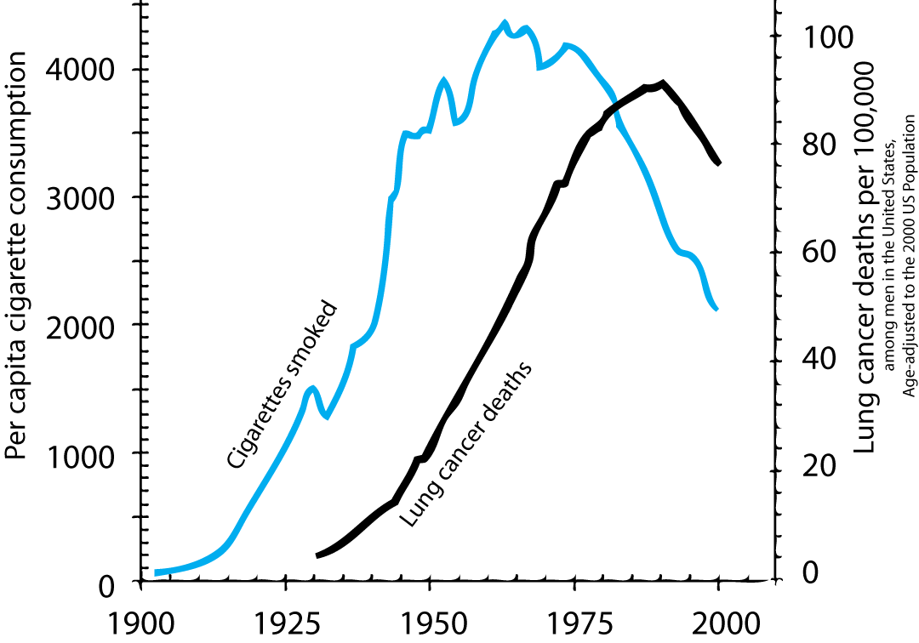
Association between smoking and lung cancer deaths (1960)
.

Slide 15
Does smoking cause cancer? Sir Ronald Fisher (1950s):
Fisher was pre-eminent statistician of that time!
He noted that association is not causation!
Fisher, a smoker, provided data showing a correlation between twinship (fraternal vs. identical) and smoking preference.
Fisher’s data supported the claim that genetics could be a cause of smoking and lung cancer.
Who would think of confronting Fisher?

Slide 16
Cornfield Conditions Jerome Cornfield
There is no test for confounding!
Cornfield proved a necessary condition for a confounder to nullify an observed association.
“Cornfield's minimum effect size is as important to observational studies as is the use of random assignment to experimental studies.” Schield (1999) Simpson’s Paradox & the Cornfield Conditions
www.statlit.org/pdf/1999SchieldASA.pdf

Slide 17
Three Greatest Contributions of Statistics to Human Knowledge
Standard error: Error expected in random samples between parameter and statistic.
Random assignment: statistically controls pre-existing confounders. Fisher (1930)
Cornfield conditions: Conditions necessary for a confounder to nullify or reverse an observed association. Cornfield (1958)

Slide 18
Patient Condition: Good versus Poor
* 1.6 pts more likely to die at City (5.5) than Rural (4.2) Good condition: walked in. Poor condition: carried in. * 3.7 pts more likely to die if Poor (6.25) than Good (2.75) 3.7 points > 1.6 points. So Cornfield #1 is satisfied.
Notes:
StatLit for Managers
2013
2013Schield-MBAA
18
Analyzing Numbers in the News
15 May 2008
2008SchieldNNN6up.pdf
18
18

Slide 19
Cornfield Condition for Nullification or Reversal
An association is nullified or reversed only if
confounder (patient condition) has a stronger association with the outcome (death) than does the predictor (hospital).
predictor (hospital) has a stronger association with the confounder (patient condition) than with the outcome (death).

Slide 20
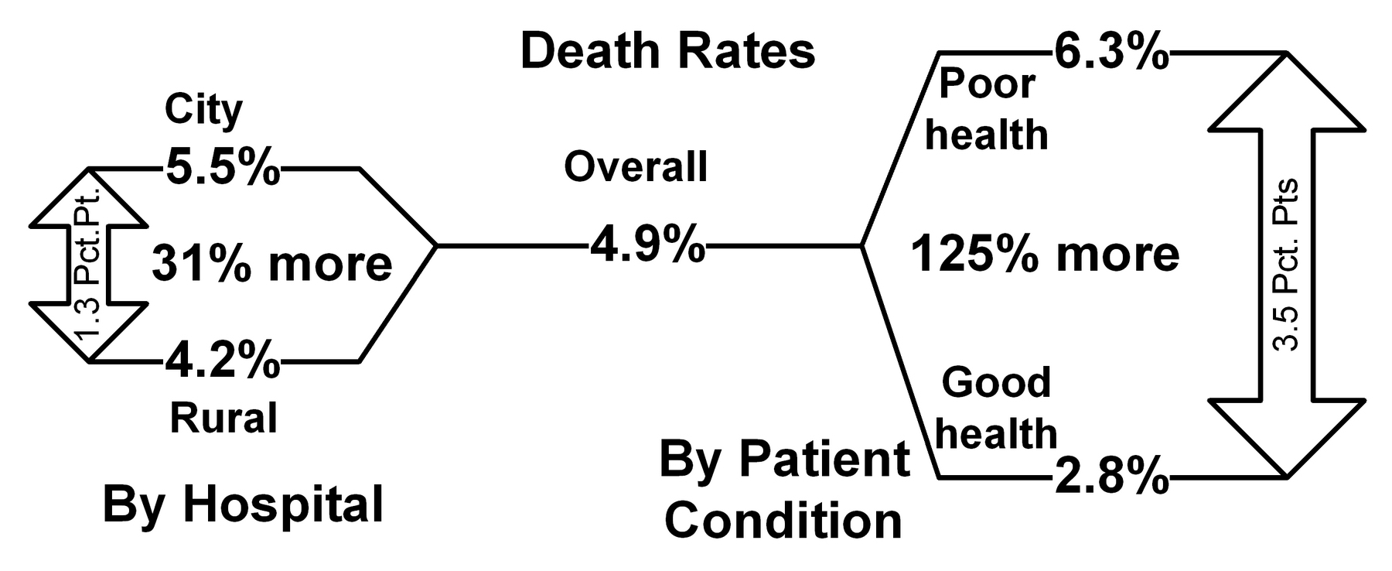
Cornfield Condition for Nullification or Reversal
Condition: bigger death separation than Hospital. So Hospital-Death association could be reversed.

Slide 21
How does Confounding Interact with Statistical Significance?
Statistical educators know that a statistically-significant difference in observational data can become statistically insignificant after controlling for a related factor.
But our students never see this.
This is statistical negligence!
Here is how it is shown in statistical literacy.

Slide 22
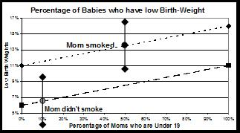
Confounder Influence: Non-Overlap = Statistical Significance
.

Slide 23
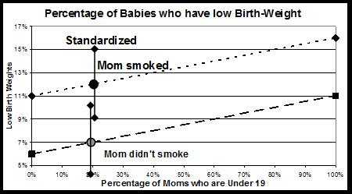
Confounder Influence on Statistical Significance
.

Slide 24
Meaning of Statistically Significant
If a sample outcome is statistically significant, what does this mean?
Outcome is very unlikely IF* due to chance
Outcome is very unlikely …… due to chance
Outcome is very unlikely TO BE due to chance
#1 is accurate (* given or assuming)
#3 is wrong: opens the door to causation. #2 is in-between and ambiguous.

Slide 25
Why We Should Teach Statistical Literacy
Most students need it, see value in it.
Separating stats from math has benefits
Link statistics to critical thinking (rhetoric)
Can show influence of confounding, assembly and bias on statistical significance
Can show the story behind the statistics
Cornfield conditions offset cynicism
Can improve debate on social issues

Slide 26
Schield Resources
Read papers: www.StatLit.org/Schield-Pubs.htm
Buy textbook: Wiley to publish in 2022.

