Slide 1
UNM Statistical Literacy:
Design and Rationale
Milo Schield
Statistical Literacy Coordinator: Univ. of New Mexico
Fellow: American Statistical Association
Elected Member: International Statistical Institute
US Rep: International Statistical Literacy Project
President: National Numeracy Network
February 18, 2022
www.StatLit.org/pdf/2022-Schield-UTEP-Slides.pdf
Notes:
StatLit for Managers
2013
2013Schield-MBAA
1
Analyzing Numbers in the News
15 May 2008
2008SchieldNNN6up.pdf
1
1

Slide 2
Today’s student need to study Statistics
Disparities in
Education, suspensions and graduation
Policing, crime, sentencing and prison
Wages, income, assets, loans and wealth
Health, health care, homicides and deaths
Disparities by
gender, race, ethnicity, religion, politics, age, etc.
All of these rely on statistics: social statistics.
Notes:
StatLit for Managers
2013
2013Schield-MBAA
2
Analyzing Numbers in the News
15 May 2008
2008SchieldNNN6up.pdf
2
2

Slide 3
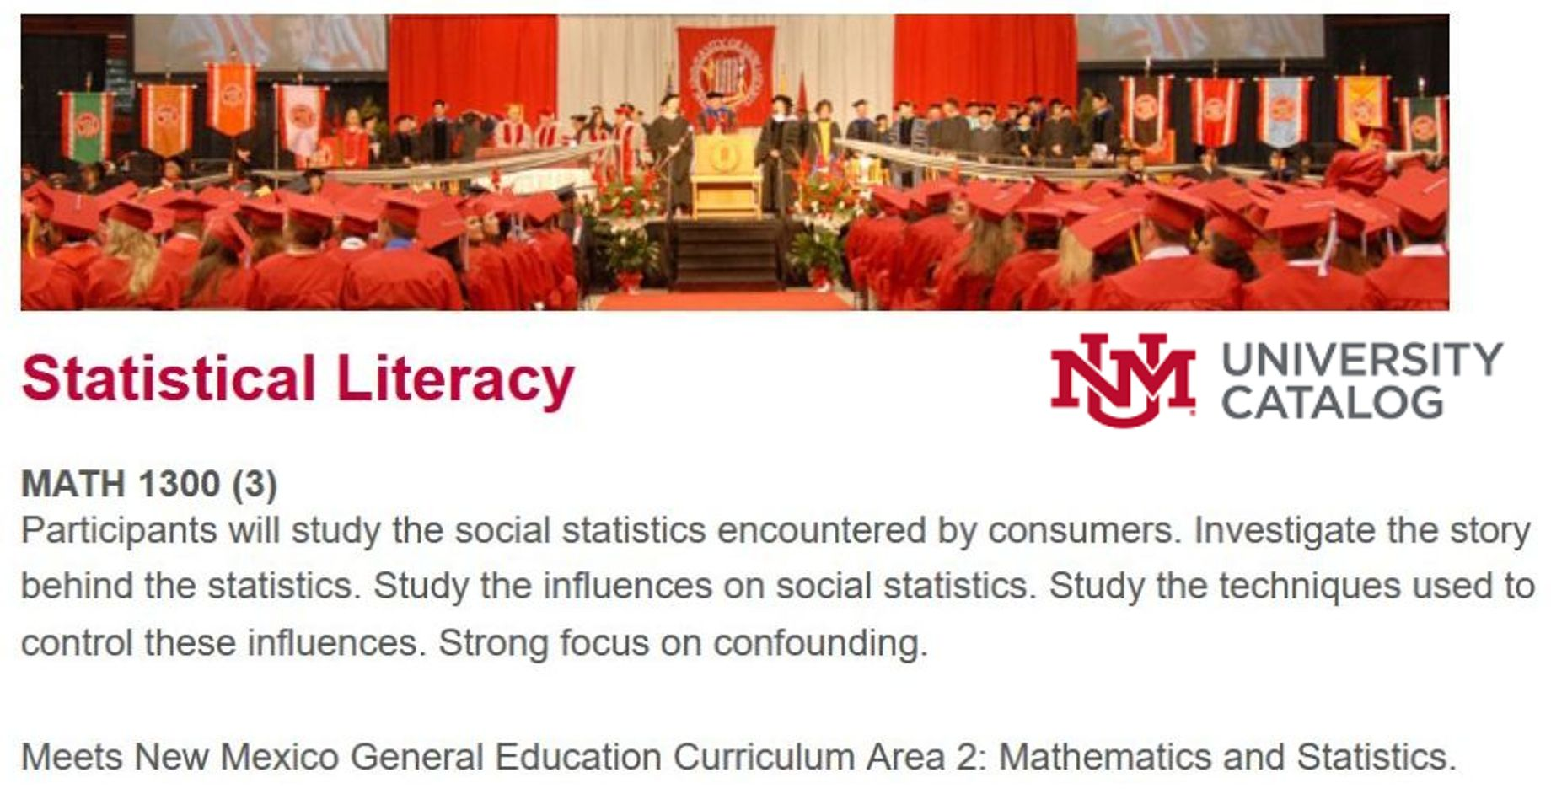
University of New Mexico is offering a new course!
Taught 4 sections in fall 2021
Notes:
StatLit for Managers
2013
2013Schield-MBAA
3
Analyzing Numbers in the News
15 May 2008
2008SchieldNNN6up.pdf
3
3

Slide 4
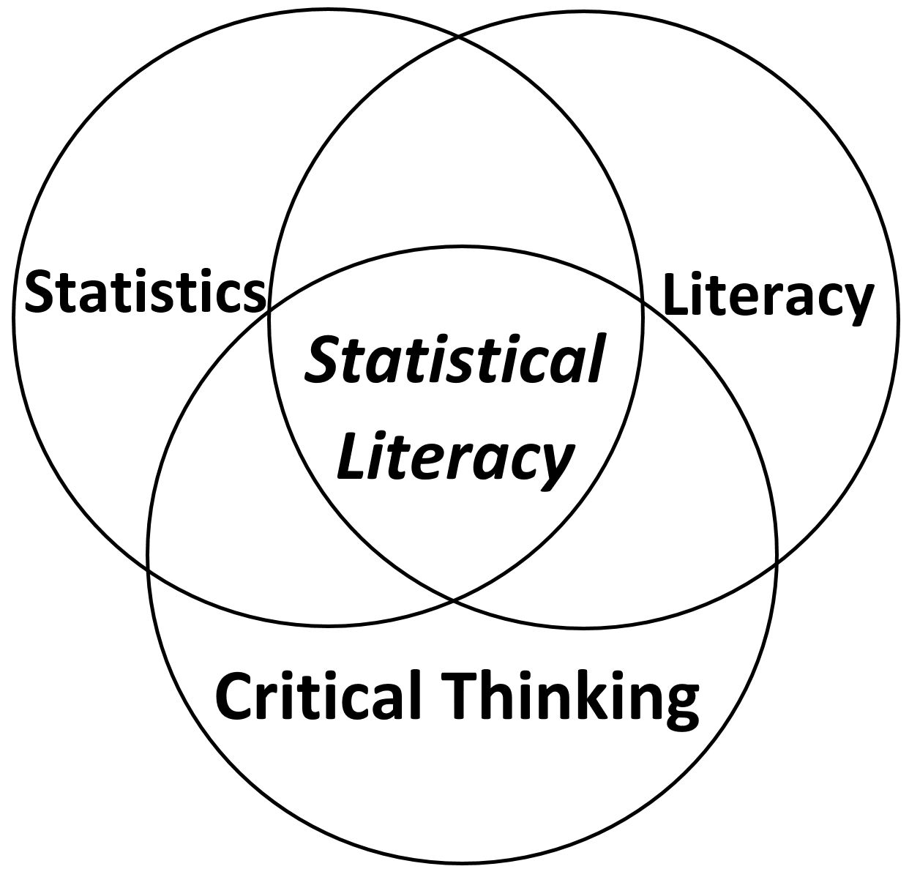
Math1300: Statistical Literacy
Less than 30% overlap with traditional statistics
Notes:
StatLit for Managers
2013
2013Schield-MBAA
4
Analyzing Numbers in the News
15 May 2008
2008SchieldNNN6up.pdf
4
4

Slide 5
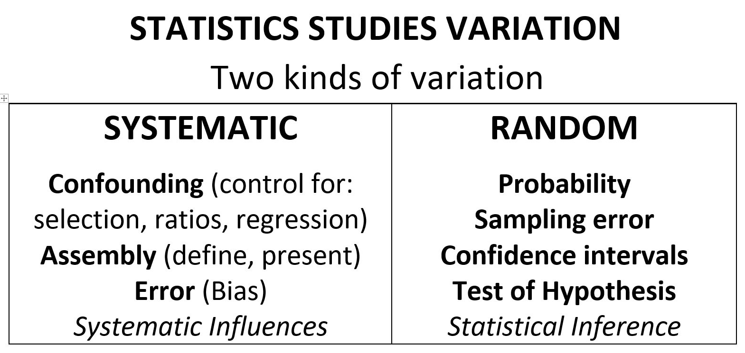
Math1300: Statistical Literacy
Notes:
StatLit for Managers
2013
2013Schield-MBAA
5
Analyzing Numbers in the News
15 May 2008
2008SchieldNNN6up.pdf
5
5

Slide 6
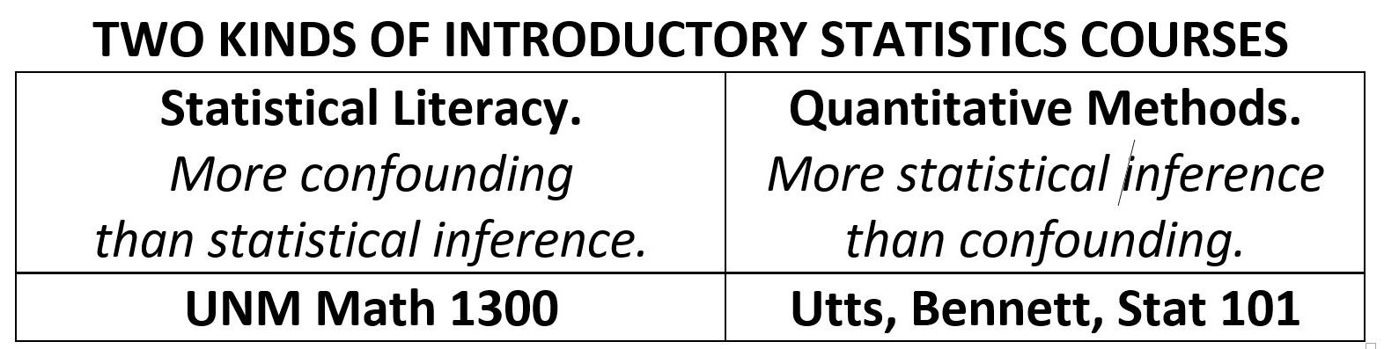
Math1300: Statistical Literacy
By what standard is the content selected?
Notes:
StatLit for Managers
2013
2013Schield-MBAA
6
Analyzing Numbers in the News
15 May 2008
2008SchieldNNN6up.pdf
6
6

Slide 7
Math1300: Statistical Literacy
Statistical literacy is designed for the consumers of statistics: students, citizens, and decision makers.
Students in non-quantitative majors.
But this statement of audience is still ambiguous.
Who decides what the content will be?
Statisticians: GAISE 2016 update?
The statistics in research articles?
The statistics in the everyday media?
Notes:
StatLit for Managers
2013
2013Schield-MBAA
7
Analyzing Numbers in the News
15 May 2008
2008SchieldNNN6up.pdf
7
7

Slide 8
Math1300: Statistical Literacy
Statistics in the everyday Media
  Resear
This is what these students “NEED”.
Statistical content analysis:
hundreds of news stories containing statistics
46,000 articles in the Harvard Business Review
4.5 billion words in UK Cobuild corpus
1 billion words BYU corpus (COCA)
Notes:
StatLit for Managers
2013
2013Schield-MBAA
8
Analyzing Numbers in the News
15 May 2008
2008SchieldNNN6up.pdf
8
8

Slide 9
Statistical Literacy:
Social Statistics
9
Statistics are different from numbers
Statistics are numbers in context (in reality)
Statistics can be influenced by reality:
  In arithmetic, 1 plus 1 is always 2.
  In reality math:
  1 bunny plus 1 bunny can give three bunnies
  1 ice-cube plus 1 ice-cube can give zero ice-cubes
Notes:
Model Trendline Linear 2Y1X using Excel 2013
11/24/2013 V0a
www.StatLit.org/pdf/Model-Trendline-Linear-2Y1X-Excel2013-6up.pdf
9
Analyzing Numbers in the News
15 May 2008
2008SchieldNNN6up.pdf
9
9

Slide 10
Statistics are
Socially Constructed
Joel Best, author of “Lies, Damned Lies and Statistics” identified this as fact as the most important, the most fundamental aspect of all reality-based statistics.
He didn’t mean all of reality was a mental construct.
He meant that statistics, just like words, are created by people: people with motives, values and goals.
Each statistic embodies a particular view of reality.
Notes:
StatLit for Managers
2013
2013Schield-MBAA
10
Analyzing Numbers in the News
15 May 2008
2008SchieldNNN6up.pdf
10
10

Slide 11
Statistics can Be Influenced
Q. Best advice when dealing with statistics?
“Take CARE”. Statistics can be influenced.
All influences are grouped into four categories:
C: Confounding
A: Assembly (how things are defined, counted, etc.)
R: Randomness
E: Error (including bias)
Notes:
StatLit for Managers
2013
2013Schield-MBAA
11
Analyzing Numbers in the News
15 May 2008
2008SchieldNNN6up.pdf
11
11

Slide 12
Admonition: “Take CARE”
Students like “CARE”. It gives them a structure.
Without a unifying structure, statistical literacy is just a collection of disparate influences.
Everything they learn about influences fits.
When asked to rank what they considered most valuable, they chose “CARE”.
If they remember just one thing from the course, it should be “Take CARE”.
Notes:
StatLit for Managers
2013
2013Schield-MBAA
12
Analyzing Numbers in the News
15 May 2008
2008SchieldNNN6up.pdf
12
12

Slide 13
Seven Student Failures:
Failure to recognize that…
Association is not causation
Statistics can be manipulated
Statistics can be confounded: Simpson’s paradox
Bigger data, the more likely an unlikely statistic
Ratio statistics are ordered: confusion of the inverse
Spotty statistics are modeled
Statistical significance can be influenced
Notes:
StatLit for Managers
2013
2013Schield-MBAA
13
Analyzing Numbers in the News
15 May 2008
2008SchieldNNN6up.pdf
13
13

Slide 14
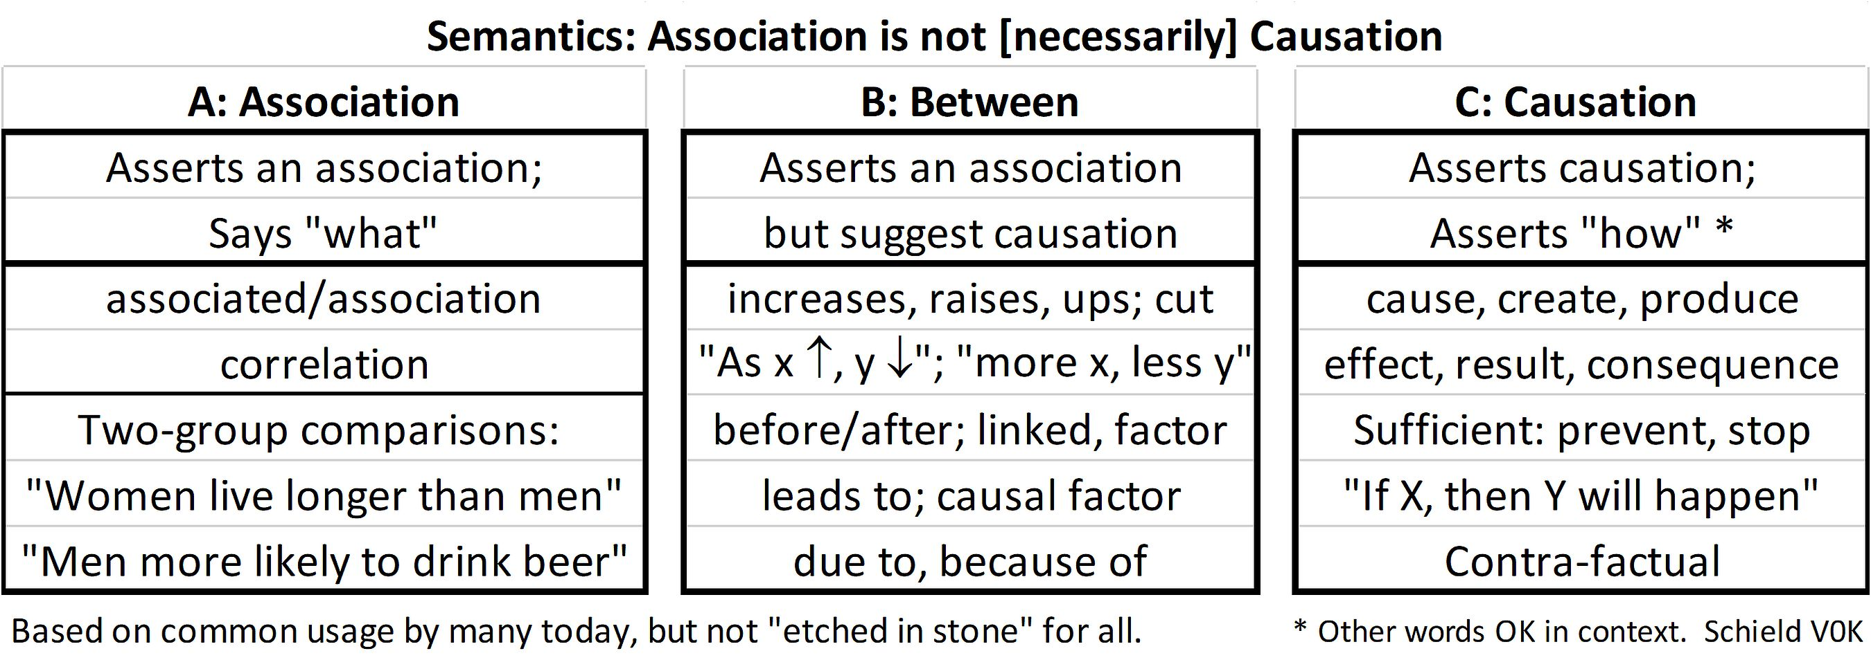
Association is Not Causation
Failure #1
Notes:
StatLit for Managers
2013
2013Schield-MBAA
14
Analyzing Numbers in the News
15 May 2008
2008SchieldNNN6up.pdf
14
14

Slide 15
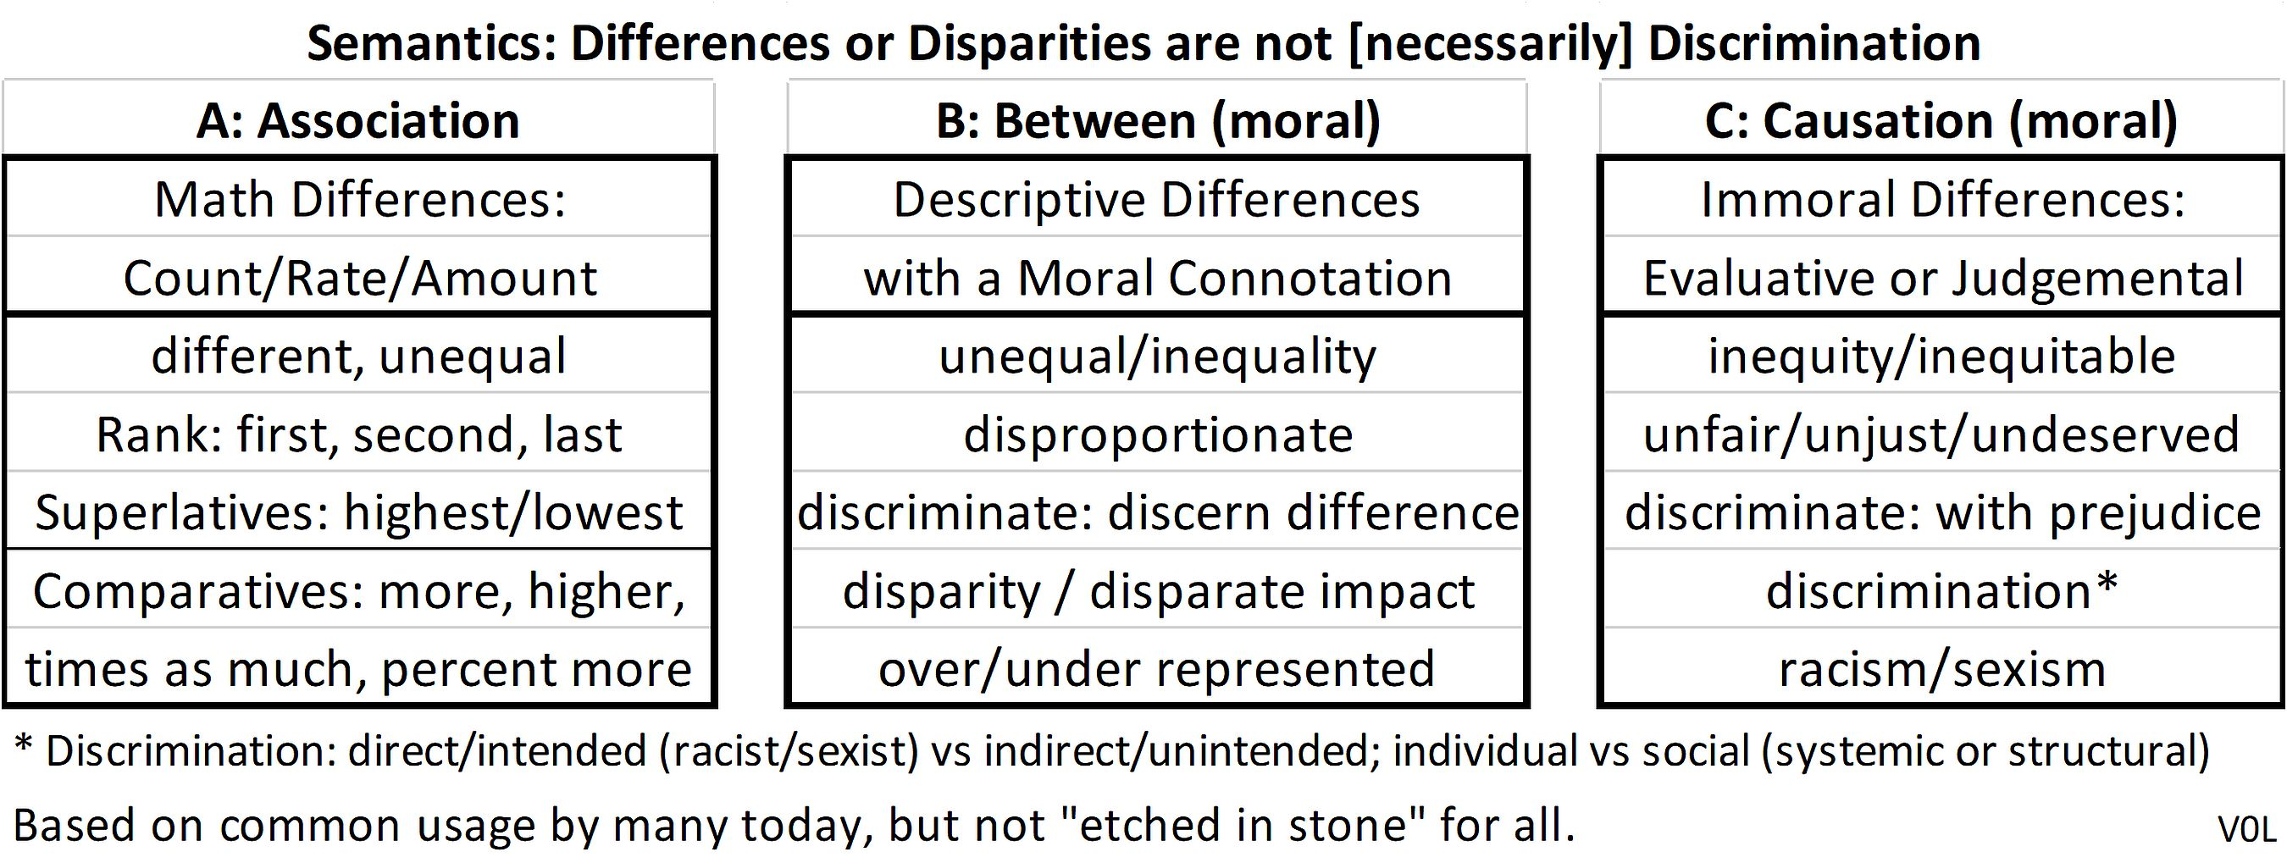
Disparity is Not Discrimination
Failure #1
Notes:
StatLit for Managers
2013
2013Schield-MBAA
15
Analyzing Numbers in the News
15 May 2008
2008SchieldNNN6up.pdf
15
15

Slide 16
Seven Student Failures:
Failure to recognize that…
Association is not causation (eg., disparity…)
Statistics can be manipulated
Statistics can be confounded: Simpson’s paradox
Bigger data, the more likely an unlikely statistic
Ratio statistics are ordered: confusion of the inverse
Spotty statistics are modeled
Statistical significance can be influenced
Notes:
StatLit for Managers
2013
2013Schield-MBAA
16
Analyzing Numbers in the News
15 May 2008
2008SchieldNNN6up.pdf
16
16

Slide 17
Statistics can be Manipulated
Assembly/Assumptions
Failure #2
The number of children killed by gunfire has doubled each year since 1950;
The number of children killed by gunfire each year has doubled since 1950
30% of middle school students are bullied.
Define bullying. Increase or decrease the percentage
Notes:
StatLit for Managers
2013
2013Schield-MBAA
17
Analyzing Numbers in the News
15 May 2008
2008SchieldNNN6up.pdf
17
17

Slide 18
Seven Student Failures:
Failure to recognize that…
Association is not causation
Statistics can be manipulated
Statistics can be confounded: Simpson’s paradox
Bigger data, the more likely an unlikely statistic
Ratio statistics are ordered: confusion of the inverse
Spotty statistics are modeled
Statistical significance can be influenced
Notes:
StatLit for Managers
2013
2013Schield-MBAA
18
Analyzing Numbers in the News
15 May 2008
2008SchieldNNN6up.pdf
18
18

Slide 19
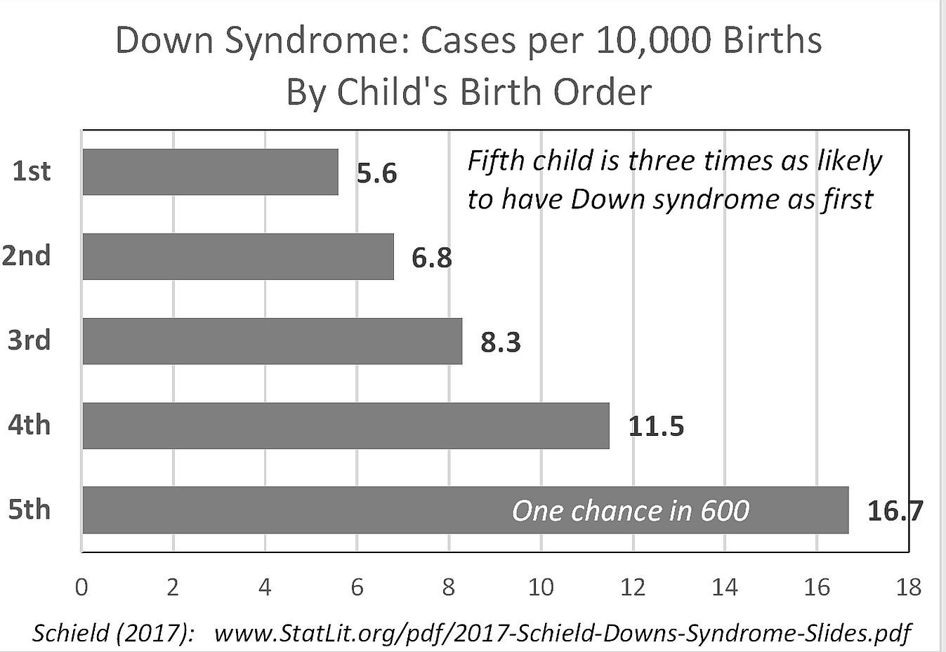
Statistics can be Confounded
Downs Syndrome
Failure #3
.
Notes:
StatLit for Managers
2013
2013Schield-MBAA
19
Analyzing Numbers in the News
15 May 2008
2008SchieldNNN6up.pdf
19
19

Slide 20
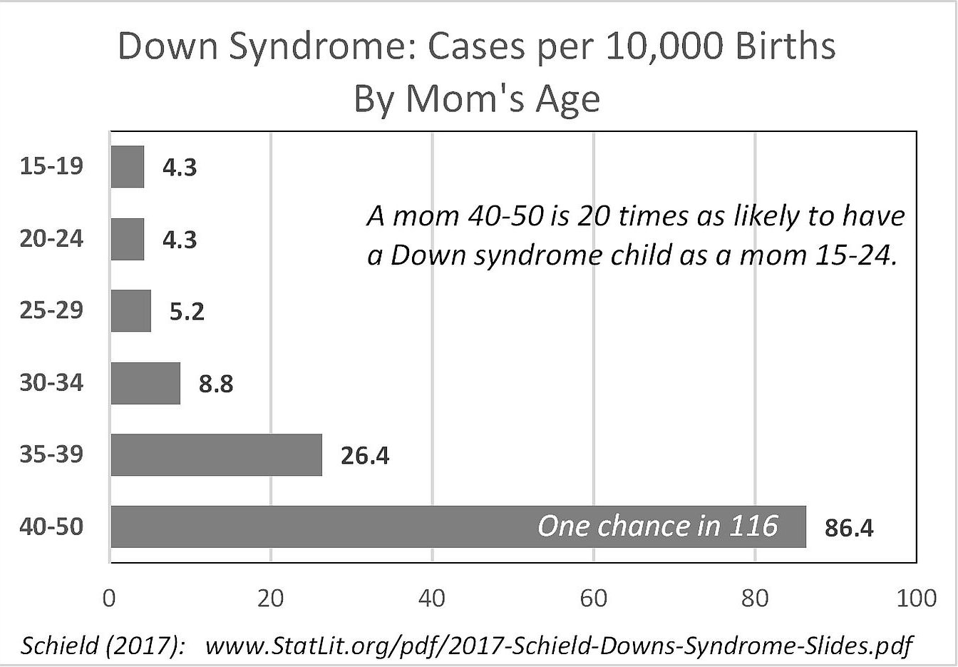
Statistics can be Confounded
Down Syndrome
Failure #3
.
Notes:
StatLit for Managers
2013
2013Schield-MBAA
20
Analyzing Numbers in the News
15 May 2008
2008SchieldNNN6up.pdf
20
20

Slide 21
Statistics can be Confounded
Vaccinated: More Likely to Die
Failure #3
In the UK, vaccinated cases are 2.4 times as likely to die from Covid as [are] the unvaccinated cases.
National Health Service. 268,169 cases.
A crude comparison (mixed fruit comparison).
What could confound this association?
Age!
Notes:
StatLit for Managers
2013
2013Schield-MBAA
21
Analyzing Numbers in the News
15 May 2008
2008SchieldNNN6up.pdf
21
21

Slide 22
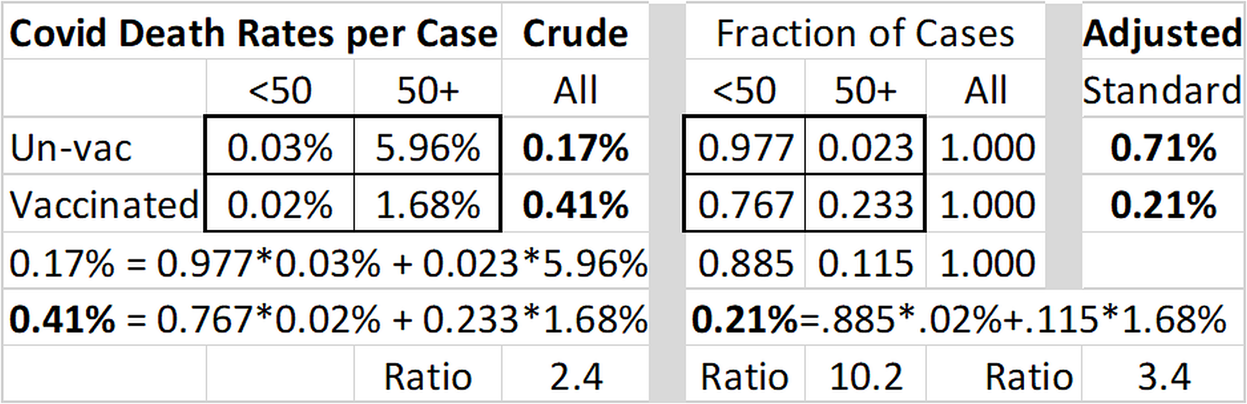
Statistics can be Confounded
Vaccinated: More Likely to Die
Failure #3
UK 260,000 cases May-Sept 2021
After standardizing, unvaccinated are
more likely to die than [are] the vaccinated.
Notes:
StatLit for Managers
2013
2013Schield-MBAA
22
Analyzing Numbers in the News
15 May 2008
2008SchieldNNN6up.pdf
22
22

Slide 23
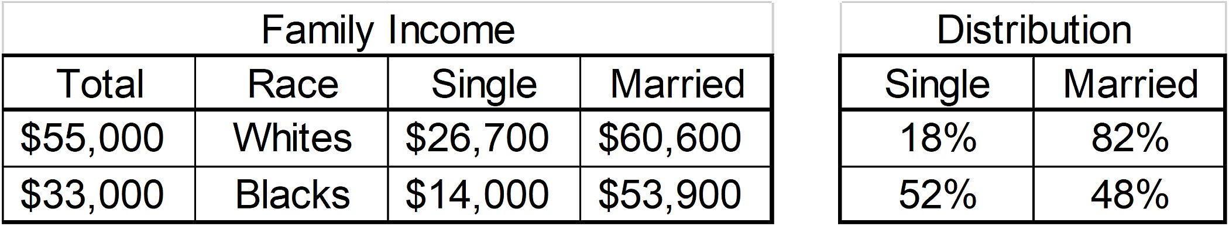
Black-White Income Gap
22K Income Disparity
Failure #3
.
Notes:
StatLit for Managers
2013
2013Schield-MBAA
23
Analyzing Numbers in the News
15 May 2008
2008SchieldNNN6up.pdf
23
23

Slide 24
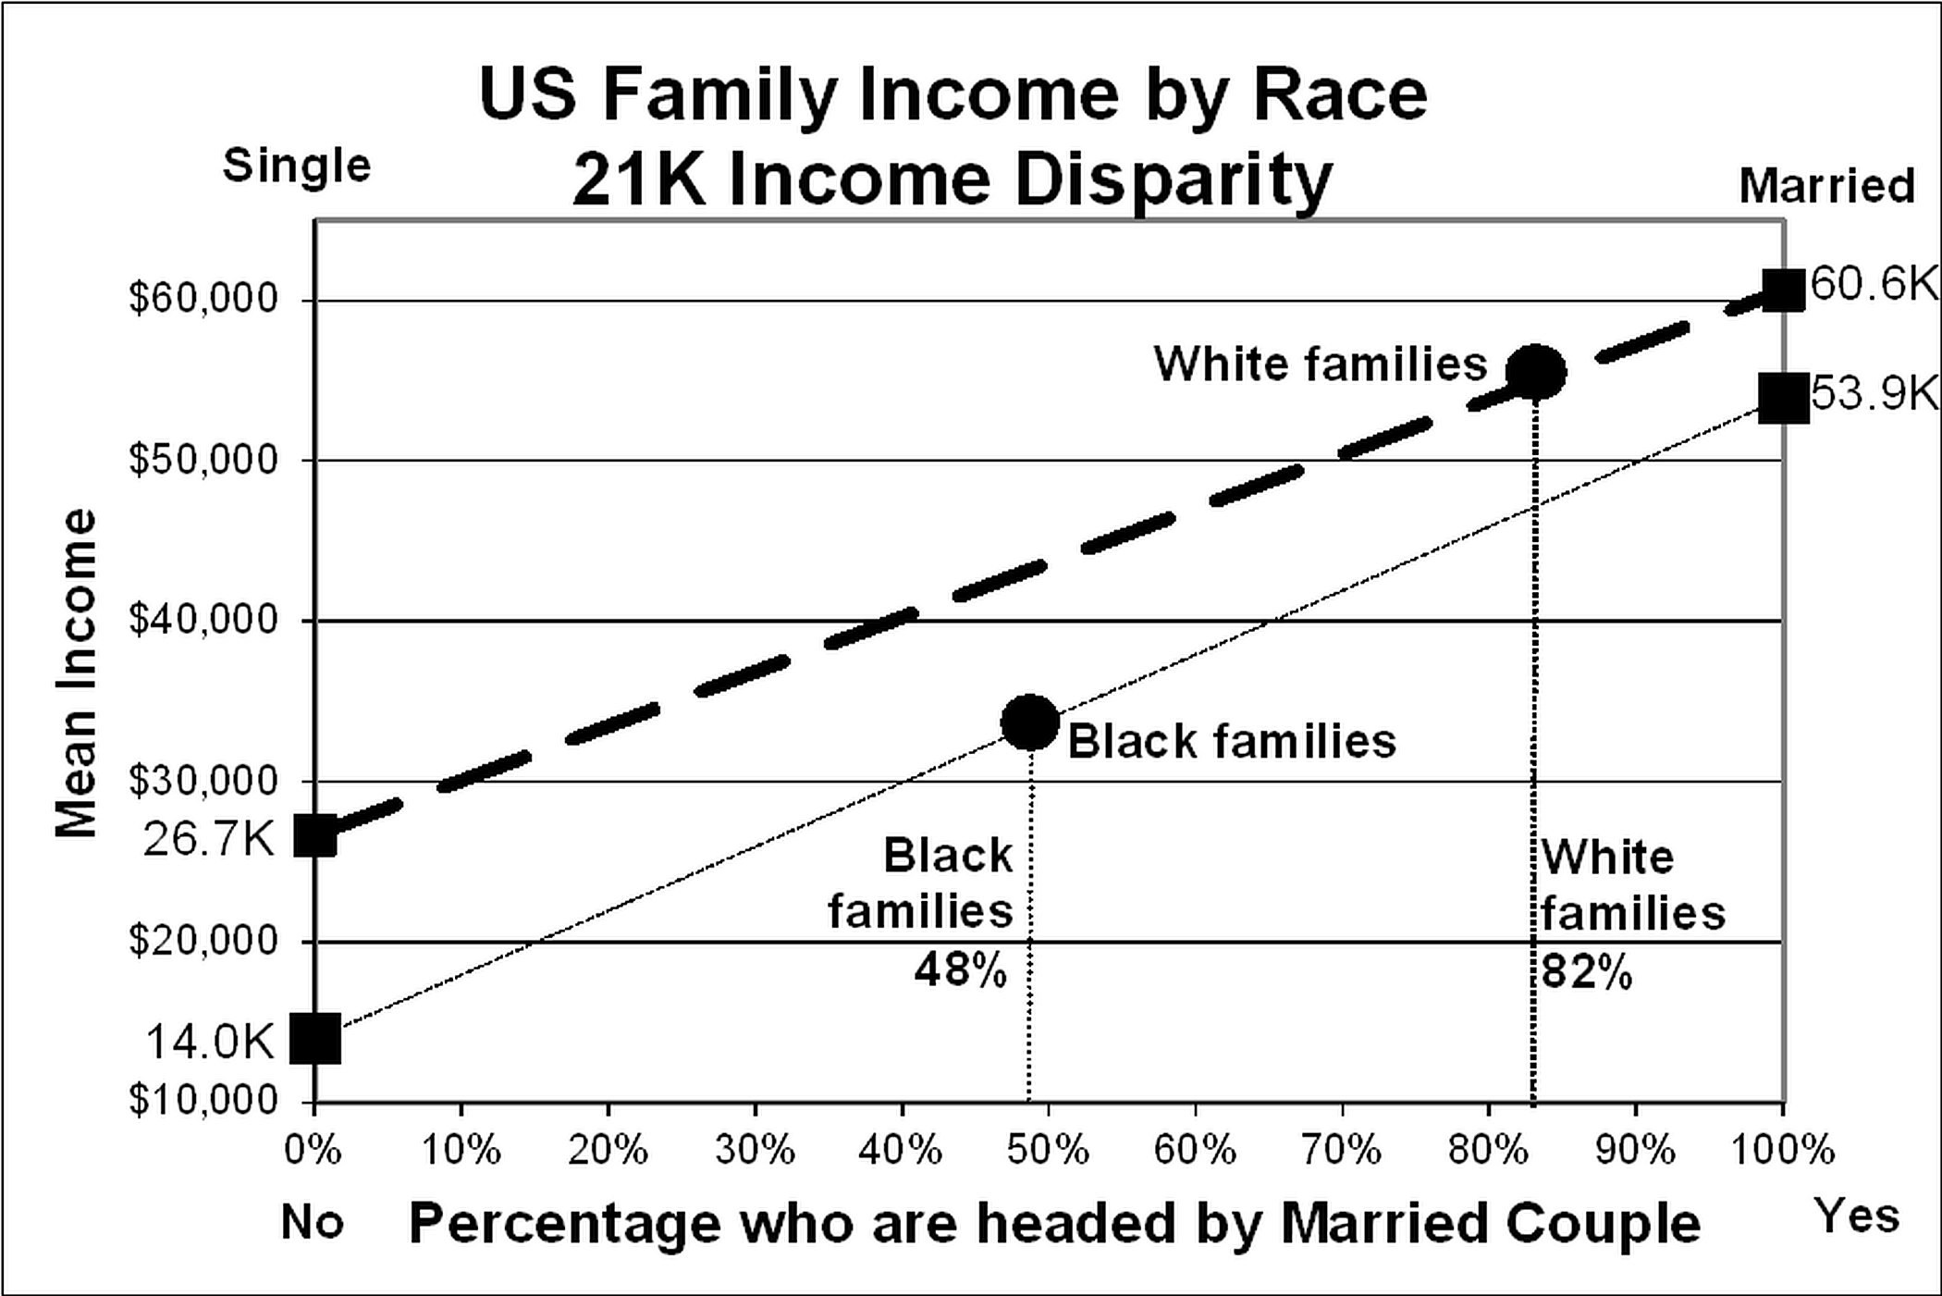
Standardization Graphically:
21K Income Disparity
Failure #3
.
Notes:
StatLit for Managers
2013
2013Schield-MBAA
24
Analyzing Numbers in the News
15 May 2008
2008SchieldNNN6up.pdf
24
24

Slide 25
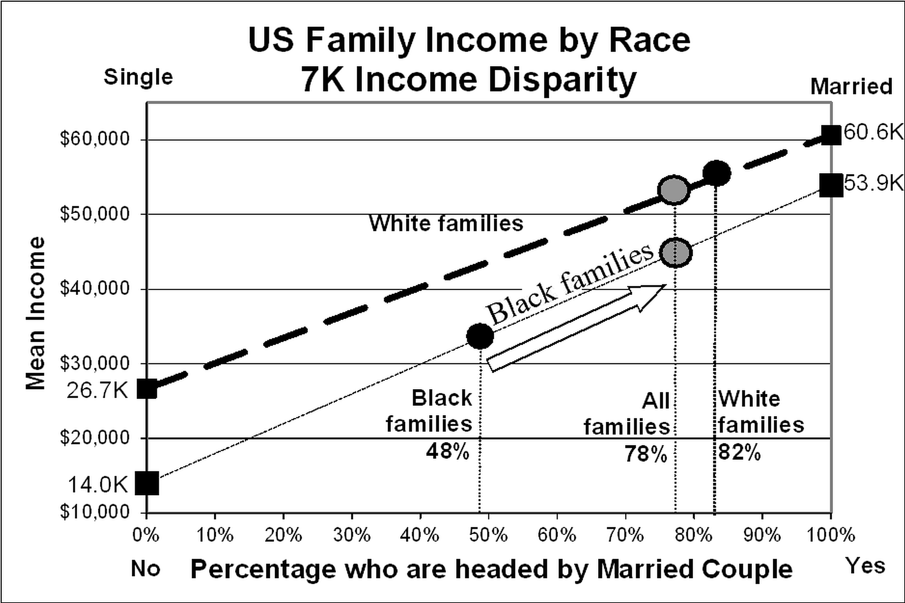
Standardization Graphically:
7K Income Disparity
Failure #3
.
Notes:
StatLit for Managers
2013
2013Schield-MBAA
25
Analyzing Numbers in the News
15 May 2008
2008SchieldNNN6up.pdf
25
25

Slide 26
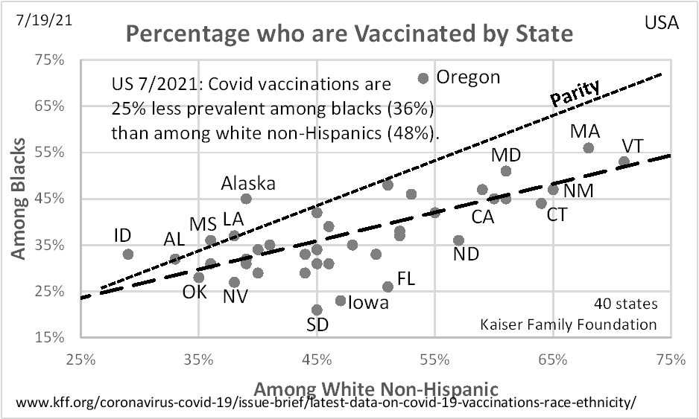
Blacks less likely to be Vaccinated than White NH
Failure #3
.
Notes:
StatLit for Managers
2013
2013Schield-MBAA
26
Analyzing Numbers in the News
15 May 2008
2008SchieldNNN6up.pdf
26
26

Slide 27
Students Need Practice with Confounding
Failure #3
Understand how a crude association can be a:
Mixed fruit comparison
An apples and oranges comparison.
Students need to really understand what it means:
To take something into account
To control for something.
To standardize an association:
To give both groups the same mix!
Notes:
StatLit for Managers
2013
2013Schield-MBAA
27
Analyzing Numbers in the News
15 May 2008
2008SchieldNNN6up.pdf
27
27

Slide 28
Seven Student Failures:
Failure to recognize that…
Association is not causation
Statistics can be manipulated
Statistics can be confounded: Simpson’s paradox
Bigger data, the more likely an unlikely statistic
Ratio statistics are ordered: confusion of the inverse
Spotty statistics are modeled
Statistical significance can be influenced
Notes:
StatLit for Managers
2013
2013Schield-MBAA
28
Analyzing Numbers in the News
15 May 2008
2008SchieldNNN6up.pdf
28
28

Slide 29
Randomness and Big Data
Failure #4
The bigger the data, the more likely a rare event.
The Law of Truly Large Numbers.
Suppose an unlikely event occurs one chance in N.
Given N tries,
one such event is expected, and
at least one such event is more likely than not.
Schield (2009).
Notes:
StatLit for Managers
2013
2013Schield-MBAA
29
Analyzing Numbers in the News
15 May 2008
2008SchieldNNN6up.pdf
29
29

Slide 30
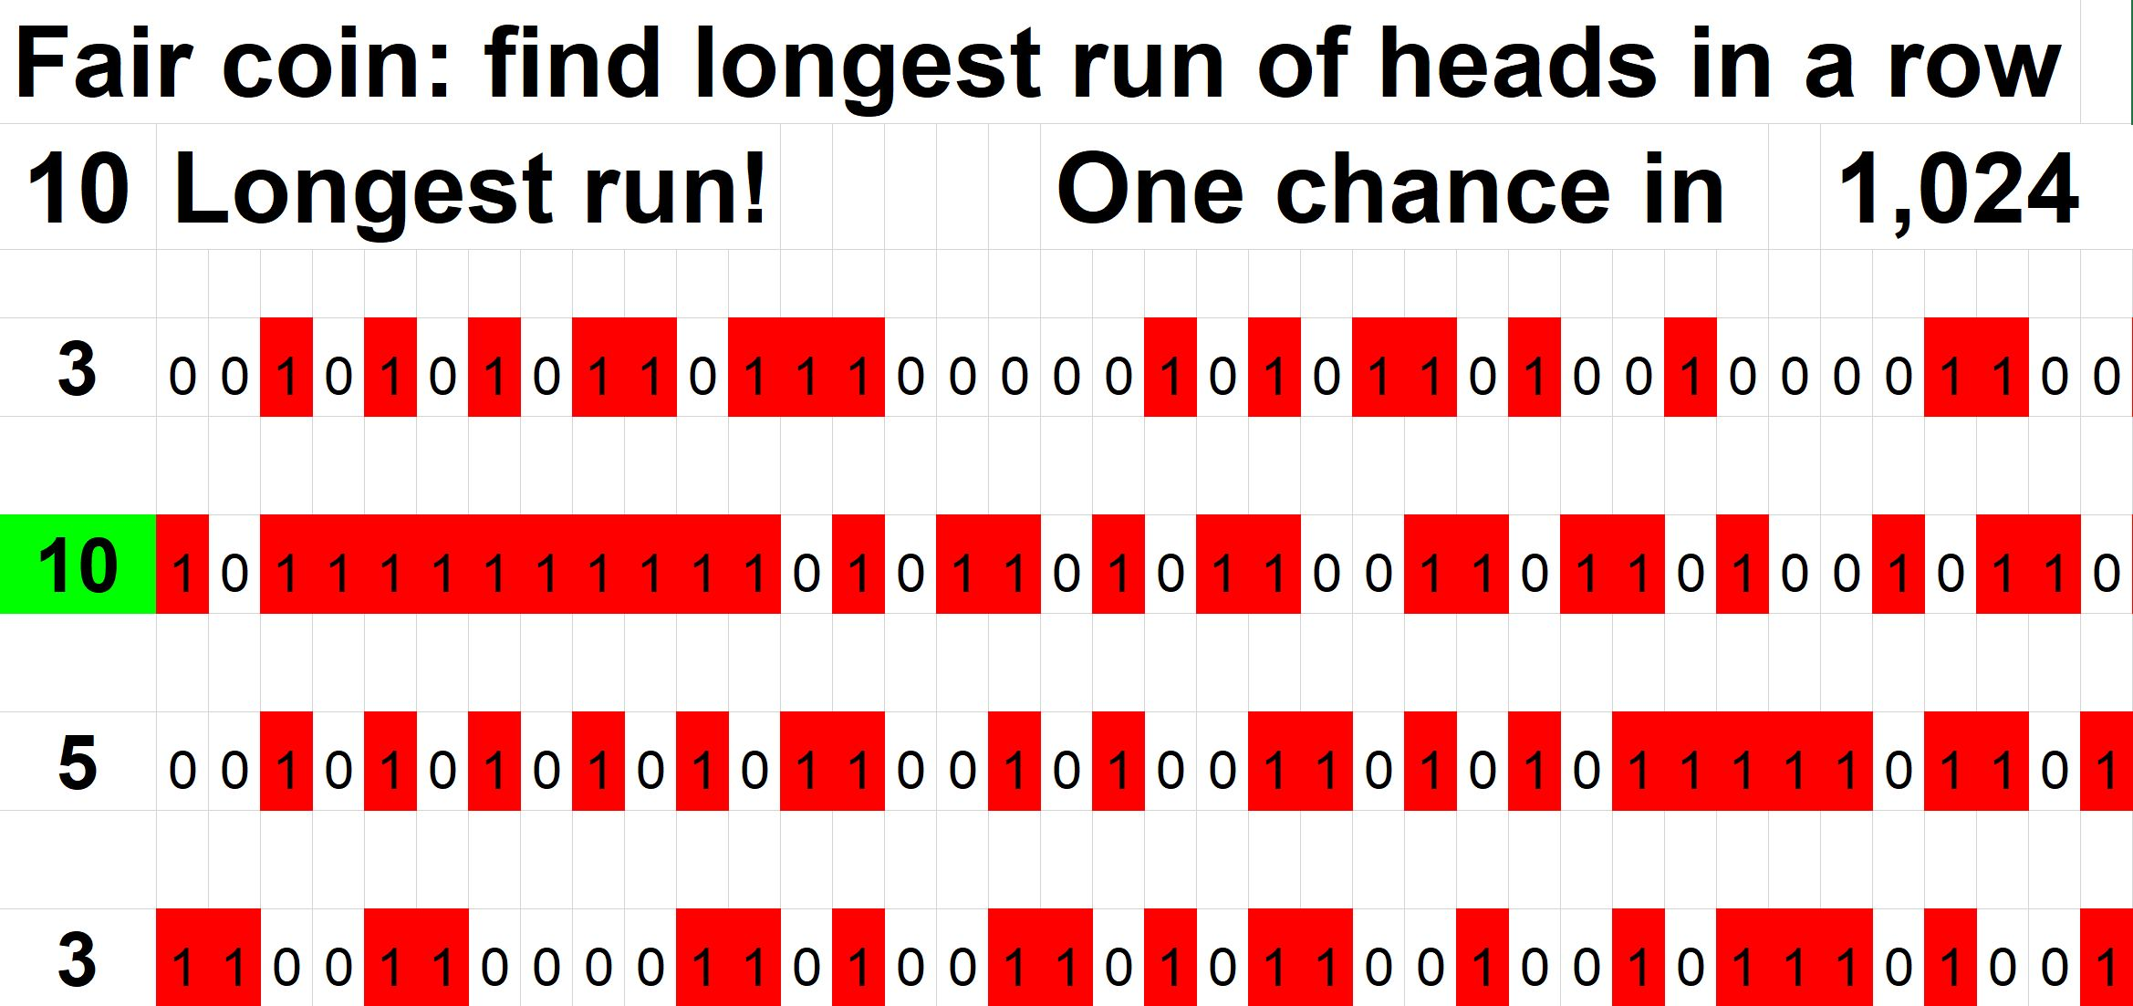
The bigger the data, the more likely an unlikely outcome
Failure #4
.
Notes:
StatLit for Managers
2013
2013Schield-MBAA
30
Analyzing Numbers in the News
15 May 2008
2008SchieldNNN6up.pdf
30
30

Slide 31
Seven Student Failures:
Failure to recognize that…
Association is not causation
Statistics can be manipulated
Statistics can be confounded: Simpson’s paradox
Bigger data, the more likely an unlikely statistic
Ratio statistics are ordered: confusion of the inverse
Spotty statistics are modeled
Statistical significance can be influenced
Notes:
StatLit for Managers
2013
2013Schield-MBAA
31
Analyzing Numbers in the News
15 May 2008
2008SchieldNNN6up.pdf
31
31

Slide 32
Distinguish Numerator and Denominator
Failure #5
The percentage of smokers who are men.
The percentage of men who are smokers.
The percentage of men among smokers.
Confusion of the inverse
Guys are more likely to smoke than gals.
Guys are more likely among smokers than gals.
Notes:
StatLit for Managers
2013
2013Schield-MBAA
32
Analyzing Numbers in the News
15 May 2008
2008SchieldNNN6up.pdf
32
32

Slide 33
Distinguish Percent and Percentage Grammar
Failure #5
If “20% of guys are smokers”,
then 20% is the percentage of guys who smoke.
So if 20% of guys who run are smokers,
then 20% is
the percentage of guys who run who are smokers.
This last phrase is ambiguous!
What is the status of run?
Notes:
StatLit for Managers
2013
2013Schield-MBAA
33
Analyzing Numbers in the News
15 May 2008
2008SchieldNNN6up.pdf
33
33

Slide 34
Seven Student Failures:
Failure to recognize that…
Association is not causation
Statistics can be manipulated
Statistics can be confounded: Simpson’s paradox
Bigger data, the more likely an unlikely statistic
Ratio statistics are ordered: confusion of the inverse
Spotty statistics are modeled
Statistical significance can be influenced
Notes:
StatLit for Managers
2013
2013Schield-MBAA
34
Analyzing Numbers in the News
15 May 2008
2008SchieldNNN6up.pdf
34
34

Slide 35
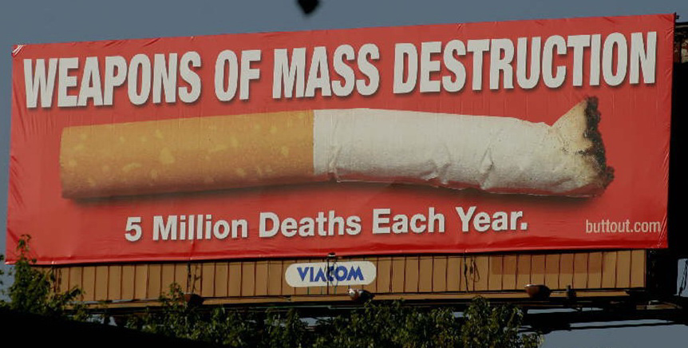
Distinguish Counted Counts from Modeled Counts
Failure #6
.
Notes:
StatLit for Managers
2013
2013Schield-MBAA
35
Analyzing Numbers in the News
15 May 2008
2008SchieldNNN6up.pdf
35
35

Slide 36
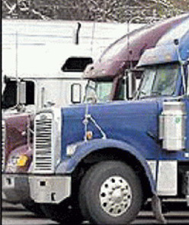
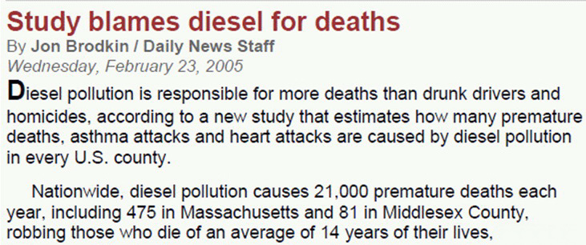
Responsible for …
Failure #6
36
Notes:
Social Construction of Rankings
8/4/2010
www.StatLit.org/pdf/2010SchieldASA6up.pdf
36
2008 StatLit Skills Survey
Fall 2008
2008SchieldSkillsSurvey6up.pdf
36
We have the top and bottom of this pyramid.
The Top: We know where we are headed. We are clear on our goal.
Our common goal is to see quantitative literacy grow.
The bottom: We have the foundation.
The need for quantitative literacy has been documented.
The books by Steen and Madison have documented this very clearly.
So, we have the foundation and we know where we are headed.
-------------------------------------
To support an interdisciplinary area, college-wide support is necessary.
To obtain college-wide support, the subject must have wide faculty support.
And in today’s climate, it must be assessable.
Unless QL is a clearly-stated campus-wide goal,
QL programs are likely to be transient.
Interdisciplinary programs cannot survive in a disciplinary world without strong college support
None of this will not happen unless quantitative literacy is “understandable and teachable.”
That brings us back to the problems mentioned in the previous slide.
Quantitative literacy must be “understandable and teachable.”
Whether QL is understandable and teachable depends critically on the content of QL.
> Let’s focus in on some core content of Quantitative Literacy >

Slide 37
2. Epidemiological statistics are common!
US Annual Deaths Attributable To:
Failure #6
37
Smoking: 467,000 Blood pressure: 395,000
Overweight: 216,000 Inactivity: 191,000
Blood sugar: 190,000 LDL cholesterol: 113,000
Dietary salt: 102,000 Low omega-3 : 84,000
High dietary trans fatty acids: 82,000
Alcohol use: 64,000 (90,000 less 26,000 averted)
Low intake of fruits and vegetables: 58,000
Low poly-unsaturated fatty acids: 15,000
www.emaxhealth.com/2/24/30740/
smoking-high-blood-pressure-obesity-top-preventable-death-causes.html
Notes:
Social Construction of Rankings
8/4/2010
www.StatLit.org/pdf/2010SchieldASA6up.pdf
37
2008 StatLit Skills Survey
Fall 2008
2008SchieldSkillsSurvey6up.pdf
37
We have the top and bottom of this pyramid.
The Top: We know where we are headed. We are clear on our goal.
Our common goal is to see quantitative literacy grow.
The bottom: We have the foundation.
The need for quantitative literacy has been documented.
The books by Steen and Madison have documented this very clearly.
So, we have the foundation and we know where we are headed.
-------------------------------------
To support an interdisciplinary area, college-wide support is necessary.
To obtain college-wide support, the subject must have wide faculty support.
And in today’s climate, it must be assessable.
Unless QL is a clearly-stated campus-wide goal,
QL programs are likely to be transient.
Interdisciplinary programs cannot survive in a disciplinary world without strong college support
None of this will not happen unless quantitative literacy is “understandable and teachable.”
That brings us back to the problems mentioned in the previous slide.
Quantitative literacy must be “understandable and teachable.”
Whether QL is understandable and teachable depends critically on the content of QL.
> Let’s focus in on some core content of Quantitative Literacy >

Slide 38
Distinguish Counted Counts from Modeled Counts
Failure #6
Counted deaths are coroner certified.
Some causal deaths are coroner certified: alcohol.
Modeled deaths are statistical deaths.
Smoking, second-hand smoke, obesity, etc.
These counts are speculative (spotty) statistics.
Schield (2009): Confound those Speculative Statistics
www.StatLit.org/pdf/2009SchieldASA.pdf
Schield (2011): Epidemiological Models and Spotty Statistics
www.StatLit.org/pdf/2011SchieldISI.pdf
Notes:
StatLit for Managers
2013
2013Schield-MBAA
38
Analyzing Numbers in the News
15 May 2008
2008SchieldNNN6up.pdf
38
38

Slide 39
Epidemiological statistics encourage seductive grammar
Failure #6
Consider these titles of news stories:
45,000 deaths attributable to uninsurance
45,000 deaths associated with lack of insurance
Lack of insurance linked to 45,000 deaths
45,000 die … because of lack of health insurance
Lack of Health Insurance Kills 45,000 a Year
Lack of Health Insurance cause 44789 deaths
Lack of insurance to blame for almost 45,000 deaths
Source: www.StatLit.org/pdf/2010SchieldICOTS.pdf
Notes:
Social Construction of Rankings
8/4/2010
www.StatLit.org/pdf/2010SchieldASA6up.pdf
39
2008 StatLit Skills Survey
Fall 2008
2008SchieldSkillsSurvey6up.pdf
39

Slide 40
Seven Student Failures:
Failure to recognize that…
Association is not causation
Statistics can be manipulated
Statistics can be confounded: Simpson’s paradox
Bigger data, the more likely an unlikely statistic
Ratio statistics are ordered: confusion of the inverse
Spotty statistics are modeled
Statistical significance can be influenced
Notes:
StatLit for Managers
2013
2013Schield-MBAA
40
Analyzing Numbers in the News
15 May 2008
2008SchieldNNN6up.pdf
40
40

Slide 41
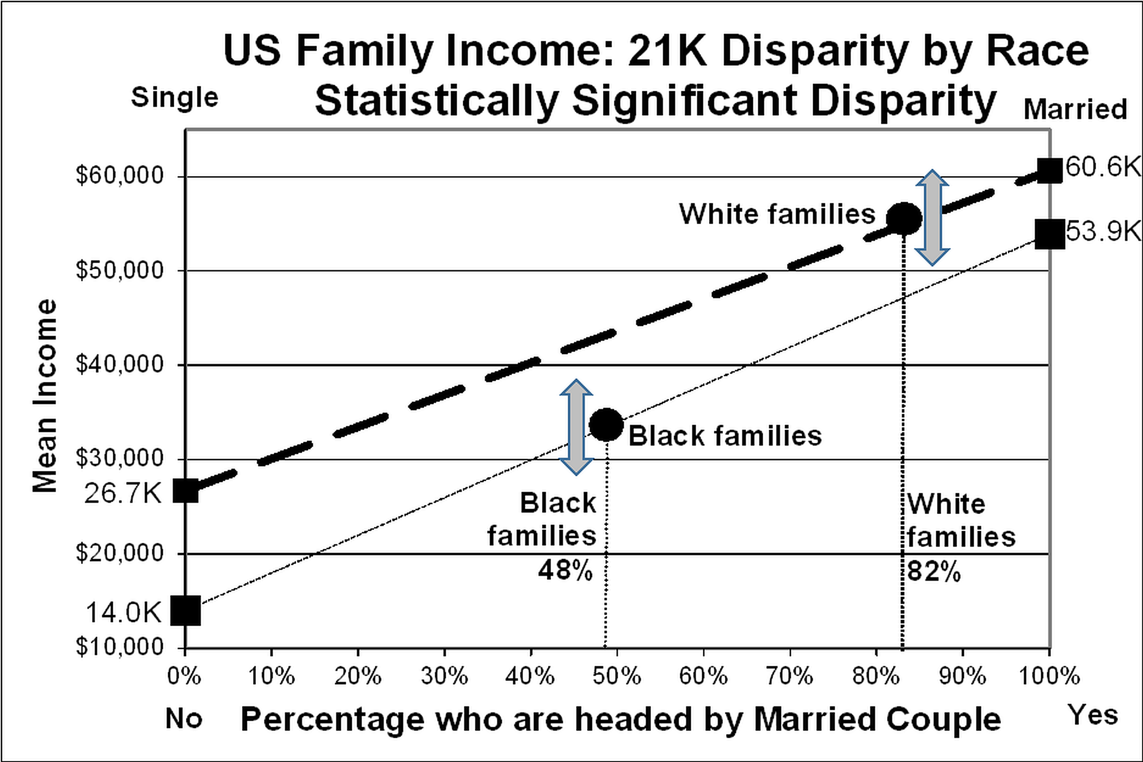
Statistical significance:
Influenced by Confounding
Failure #7
.
Notes:
StatLit for Managers
2013
2013Schield-MBAA
41
Analyzing Numbers in the News
15 May 2008
2008SchieldNNN6up.pdf
41
41

Slide 42
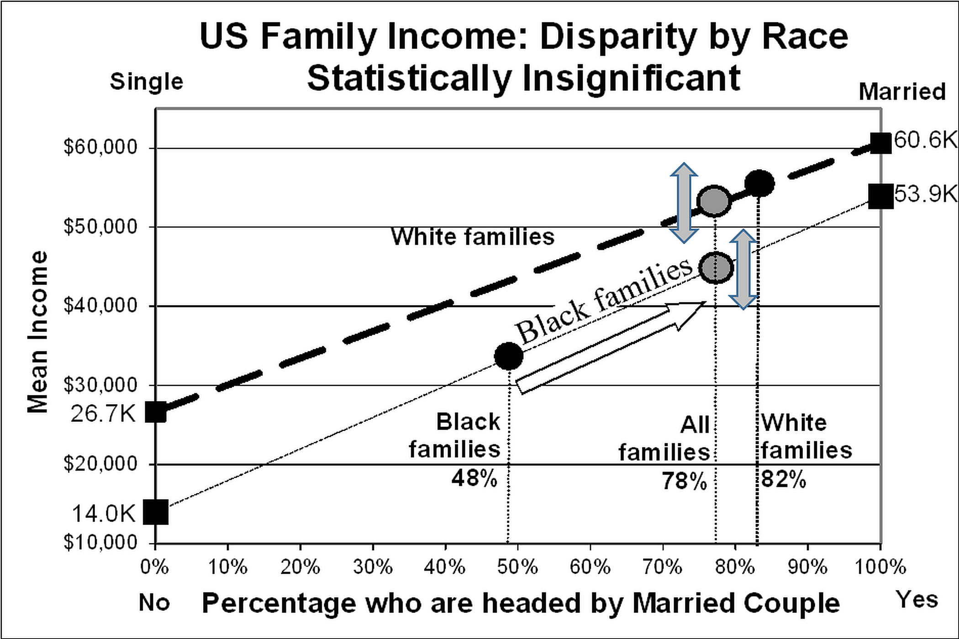
Statistical Insignificance:
Influenced by Confounding
Failure #7
.
Notes:
StatLit for Managers
2013
2013Schield-MBAA
42
Analyzing Numbers in the News
15 May 2008
2008SchieldNNN6up.pdf
42
42

Slide 43
Result:
Students should:
Know that statistics can be influenced.
Understand “control for” and “take into account.”
Know that standardizing converts a mixed fruit comparison into an apples and apples comparison.
Recognize the possibility of a Simpson’s paradox.
Notes:
StatLit for Managers
2013
2013Schield-MBAA
43
Analyzing Numbers in the News
15 May 2008
2008SchieldNNN6up.pdf
43
43

Slide 44
Math1300 Highlights
Asserts that Association is Not Causation
Asserts that Disparity is Not Discrimination
Focus on The Story Behind the Statistics
Shows how a crude association (mixed fruit comparison) may conceal the real story!
Shows students how to control for confounders
Shows students these things without computers
Notes:
StatLit for Managers
2013
2013Schield-MBAA
44
Analyzing Numbers in the News
15 May 2008
2008SchieldNNN6up.pdf
44
44

Slide 45
Anonymous Student Survey
45
Before finals, students are asked three questions.
Did this course improve your critical thinking?
Would you recommend this course to a friend?
Should all students be required to take this course?
When I teach traditional statistics I get ‘Yes’ (Agree or Strongly agree) from 15% to 25% of the students.
When I teach Statistical Literacy to art, music and management majors, I get ‘Yes’ from at least 50%.
Notes:
Model Trendline Linear 2Y1X using Excel 2013
11/24/2013 V0a
www.StatLit.org/pdf/Model-Trendline-Linear-2Y1X-Excel2013-6up.pdf
45
Analyzing Numbers in the News
15 May 2008
2008SchieldNNN6up.pdf
45
45

Slide 46
Anonymous Student Comments (Fall 2021)
46
I like the content and critical thinking aspect of the class. As someone who had to drop the regular stats class, I was very happy to have this class as an option.
This course is an answer to my prayers, I am a music major and horrible at math so fulfilling my math requirement has been hard. This is the first math class I actually liked. … the material is about things I can apply to everyday life. …I would recommend this class for anyone.
Notes:
Model Trendline Linear 2Y1X using Excel 2013
11/24/2013 V0a
www.StatLit.org/pdf/Model-Trendline-Linear-2Y1X-Excel2013-6up.pdf
46
Analyzing Numbers in the News
15 May 2008
2008SchieldNNN6up.pdf
46
46

Slide 47
Study Confounder-Based Statistical Literacy
Statistical Literacy: What Students Like about the Course
www.statlit.org/pdf/2021-Fall-UNM-MATH1300-S1.pdf
Statistical Literacy: The Diabolical Denominator
www.StatLit.org/pdf/2021-Schield-MathFest.pdf
Statistical Literacy: Teaching Confounding
www.StatLit.org/pdf/2021-Schield-USCOTS.pdf
University of New Mexico Offers Math 1300
www.StatLit.org/pdf/2021-Schield-ASA.pdf
Schield’s papers: www.StatLit.org/Schield-Pubs.htm
Notes:
StatLit for Managers
2013
2013Schield-MBAA
47
Analyzing Numbers in the News
15 May 2008
2008SchieldNNN6up.pdf
47
47

