Slide 1
Statistical Literacy Textbook:
Chapter 4 Slides
Statistical Literacy:
Critical Thinking about Everyday Statistics
Kendall-Hunt 2023
Milo Schield
ASA Fellow
Adjunct: University of New Mexico
Visiting Professor: New College of Florida
www.StatLit.org/pdf/
2023-Schield-StatLit-Ch4-Slides.pdf
Notes:
Model Trendline Linear 2Y1X using Excel 2013
11/24/2013 V0a
www.StatLit.org/pdf/Model-Trendline-Linear-2Y1X-Excel2013-6up.pdf
1
Analyzing Numbers in the News
15 May 2008
2008SchieldNNN6up.pdf
1
1

Slide 2
Describe Ratios: Percent & Percentage
Chapter 4: Table of Contents
4.0, P 177
2
4.1 p 177 Learning Outcomes
4.2 p 178 Review
4.3 p 178 Part-Whole Ratios
4.4 p 182 Percent Grammar Statements
4.5 p 193 Percentage Grammar Statements
4.6 p 199 Count Tables (Percent or Percentage)
4.7 p 200 Distribution Grammar: Discrete Data
4.8 p 201 Half-Tables of Percentages
4.9 p 210 Chapter Summary
4.10 p 211 Advanced/Optional
Notes:
Model Trendline Linear 2Y1X using Excel 2013
11/24/2013 V0a
www.StatLit.org/pdf/Model-Trendline-Linear-2Y1X-Excel2013-6up.pdf
2
Analyzing Numbers in the News
15 May 2008
2008SchieldNNN6up.pdf
2
2

Slide 3
Understanding Measurements:
Learning Outcomes
4.1, P 177
3
Identify part and whole in statements and questions
Learn percent and percentage named-ratio grammars
Describe percentages using percent & percentage grammar
Translate part-whole statements between grammars
Describe percentage in 100% tables and half-tables
Describe percentages in tables with missing margins
Recognize a wrong-order error: confusion of the inverse
Notes:
Model Trendline Linear 2Y1X using Excel 2013
11/24/2013 V0a
www.StatLit.org/pdf/Model-Trendline-Linear-2Y1X-Excel2013-6up.pdf
3
Analyzing Numbers in the News
15 May 2008
2008SchieldNNN6up.pdf
3
3

Slide 4
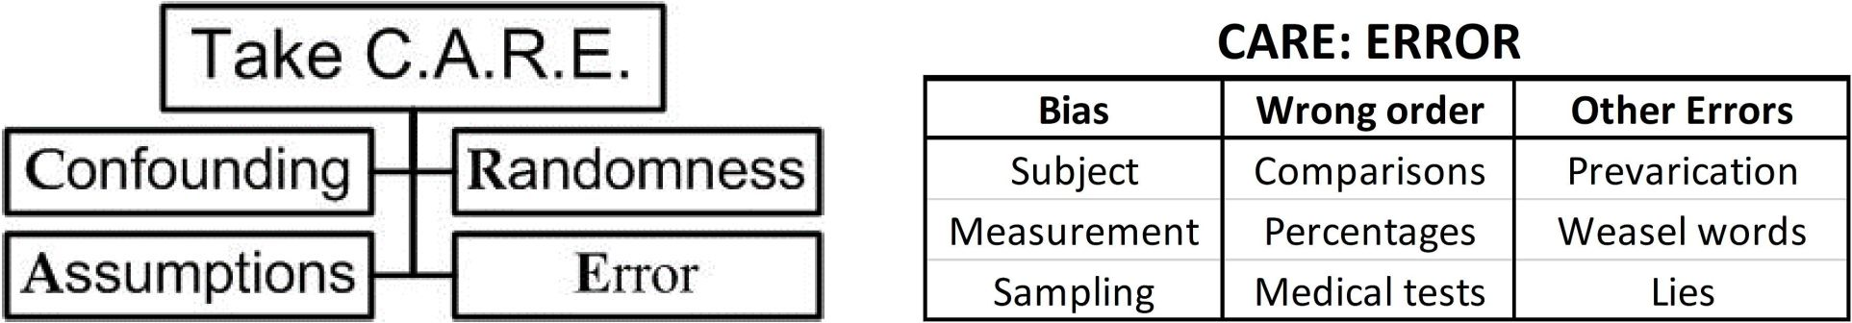
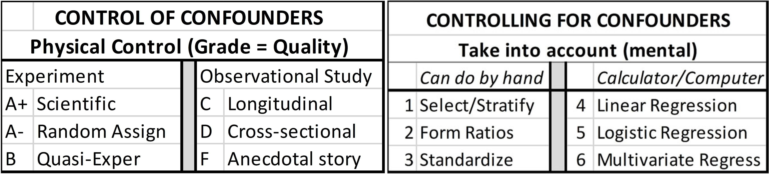
Review
Chapter 1 (CARE); Chapter 2 (control for)
4.2, P 178
4
Percent & percentage grammar
Notes:
Model Trendline Linear 2Y1X using Excel 2013
11/24/2013 V0a
www.StatLit.org/pdf/Model-Trendline-Linear-2Y1X-Excel2013-6up.pdf
4
Analyzing Numbers in the News
15 May 2008
2008SchieldNNN6up.pdf
4
4

Slide 5
Part-Whole Ratios
Named Ratio Grammars
4.3, P 179
5
Ratios take into account the size of the group.
Part-whole (P/W) ratios involve a part of a whole
Four P/W grammars: percent, percentage, rate & chance
Of: introduces the whole in percent grammar
“10% of adult women are smokers.
25% of adults smoke
40% of adult smokers are women.”
Details matter!
Notes:
Model Trendline Linear 2Y1X using Excel 2013
11/24/2013 V0a
www.StatLit.org/pdf/Model-Trendline-Linear-2Y1X-Excel2013-6up.pdf
5
Analyzing Numbers in the News
15 May 2008
2008SchieldNNN6up.pdf
5
5

Slide 6
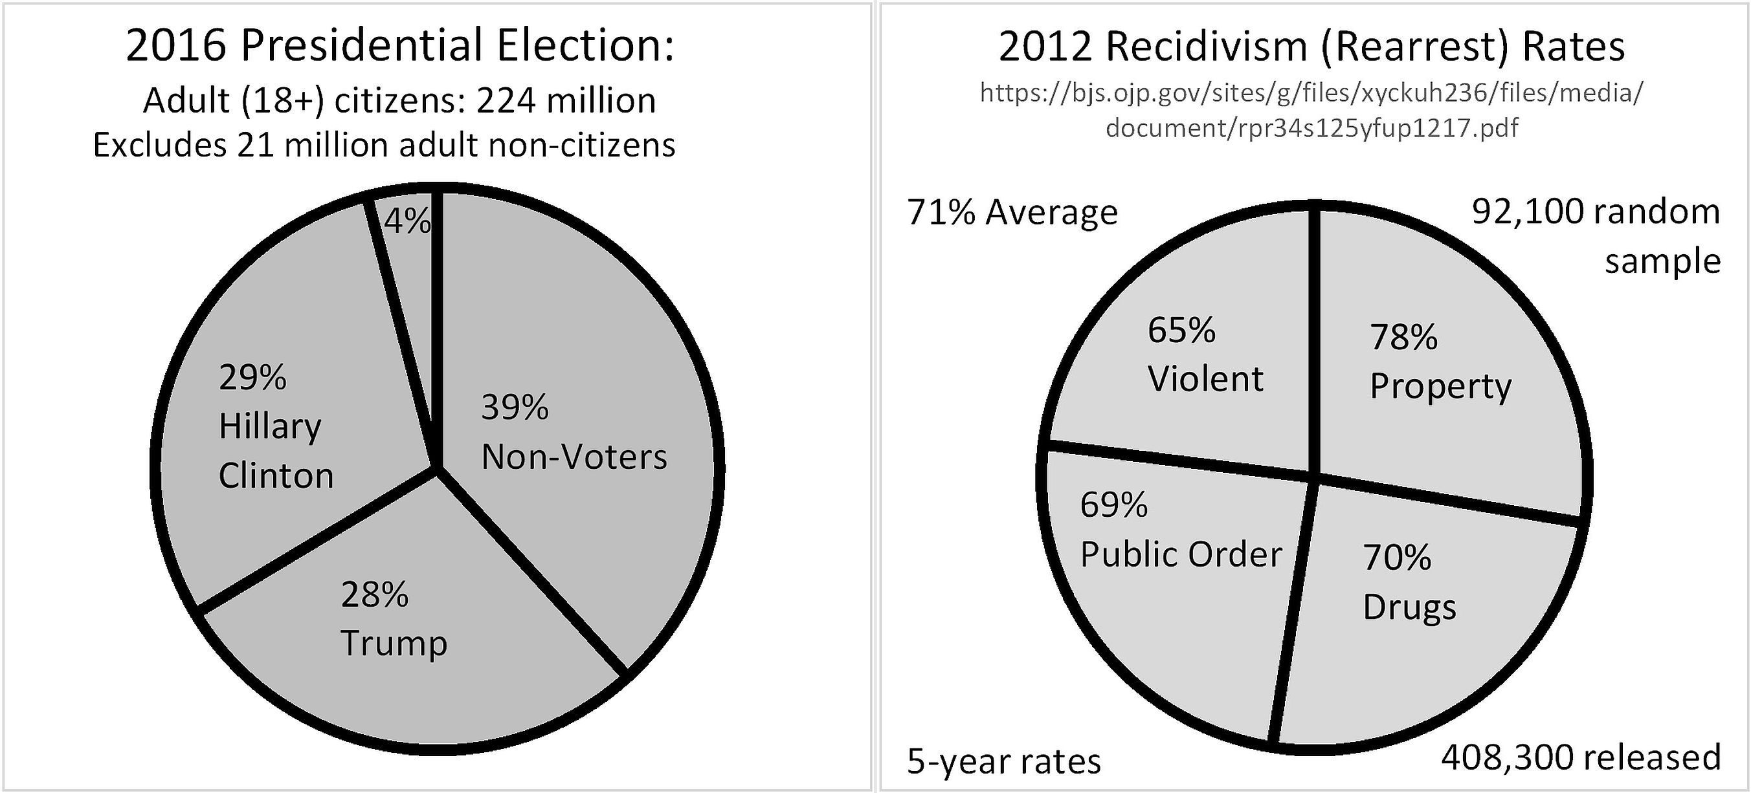
Pie Charts are the Best way to Illustrate Part-Whole Ratios
4.3.1; P 180
6
Part is the slice; whole is the pie
Excel can create pie charts that add to more than 100%.
Notes:
Model Trendline Linear 2Y1X using Excel 2013
11/24/2013 V0a
www.StatLit.org/pdf/Model-Trendline-Linear-2Y1X-Excel2013-6up.pdf
6
Analyzing Numbers in the News
15 May 2008
2008SchieldNNN6up.pdf
6
6

Slide 7
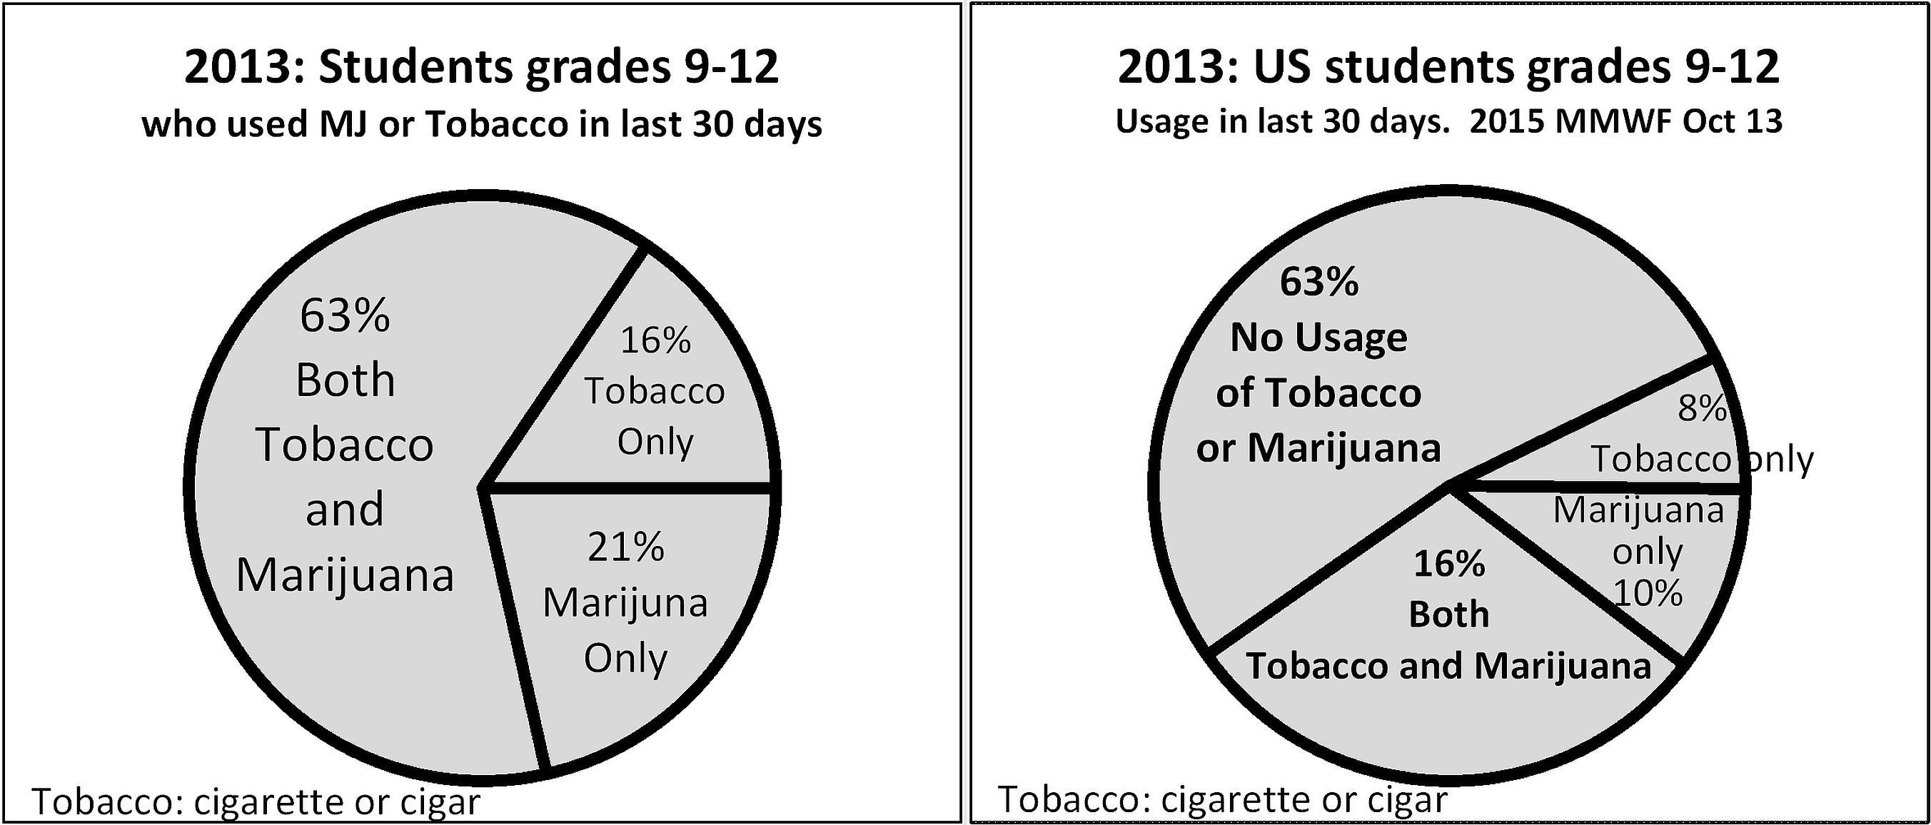
Pie Charts:
Wording is critical
4.3.1; P 181
7
Left: 21% of students* used only marijuana in last 30 days.
Right: 10% of students* used only marijuana in last 30 days.
*: US grades 9-12 in 2015,
Notes:
Model Trendline Linear 2Y1X using Excel 2013
11/24/2013 V0a
www.StatLit.org/pdf/Model-Trendline-Linear-2Y1X-Excel2013-6up.pdf
7
Analyzing Numbers in the News
15 May 2008
2008SchieldNNN6up.pdf
7
7

Slide 8
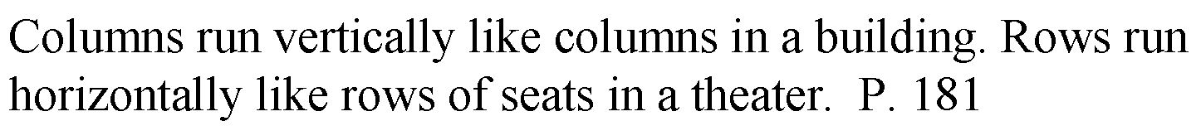
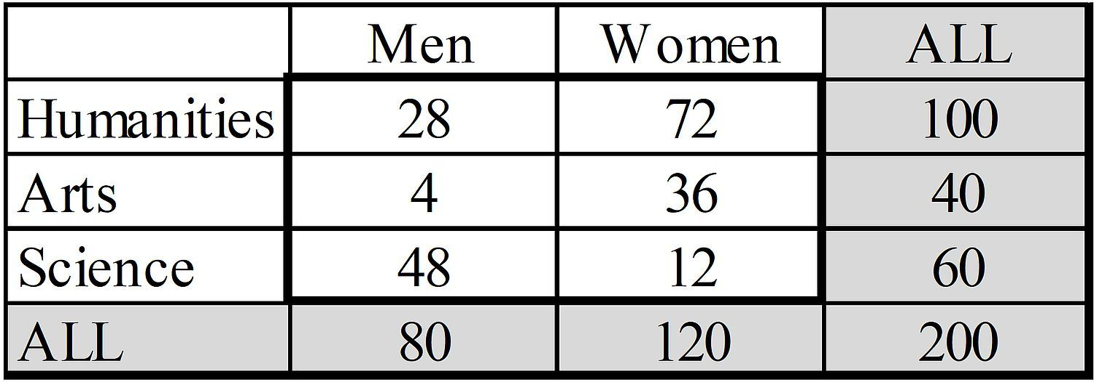
Count Questions:
Order Doesn’t Matter
4.3.2; P 181
8
1) How many of these men are art majors?
2) How many of these art majors are men?
Notes:
Model Trendline Linear 2Y1X using Excel 2013
11/24/2013 V0a
www.StatLit.org/pdf/Model-Trendline-Linear-2Y1X-Excel2013-6up.pdf
8
Analyzing Numbers in the News
15 May 2008
2008SchieldNNN6up.pdf
8
8

Slide 9
Ratios in Count Tables:
Order Matters
4.3.2; P 182
9
1) What fraction of these men are art majors?
2) What proportion of these art majors are men?
3) What percentage of these people are male art majors?
Sex is physical (M/F). Ambiguous: One baby in 2,000
Gender (GLB) is sexual preference.
Of adults: Bisexual 4.4%; Gay 1.4%; Lesbian 1.2%. Trans: 0.9%
Notes:
Model Trendline Linear 2Y1X using Excel 2013
11/24/2013 V0a
www.StatLit.org/pdf/Model-Trendline-Linear-2Y1X-Excel2013-6up.pdf
9
Analyzing Numbers in the News
15 May 2008
2008SchieldNNN6up.pdf
9
9

Slide 10
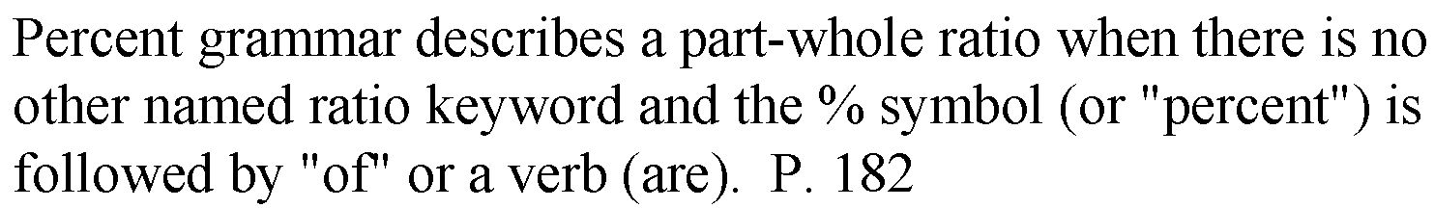
Percent Grammar Statements
4.4.1; P 182
10
15% of US adult males* are smokers?
Among US adults males*, 15% are smokers.
* ‘US’ and ‘adult’ determine which males.
Notes:
Model Trendline Linear 2Y1X using Excel 2013
11/24/2013 V0a
www.StatLit.org/pdf/Model-Trendline-Linear-2Y1X-Excel2013-6up.pdf
10
Analyzing Numbers in the News
15 May 2008
2008SchieldNNN6up.pdf
10
10

Slide 11
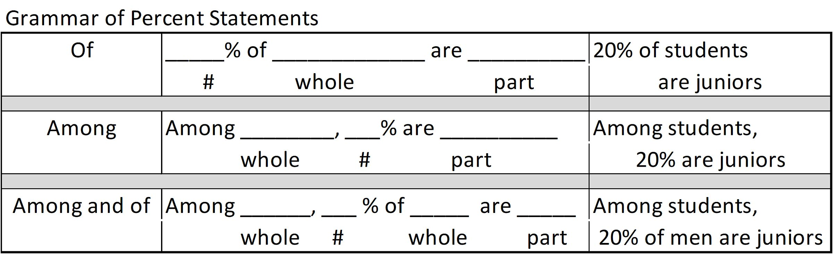
Percent Grammar Statements
Template
4.4.2; P 183
11
‘Among’ and ‘of’ introduce the whole.
Predicate or verb normally introduces the part.
Grammatically, percent grammar is main clause grammar.
Whole is on one side of main verb; part on the other.
Notes:
Model Trendline Linear 2Y1X using Excel 2013
11/24/2013 V0a
www.StatLit.org/pdf/Model-Trendline-Linear-2Y1X-Excel2013-6up.pdf
11
Analyzing Numbers in the News
15 May 2008
2008SchieldNNN6up.pdf
11
11

Slide 12
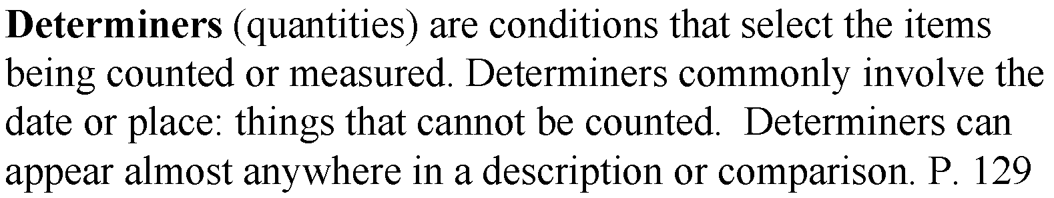
Percent Grammar Statements
4.4.2; P 183
12
Leading prepositions introduce determiners:
  In 1990 in Bulgaria, 40% of the adults smoke.
  Trailing modifiers can introduce determiners:
    40% of adults in Bulgaria in 1990 smoke.
* ‘1990’ and ‘Bulgaria’ determine which ‘adults’.
Notes:
Model Trendline Linear 2Y1X using Excel 2013
11/24/2013 V0a
www.StatLit.org/pdf/Model-Trendline-Linear-2Y1X-Excel2013-6up.pdf
12
Analyzing Numbers in the News
15 May 2008
2008SchieldNNN6up.pdf
12
12

Slide 13
Percent Grammar Statements
Identify part and whole
4.4.2; P 184
13
In 1997, 23% of US 8th graders have tried marijuana.
Among US 8th graders, 17% used smokeless tobacco.
Simple rule: Whole comes first; part comes last???
LSD has be used by 5% of US 8th graders.
17% of men (10% of women) involved in an affair.
How can fraction of men exceed fraction of women?
Must both parties to an affair be married?
Parents should stay in a bad marriage. Men 40%; women 25%. What might explain the difference?
Notes:
Model Trendline Linear 2Y1X using Excel 2013
11/24/2013 V0a
www.StatLit.org/pdf/Model-Trendline-Linear-2Y1X-Excel2013-6up.pdf
13
Analyzing Numbers in the News
15 May 2008
2008SchieldNNN6up.pdf
13
13

Slide 14
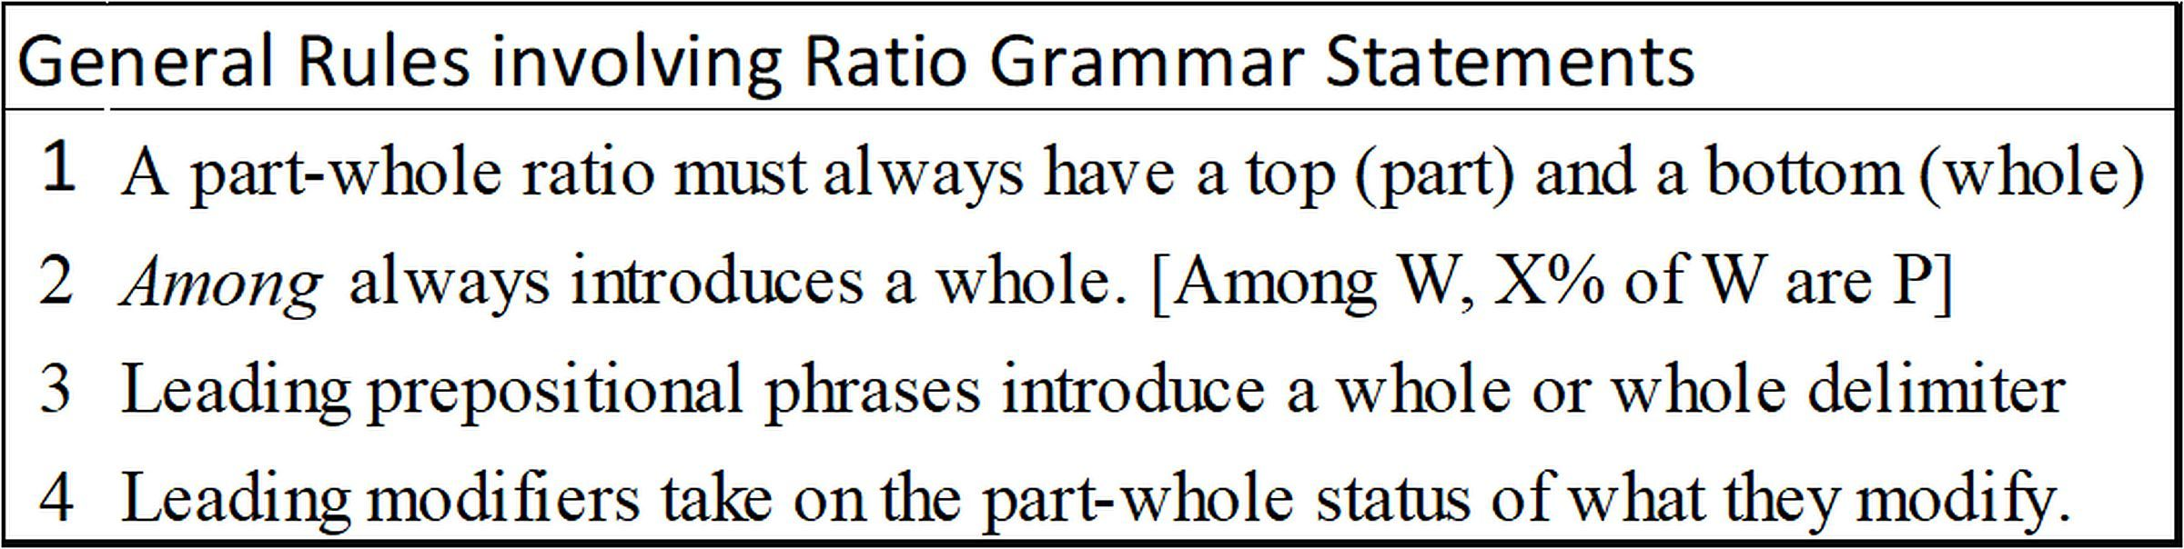
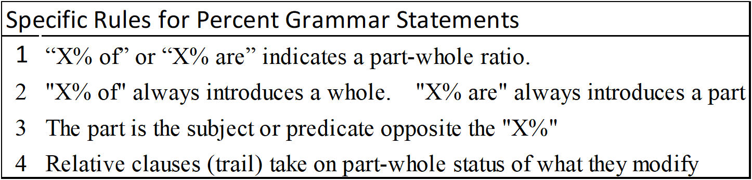
Percent Grammar Statements
Part and Whole Rules
4.4.2; P 184
14
.
Notes:
Model Trendline Linear 2Y1X using Excel 2013
11/24/2013 V0a
www.StatLit.org/pdf/Model-Trendline-Linear-2Y1X-Excel2013-6up.pdf
14
Analyzing Numbers in the News
15 May 2008
2008SchieldNNN6up.pdf
14
14

Slide 15
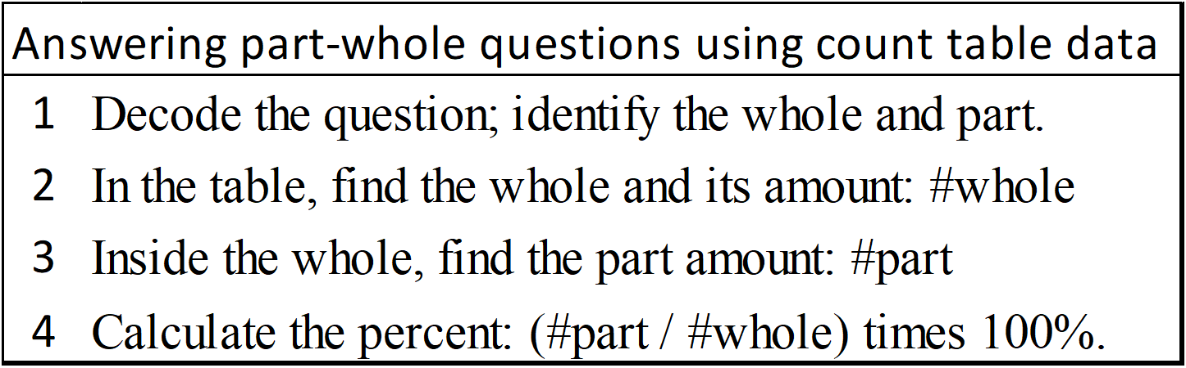
Count Tables:
Answering Part-Whole Questions
4.4.3; P 185
15
.
Don’t calculate.
Use part ‘out of’ whole.
What percentage of [these] men are science majors?
Among science majors, what percentage are men?
Male science majors are what percentage of students?
Notes:
Model Trendline Linear 2Y1X using Excel 2013
11/24/2013 V0a
www.StatLit.org/pdf/Model-Trendline-Linear-2Y1X-Excel2013-6up.pdf
15
Analyzing Numbers in the News
15 May 2008
2008SchieldNNN6up.pdf
15
15

Slide 16
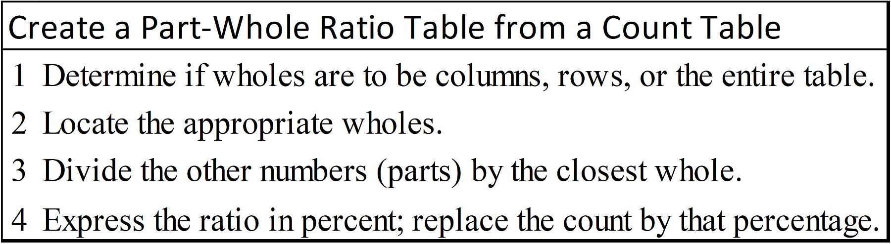
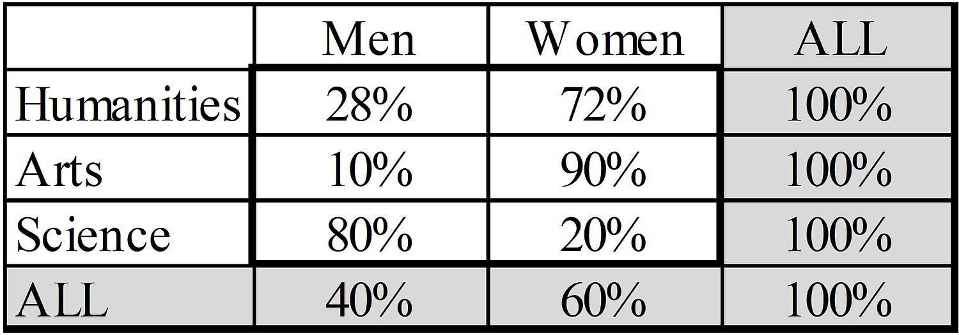
Count Tables:
Create Part-Whole Ratio Table
4.4.3; P 185
16
Create a
100% row table.
Note: A 100% total table
mirrors the underlying
count table.
Notes:
Model Trendline Linear 2Y1X using Excel 2013
11/24/2013 V0a
www.StatLit.org/pdf/Model-Trendline-Linear-2Y1X-Excel2013-6up.pdf
16
Analyzing Numbers in the News
15 May 2008
2008SchieldNNN6up.pdf
16
16

Slide 17
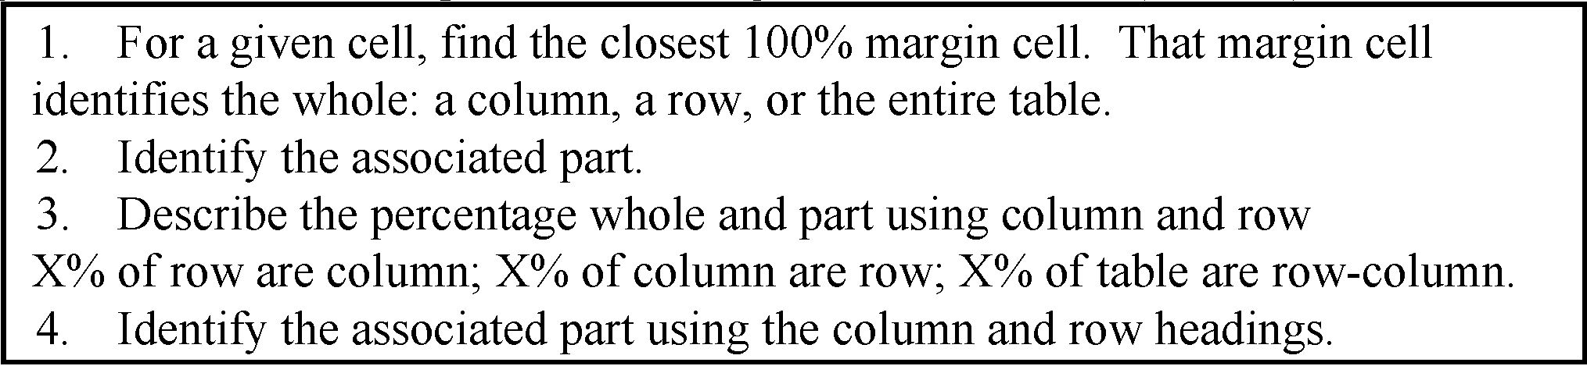
Count Tables:
Describe Percentage in a Table
4.4.3; P 185
17
Describe:
28%: 1st row, 1st column
90%: 2nd row, 2nd column
20%: 3rd row 2nd column
40%: 4th row 1st column
Notes:
Model Trendline Linear 2Y1X using Excel 2013
11/24/2013 V0a
www.StatLit.org/pdf/Model-Trendline-Linear-2Y1X-Excel2013-6up.pdf
17
Analyzing Numbers in the News
15 May 2008
2008SchieldNNN6up.pdf
17
17

Slide 18
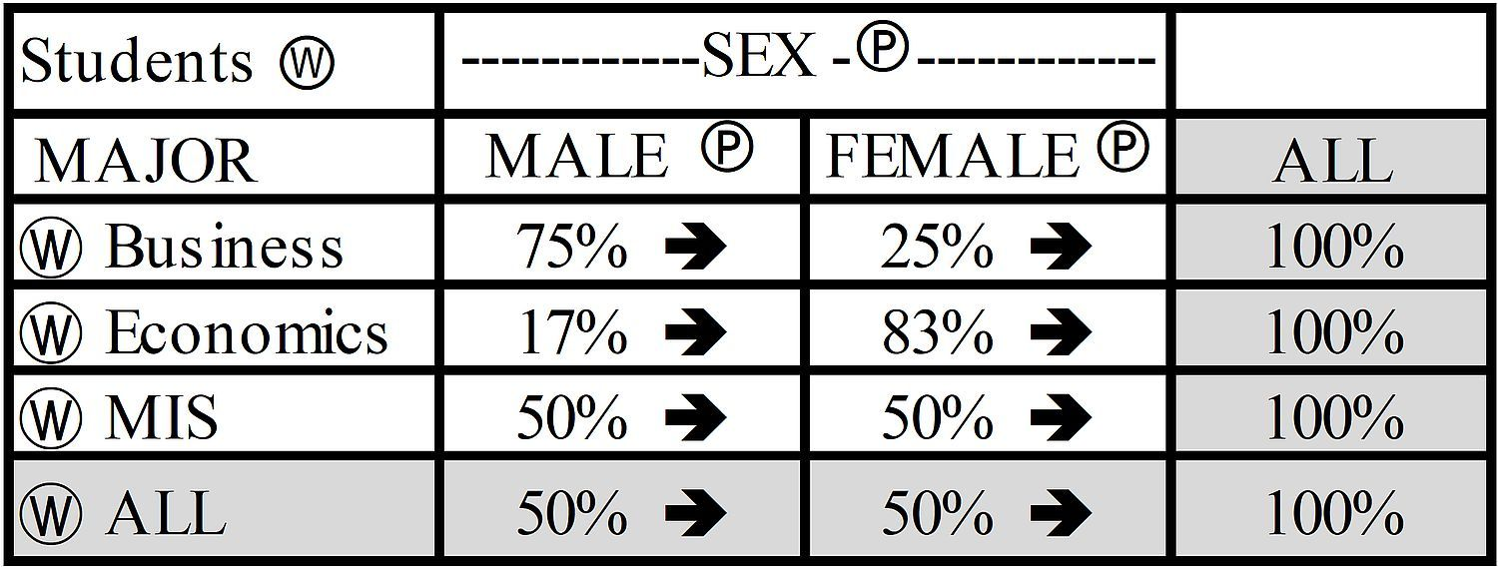
100% Tables:
Percentages in Row Table
4.4.4, P 186
18
What percentage of business majors are female?
What percentage of females are Business majors?
Describe the 17% in the 2nd row, 1st column.
Notes:
Model Trendline Linear 2Y1X using Excel 2013
11/24/2013 V0a
www.StatLit.org/pdf/Model-Trendline-Linear-2Y1X-Excel2013-6up.pdf
18
Analyzing Numbers in the News
15 May 2008
2008SchieldNNN6up.pdf
18
18

Slide 19
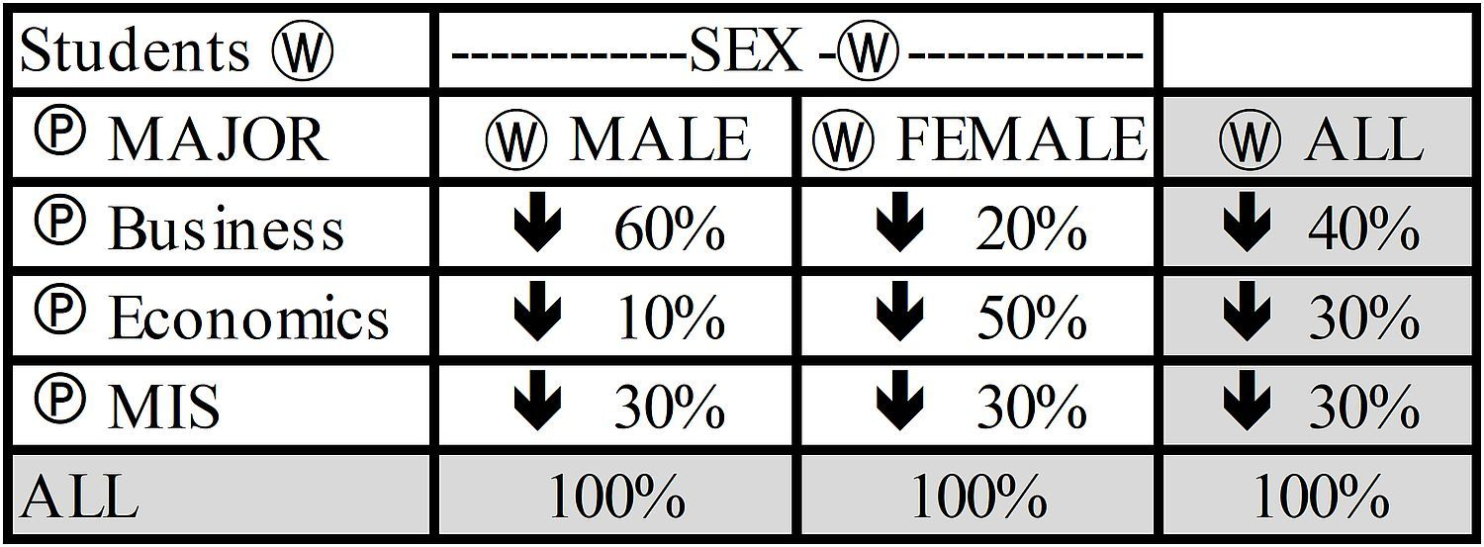
100% Tables:
Percentages in Column Table
4.4.4, P 186
19
What percentage of business majors are female?
What percentage of females are Business majors?
Describe the 10% in the 2nd row, 1st column.
Notes:
Model Trendline Linear 2Y1X using Excel 2013
11/24/2013 V0a
www.StatLit.org/pdf/Model-Trendline-Linear-2Y1X-Excel2013-6up.pdf
19
Analyzing Numbers in the News
15 May 2008
2008SchieldNNN6up.pdf
19
19

Slide 20
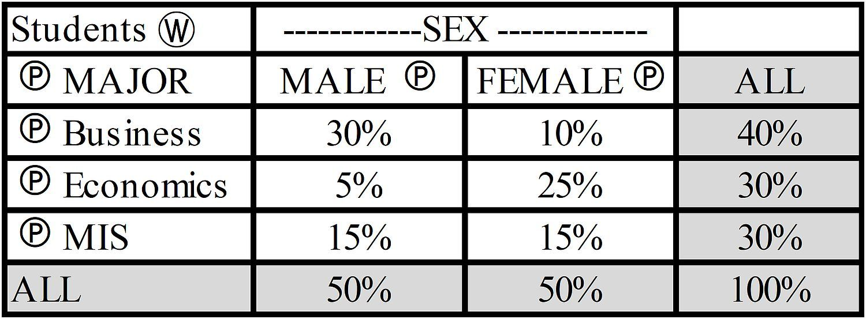
100% Tables:
Percentages in Total Table
4.4.4, P 186
20
What percentage of students are male Econ majors?
What percentage of business majors are female?
Describe the 5% in 2nd row, 1st column as total ratio.
Describe the 15% in 3rd row, 1st column as row ratio.
Notes:
Model Trendline Linear 2Y1X using Excel 2013
11/24/2013 V0a
www.StatLit.org/pdf/Model-Trendline-Linear-2Y1X-Excel2013-6up.pdf
20
Analyzing Numbers in the News
15 May 2008
2008SchieldNNN6up.pdf
20
20

Slide 21
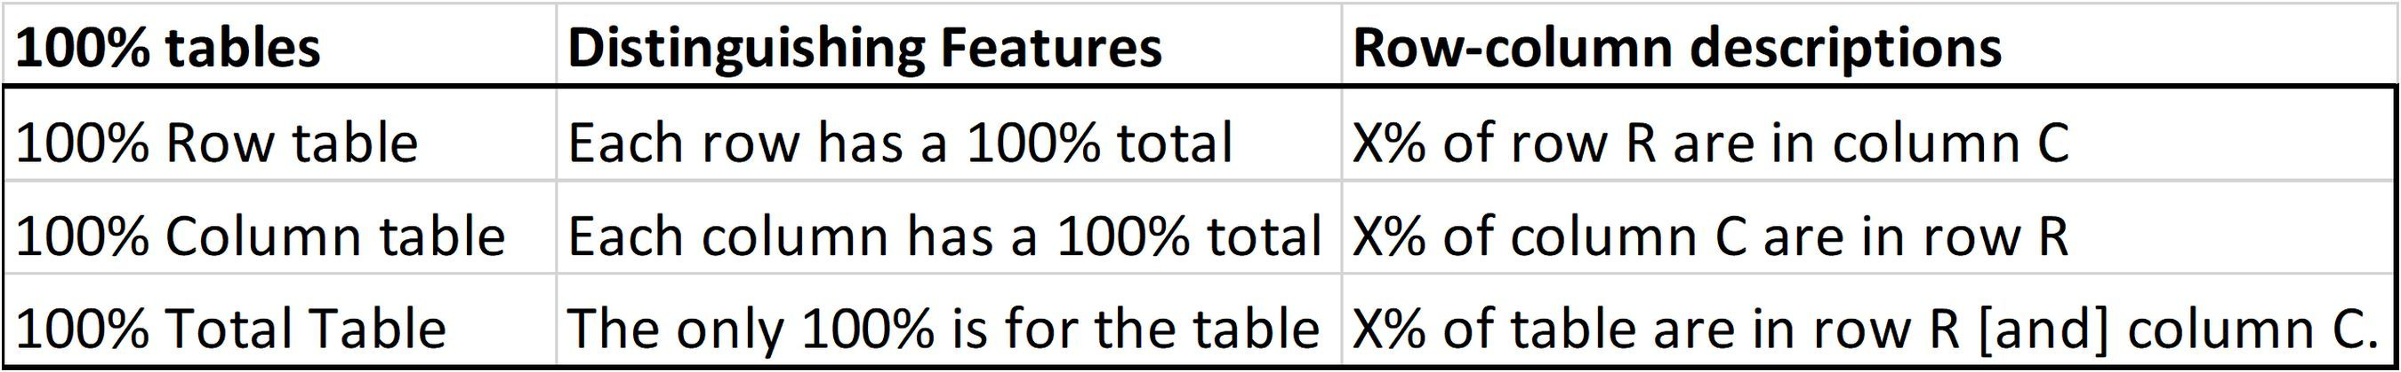
100% Tables:
Describe: use ‘row’ and ‘column’
4.4.4, P 187
21
Describe using
#Row & #Column.
72% 1st row.
10% 2nd row
20% 3rd row
60% 4th row
Notes:
Model Trendline Linear 2Y1X using Excel 2013
11/24/2013 V0a
www.StatLit.org/pdf/Model-Trendline-Linear-2Y1X-Excel2013-6up.pdf
21
Analyzing Numbers in the News
15 May 2008
2008SchieldNNN6up.pdf
21
21

Slide 22
Most Common Error:
Confusion of the Inverse;
4.4.4; P 187
22
The confusion of the inverse in a part-whole ratio mistakenly exchanges part with whole. P. 187
This is arguably the most common error in describing & comparing part-whole percentages.
Easy to spot if you know the context:
> 90% of prisoners are men; 90% of men are prisoners
Hard to spot if you don’t know the context!
Notes:
Model Trendline Linear 2Y1X using Excel 2013
11/24/2013 V0a
www.StatLit.org/pdf/Model-Trendline-Linear-2Y1X-Excel2013-6up.pdf
22
Analyzing Numbers in the News
15 May 2008
2008SchieldNNN6up.pdf
22
22

Slide 23
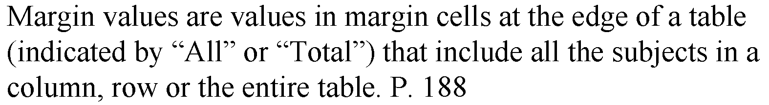
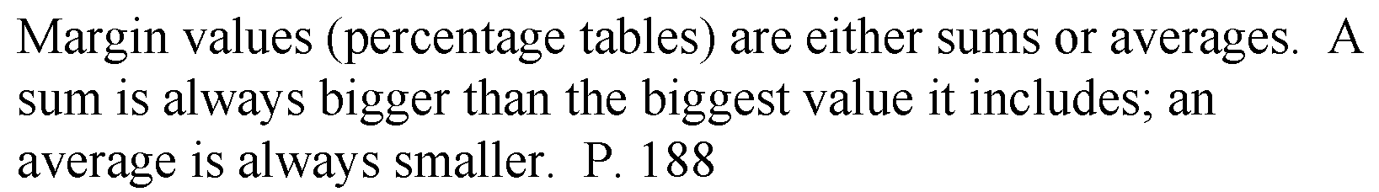
Margin Values
[Need this later!]
4.4.4; P 188
23
.
Notes:
Model Trendline Linear 2Y1X using Excel 2013
11/24/2013 V0a
www.StatLit.org/pdf/Model-Trendline-Linear-2Y1X-Excel2013-6up.pdf
23
Analyzing Numbers in the News
15 May 2008
2008SchieldNNN6up.pdf
23
23

Slide 24
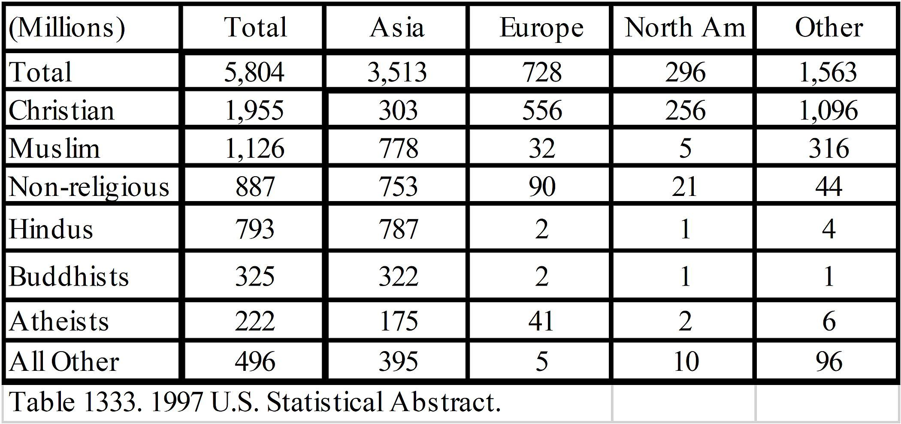
More Percentage Tables:
Count Table
4.4.4; P 188
24
What percentage of Asians are Muslim? # out of #
What percentage of Muslims are Asians?
Notes:
Model Trendline Linear 2Y1X using Excel 2013
11/24/2013 V0a
www.StatLit.org/pdf/Model-Trendline-Linear-2Y1X-Excel2013-6up.pdf
24
Analyzing Numbers in the News
15 May 2008
2008SchieldNNN6up.pdf
24
24

Slide 25
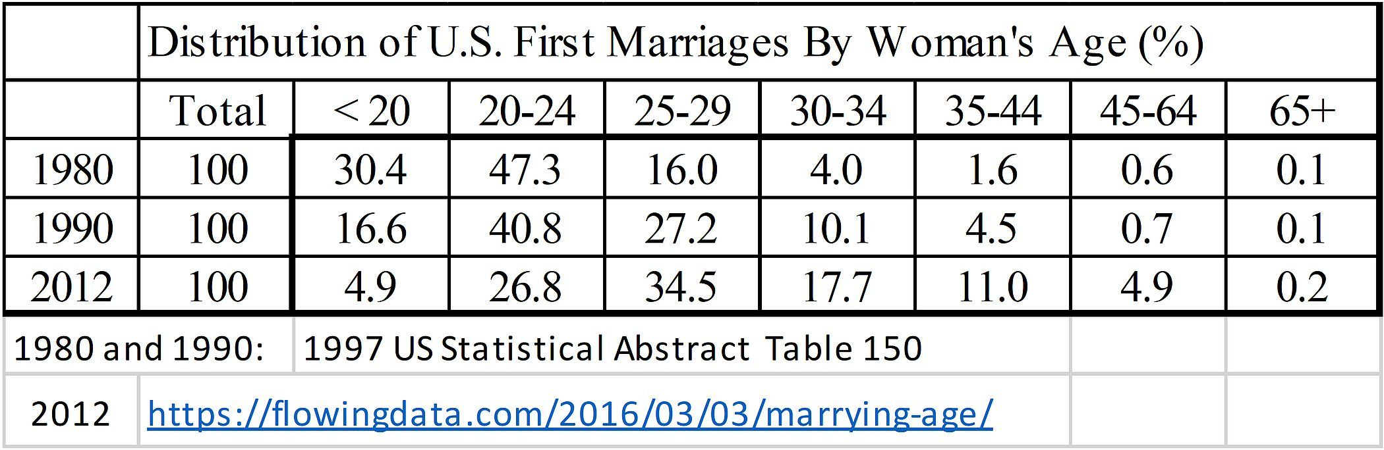
More Percentage Tables
4.4.4; P 189
25
Describe 47.3% for 1980 row and 20-24 column.
Describe 26.8% for 2012 row and 20-24 column.
Here: first marriage is an event (getting married)
not a status or a condition (being married)
Notes:
Model Trendline Linear 2Y1X using Excel 2013
11/24/2013 V0a
www.StatLit.org/pdf/Model-Trendline-Linear-2Y1X-Excel2013-6up.pdf
25
Analyzing Numbers in the News
15 May 2008
2008SchieldNNN6up.pdf
25
25

Slide 26
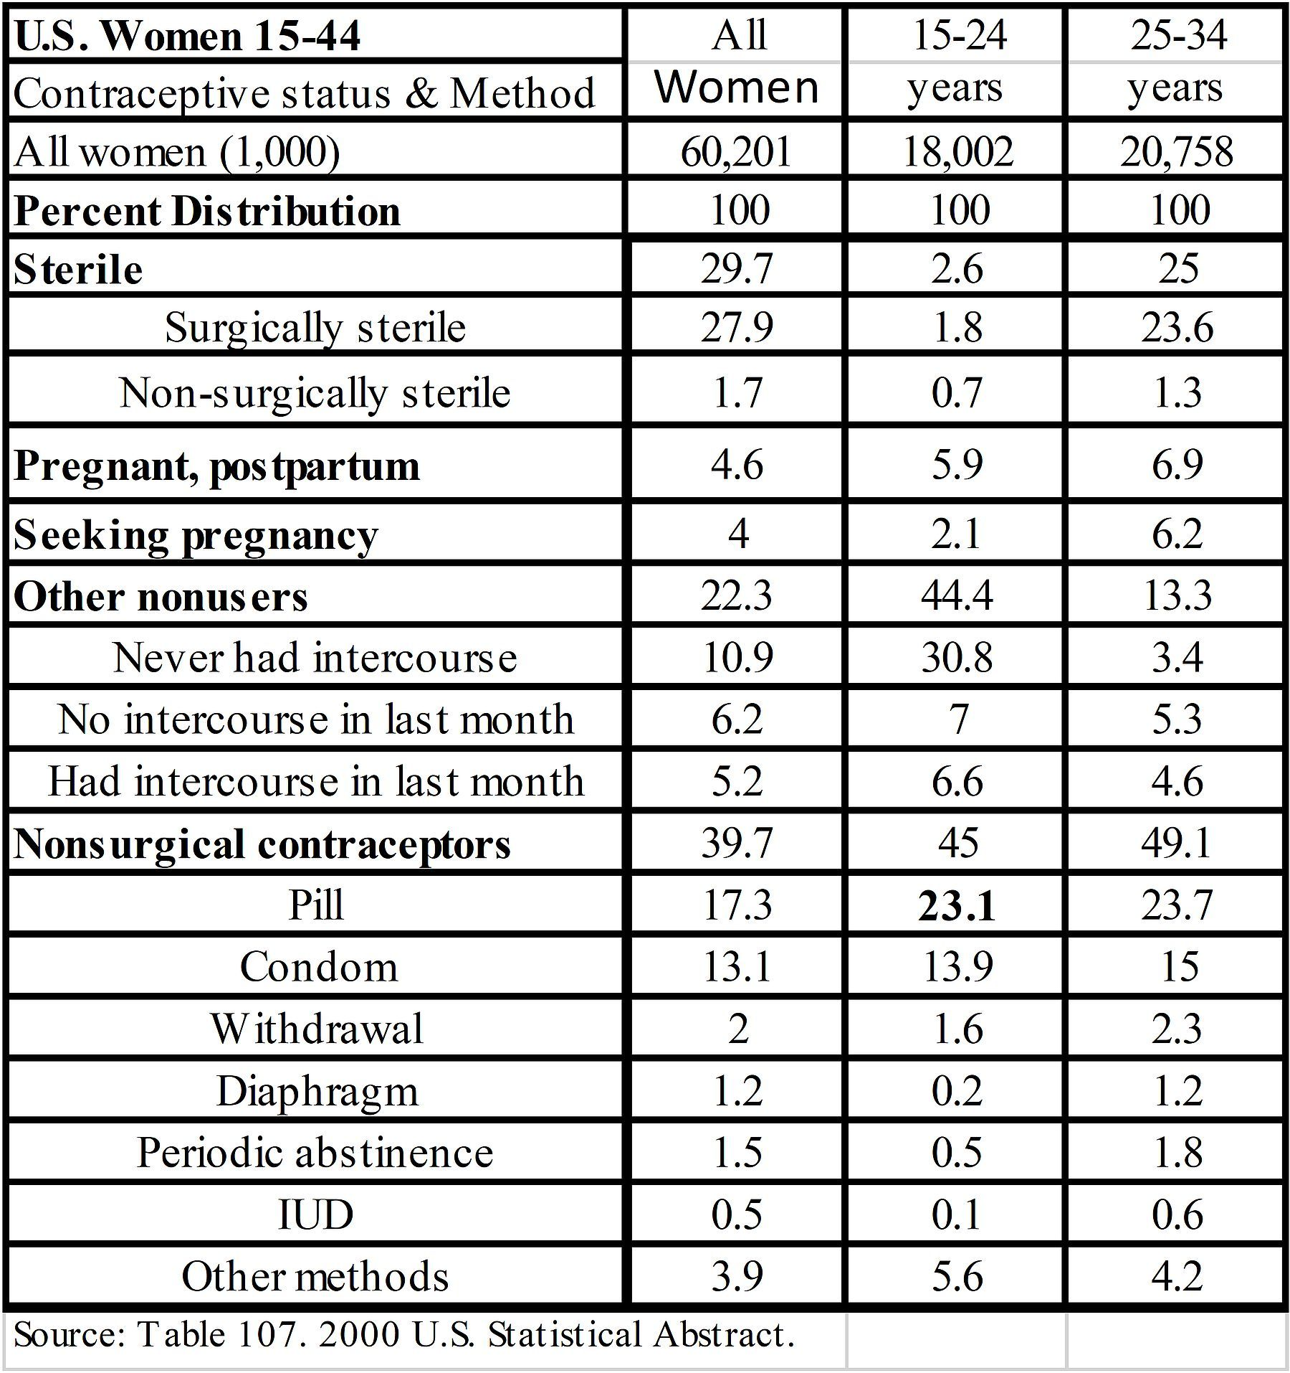
4.4.4; P 189
26
Describe
23.1%
for 15-24
and Pill.
Do the rows
add to over
100%?
Why?
Notes:
Model Trendline Linear 2Y1X using Excel 2013
11/24/2013 V0a
www.StatLit.org/pdf/Model-Trendline-Linear-2Y1X-Excel2013-6up.pdf
26
Analyzing Numbers in the News
15 May 2008
2008SchieldNNN6up.pdf
26
26

Slide 27
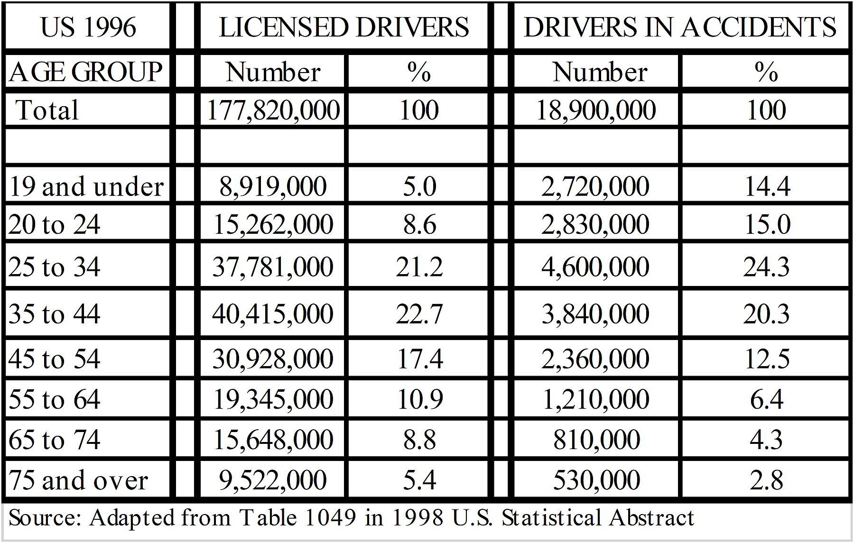
Percentage Tables:
Drivers (left); Accidents (right)
4.4.4; P 190
27
Describe for
20-24 yr-olds.
Left: 8.6%
Right: 15.0%
20-24 year-olds: Why is 15% more than 8.6%?
65-74 year-olds: Why is 4.3% less than 8.8%?
Notes:
Model Trendline Linear 2Y1X using Excel 2013
11/24/2013 V0a
www.StatLit.org/pdf/Model-Trendline-Linear-2Y1X-Excel2013-6up.pdf
27
Analyzing Numbers in the News
15 May 2008
2008SchieldNNN6up.pdf
27
27

Slide 28
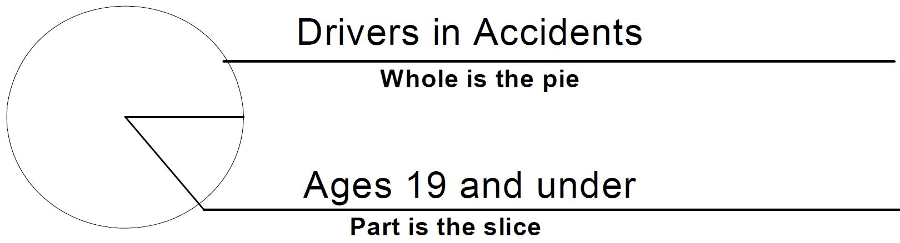
Percentage Statement:
Show as a Pie Chart
4.4.4; P 191
28
4.4% of drivers in accidents are 19 and younger.
Identify part and whole in the statement
Create pie chart: pie (whole) and slice (part)
Label the whole (pie) and the part (slice).
Notes:
Model Trendline Linear 2Y1X using Excel 2013
11/24/2013 V0a
www.StatLit.org/pdf/Model-Trendline-Linear-2Y1X-Excel2013-6up.pdf
28
Analyzing Numbers in the News
15 May 2008
2008SchieldNNN6up.pdf
28
28

Slide 29
Percentage Grammar: vs. Percent Grammar
4.5; P 193
29
Percentage grammar is different from percent grammar.
Percentage grammar always uses ‘percentage’.
Percentage grammar is never main-clause grammar.
Percentage grammar uses phrases and relative clauses.
Percentage never follows a number. Percentage follows ‘the’ or an adjective (The highest percentage).
Percentage grammar is typically used in the titles of tables and graphs, and in comparing percentages.
Notes:
Model Trendline Linear 2Y1X using Excel 2013
11/24/2013 V0a
www.StatLit.org/pdf/Model-Trendline-Linear-2Y1X-Excel2013-6up.pdf
29
Analyzing Numbers in the News
15 May 2008
2008SchieldNNN6up.pdf
29
29

Slide 30
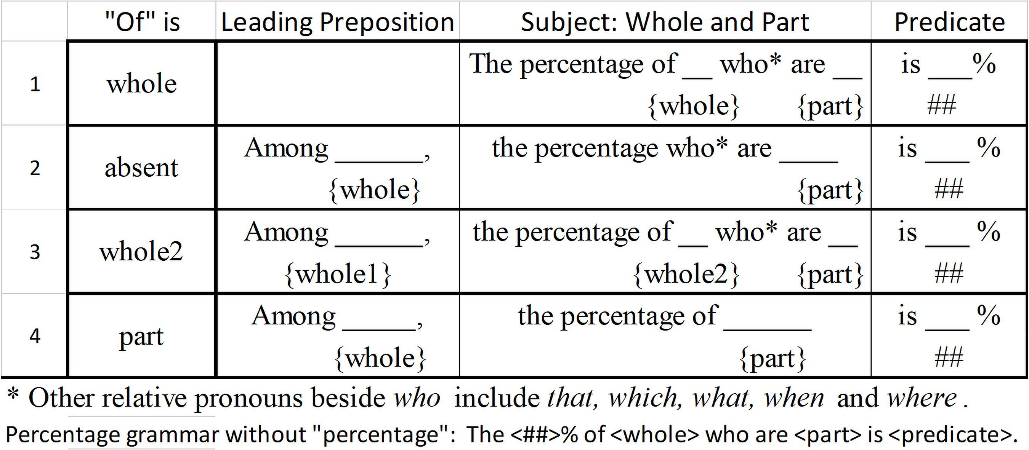
Percentage Grammar:
Statement Template
4.5; P 193
30
The first three are straight-forward; #4 is tricky!.
Notes:
Model Trendline Linear 2Y1X using Excel 2013
11/24/2013 V0a
www.StatLit.org/pdf/Model-Trendline-Linear-2Y1X-Excel2013-6up.pdf
30
Analyzing Numbers in the News
15 May 2008
2008SchieldNNN6up.pdf
30
30

Slide 31
Percentage Grammar:
Decode Statements
4.5; P 194
31
What is the compete part and complete whole?
Use the percentage grammar template!
In 2000, the percentage of US college freshmen who are women is 55%.
Among US college freshmen, the percentage who said abortion should be legal was 57%.
In 2005 among US students at two-year colleges, the percentage of Blacks was 16%.
Notes:
Model Trendline Linear 2Y1X using Excel 2013
11/24/2013 V0a
www.StatLit.org/pdf/Model-Trendline-Linear-2Y1X-Excel2013-6up.pdf
31
Analyzing Numbers in the News
15 May 2008
2008SchieldNNN6up.pdf
31
31

Slide 32
Question Grammar:
Percent vs. Percentage
4.5.1; P 195-6
32
What percentage of men are runners?
What is the percentage of men who are runners?
What is the percentage of runners among men?
#1 is shortest, simplest and easiest to understand.
#2 is more academic: longer and more complex.
#3 is like #2, but is nicely setup for comparing.
> The percentage of runners is bigger among men than [that] among women.
Notes:
Model Trendline Linear 2Y1X using Excel 2013
11/24/2013 V0a
www.StatLit.org/pdf/Model-Trendline-Linear-2Y1X-Excel2013-6up.pdf
32
Analyzing Numbers in the News
15 May 2008
2008SchieldNNN6up.pdf
32
32

Slide 33
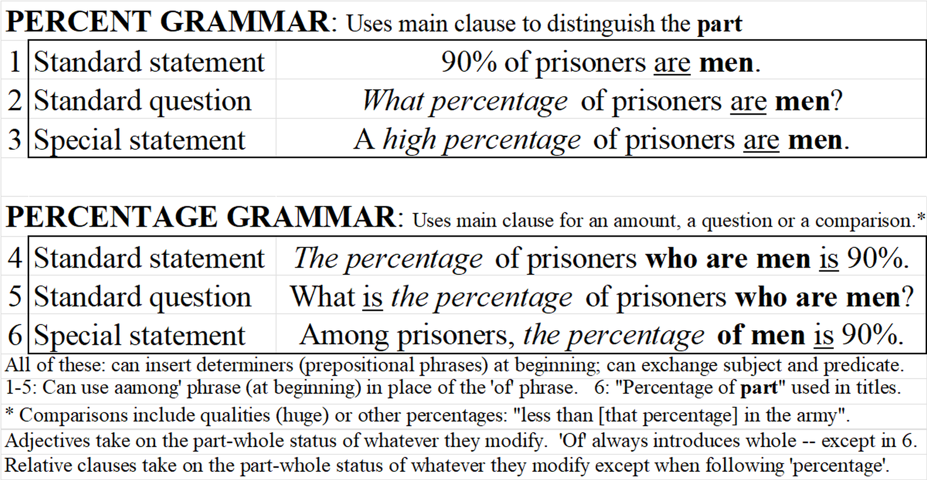
Percent vs. Percentage:
Summary
4.5.1; New
33
.
Notes:
Model Trendline Linear 2Y1X using Excel 2013
11/24/2013 V0a
www.StatLit.org/pdf/Model-Trendline-Linear-2Y1X-Excel2013-6up.pdf
33
Analyzing Numbers in the News
15 May 2008
2008SchieldNNN6up.pdf
33
33

Slide 34
Percentage Grammar:
Sports Grammar Ambiguity
4.5.2; P 198
34
Sports grammar is percentage grammar where part and whole form a single phrase.
The percentage of completed passes increased.
The percentage of passes completed increased.
The percentage of working males increased.
The percentage of male workers increased.
#1+2 Naturals: Pass is whole; completed is part
#3+4 lack a natural whole and part. Ambiguous.
Rule: Never use sports grammar!
Notes:
Model Trendline Linear 2Y1X using Excel 2013
11/24/2013 V0a
www.StatLit.org/pdf/Model-Trendline-Linear-2Y1X-Excel2013-6up.pdf
34
Analyzing Numbers in the News
15 May 2008
2008SchieldNNN6up.pdf
34
34

Slide 35
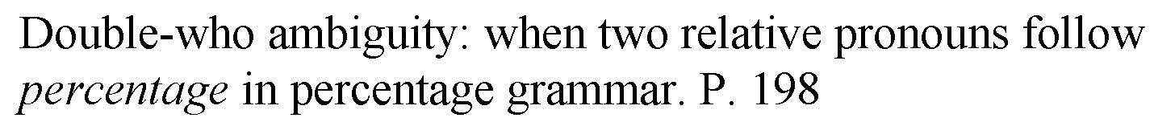
Percentage Grammar:
Double-Who Ambiguity
4.5.3; P 198
35
In 2006, the percentage of US college students who are Whites who attended four-year colleges was 44%.
Never place two relative pronouns after percentage – in writing or in speaking.
Double-who is ambiguous in reading or hearing.
Notes:
Model Trendline Linear 2Y1X using Excel 2013
11/24/2013 V0a
www.StatLit.org/pdf/Model-Trendline-Linear-2Y1X-Excel2013-6up.pdf
35
Analyzing Numbers in the News
15 May 2008
2008SchieldNNN6up.pdf
35
35

Slide 36
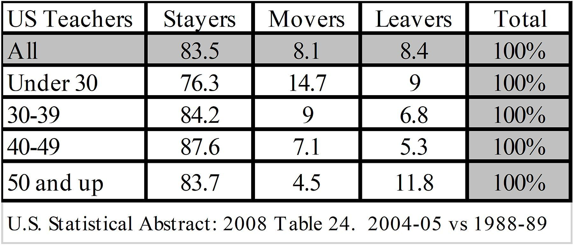
Percentage Grammar:
Tables
4.5.1; P 197
36
Describe 83.5%: ‘Stayers’, ‘All US teachers’.
Describe 14.7%: ‘Movers’ ‘under 30’.
Describe 6.8%: Leavers ages 30-39.
What percentage of Movers are ’50 and up’?
Notes:
Model Trendline Linear 2Y1X using Excel 2013
11/24/2013 V0a
www.StatLit.org/pdf/Model-Trendline-Linear-2Y1X-Excel2013-6up.pdf
36
Analyzing Numbers in the News
15 May 2008
2008SchieldNNN6up.pdf
36
36

Slide 37
Percentage Grammar:
Four most common errors
4.5.1; P 197
37
Confusion of the inverse: switching part and whole.
Misreading the percentage table.
Reading the table correctly, but writing it wrong.
Using sports grammar:
> The percentage of male runners is 30%.
Using a double who [or other relative pronoun].
> The percentage of men who run who smoke.
Omitting modifiers or determiners of the whole.
Modifiers and determiners ward off {block] confounders by selection.
Notes:
Model Trendline Linear 2Y1X using Excel 2013
11/24/2013 V0a
www.StatLit.org/pdf/Model-Trendline-Linear-2Y1X-Excel2013-6up.pdf
37
Analyzing Numbers in the News
15 May 2008
2008SchieldNNN6up.pdf
37
37

Slide 38
Double-Who Ambiguity:
Four Solutions
4.5.1; P 197
38
Move whole2 to a leading ‘among’ phrase.
Attach whole 2 to whole1 in an adjective phrase.
Convert to a trailing gerund.
Omit the relative pronoun [if applicable].
Convert to percentage grammar:
>> 20% of men who run smoke
BAD: The percentage of men who run who smoke …
GOOD:
1. Among runners, the percentage of men who smoke …
2. The percentage of male runners who smoke…
3. The percentage of men running who smoke
Notes:
Model Trendline Linear 2Y1X using Excel 2013
11/24/2013 V0a
www.StatLit.org/pdf/Model-Trendline-Linear-2Y1X-Excel2013-6up.pdf
38
Analyzing Numbers in the News
15 May 2008
2008SchieldNNN6up.pdf
38
38

Slide 39
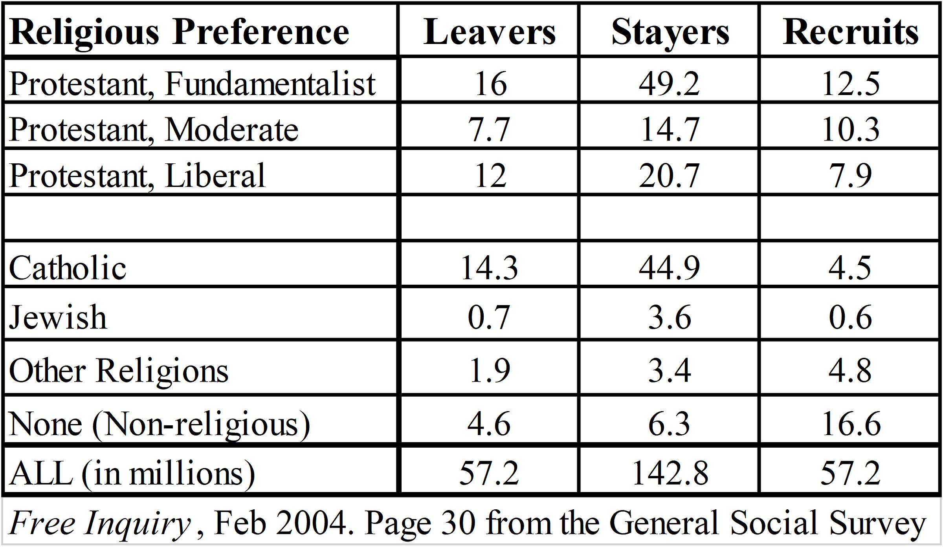
Percentage Grammar:
Count Table
4.6; P 199
39
Leaver: Left this row between ages 15 and 30.
Stayer: Was in this row at both ages 15 and 30.
Recruit: Joined this row between ages 15 and 30.
Notes:
Model Trendline Linear 2Y1X using Excel 2013
11/24/2013 V0a
www.StatLit.org/pdf/Model-Trendline-Linear-2Y1X-Excel2013-6up.pdf
39
Analyzing Numbers in the News
15 May 2008
2008SchieldNNN6up.pdf
39
39

Slide 40
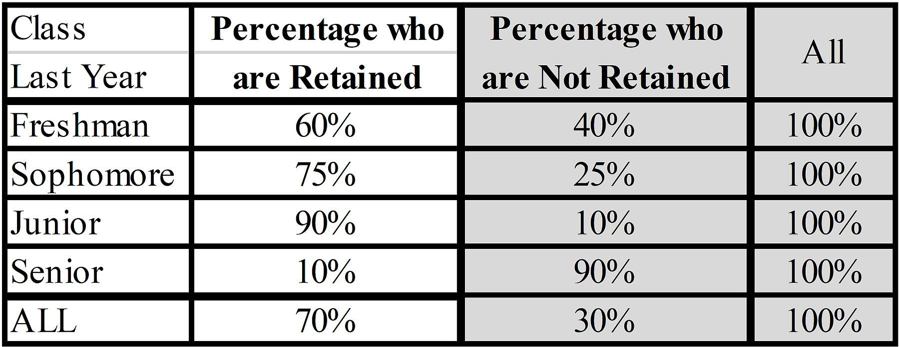
Percentage in Tables:
Half Tables
4.6; P 199
40
Retained: Returned the next year.
Right half is redundant. Omit.
Plus/Benefit of half tables: Save space
Minus/Cost of half-tables: Loose 100%.
Need a new way to identify part and whole.
Notes:
Model Trendline Linear 2Y1X using Excel 2013
11/24/2013 V0a
www.StatLit.org/pdf/Model-Trendline-Linear-2Y1X-Excel2013-6up.pdf
40
Analyzing Numbers in the News
15 May 2008
2008SchieldNNN6up.pdf
40
40

Slide 41
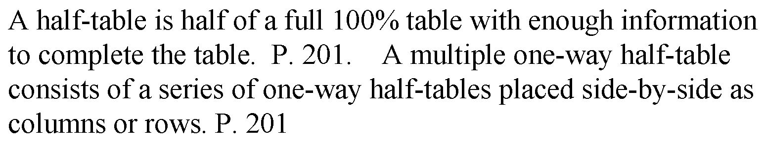
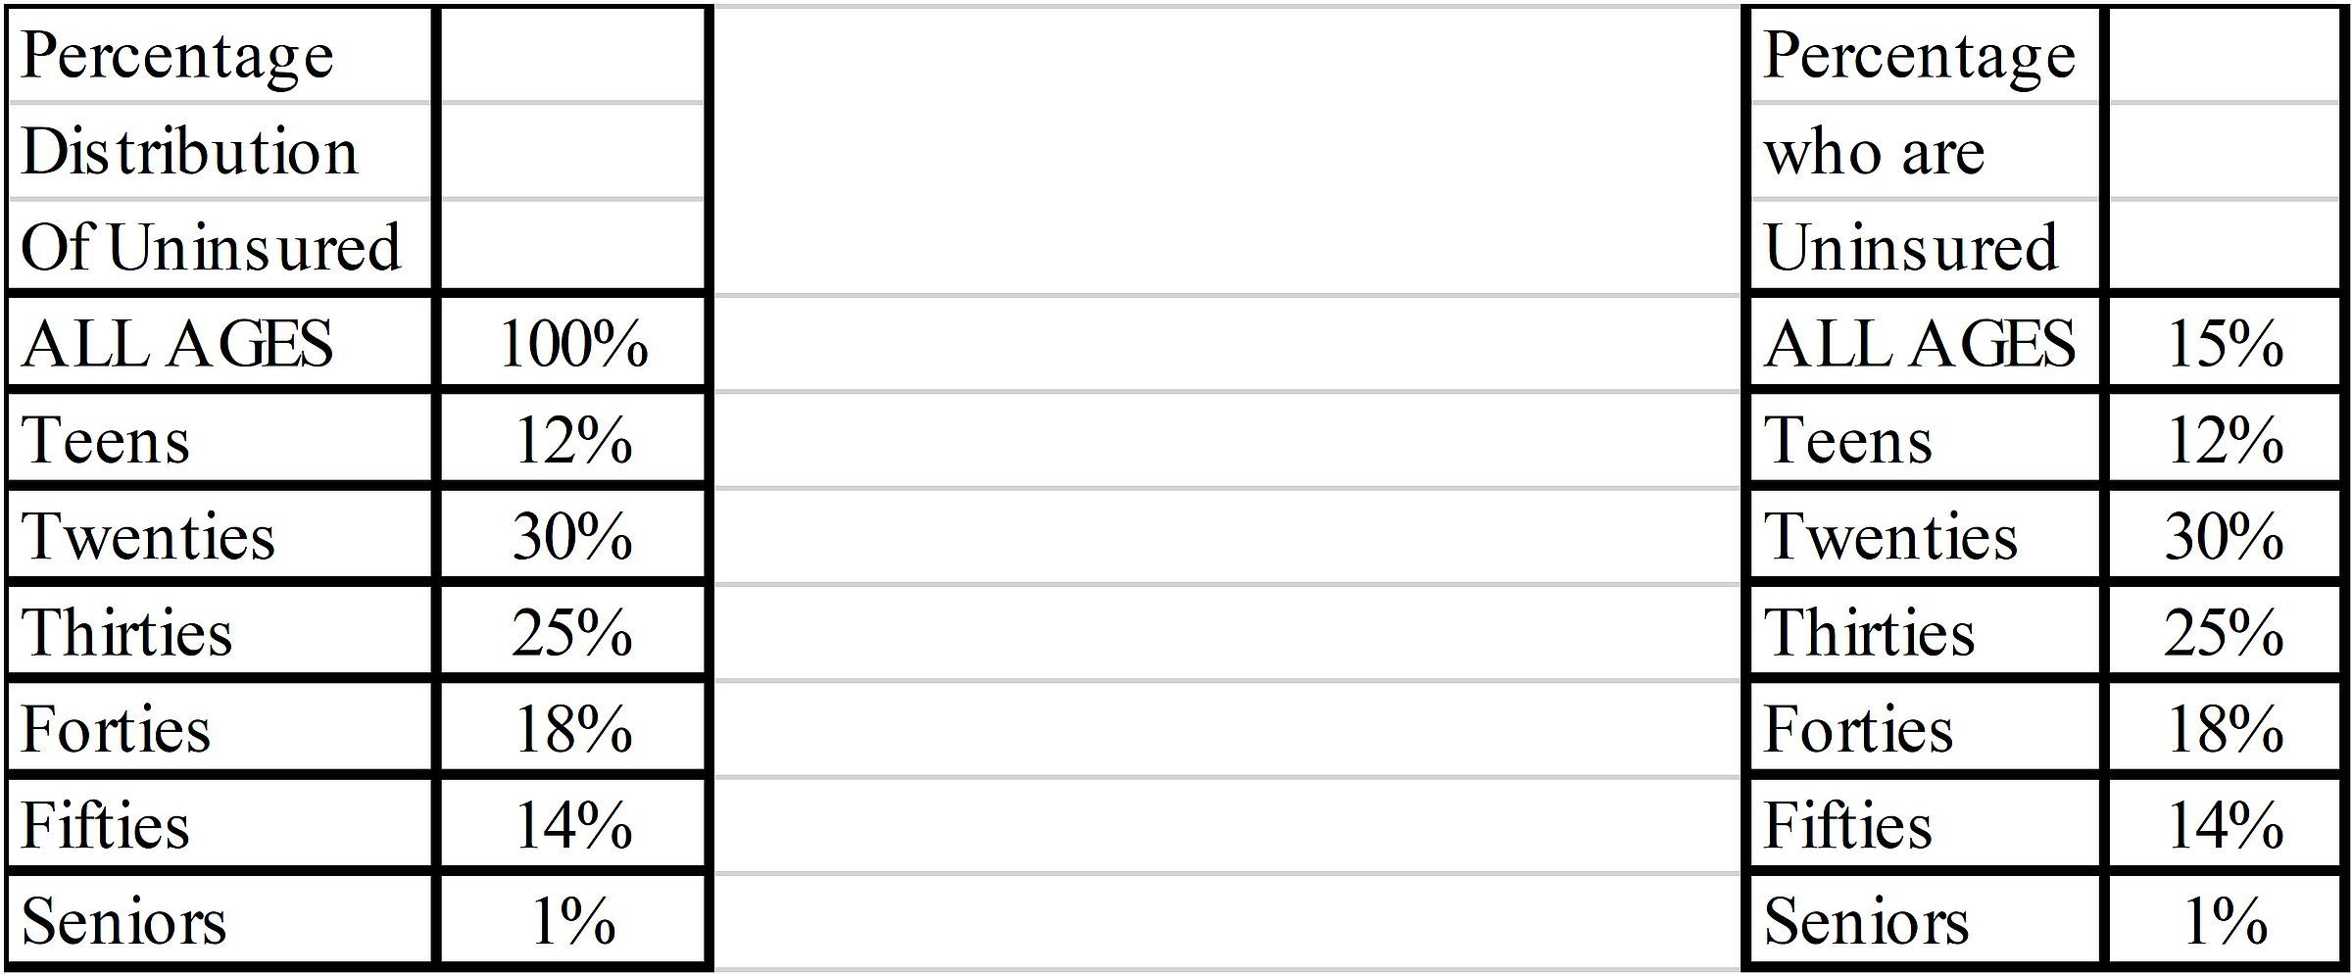
Percentage in Tables:
Half Tables w Helpful Titles
4.8.1; P 201
41
.
Notes:
Model Trendline Linear 2Y1X using Excel 2013
11/24/2013 V0a
www.StatLit.org/pdf/Model-Trendline-Linear-2Y1X-Excel2013-6up.pdf
41
Analyzing Numbers in the News
15 May 2008
2008SchieldNNN6up.pdf
41
41

Slide 42
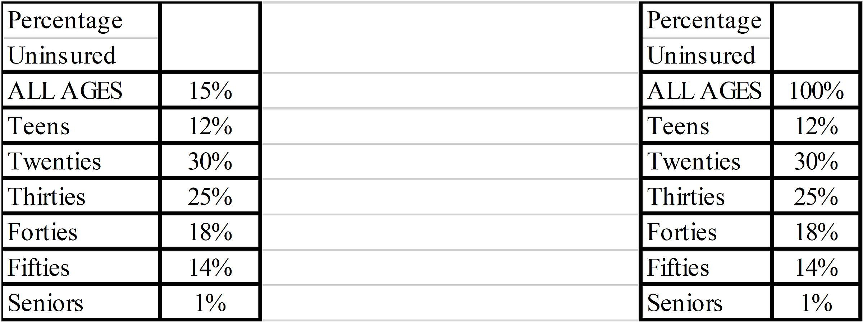
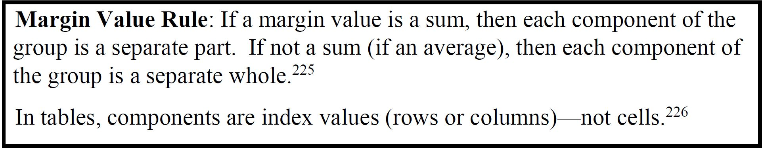
Percentage Tables:
Unhelpful titles; Margin Values
4.8.1; P 202
42
Sum:
larger than largest
100% > 30%.
.
Average:
smaller than largest
15% < 30%.
Notes:
Model Trendline Linear 2Y1X using Excel 2013
11/24/2013 V0a
www.StatLit.org/pdf/Model-Trendline-Linear-2Y1X-Excel2013-6up.pdf
42
Analyzing Numbers in the News
15 May 2008
2008SchieldNNN6up.pdf
42
42

Slide 43
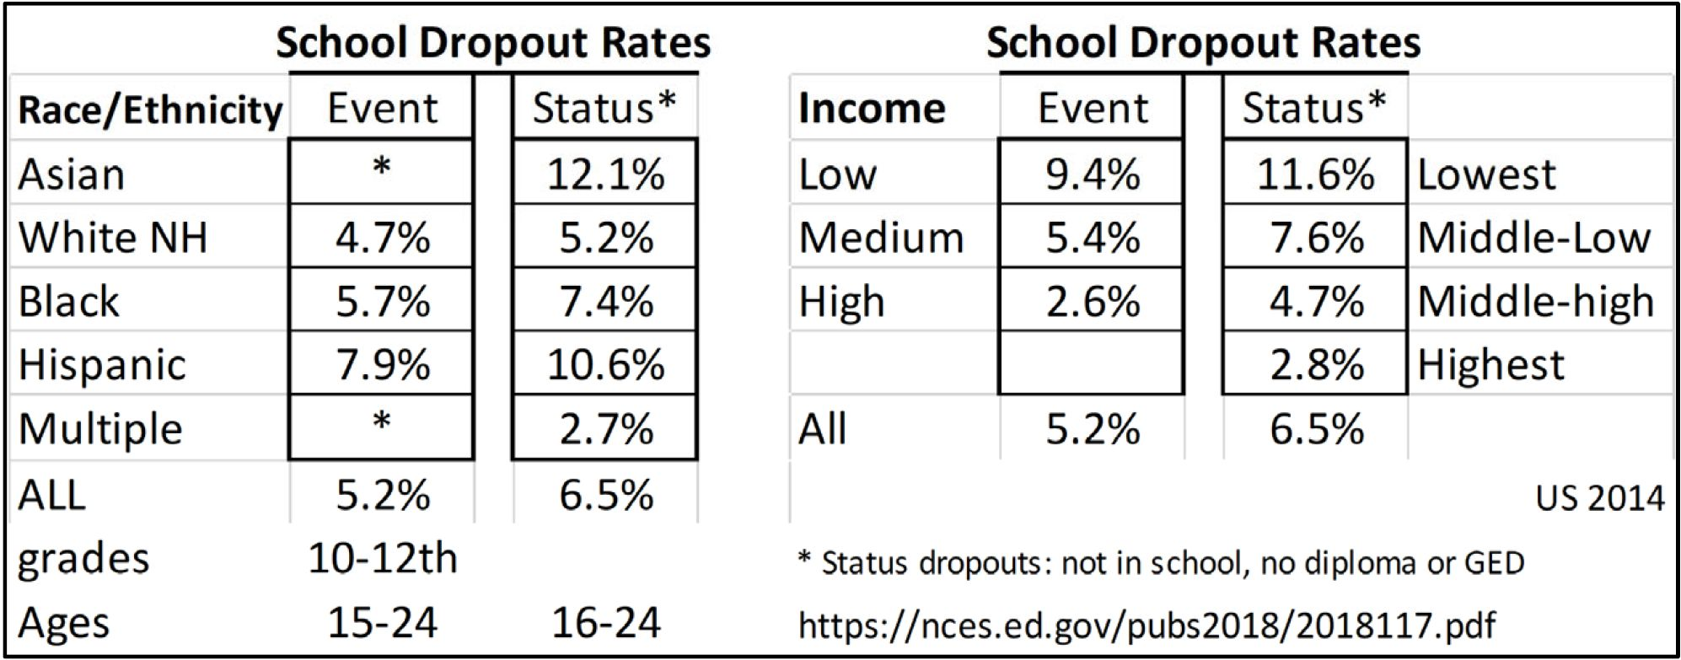
Percentage Tables:
Unhelpful titles; Margin Values
4.8.1; P 203
43
.
Event: dropping out
Status: being a dropout
Normally, the status rate is bigger than the event rate
Notes:
Model Trendline Linear 2Y1X using Excel 2013
11/24/2013 V0a
www.StatLit.org/pdf/Model-Trendline-Linear-2Y1X-Excel2013-6up.pdf
43
Analyzing Numbers in the News
15 May 2008
2008SchieldNNN6up.pdf
43
43

Slide 44
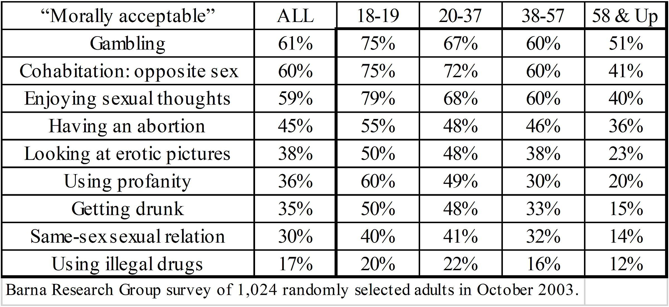
Percentage Tables:
Multiple one-way half-table
4.8.1; P 204
44
.
Q. Do people get less accepting as they get older
Also known as a “rate” table
Notes:
Model Trendline Linear 2Y1X using Excel 2013
11/24/2013 V0a
www.StatLit.org/pdf/Model-Trendline-Linear-2Y1X-Excel2013-6up.pdf
44
Analyzing Numbers in the News
15 May 2008
2008SchieldNNN6up.pdf
44
44

Slide 45
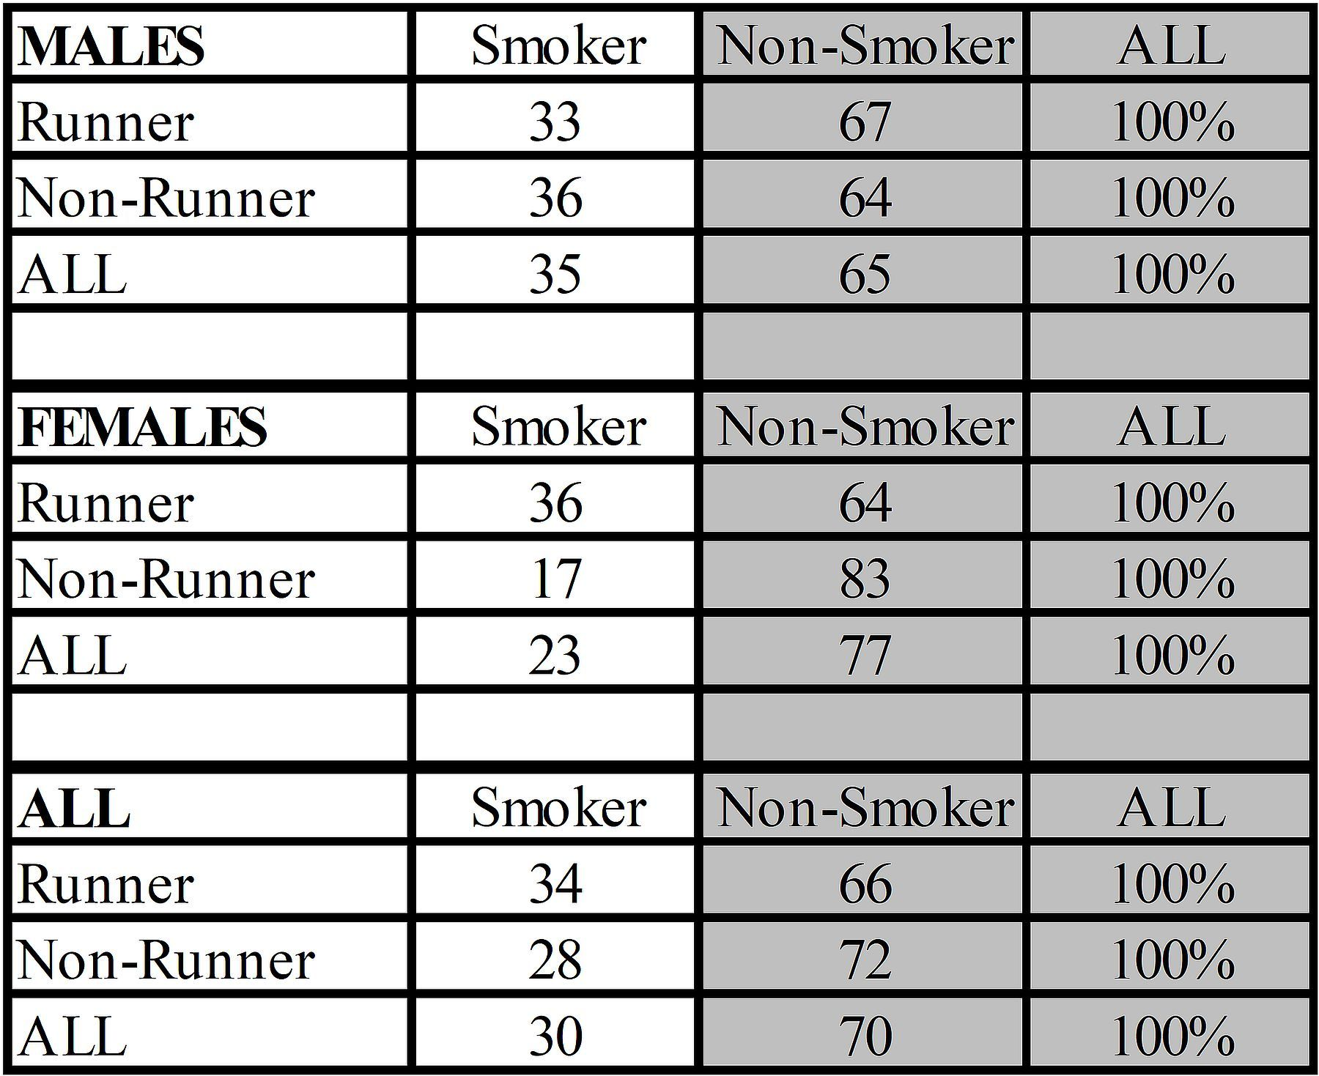
Three-Variable 100% Table:
Can create a Half-Table
4.8.1; P 204
45
.
Notes:
Model Trendline Linear 2Y1X using Excel 2013
11/24/2013 V0a
www.StatLit.org/pdf/Model-Trendline-Linear-2Y1X-Excel2013-6up.pdf
45
Analyzing Numbers in the News
15 May 2008
2008SchieldNNN6up.pdf
45
45

Slide 46
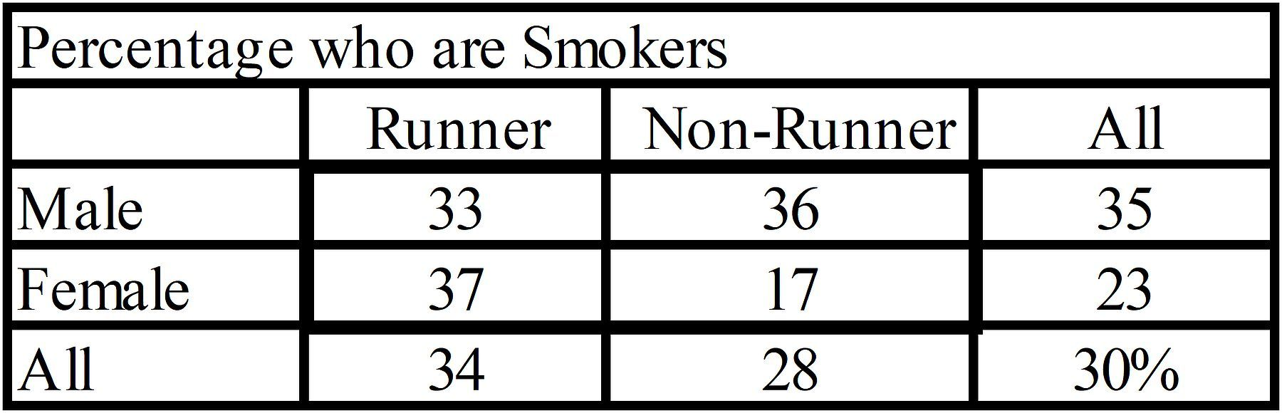
Two-Way Half Table:
Helpful Title
4.8.2; P 205
46
All margin values are averages.
So, rows and columns are both wholes.
Part must be in the title.
Notes:
Model Trendline Linear 2Y1X using Excel 2013
11/24/2013 V0a
www.StatLit.org/pdf/Model-Trendline-Linear-2Y1X-Excel2013-6up.pdf
46
Analyzing Numbers in the News
15 May 2008
2008SchieldNNN6up.pdf
46
46

Slide 47
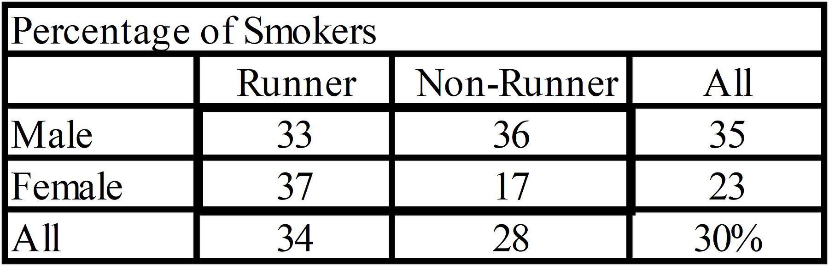
Two-Way Half Table:
Ambiguous Title
4.8.2; P 206
47
All margin values are averages.
So, rows and columns are both wholes.
Part must be in the title: smoker.
Notes:
Model Trendline Linear 2Y1X using Excel 2013
11/24/2013 V0a
www.StatLit.org/pdf/Model-Trendline-Linear-2Y1X-Excel2013-6up.pdf
47
Analyzing Numbers in the News
15 May 2008
2008SchieldNNN6up.pdf
47
47

Slide 48
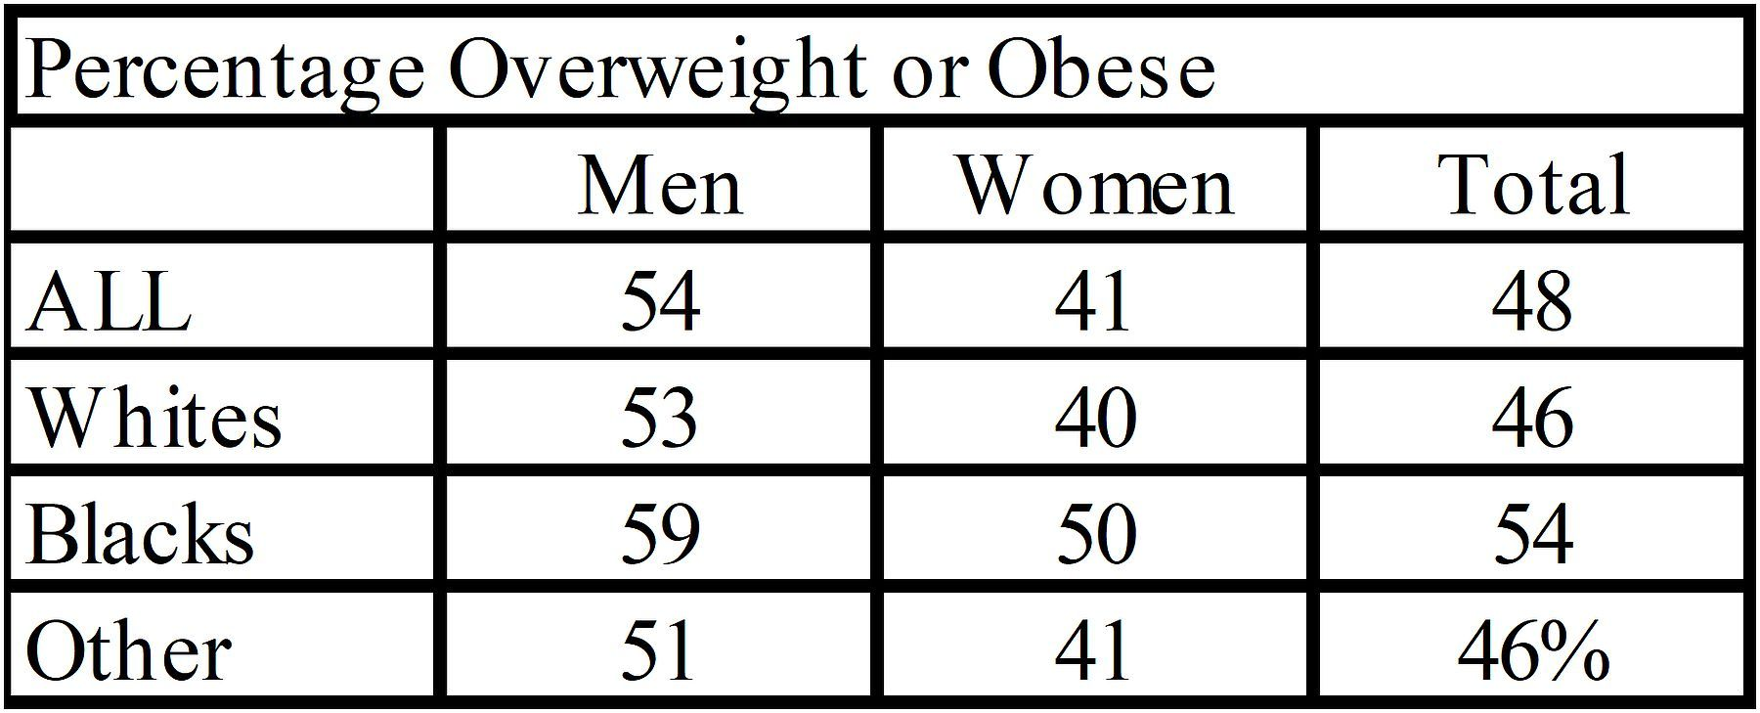
Two-Way Half Table:
Unhelpful Title
4.8.2; P 206
48
For percentages, Total means All – not Sum.
Notes:
Model Trendline Linear 2Y1X using Excel 2013
11/24/2013 V0a
www.StatLit.org/pdf/Model-Trendline-Linear-2Y1X-Excel2013-6up.pdf
48
Analyzing Numbers in the News
15 May 2008
2008SchieldNNN6up.pdf
48
48

Slide 49
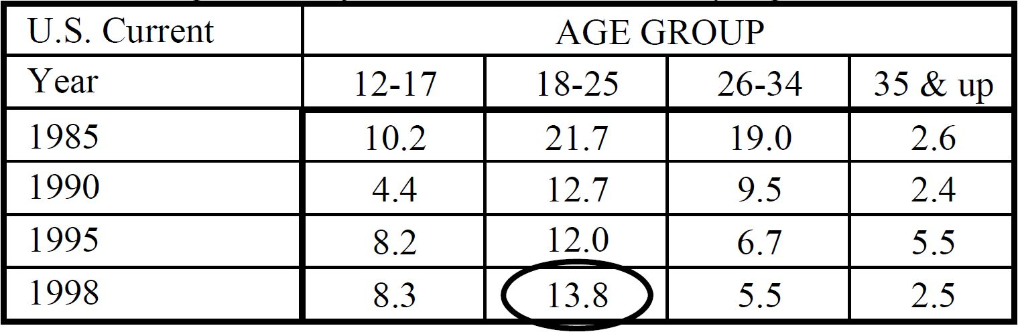
Table with Missing Margins
4.8.3; P 207
49
Percentage of Marijuana or Hashish Users
Missing Margin Rule: If a margin is missing and the index values are exclusive, then the indexes are wholes (unless they add to 100%)
Notes:
Model Trendline Linear 2Y1X using Excel 2013
11/24/2013 V0a
www.StatLit.org/pdf/Model-Trendline-Linear-2Y1X-Excel2013-6up.pdf
49
Analyzing Numbers in the News
15 May 2008
2008SchieldNNN6up.pdf
49
49

Slide 50
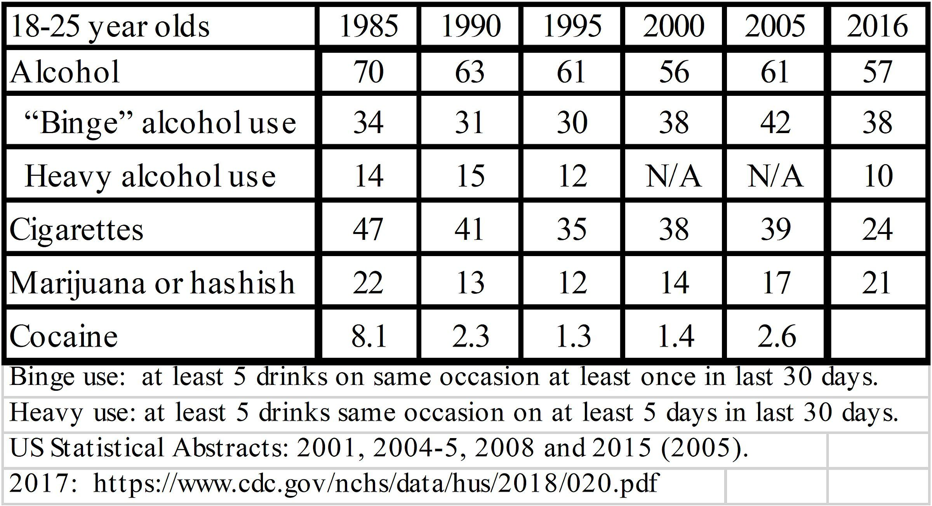
Table with a Missing Margins
4.8.3; P 209
50
Current (last month) Drug Use (%)
Notes:
Model Trendline Linear 2Y1X using Excel 2013
11/24/2013 V0a
www.StatLit.org/pdf/Model-Trendline-Linear-2Y1X-Excel2013-6up.pdf
50
Analyzing Numbers in the News
15 May 2008
2008SchieldNNN6up.pdf
50
50

Slide 51
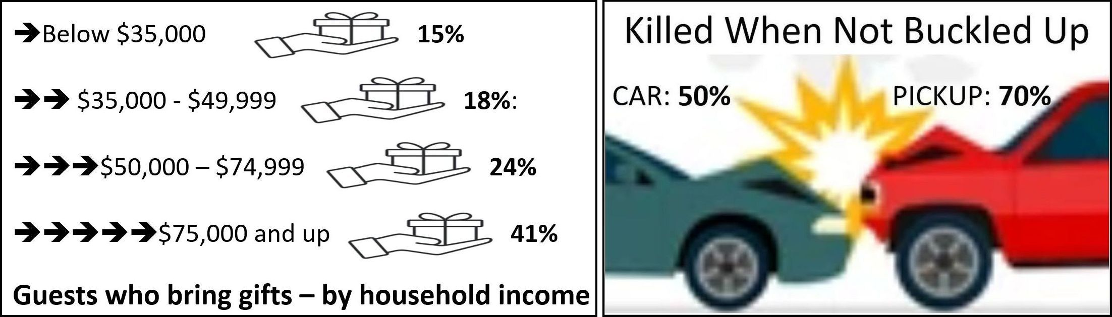
Ambiguous Graphs:
USA Today
4.8.3; P 209
51
15% of guests bringing gifts have <35K income.
15% of guests w <35K income bring gifts.
In accidents:
50% of car drivers killed were not buckled up.
50% of unbuckled car drivers were killed
Notes:
Model Trendline Linear 2Y1X using Excel 2013
11/24/2013 V0a
www.StatLit.org/pdf/Model-Trendline-Linear-2Y1X-Excel2013-6up.pdf
51
Analyzing Numbers in the News
15 May 2008
2008SchieldNNN6up.pdf
51
51

Slide 52
Seven Questions when
Dealing with Statistics
3.8: P 158
52
Confounding. How big/many/much?
Assembly: Compared to what?
Assembly: How are things defined, counted/
measured, summarized, grouped, presented?
Confounded: Why not a rate? Per what?
Confounded: What was taken into account?
Confounded: What should be controlled for?
Random/Error: Coincidence/selection bias?
Notes:
Model Trendline Linear 2Y1X using Excel 2013
11/24/2013 V0a
www.StatLit.org/pdf/Model-Trendline-Linear-2Y1X-Excel2013-6up.pdf
52
Analyzing Numbers in the News
15 May 2008
2008SchieldNNN6up.pdf
52
52

Slide 53
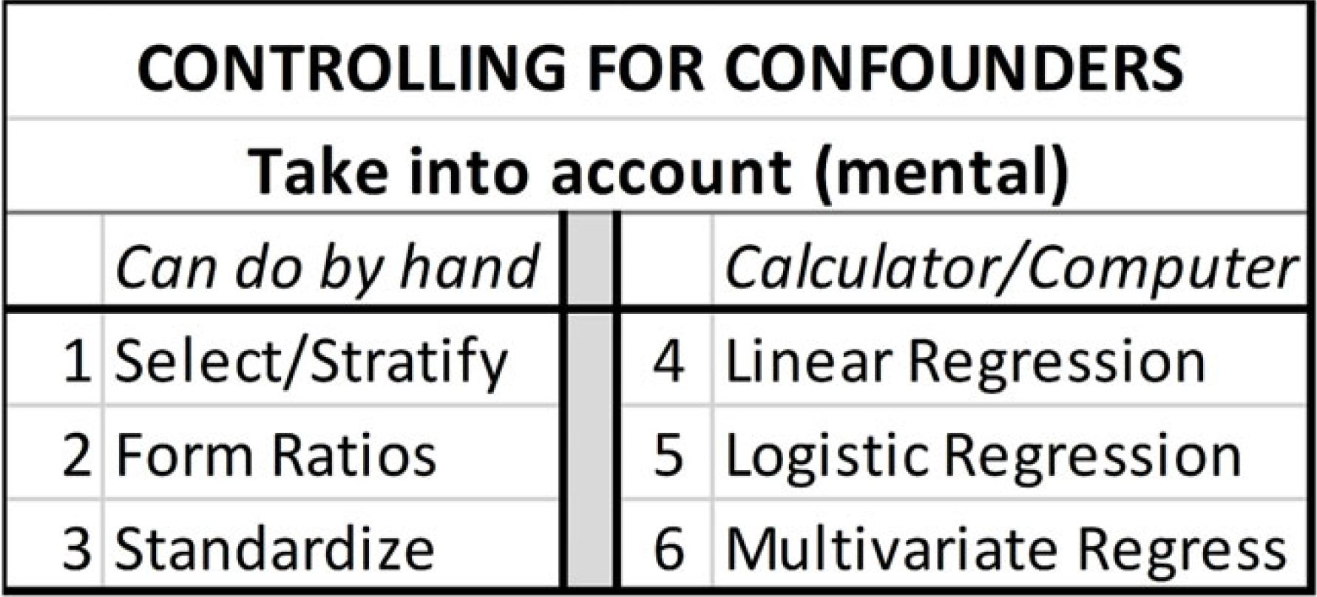
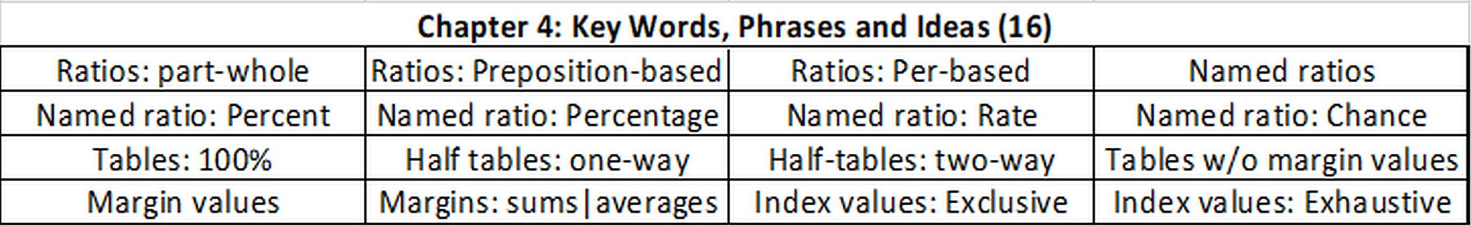
Chapter 4 Summary
4.9; P 210
53
Notes:
Model Trendline Linear 2Y1X using Excel 2013
11/24/2013 V0a
www.StatLit.org/pdf/Model-Trendline-Linear-2Y1X-Excel2013-6up.pdf
53
Analyzing Numbers in the News
15 May 2008
2008SchieldNNN6up.pdf
53
53

Slide 54
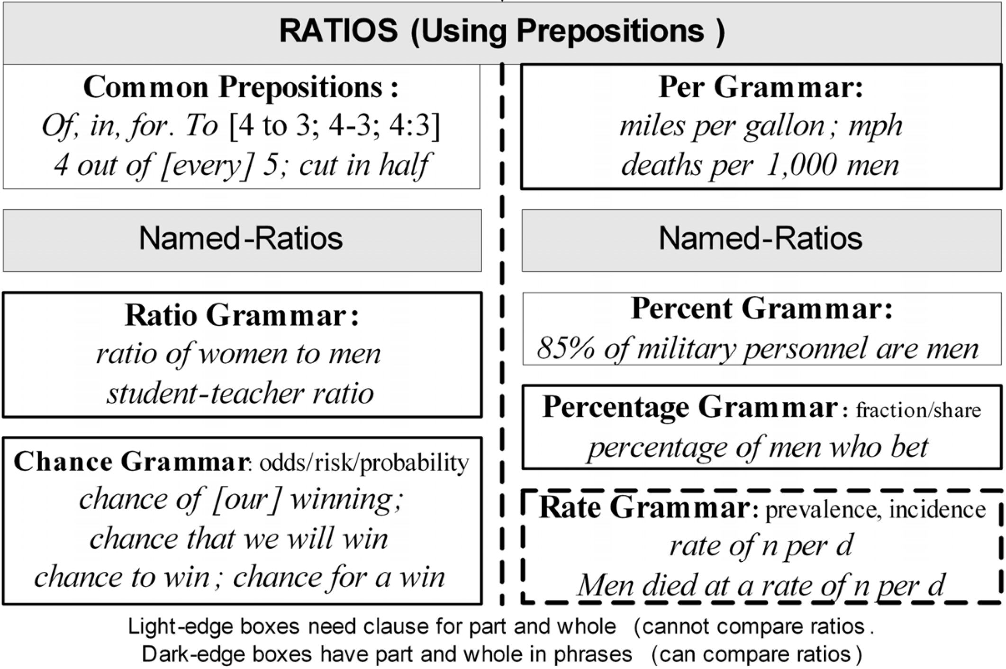
Table with Missing Margins
4.10.4; P 216
54
.
Notes:
Model Trendline Linear 2Y1X using Excel 2013
11/24/2013 V0a
www.StatLit.org/pdf/Model-Trendline-Linear-2Y1X-Excel2013-6up.pdf
54
Analyzing Numbers in the News
15 May 2008
2008SchieldNNN6up.pdf
54
54

