Slide 1
Statistical Literacy Textbook:
Chapter 6 Slides
Statistical Literacy:
Critical Thinking about Everyday Statistics
Kendall-Hunt 2023
Milo Schield
ASA Fellow
Adjunct: University of New Mexico
Visiting Professor: New College of Florida
www.StatLit.org/pdf/
2023-Schield-StatLit-Ch6-Slides.pdf
Notes:
Model Trendline Linear 2Y1X using Excel 2013
11/24/2013 V0a
www.StatLit.org/pdf/Model-Trendline-Linear-2Y1X-Excel2013-6up.pdf
1
Analyzing Numbers in the News
15 May 2008
2008SchieldNNN6up.pdf
1
1

Slide 2
Comparing Ratios
Chapter 6: Table of Contents
6.0, P 234
2
6.1 p 234 Learning Outcomes
6.2 p 235 Review
6.3 p 235 Comparing Ratios: Introduction
6.4 p 236 Attributable Comparisons
6.5 p 240 Comparing Ratios: Common vs Distinct Part
6.6 p 243 Comparing Ratios using Likely
6.7 p 254 Comparing Ratios using Named Ratios
6.8 p 263 Comparing Quintiles
6.9 p 263 Comparing Ratios: Critical Thinking
6.10 p 264 Confounding: A Review
Notes:
Model Trendline Linear 2Y1X using Excel 2013
11/24/2013 V0a
www.StatLit.org/pdf/Model-Trendline-Linear-2Y1X-Excel2013-6up.pdf
2
Analyzing Numbers in the News
15 May 2008
2008SchieldNNN6up.pdf
2
2

Slide 3
Understanding Measurements:
Learning Outcomes
6.1, P 234
3
Calculate percentage and counts attributable to group
Distinguish common part and distinct part comparisons
Read and write comparisons of ratios using likely grammar
Read and write comparisons of ratios: named ratio grammar
Notes:
Model Trendline Linear 2Y1X using Excel 2013
11/24/2013 V0a
www.StatLit.org/pdf/Model-Trendline-Linear-2Y1X-Excel2013-6up.pdf
3
Analyzing Numbers in the News
15 May 2008
2008SchieldNNN6up.pdf
3
3

Slide 4
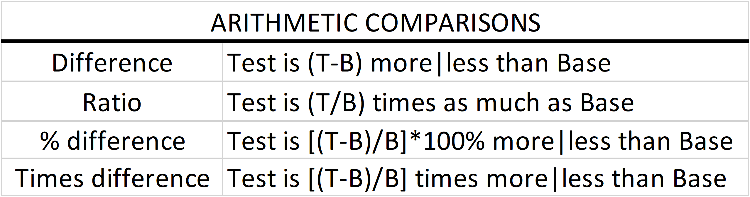
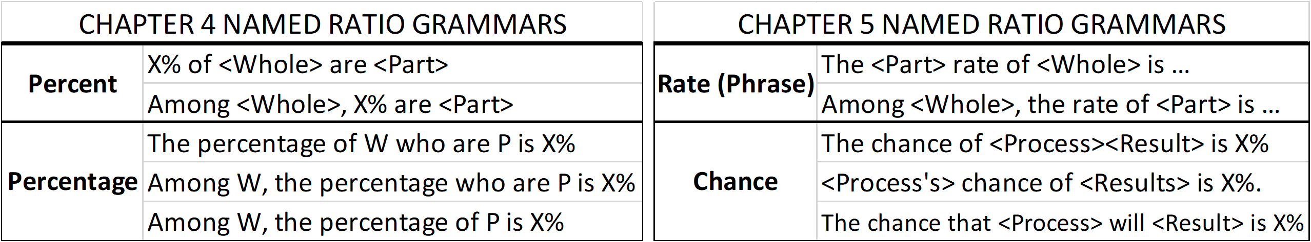
Review
Comparisons and Named Ratios
6.2, P 235
4
Chapter 2: Comparisons
Chapters 4 and 5: Named Ratios
Notes:
Model Trendline Linear 2Y1X using Excel 2013
11/24/2013 V0a
www.StatLit.org/pdf/Model-Trendline-Linear-2Y1X-Excel2013-6up.pdf
4
Analyzing Numbers in the News
15 May 2008
2008SchieldNNN6up.pdf
4
4

Slide 5
Introduction:
Comparing Ratios
6.3, P 235
5
This chapter introduces two kinds of comparisons:
Attributable comparisons of ratios. These are modeled.
Arithmetic comparisons of ratios
Attributable vs. caused:
216,000 deaths attributable to obesity
216,000 deaths caused by obesity.
Likely vs. frequently or commonly:
Military men: less likely to be patients than women
Military men: more commonly patients than are women.
Notes:
Model Trendline Linear 2Y1X using Excel 2013
11/24/2013 V0a
www.StatLit.org/pdf/Model-Trendline-Linear-2Y1X-Excel2013-6up.pdf
5
Analyzing Numbers in the News
15 May 2008
2008SchieldNNN6up.pdf
5
5

Slide 6
Attributable Data:
6.4.1, P 237
6
What percentage is attributable to ________?
About 33% of all private medical insurance costs, and 20% of Medicare medical costs are attributed to smoking.
How many cases (deaths) are attributable to_______?
Premature deaths attributed to: smoking (470K), hypertension (395K), overweight (216K), high salt intake (102K), low omega3 fatty acids (84K), and high trans-fatty acids (82K). Pollution kills 9 million people/year.
Can anyone know any of these things?
Can these things be counted or connected?
A. No! They can’t!
Notes:
Model Trendline Linear 2Y1X using Excel 2013
11/24/2013 V0a
www.StatLit.org/pdf/Model-Trendline-Linear-2Y1X-Excel2013-6up.pdf
6
Analyzing Numbers in the News
15 May 2008
2008SchieldNNN6up.pdf
6
6

Slide 7
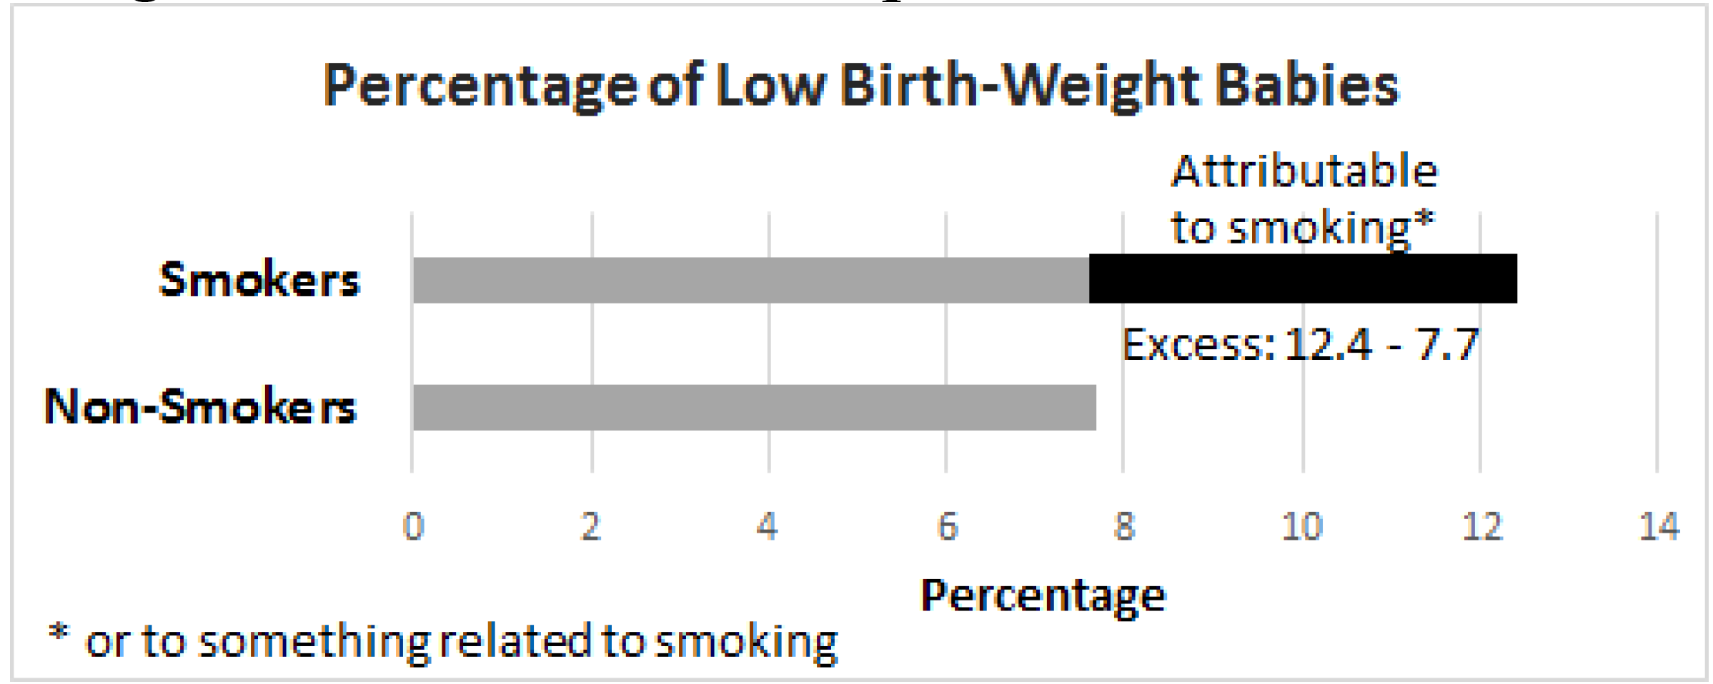
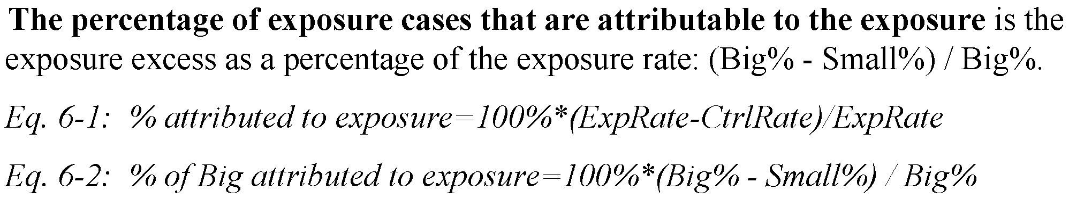
Attributable Comparisons:
Percentage Attributable
6.4,1, P 237
7
The excess rate is the difference between the bigger (exposure) rate and the smaller (control) rate.
.
Notes:
Model Trendline Linear 2Y1X using Excel 2013
11/24/2013 V0a
www.StatLit.org/pdf/Model-Trendline-Linear-2Y1X-Excel2013-6up.pdf
7
Analyzing Numbers in the News
15 May 2008
2008SchieldNNN6up.pdf
7
7

Slide 8
Attributable Comparisons:
Cases Attributable
6.4.1, P 237
8
The percentage of low birth-weight babies attributable to having a mom who smoked is 38%: 100%*(.124-.077)/.124
If moms who smoked had 20,000 low-birthweight babies, them the # of low birth-weight babies attributable to having a mom who smoked is 7,600: 0.38*20K
Notes:
Model Trendline Linear 2Y1X using Excel 2013
11/24/2013 V0a
www.StatLit.org/pdf/Model-Trendline-Linear-2Y1X-Excel2013-6up.pdf
8
Analyzing Numbers in the News
15 May 2008
2008SchieldNNN6up.pdf
8
8

Slide 9
Attributable Comparisons:
Percentage Attributable
6.4.1, P 238, 239
9
If lung cancer death rate: 200/100K smokers (20/100K non-smokers), what percentage of lung cancer deaths for smokers is attributed to smoking?
If accident rate per 100K licensed drivers is 20 for young (10 for older), what percentage of accidents among the young are attributed to being young?
If US poverty rate is 50% for children in single parent families (10% in married-parent families), what percentage of poverty in single parent families is attributable to living in a single-parent family?
Notes:
Model Trendline Linear 2Y1X using Excel 2013
11/24/2013 V0a
www.StatLit.org/pdf/Model-Trendline-Linear-2Y1X-Excel2013-6up.pdf
9
Analyzing Numbers in the News
15 May 2008
2008SchieldNNN6up.pdf
9
9

Slide 10
Attributable Comparisons:
Cases Attributable
6.4.1, P 238, 239
10
If 90% of lung cancer deaths among smokers are attributed to smoking, and there are 100,000 lung cancer deaths for smokers in the US in 2026, how many of these deaths among smokers are attributable to smoking?
If 50% of auto accidents are attributed to younger drivers (under 20), and there are 1 million auto accidents involving younger drivers, how many of these accidents are attributable to the driver being a teenager?
If 80% of families in poverty are attributable to having a single parent, and there are 11 million US families in poverty headed by a single parent, then how many of these of these families in poverty are attributable to being headed by a single parent?
Notes:
Model Trendline Linear 2Y1X using Excel 2013
11/24/2013 V0a
www.StatLit.org/pdf/Model-Trendline-Linear-2Y1X-Excel2013-6up.pdf
10
Analyzing Numbers in the News
15 May 2008
2008SchieldNNN6up.pdf
10
10

Slide 11
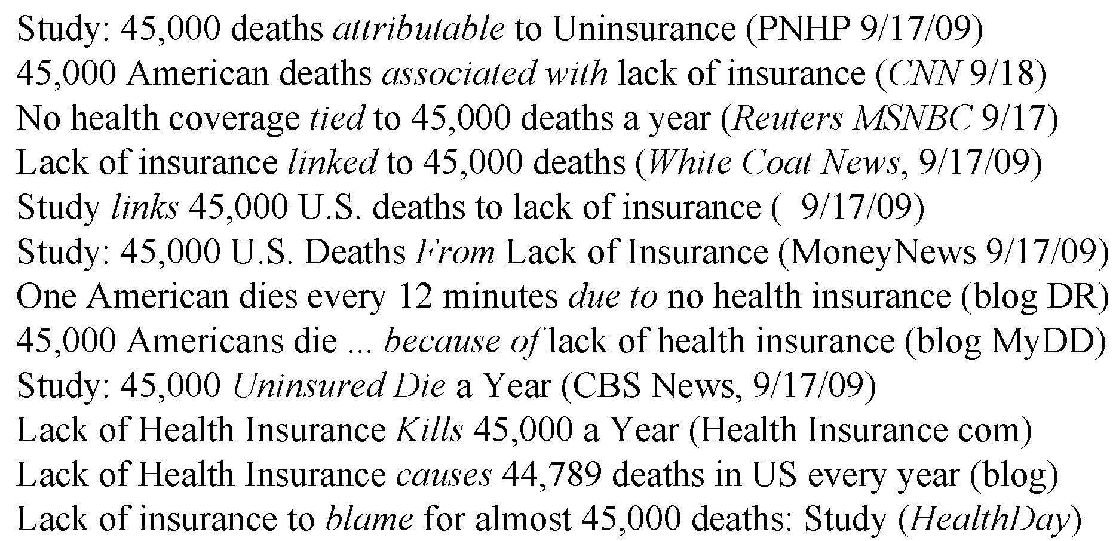
Attributable Comparisons:
Percentage Attributable
6.4, P 239
11
.
.
Notes:
Model Trendline Linear 2Y1X using Excel 2013
11/24/2013 V0a
www.StatLit.org/pdf/Model-Trendline-Linear-2Y1X-Excel2013-6up.pdf
11
Analyzing Numbers in the News
15 May 2008
2008SchieldNNN6up.pdf
11
11

Slide 12
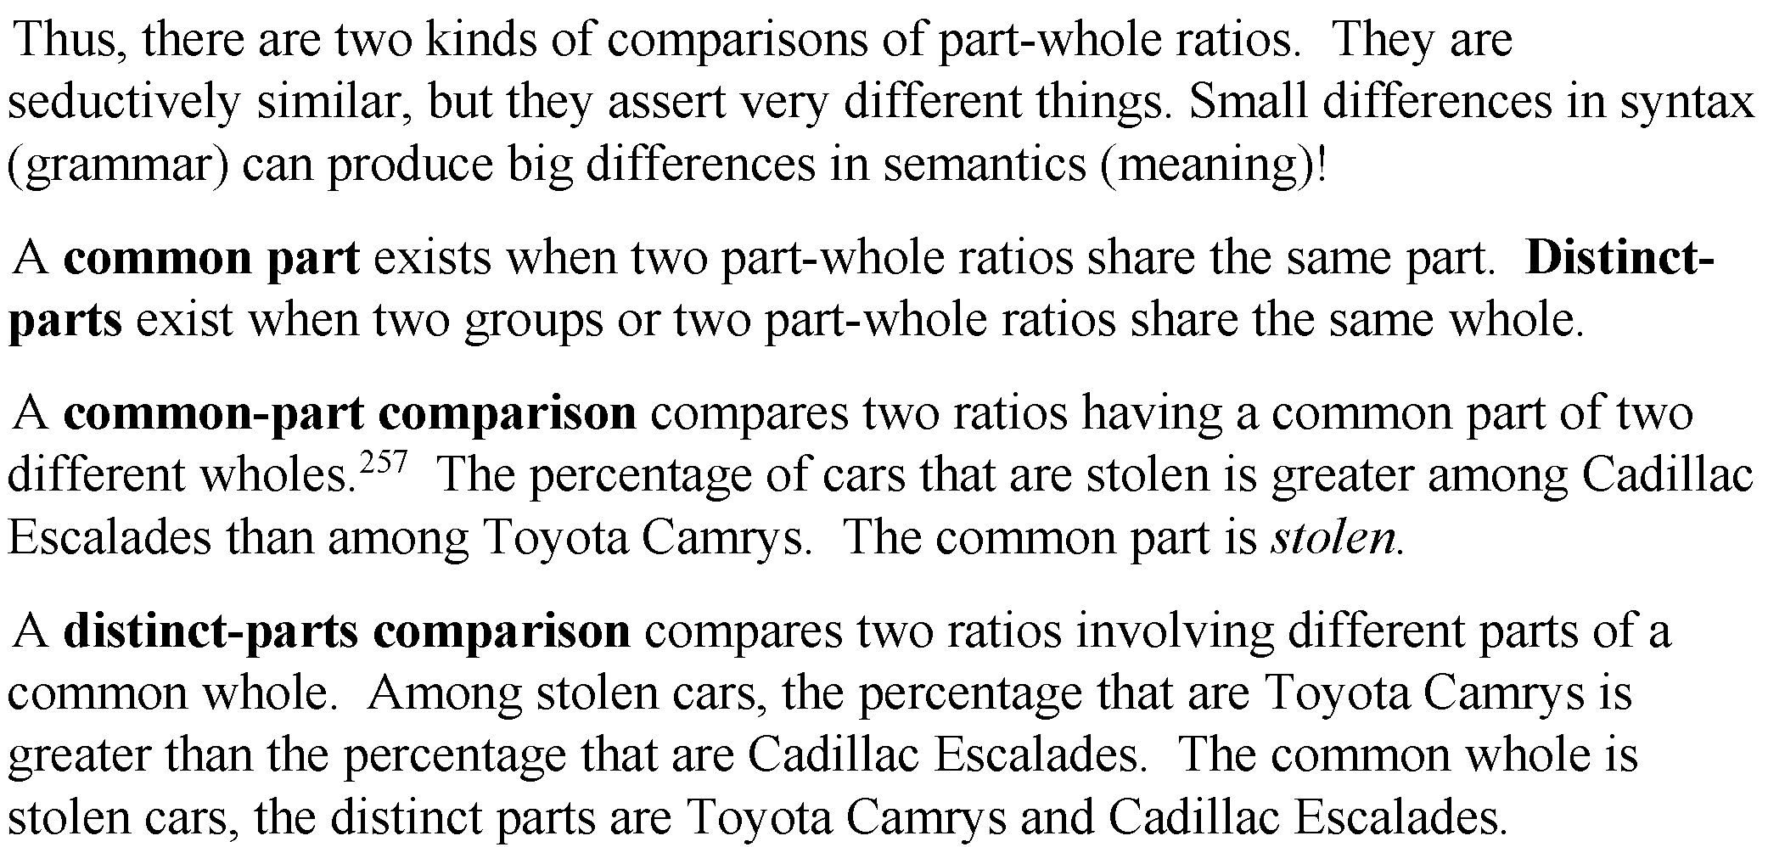
Comparing
Part-Whole Ratios
6.5, P 240
12
.
.
Notes:
Model Trendline Linear 2Y1X using Excel 2013
11/24/2013 V0a
www.StatLit.org/pdf/Model-Trendline-Linear-2Y1X-Excel2013-6up.pdf
12
Analyzing Numbers in the News
15 May 2008
2008SchieldNNN6up.pdf
12
12

Slide 13
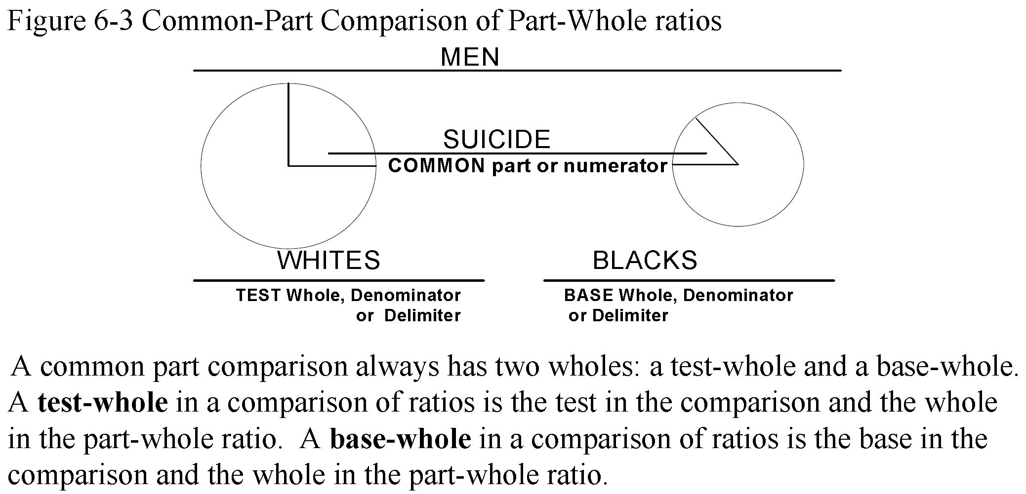
Common-Part
Comparison
6.5, P 241
13
Percentage of suicides among white men vs. that among black men:
.
Notes:
Model Trendline Linear 2Y1X using Excel 2013
11/24/2013 V0a
www.StatLit.org/pdf/Model-Trendline-Linear-2Y1X-Excel2013-6up.pdf
13
Analyzing Numbers in the News
15 May 2008
2008SchieldNNN6up.pdf
13
13

Slide 14
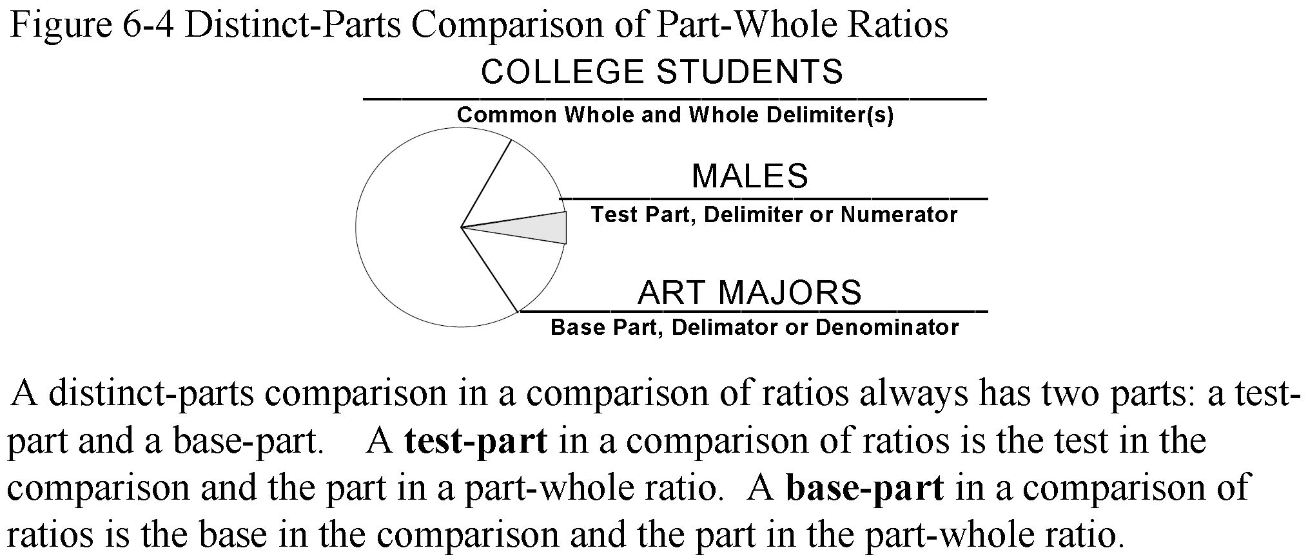
Distinct-Parts Comparison
6.5, P 241
14
The percentage of college students who are male versus
the percentage of art majors among college students.
.
Notes:
Model Trendline Linear 2Y1X using Excel 2013
11/24/2013 V0a
www.StatLit.org/pdf/Model-Trendline-Linear-2Y1X-Excel2013-6up.pdf
14
Analyzing Numbers in the News
15 May 2008
2008SchieldNNN6up.pdf
14
14

Slide 15
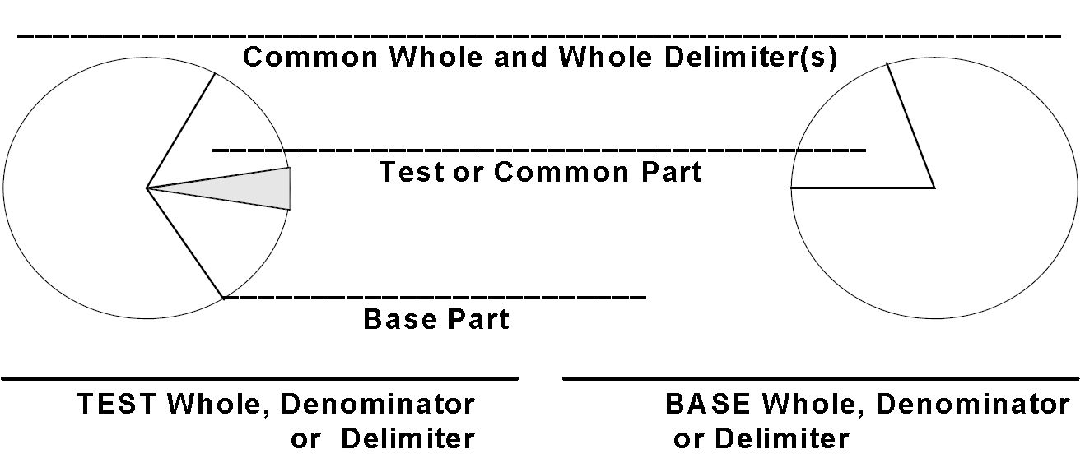
Comparison of Ratios:
Graphical Template
6.5, P 242
15
.
.
Notes:
Model Trendline Linear 2Y1X using Excel 2013
11/24/2013 V0a
www.StatLit.org/pdf/Model-Trendline-Linear-2Y1X-Excel2013-6up.pdf
15
Analyzing Numbers in the News
15 May 2008
2008SchieldNNN6up.pdf
15
15

Slide 16
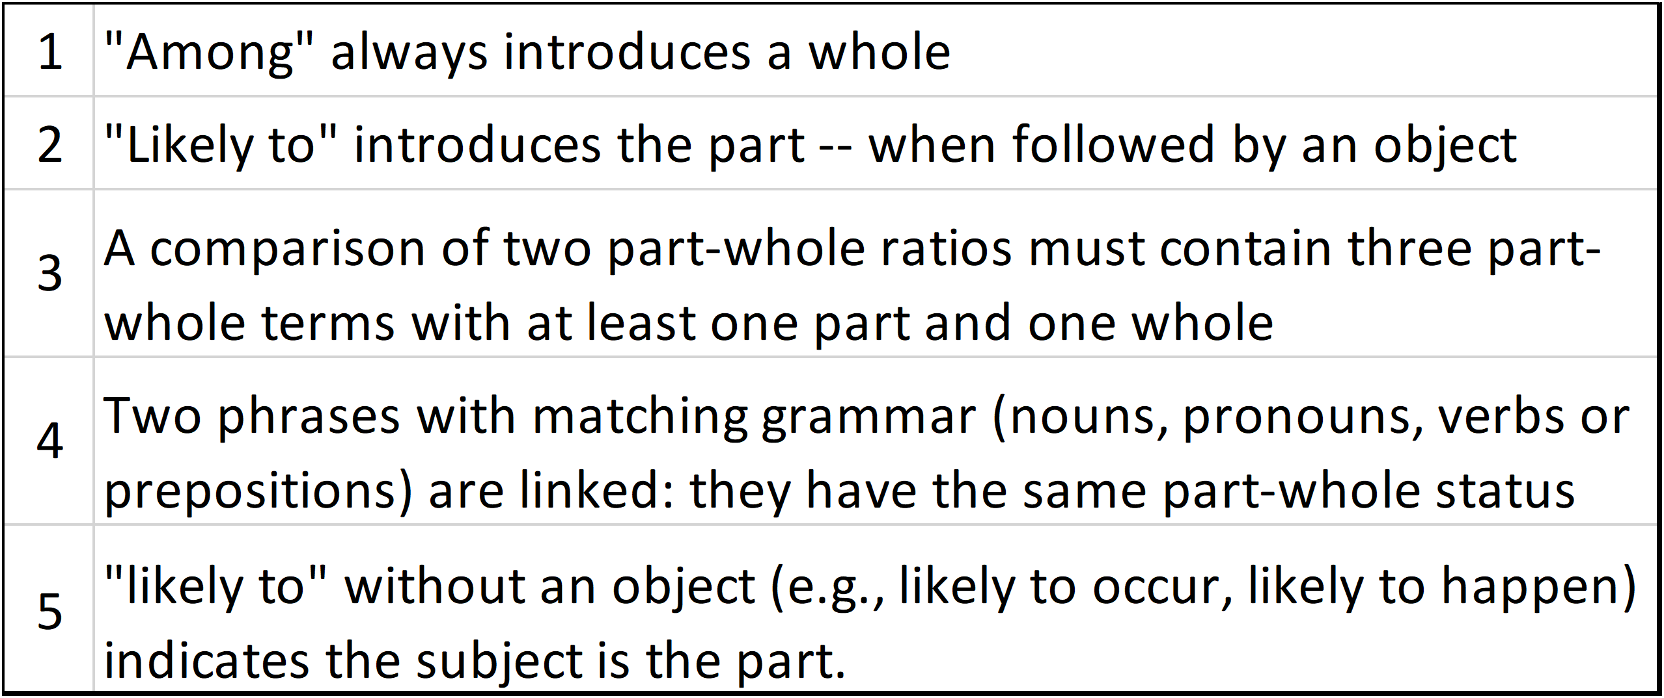
Comparing Ratios
Using Likely Grammar
6.6, P 244
16
The percentage of smokers among men is greater than among women.
1) Men are more likely to smoke than women.
2 Smokers are more likely (prevalent) among men than among women
.
Notes:
Model Trendline Linear 2Y1X using Excel 2013
11/24/2013 V0a
www.StatLit.org/pdf/Model-Trendline-Linear-2Y1X-Excel2013-6up.pdf
16
Analyzing Numbers in the News
15 May 2008
2008SchieldNNN6up.pdf
16
16

Slide 17
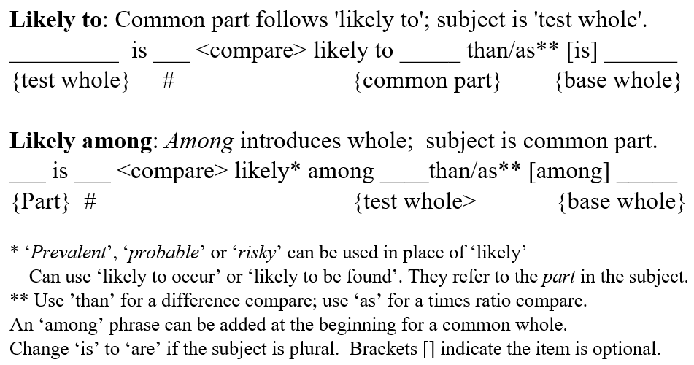
Comparing Part-Whole Ratios.
Likely Grammar: Common Part
6.6, P 246
17
This figure fixes an error in the 2023 textbook: Figure 6-9.
Notes:
Model Trendline Linear 2Y1X using Excel 2013
11/24/2013 V0a
www.StatLit.org/pdf/Model-Trendline-Linear-2Y1X-Excel2013-6up.pdf
17
Analyzing Numbers in the News
15 May 2008
2008SchieldNNN6up.pdf
17
17

Slide 18
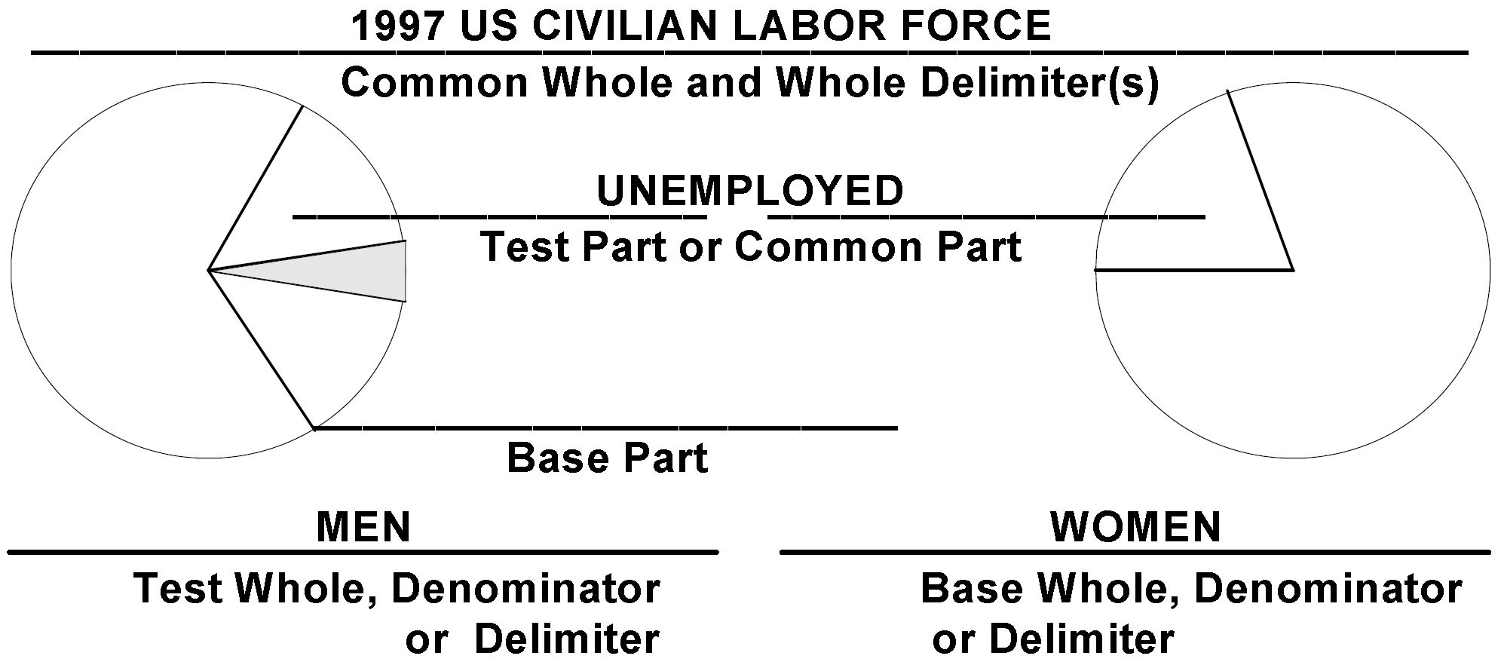
Comparing Part-Whole Ratios.
Named Ratios: Common Part
6.7, P 254
18
In the 1997 US civilian labor force, the percentage of men who were unemployed was 13% higher than that of women.
In the 1997 US civilian labor force, unemployment was 13% more likely among men than [among] women.
Notes:
Model Trendline Linear 2Y1X using Excel 2013
11/24/2013 V0a
www.StatLit.org/pdf/Model-Trendline-Linear-2Y1X-Excel2013-6up.pdf
18
Analyzing Numbers in the News
15 May 2008
2008SchieldNNN6up.pdf
18
18

Slide 19
Likely/Prevalent Grammar:
Covert between ‘likely’ statements
6.6.4; P 249
19
Likely common-part comparisons of part-whole ratios:
<Test> are <compare> likely to <part> than/as [are] <base>
<Part> are <compare> likely among <test> than/as [among] <base>
Smoking is more likely among women than among men. Convert to ‘likely to’.
Black families are more likely to have (be headed by) a single parent than [are] White families. Convert to ‘likely among’.
Notes:
Model Trendline Linear 2Y1X using Excel 2013
11/24/2013 V0a
www.StatLit.org/pdf/Model-Trendline-Linear-2Y1X-Excel2013-6up.pdf
19
Analyzing Numbers in the News
15 May 2008
2008SchieldNNN6up.pdf
19
19

Slide 20
Likely/Prevalent Grammar:
Covert between ‘likely’ statements
6.6.4; P 250
20
Common-part comparison of part-whole ratios.
<Test> are <compare> likely to <part> than/as [are] <base>
<Part> are <compare> likely among <test> than/as [among] <base>
Among single-parent families, living in poverty is more likely among those with a GED than that among those with a high- school degree. Convert to ‘likely to’
Families headed by a single parent are more likely to live in poverty than [are] families headed by a married couple. Convert to ‘likely among’.
Notes:
Model Trendline Linear 2Y1X using Excel 2013
11/24/2013 V0a
www.StatLit.org/pdf/Model-Trendline-Linear-2Y1X-Excel2013-6up.pdf
20
Analyzing Numbers in the News
15 May 2008
2008SchieldNNN6up.pdf
20
20

Slide 21
Using ‘likely’ to compare %:
Given Percent Grammar
6.6.2; P 246
21
75% of business majors are males. (50% of MIS majors).
Compare as a % difference; smaller as base; use ‘likely among’.
<Part> are <compare>likely among <test> than/as <base>
Men are 50% more prevalent among business majors
than [among] MIS majors.
2. Compare as a times ratio; smaller as the base; use ‘likely to’
<Test> are <compare> likely to <part> than/as [are] <base>.
Business majors are 1.5 times as likely to be men
as [are] MIS majors.
Notes:
Model Trendline Linear 2Y1X using Excel 2013
11/24/2013 V0a
www.StatLit.org/pdf/Model-Trendline-Linear-2Y1X-Excel2013-6up.pdf
21
Analyzing Numbers in the News
15 May 2008
2008SchieldNNN6up.pdf
21
21

Slide 22
Using ‘likely’ to compare %:
Given Percentage Grammar
6.6.2; P 246
22
The percentage of men who smoke is 25% (20% of women)
Compare as a % difference; smaller as base; use ‘likely among’.
<Part> are <compare>likely among <test> than/as <base>
Smoking is 25% more prevalent among men
than [among] women.
2. Compare as a times ratio; smaller as the base; use ‘likely to’
<Test> are <compare> likely to <part> than/as [are] <base>.
Men are 1.25 times as likely to be smokers
as [are] women.
Notes:
Model Trendline Linear 2Y1X using Excel 2013
11/24/2013 V0a
www.StatLit.org/pdf/Model-Trendline-Linear-2Y1X-Excel2013-6up.pdf
22
Analyzing Numbers in the News
15 May 2008
2008SchieldNNN6up.pdf
22
22

Slide 23
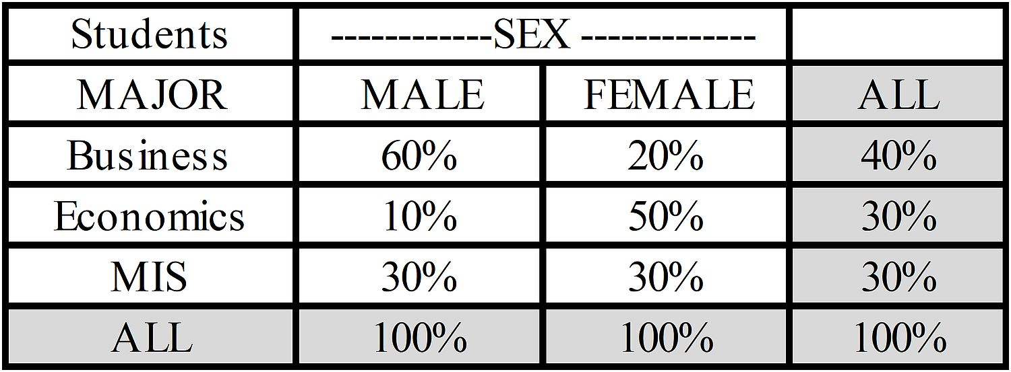
Using ‘likely’ to compare %:
Given Percentage Tables
6.6.6; P 253
23
In left column, compare 60% with 20%. Use likely-to grammar.
<Test> are <compare> likely to <part> than/as [are] <Base>.
Use ‘times ratio’ if ratio > 2. Otherwise, use ‘% more’.
Men are 3 times as likely to be business majors
as [are] women.
Notes:
Model Trendline Linear 2Y1X using Excel 2013
11/24/2013 V0a
www.StatLit.org/pdf/Model-Trendline-Linear-2Y1X-Excel2013-6up.pdf
23
Analyzing Numbers in the News
15 May 2008
2008SchieldNNN6up.pdf
23
23

Slide 24
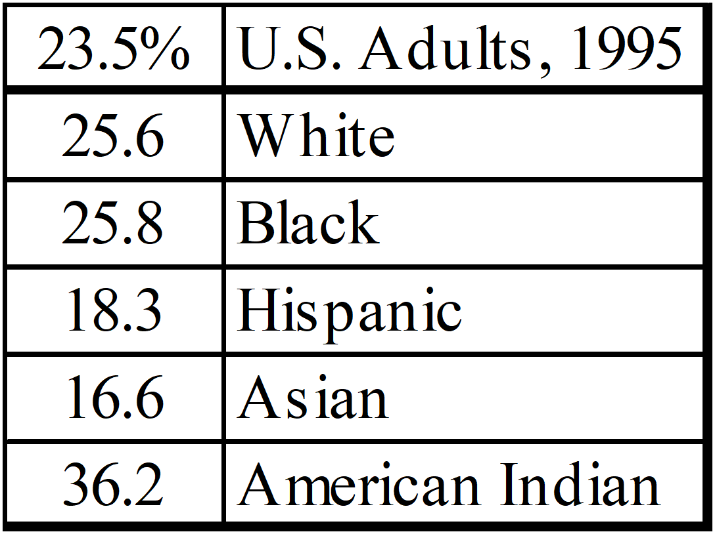
Using ‘likely’ to compare %:
Given Percentage Half-Table
6.7.2; P 256
24
Compare 36.2% with 16.6%. Use likely-among grammar.
<Part> is <compare> likely among <Test> than/as [among] <base>
Use ‘times ratio’ if ratio > 2. Otherwise, Use ‘% more’.
Smoking is 100% more likely among American Indians
than [among] Asians.
Notes:
Model Trendline Linear 2Y1X using Excel 2013
11/24/2013 V0a
www.StatLit.org/pdf/Model-Trendline-Linear-2Y1X-Excel2013-6up.pdf
24
Analyzing Numbers in the News
15 May 2008
2008SchieldNNN6up.pdf
24
24

Slide 25
Comparing
Part-Whole Percentages
6.7; P 254
25
Common-part comparisons:
Slides 26-28: Using named ratios:
percentage, rate and chance grammar.
Distinct-part comparisons:
Slides 29-30. Graph and template
Notes:
Model Trendline Linear 2Y1X using Excel 2013
11/24/2013 V0a
www.StatLit.org/pdf/Model-Trendline-Linear-2Y1X-Excel2013-6up.pdf
25
Analyzing Numbers in the News
15 May 2008
2008SchieldNNN6up.pdf
25
25

Slide 26
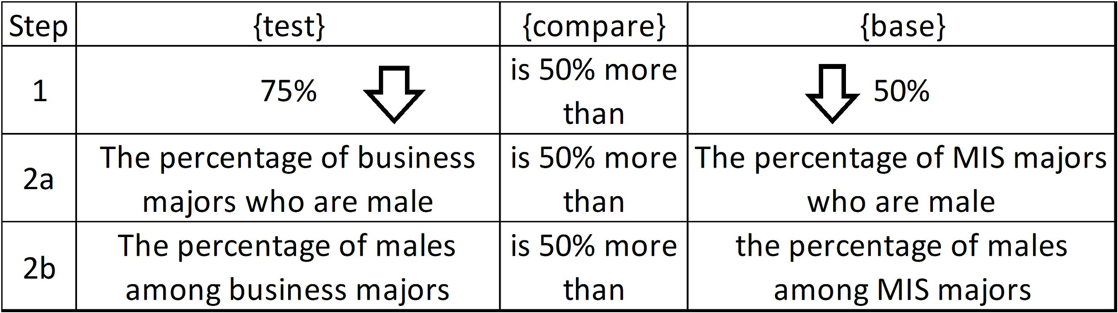
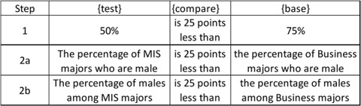
Comparing Percentages:
Using Percentage Grammar
6.7.2; P 256
26
75% of business majors are male. (50% of MIS majors).
Percentage difference; smaller as the base.
Simple difference; larger as the base
Notes:
Model Trendline Linear 2Y1X using Excel 2013
11/24/2013 V0a
www.StatLit.org/pdf/Model-Trendline-Linear-2Y1X-Excel2013-6up.pdf
26
Analyzing Numbers in the News
15 May 2008
2008SchieldNNN6up.pdf
26
26

Slide 27
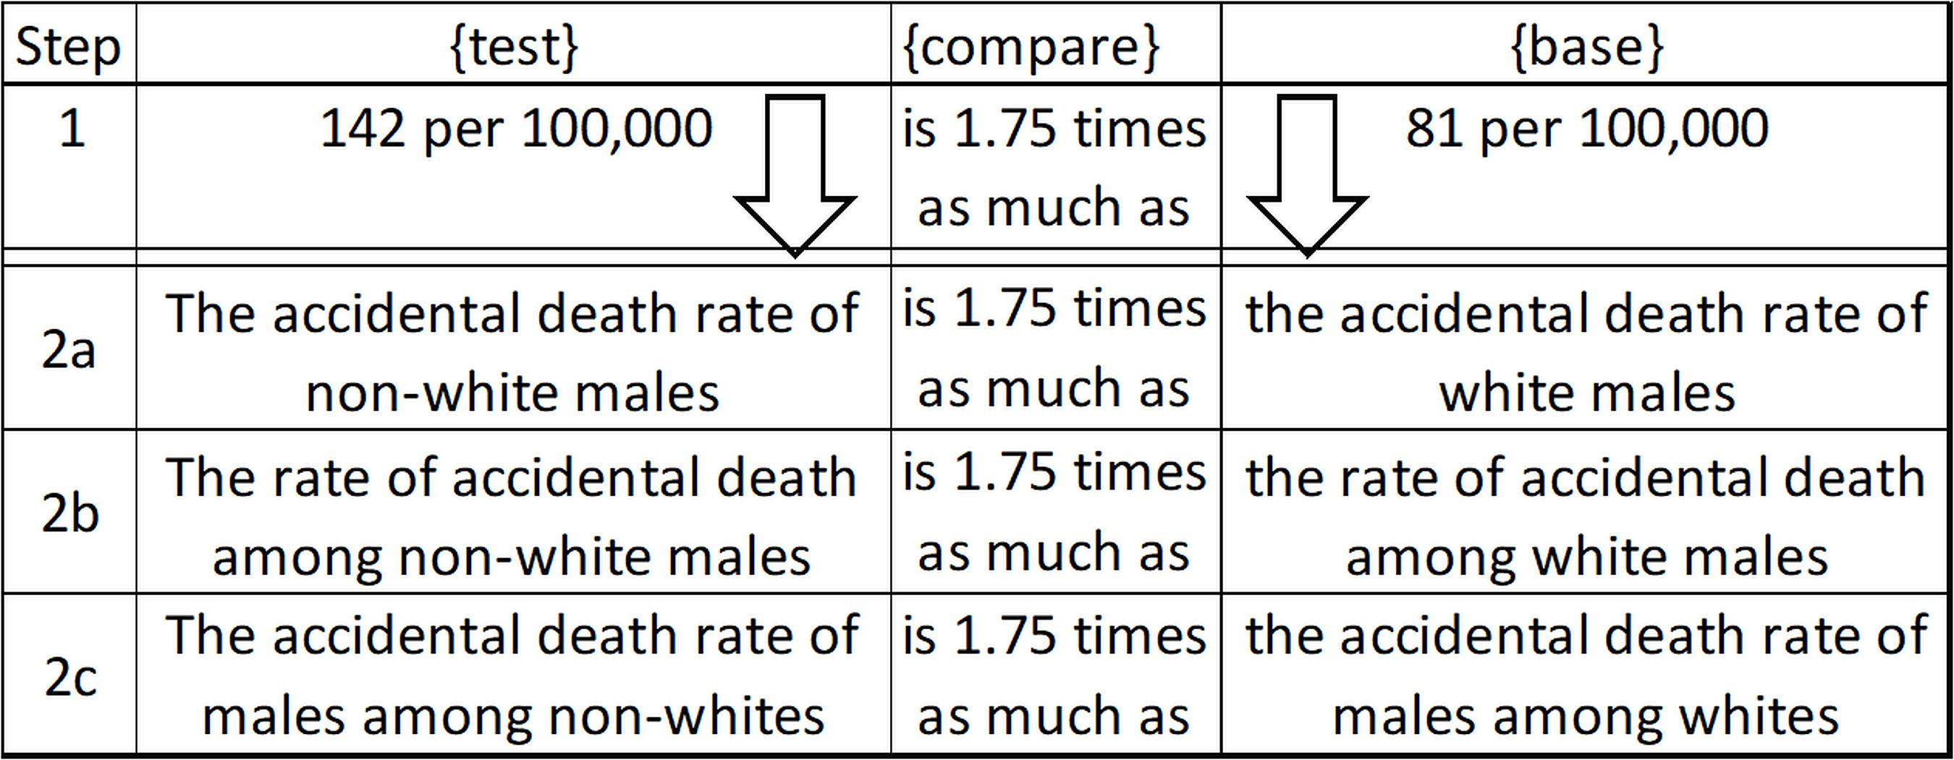
Comparing Percentages:
Using Rate Grammar
6.7.2; P 257
27
Male’s accidental death rate:
142/100K for non-Whites (81/100K for White).
Times ratio; smaller as the base.
Notes:
Model Trendline Linear 2Y1X using Excel 2013
11/24/2013 V0a
www.StatLit.org/pdf/Model-Trendline-Linear-2Y1X-Excel2013-6up.pdf
27
Analyzing Numbers in the News
15 May 2008
2008SchieldNNN6up.pdf
27
27

Slide 28
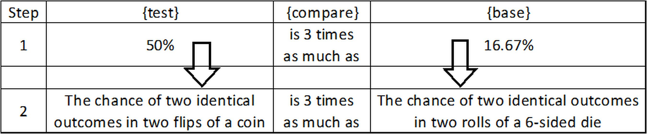
Comparing Percentages:
Using Chance Grammar
6.7.2; P 257
28
Chance of two identical outcomes:
flipping a coin (1/2) vs. rolling a six-sided die (1/6)
Times ratio; smaller as the base.
Notes:
Model Trendline Linear 2Y1X using Excel 2013
11/24/2013 V0a
www.StatLit.org/pdf/Model-Trendline-Linear-2Y1X-Excel2013-6up.pdf
28
Analyzing Numbers in the News
15 May 2008
2008SchieldNNN6up.pdf
28
28

Slide 29
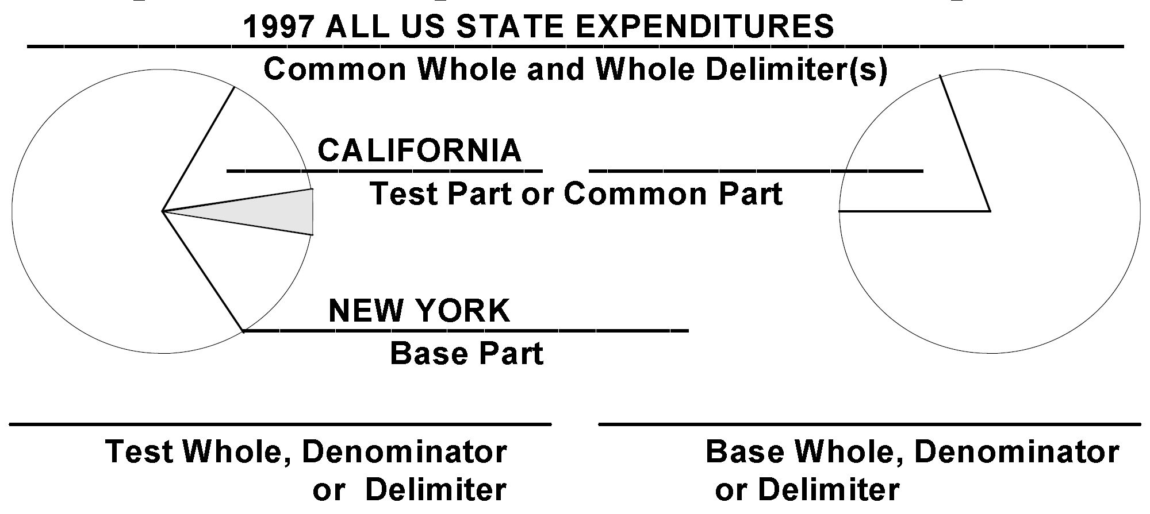
Comparing Part-Whole Ratios.
Named Ratios: Distinct Parts
6.7, P 255
29
In the US in 1997, the percentage of all state expenditures that were spent by California was 33% more than that spent by New York.
Likely grammar requires countables for part and whole.
Notes:
Model Trendline Linear 2Y1X using Excel 2013
11/24/2013 V0a
www.StatLit.org/pdf/Model-Trendline-Linear-2Y1X-Excel2013-6up.pdf
29
Analyzing Numbers in the News
15 May 2008
2008SchieldNNN6up.pdf
29
29

Slide 30
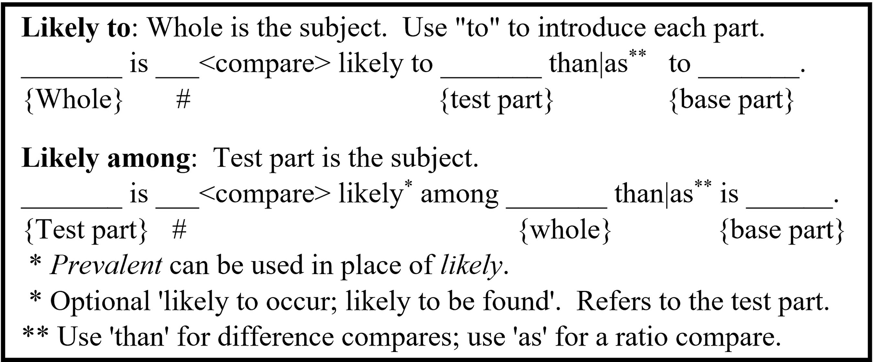
Comparing Part-Whole Ratios.
Likely Grammar: Distinct Parts
6.6, P 247
30
.
Notes:
Model Trendline Linear 2Y1X using Excel 2013
11/24/2013 V0a
www.StatLit.org/pdf/Model-Trendline-Linear-2Y1X-Excel2013-6up.pdf
30
Analyzing Numbers in the News
15 May 2008
2008SchieldNNN6up.pdf
30
30

Slide 31
Comparing Part-Whole Ratios.
Likely Grammar: Distinct Parts
6.6, P 247
31
Compare the 60% with the 30% in the left column.
Business majors are 2 times as prevalent among males as [are] MIS majors. [One ‘among’]
Males are 2 times as likely to be business majors as to be MIS majors. [Two ‘likely to’.
Notes:
Model Trendline Linear 2Y1X using Excel 2013
11/24/2013 V0a
www.StatLit.org/pdf/Model-Trendline-Linear-2Y1X-Excel2013-6up.pdf
31
Analyzing Numbers in the News
15 May 2008
2008SchieldNNN6up.pdf
31
31

Slide 32
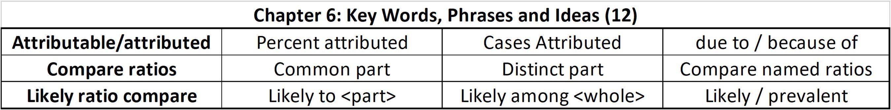
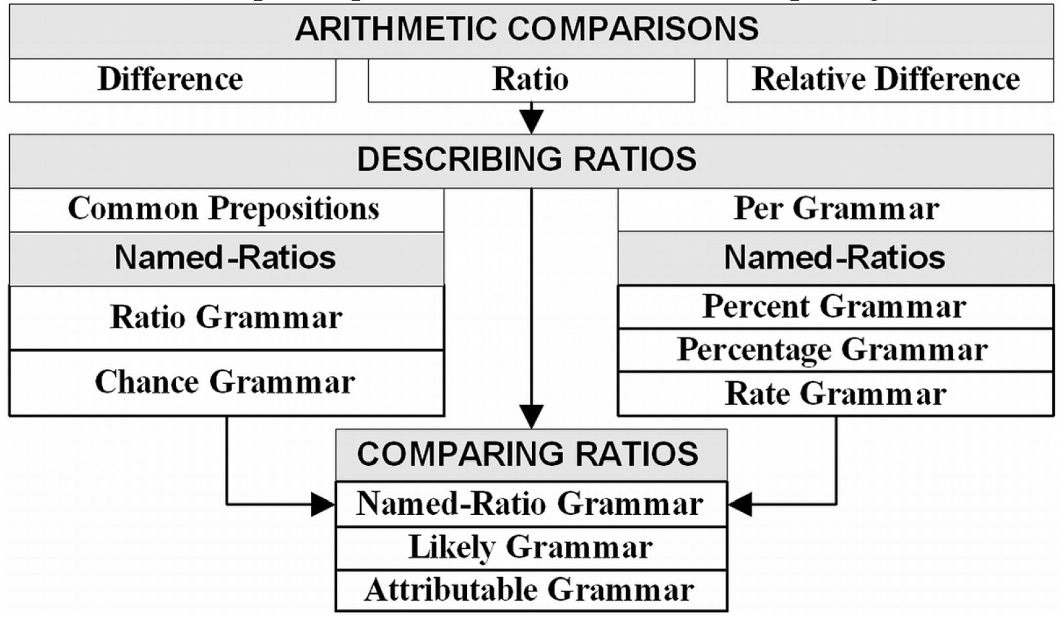
Chapter Summary
Ch 6: P 365
32
.
Notes:
Model Trendline Linear 2Y1X using Excel 2013
11/24/2013 V0a
www.StatLit.org/pdf/Model-Trendline-Linear-2Y1X-Excel2013-6up.pdf
32
Analyzing Numbers in the News
15 May 2008
2008SchieldNNN6up.pdf
32
32

Slide 33
Seven Questions when
Dealing with Statistics
Ch 2: P 155
33
Confounding. How big/many/much?
Assembly: Compared to what?
Assembly: How are things defined, counted/
measured, summarized, grouped, presented?
Confounded: Why not a rate? Per what?
Confounded: What was taken into account?
Confounded: What should be controlled for?
Random/Error: Coincidence/selection bias?
Notes:
Model Trendline Linear 2Y1X using Excel 2013
11/24/2013 V0a
www.StatLit.org/pdf/Model-Trendline-Linear-2Y1X-Excel2013-6up.pdf
33
Analyzing Numbers in the News
15 May 2008
2008SchieldNNN6up.pdf
33
33

