Slide 1
Statistical Literacy Textbook:
Chapter 2 Slides
Statistical Literacy:
Critical Thinking about Everyday Statistics
Kendall-Hunt 2023
Milo Schield
ASA Fellow
Adjunct: University of New Mexico
Visiting Professor: New College of Florida
www.StatLit.org/pdf/
2023-Schield-StatLit-Ch2-Slides.pdf
Notes:
Model Trendline Linear 2Y1X using Excel 2013
11/24/2013 V0a
www.StatLit.org/pdf/Model-Trendline-Linear-2Y1X-Excel2013-6up.pdf
1
Analyzing Numbers in the News
15 May 2008
2008SchieldNNN6up.pdf
1
1

Slide 2
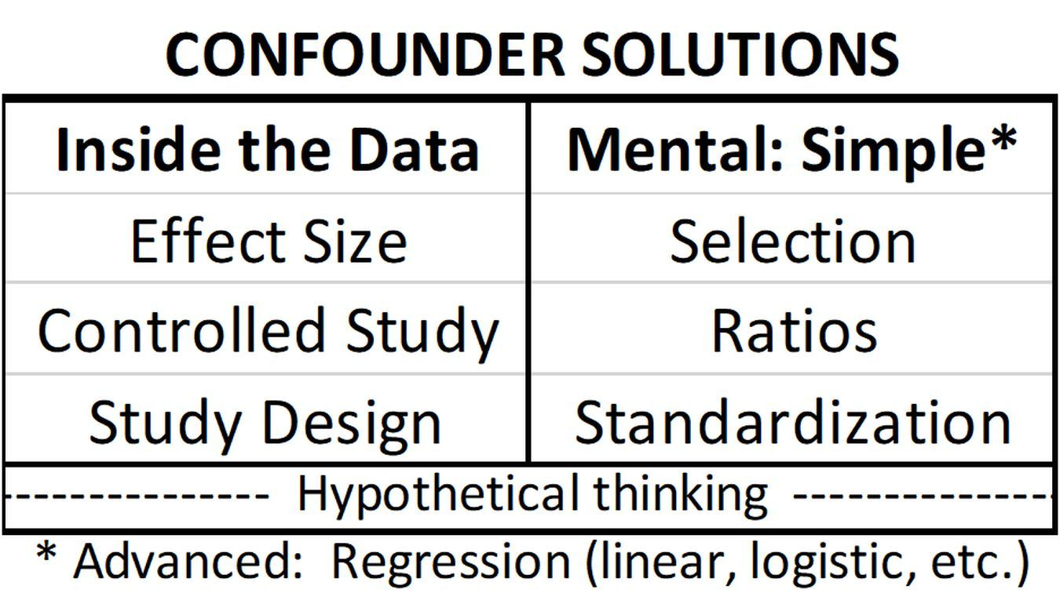
CARE:
Confounder Solutions
2.4 P 67
2
Confounder: Anything that provides an alternate explanation for an association.
Notes:
Model Trendline Linear 2Y1X using Excel 2013
11/24/2013 V0a
www.StatLit.org/pdf/Model-Trendline-Linear-2Y1X-Excel2013-6up.pdf
2
Analyzing Numbers in the News
15 May 2008
2008SchieldNNN6up.pdf
2
2

Slide 3
2.4.1 Confounder Solution:
Effect Size
2.4.1 P 68
3
Effect size: size of an arithmetic comparison.
The larger the effect size, the fewer the # of confounders that can influence an association.
The smaller the effect size, the more likely the association is influenced by confounding.
A study that doesn’t present the effect size:
probably has a small effect size.
Notes:
Model Trendline Linear 2Y1X using Excel 2013
11/24/2013 V0a
www.StatLit.org/pdf/Model-Trendline-Linear-2Y1X-Excel2013-6up.pdf
3
Analyzing Numbers in the News
15 May 2008
2008SchieldNNN6up.pdf
3
3

Slide 4
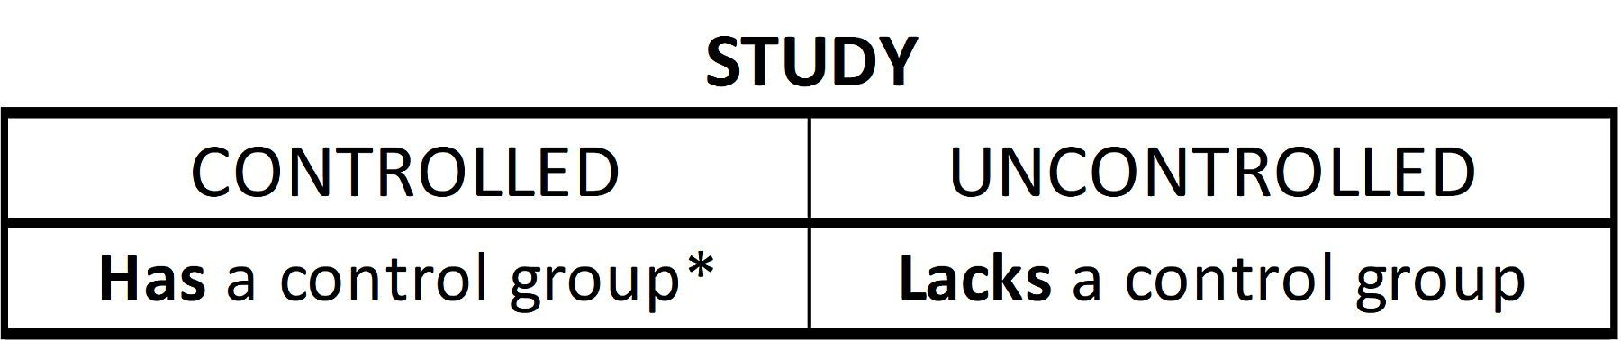
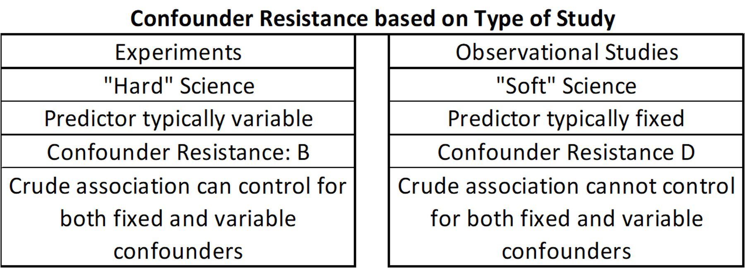
Confounder Resistance:
Control Group; Study Design
2.4 P 69, 70
4
Resisting confounder influence (warding off confounders)
controlled study is better than an uncontrolled study
experiment is better than an observational study.
Notes:
Model Trendline Linear 2Y1X using Excel 2013
11/24/2013 V0a
www.StatLit.org/pdf/Model-Trendline-Linear-2Y1X-Excel2013-6up.pdf
4
Analyzing Numbers in the News
15 May 2008
2008SchieldNNN6up.pdf
4
4

Slide 5
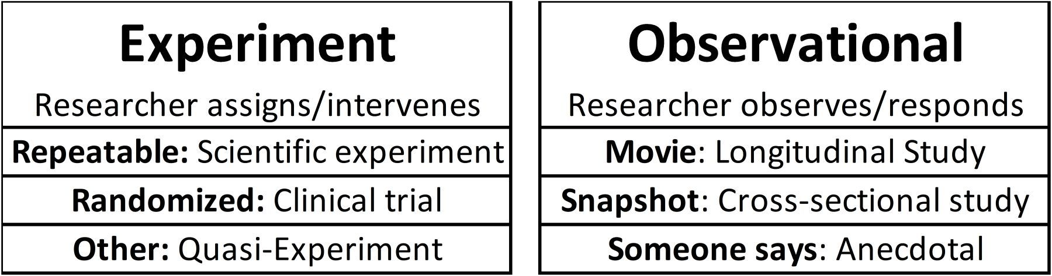
Types of Studies:
Experiments vs. Observational
2.4.3 P 71
5
Doing versus just Seeing
Researcher (or nature) Researcher just
initiates (a doing). observes (passive)
Notes:
Model Trendline Linear 2Y1X using Excel 2013
11/24/2013 V0a
www.StatLit.org/pdf/Model-Trendline-Linear-2Y1X-Excel2013-6up.pdf
5
Analyzing Numbers in the News
15 May 2008
2008SchieldNNN6up.pdf
5
5

Slide 6
Experiment #1:
Ideal Experiment
2.4.3 P 71-72
6
The subjects:
are homogeneous (alike internally)
have no memory of being treated
can be switched: treatment and control.
Examples: most laboratory assignments in
physics, chemistry or biology.
Notes:
Model Trendline Linear 2Y1X using Excel 2013
11/24/2013 V0a
www.StatLit.org/pdf/Model-Trendline-Linear-2Y1X-Excel2013-6up.pdf
6
Analyzing Numbers in the News
15 May 2008
2008SchieldNNN6up.pdf
6
6

Slide 7
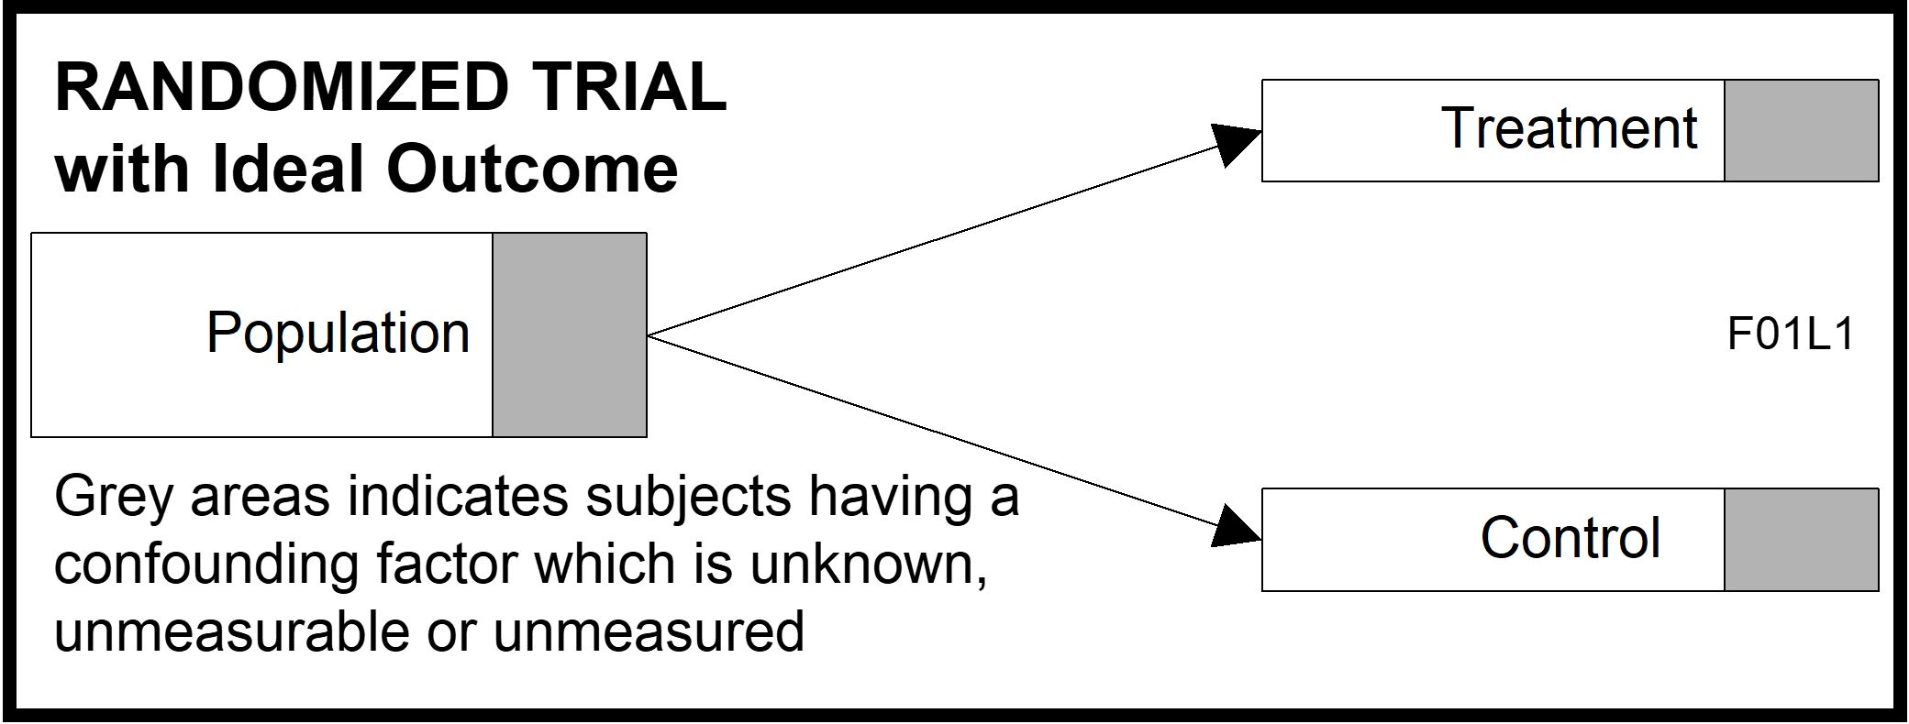
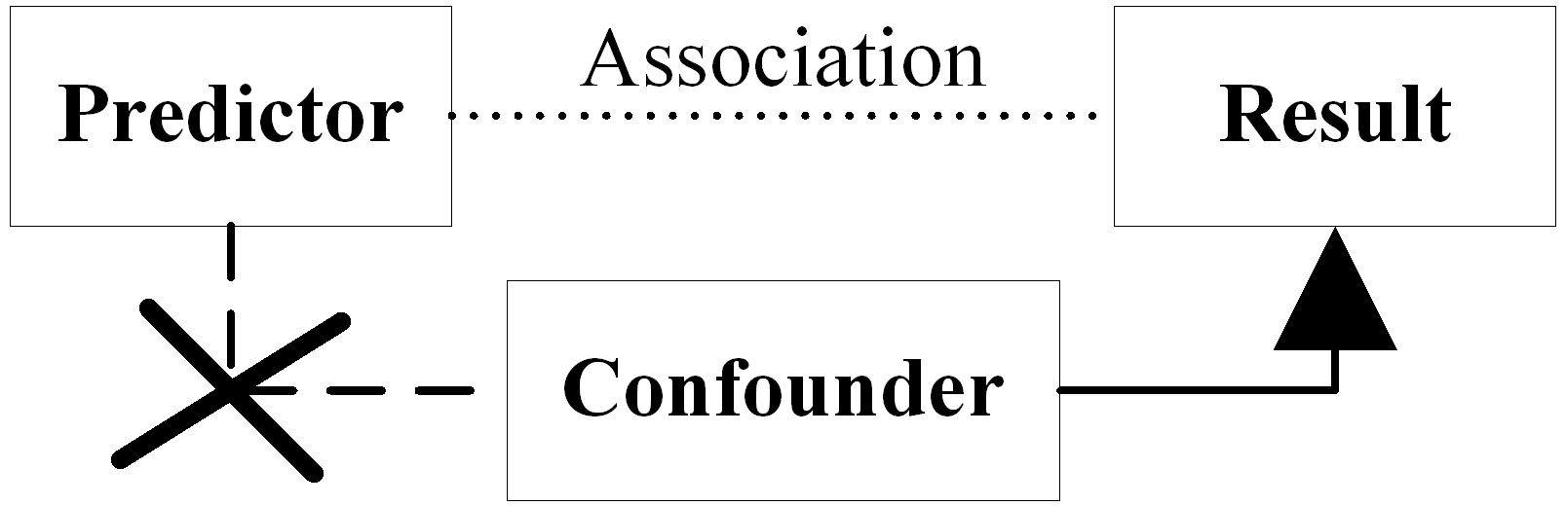
Experiment #2:
Randomized Clinical Trial
2.4.3 P 72
7
Best way to create two groups balanced on known and unknown factors without looking.
Randomizing: breaks predictor-confounder link
Shuffle cards (randomize) to get ‘equal’ hands
Notes:
Model Trendline Linear 2Y1X using Excel 2013
11/24/2013 V0a
www.StatLit.org/pdf/Model-Trendline-Linear-2Y1X-Excel2013-6up.pdf
7
Analyzing Numbers in the News
15 May 2008
2008SchieldNNN6up.pdf
7
7

Slide 8
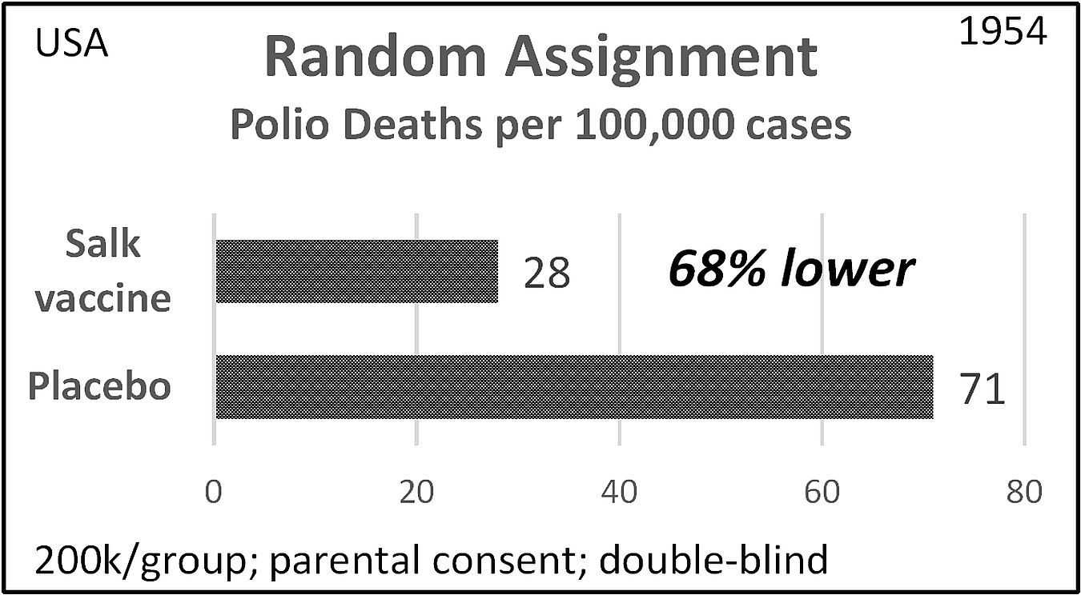
Randomized Clinical Trial
Salk Vaccine
2.4.3 P 72
8
.
Notes:
Model Trendline Linear 2Y1X using Excel 2013
11/24/2013 V0a
www.StatLit.org/pdf/Model-Trendline-Linear-2Y1X-Excel2013-6up.pdf
8
Analyzing Numbers in the News
15 May 2008
2008SchieldNNN6up.pdf
8
8

Slide 9
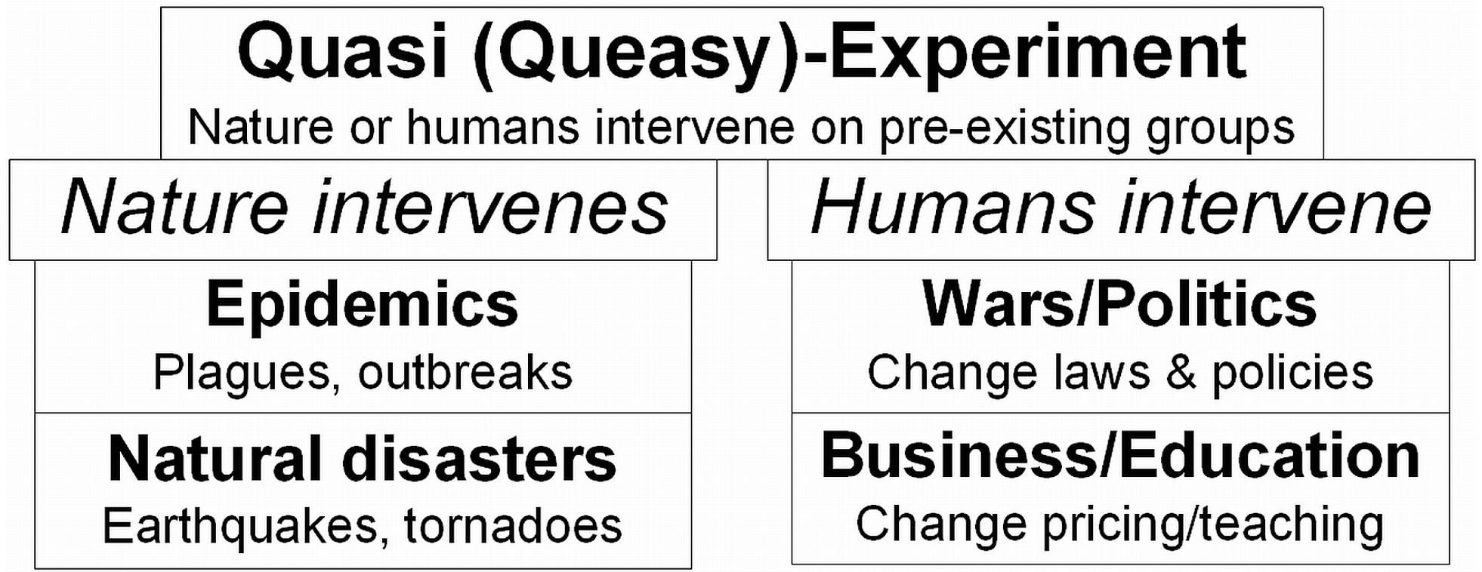
Experiment #3:
Quasi-Experiments
2.4.3 P 74
9
Quasi-experiments: experiments that involve pre-existing groups.
Notes:
Model Trendline Linear 2Y1X using Excel 2013
11/24/2013 V0a
www.StatLit.org/pdf/Model-Trendline-Linear-2Y1X-Excel2013-6up.pdf
9
Analyzing Numbers in the News
15 May 2008
2008SchieldNNN6up.pdf
9
9

Slide 10
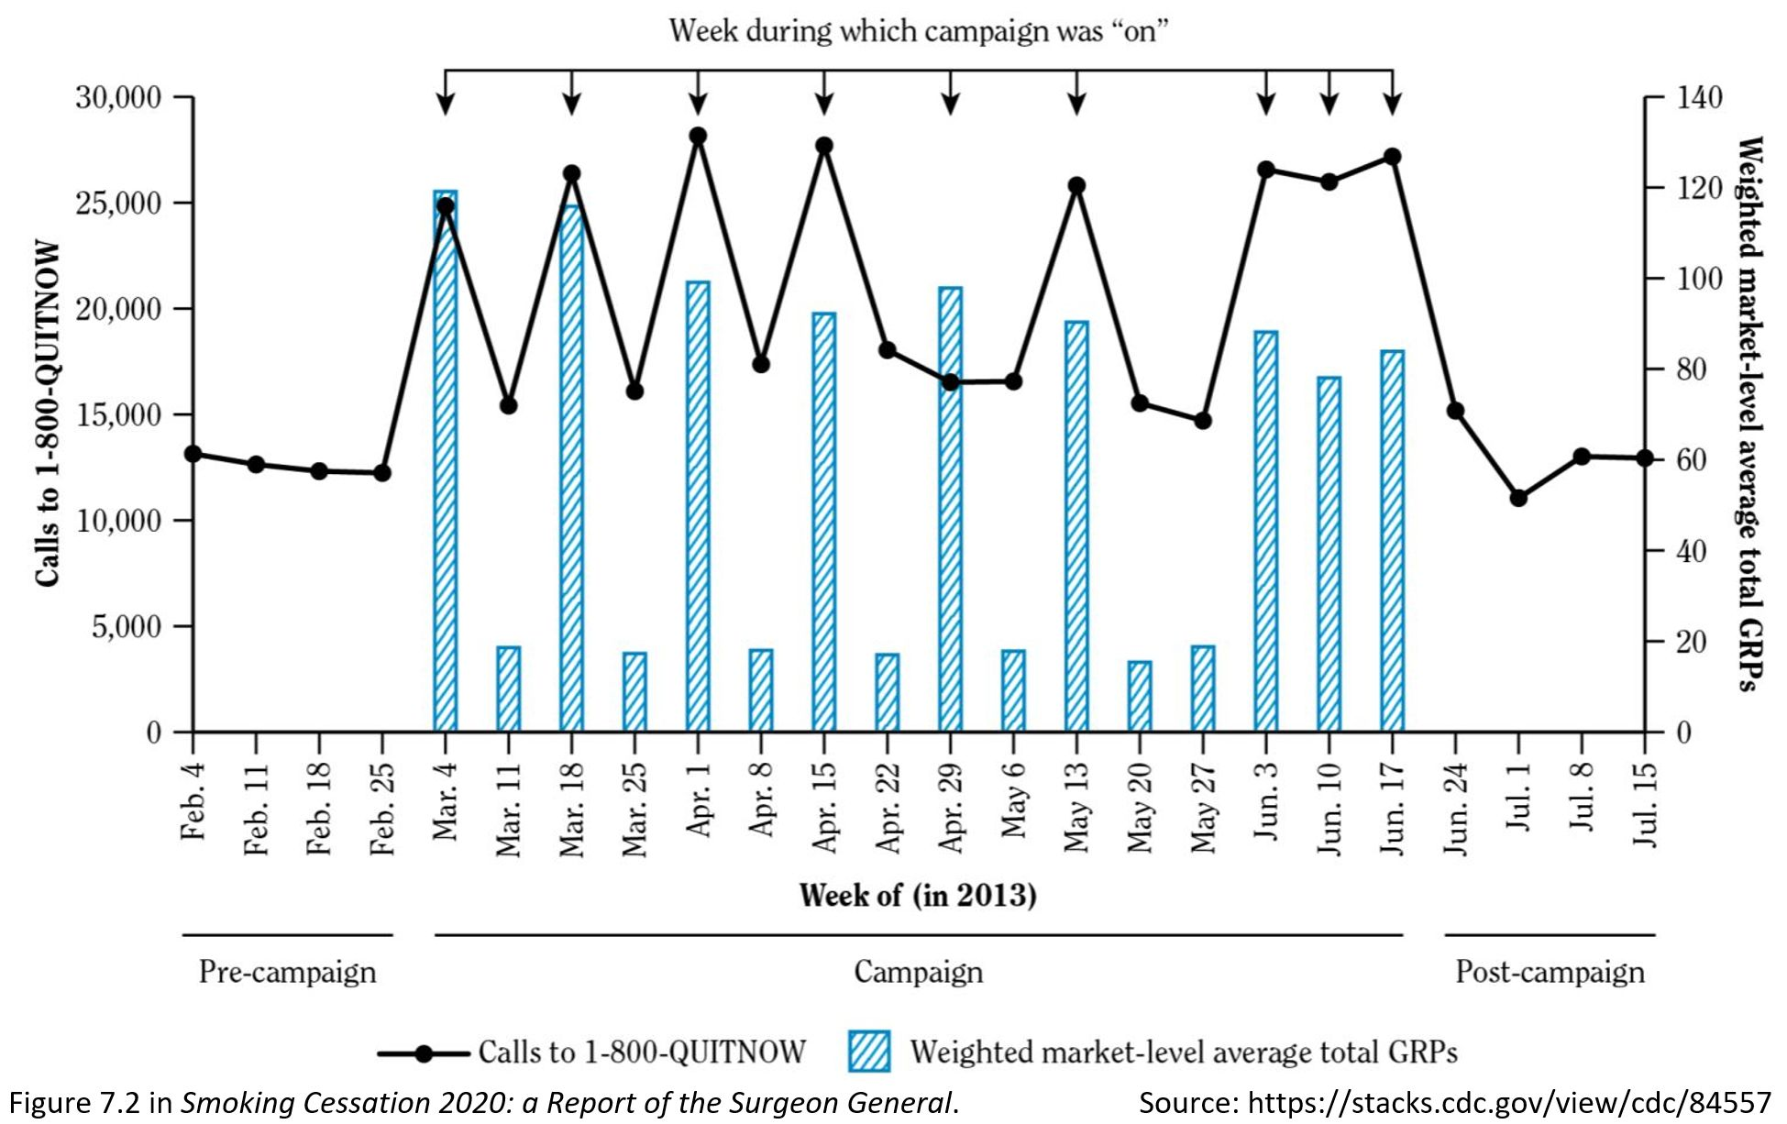
Quasi-Experiment
2.4.3 P 22
10
Notes:
Model Trendline Linear 2Y1X using Excel 2013
11/24/2013 V0a
www.StatLit.org/pdf/Model-Trendline-Linear-2Y1X-Excel2013-6up.pdf
10
Analyzing Numbers in the News
15 May 2008
2008SchieldNNN6up.pdf
10
10

Slide 11
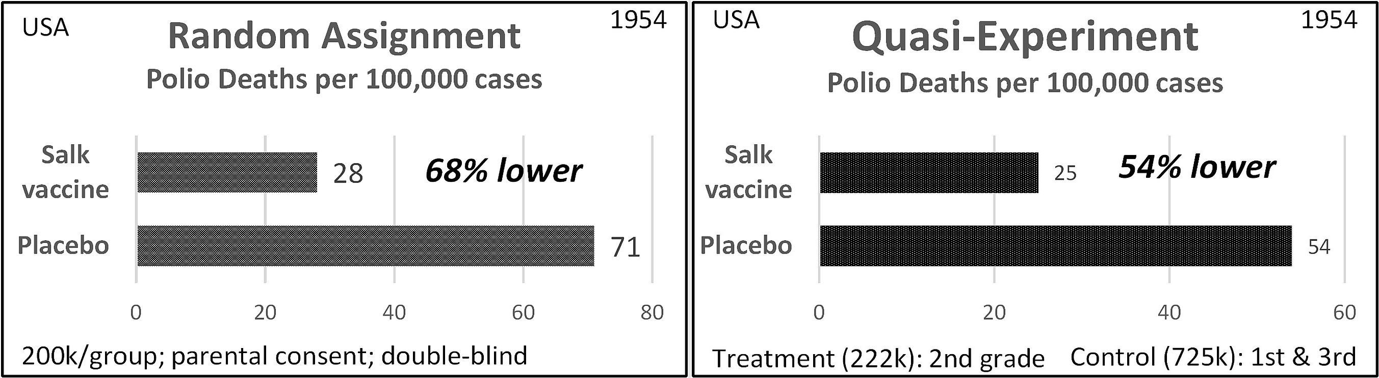
Comparison:
Clinical Trial vs Quasi-Experiment
2.4.3 P 75
11
Researchers trusted the clinical trial.
Parents trusted the quasi-experiment.
Notes:
Model Trendline Linear 2Y1X using Excel 2013
11/24/2013 V0a
www.StatLit.org/pdf/Model-Trendline-Linear-2Y1X-Excel2013-6up.pdf
11
Analyzing Numbers in the News
15 May 2008
2008SchieldNNN6up.pdf
11
11

Slide 12
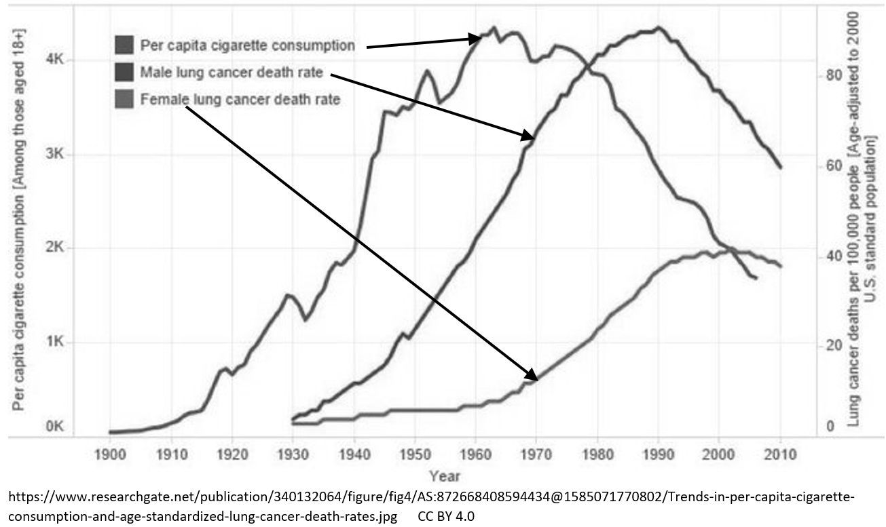
Observational study #1: Longitudinal (movie)
2.4.3 P 76
12
Notes:
Model Trendline Linear 2Y1X using Excel 2013
11/24/2013 V0a
www.StatLit.org/pdf/Model-Trendline-Linear-2Y1X-Excel2013-6up.pdf
12
Analyzing Numbers in the News
15 May 2008
2008SchieldNNN6up.pdf
12
12

Slide 13
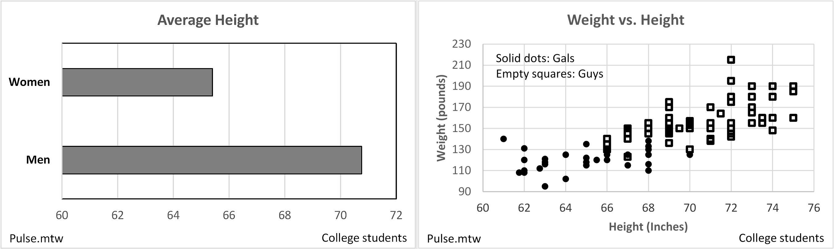
Observational study #2:
Cross-Sectional (snapshot)
C: Confounding
13
Two-group Two Factor
Comparison Co-variation
Notes:
Model Trendline Linear 2Y1X using Excel 2013
11/24/2013 V0a
www.StatLit.org/pdf/Model-Trendline-Linear-2Y1X-Excel2013-6up.pdf
13
Analyzing Numbers in the News
15 May 2008
2008SchieldNNN6up.pdf
13
13

Slide 14
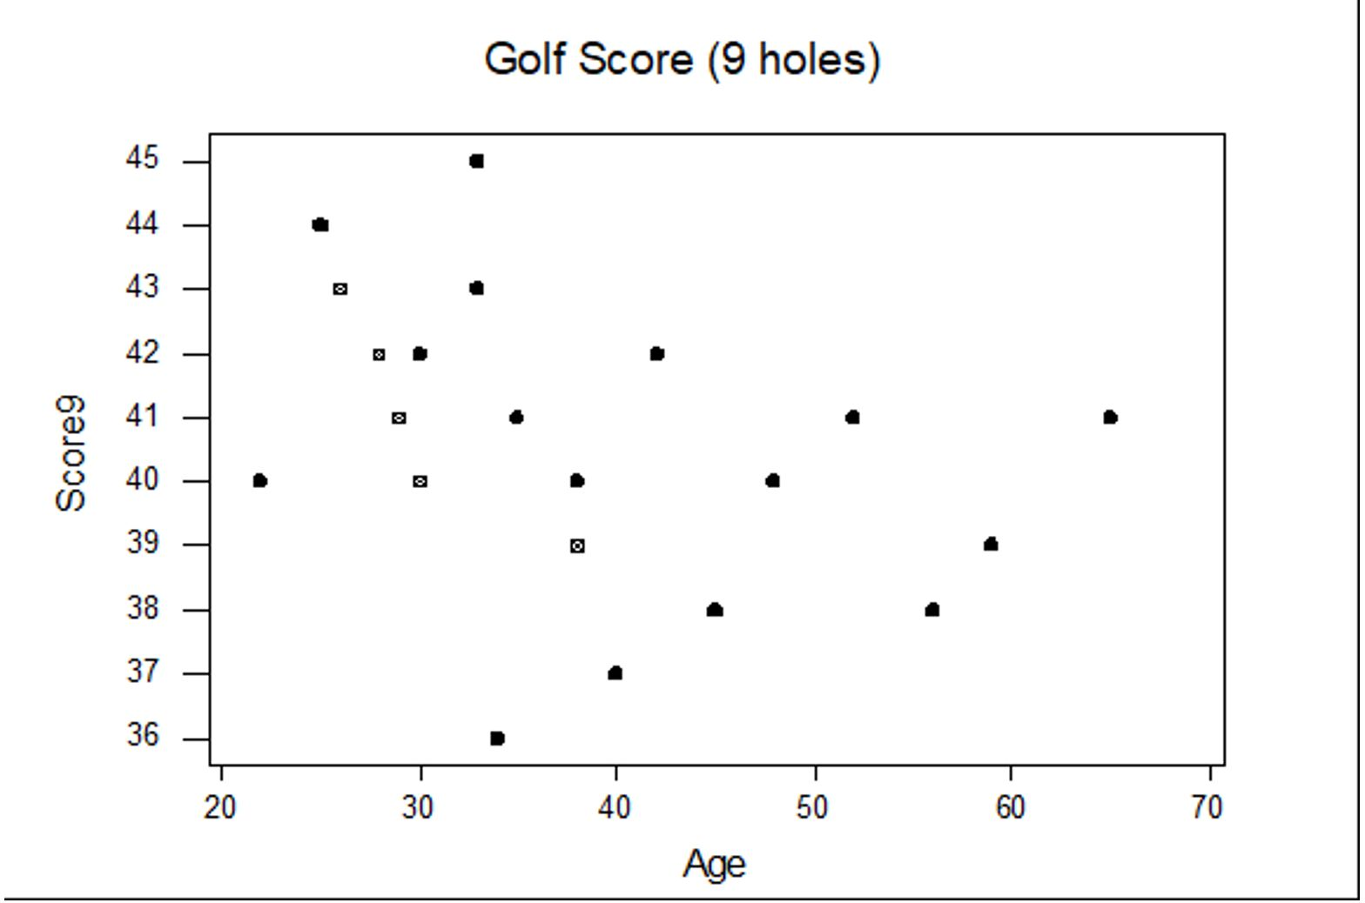
Cross-Sectional Study:
Time-Related Snapshot
C: Confounding
14
As age increases, golf scores improve???
Notes:
Model Trendline Linear 2Y1X using Excel 2013
11/24/2013 V0a
www.StatLit.org/pdf/Model-Trendline-Linear-2Y1X-Excel2013-6up.pdf
14
Analyzing Numbers in the News
15 May 2008
2008SchieldNNN6up.pdf
14
14

Slide 15
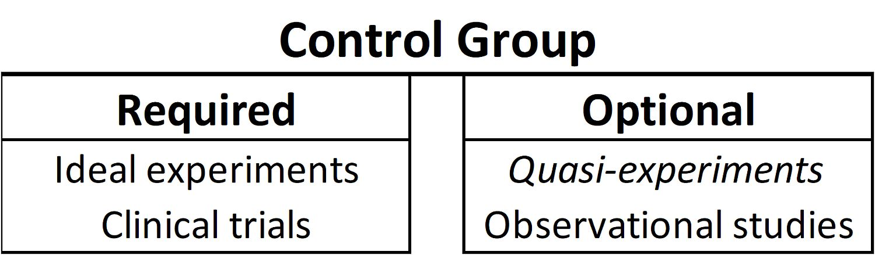
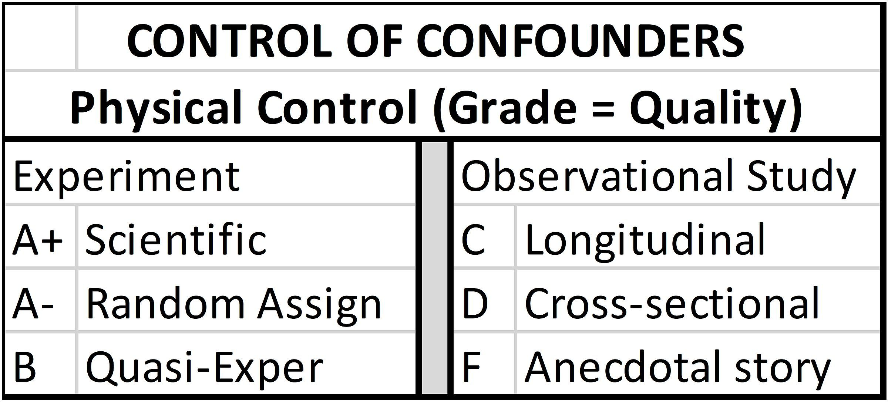
Control Group (Review);
Study Design: Graded
C: Confounding
15
Notes:
Model Trendline Linear 2Y1X using Excel 2013
11/24/2013 V0a
www.StatLit.org/pdf/Model-Trendline-Linear-2Y1X-Excel2013-6up.pdf
15
Analyzing Numbers in the News
15 May 2008
2008SchieldNNN6up.pdf
15
15

Slide 16
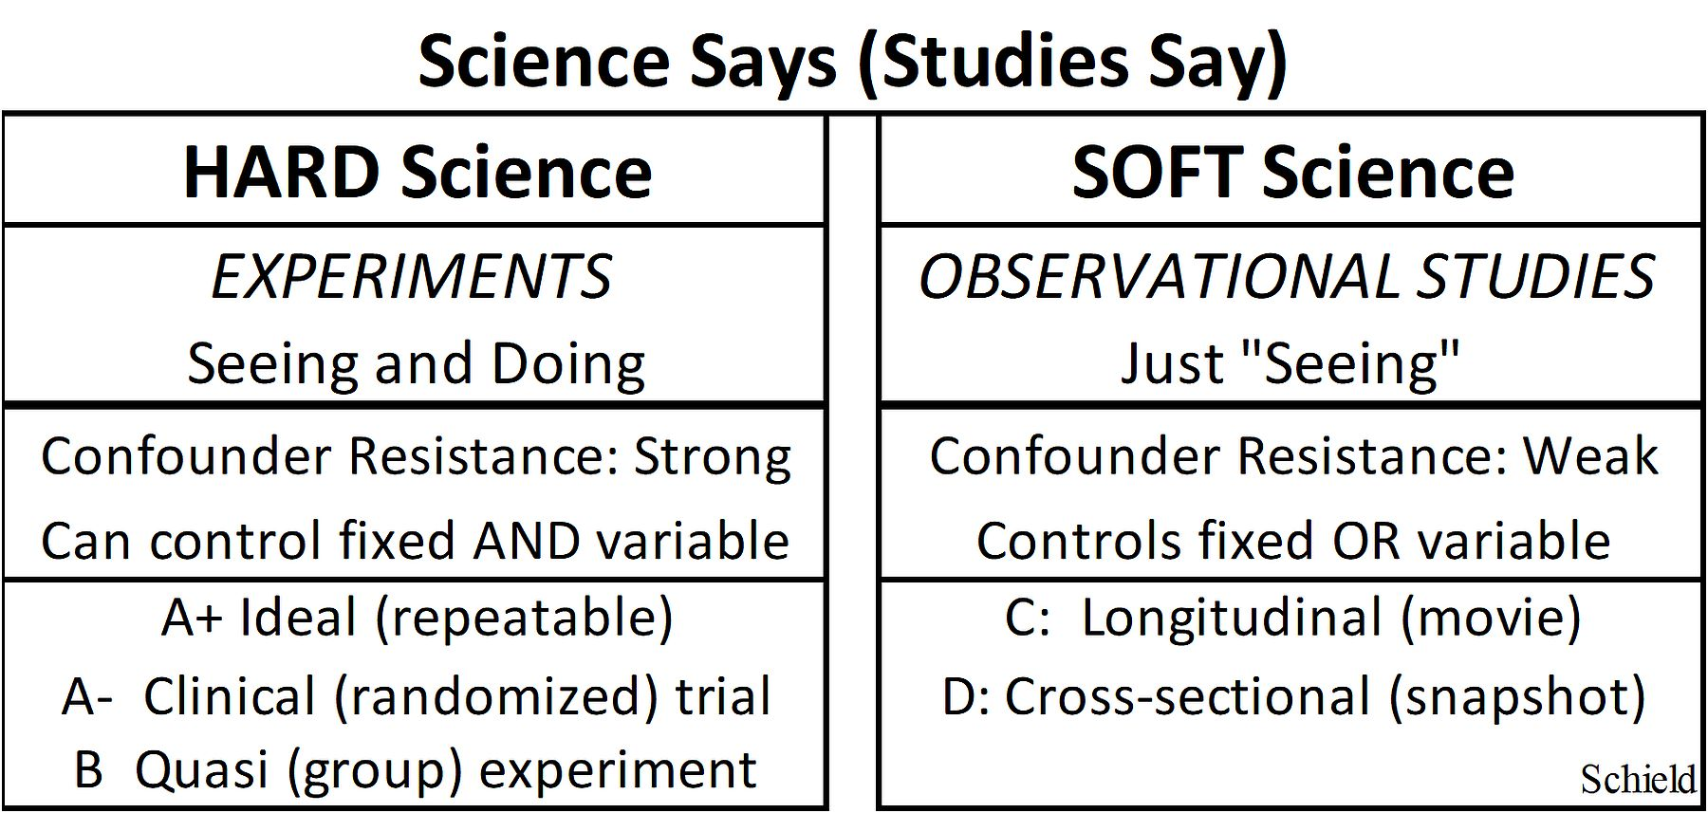
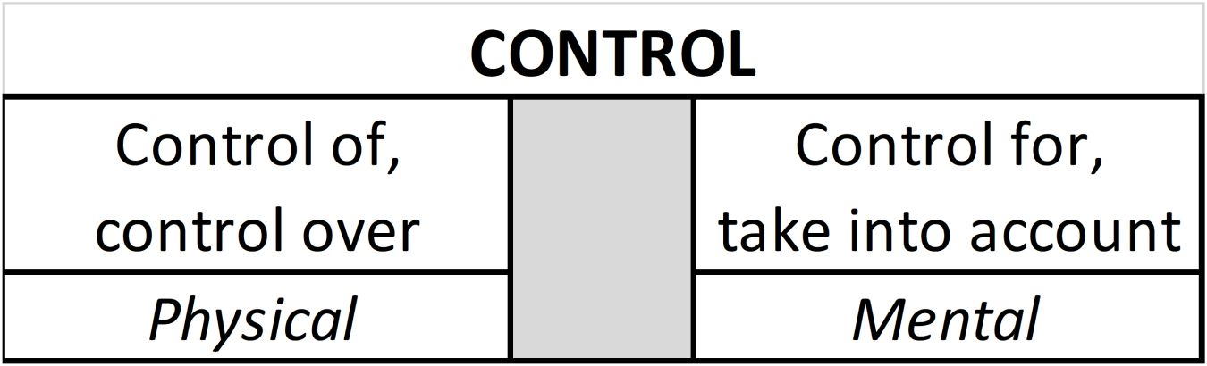
Study Design: Hard vs. Soft.
‘Control of’ versus ‘Control for’
C: Confounding
16
Notes:
Model Trendline Linear 2Y1X using Excel 2013
11/24/2013 V0a
www.StatLit.org/pdf/Model-Trendline-Linear-2Y1X-Excel2013-6up.pdf
16
Analyzing Numbers in the News
15 May 2008
2008SchieldNNN6up.pdf
16
16

Slide 17
Confounder Solutions
(Repeat)
C: Confounding
17
Confounder: Anything that provides an alternate explanation for an association.
Notes:
Model Trendline Linear 2Y1X using Excel 2013
11/24/2013 V0a
www.StatLit.org/pdf/Model-Trendline-Linear-2Y1X-Excel2013-6up.pdf
17
Analyzing Numbers in the News
15 May 2008
2008SchieldNNN6up.pdf
17
17

Slide 18
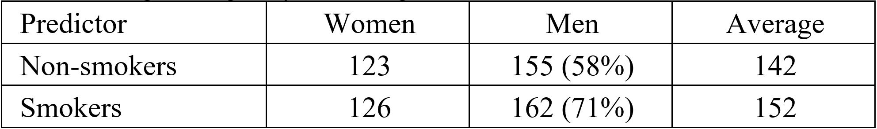
Mental Solution:
#1: Selection
C: Confounding
18
Selection: simple way to control for the influence of a confounder. Convert mixed-fruit compare into an apples and apples comparison.
Notes:
Model Trendline Linear 2Y1X using Excel 2013
11/24/2013 V0a
www.StatLit.org/pdf/Model-Trendline-Linear-2Y1X-Excel2013-6up.pdf
18
Analyzing Numbers in the News
15 May 2008
2008SchieldNNN6up.pdf
18
18

Slide 19
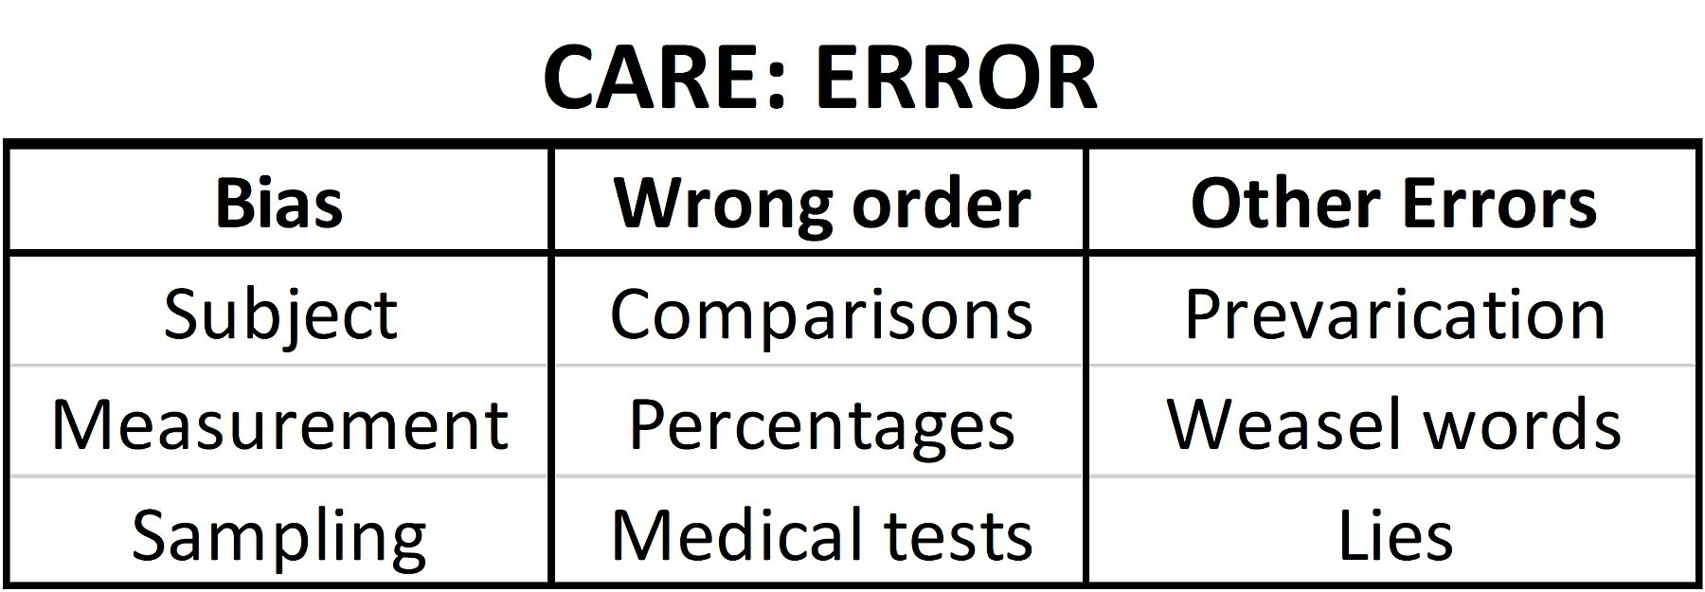
2.7 Error/Bias Influences:
Review of Problems
E: Error/Bias
19
Wrong order and Other Errors involve critical thinking (mental solutions). See Ch 4, 6 & 7.
There are physical solutions for Bias.
Notes:
Model Trendline Linear 2Y1X using Excel 2013
11/24/2013 V0a
www.StatLit.org/pdf/Model-Trendline-Linear-2Y1X-Excel2013-6up.pdf
19
Analyzing Numbers in the News
15 May 2008
2008SchieldNNN6up.pdf
19
19

Slide 20
Bias Review:
Synonyms
E: Error/Bias
20
Subject (respondent) bias
Acquiescence bias, social desirability
Sponsor bias, please the person asking
Measurement (researcher) bias
Instrument bias
Confirmation bias (select only what confirms)
Selection bias (sampling bias).
Self-selection bias, non-response bias
Survivor bias, publication bias
Notes:
Model Trendline Linear 2Y1X using Excel 2013
11/24/2013 V0a
www.StatLit.org/pdf/Model-Trendline-Linear-2Y1X-Excel2013-6up.pdf
20
Analyzing Numbers in the News
15 May 2008
2008SchieldNNN6up.pdf
20
20

Slide 21
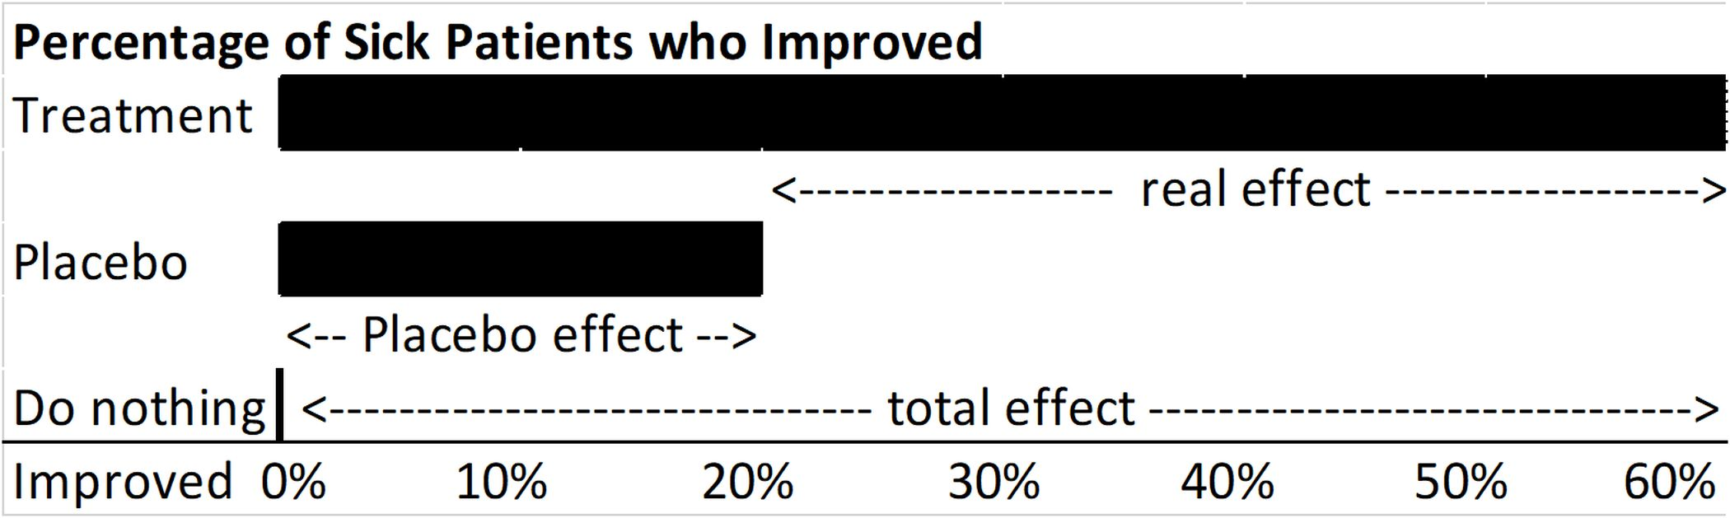
Subject-Bias Solution:
Single Blind: Placebo
E: Error/Bias
21
.
What is the effect of treatment: 60 point cure?
Placebo: a fake treatment! Mind is powerful!
What is the effect of treatment: 40 point cure.
To control subject bias: ‘blind’ the subject.
Notes:
Model Trendline Linear 2Y1X using Excel 2013
11/24/2013 V0a
www.StatLit.org/pdf/Model-Trendline-Linear-2Y1X-Excel2013-6up.pdf
21
Analyzing Numbers in the News
15 May 2008
2008SchieldNNN6up.pdf
21
21

Slide 22
Researcher-Bias Solution:
Double Blind Both
E: Error/Bias
22
To avoid researcher bias: blind the researcher
To avoid subject & researcher bias, double-blind.
Double-blind: blind subject and researcher.
Any study that could double-blind and does not
is immediately suspect of bias – if not of error.
Notes:
Model Trendline Linear 2Y1X using Excel 2013
11/24/2013 V0a
www.StatLit.org/pdf/Model-Trendline-Linear-2Y1X-Excel2013-6up.pdf
22
Analyzing Numbers in the News
15 May 2008
2008SchieldNNN6up.pdf
22
22

Slide 23
Sampling-Bias Solution:
Random Selection or Assignment
E: Error/Bias
23
To avoid sampling bias in selecting, select subject randomly: random selection.
To avoid sampling bias in creating, assign the subjects randomly: random assignment. This statistically controls for pre-existing confounders. See clinical trials.
Note: Randomness can be both an unwanted influence (a problem) and a desired solution (random selection or random assignment).
Notes:
Model Trendline Linear 2Y1X using Excel 2013
11/24/2013 V0a
www.StatLit.org/pdf/Model-Trendline-Linear-2Y1X-Excel2013-6up.pdf
23
Analyzing Numbers in the News
15 May 2008
2008SchieldNNN6up.pdf
23
23

